Slide 1
Big Data Analysis and Mining
Cluster Analysis
Qinpei Zhao 赵钦佩
qinpeizhao@tongji.edu.cn

Slide 2
Outline
Cluster Basics
Clustering algorithms
Hierarchical clustering, spectral clustering
k-means, Expectation-Maximization (EM)
DBSCAN
state-of-art algorithms
Cluster Validity
determining the number of clusters
clustering evaluation
Notes:
2

Slide 3
Clustering Analysis
Definition:
物以类聚，人以群居
Grouping the data with similar features
It’s a method of data exploration, a way of looking for patterns or structure in the data that are of interest.
Properties: unsupervised, parameter needed
Application field: Machine learning, pattern recognition, image analysis, data mining, information retrieval and bioinformatics etc.
K-means animation

Slide 4
Factors of Clustering
What data could be used in clustering?
Large or small, Gaussian or non-Gaussian, etc.
Which clustering algorithm? (cost function)
Partition-based (e.g. k-means)
Model-based (e.g. EM algorithm)
Density-based (e.g. DBSCAN)
Genetic, spectral ……
Choosing (dis)similarity measures – a critical step in clustering
Euclidean distance,…
Pearson Linear Correlation,…
How to evaluate the clustering result? (cluster validity)

Slide 5
Quality: What Is Good Clustering?
A good clustering method will produce high quality clusters with
high intra-class similarity
low inter-class similarity
The quality of a clustering result depends on both the similarity measure used by the method and its implementation
The quality of a clustering method is also measured by its ability to discover some or all of the hidden patterns

Slide 6
Requirements of clustering in data mining (1)
Scalability
Ability to deal with different types of attributes
Discovery of clusters with arbitrary shape
Minimal requirements for domain knowledge to determine input parameters

Slide 7
Requirements of clustering in data mining (2)
Ability to deal with noise and outliers
Insensitivity to order of input records
High dimensionality
Incorporation of user-specified constraints
Interpretability and usability

Slide 8
Similarity and dissimilarity
There is no single definition of similarity or dissimilarity between data objects
The definition of similarity or dissimilarity between objects depends on
the type of the data considered
what kind of similarity we are looking for

Slide 9
Edit distance
Input: two sequences, e.g.
v: ATCTGAT
w: TGCATA
Output: minimum weighted number of edit operations to transform v into w.
Edit operations: insertion, deletion, substitution.

Slide 10
Example
TGCATAT → ATCCGAT in 5 steps
TGCATAT → (delete last T)
TGCATA → (delete last A)
TGCAT → (insert A at front)
ATGCAT → (substitute C for 3rd G)
ATCCAT → (insert G before last A)
ATCCGAT (Done)
What is the edit distance? 5?

Slide 11
Example
TGCATAT → ATCCGAT in 4 steps
TGCATAT → (insert A at front)
ATGCATAT → (delete 6th T)
ATGCATA → (substitute G for 5th A)
ATGCGTA → (substitute C for 3rd G)
ATCCGAT (Done)

Slide 12
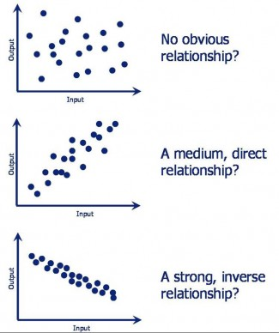
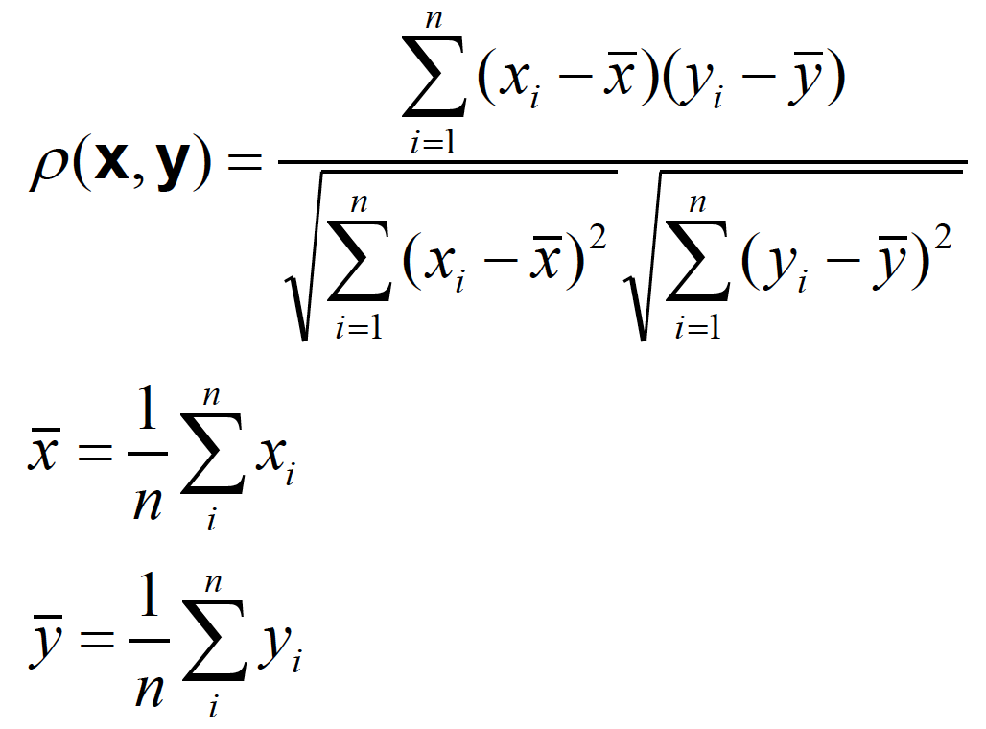
Pearson Linear Correlation
We’re shifting the expression profiles down (subtracting the means) and scaling by the standard deviations (i.e., making the data have mean = 0 and std = 1)
Always between –1 and +1 (perfectly anti-correlated and perfectly correlated)

Slide 13
Outline
Cluster Basics
Clustering algorithms
Hierarchical clustering, spectral clustering
k-means, Expectation-Maximization (EM)
DBSCAN
state-of-art algorithms
Cluster Validity
determining the number of clusters
clustering evaluation
Notes:
13

Slide 14
Hierarchical Clustering
Produces a set of nested clusters organized as a hierarchical tree.
Can be visualized as a dendrogram
A tree-like diagram that records the sequences of merges or splits

Slide 15
Strengths of Hierarchical Clustering
No assumptions on the number of clusters
Any desired number of clusters can be obtained by ‘cutting’ the dendogram at the proper level
Hierarchical clustering may correspond to meaningful taxonomies
Example in biological sciences (e.g., phylogeny reconstruction, etc), web (e.g., product catalogs) etc.

Slide 16
Hierarchical Clustering
Two main types of hierarchical clustering
Agglomerative:
Start with the points as individual clusters
At each step, merge the closest pair of clusters until only one cluster (or k clusters) left
Divisive:
Start with one, all-inclusive cluster
At each step, split a cluster until each cluster contains a point (or there are k clusters)
Traditional hierarchical algorithms use a similarity or distance matrix
Merge or split one cluster at a time

Slide 17
Hierarchical Clustering: two types
Step 0
Step 1
Step 2
Step 3
Step 4
agglomerative
a
a b
b
a b c d e
c
c d e
d
d e
e
divisive
Step 4
Step 3
Step 2
Step 1
Step 0

Slide 18
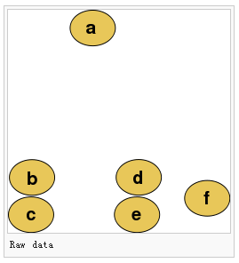
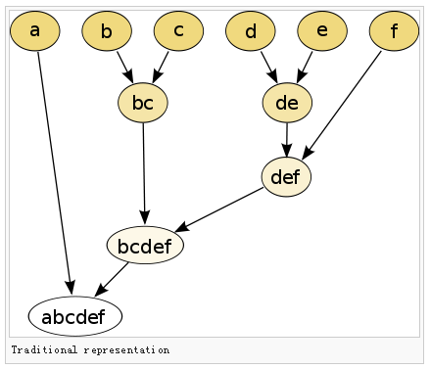
Practice?

Slide 19
Agglomerative clustering algorithm
Most popular hierarchical clustering technique
Basic algorithm
Compute the distance matrix between the input data points
Let each data point be a cluster
Repeat
Merge the two closest clusters
Update the distance matrix
Until only a single cluster remains
Key operation is the computation of the distance between two clusters
Different definitions of the distance between clusters lead to different algorithms

Slide 20
Input/ Initial setting
Start with clusters of individual points and a distance/proximity matrix
p1
p2
p3
p4
p5
. . .
p1
p2
p3
p4
p5
.
.
.
Distance/Proximity Matrix

Slide 21
Intermediate State
After some merging steps, we have some clusters
C1
C2
C3
C4
C5
C1
C2
C3
C3
C4
C4
C5
C1
Distance/Proximity Matrix
C2
C5

Slide 22
Intermediate State
Merge the two closest clusters (C2 and C5) and update the distance matrix.
C1
C2
C3
C4
C5
C1
C3
C2
C4
C3
C4
C5
C1
Distance/Proximity Matrix
C2
C5

Slide 23
After Merging
“How do we update the distance matrix?”
C2 U C5
C1
C3
C4
C3
C1
?
C4
C2 U C5
? ? ? ?
C3
?
C1
C4
?
C2 U C5

Slide 24
Distance between two clusters
Each cluster is a set of points
How do we define distance between two sets of points
Lots of alternatives
Not an easy task

Slide 25
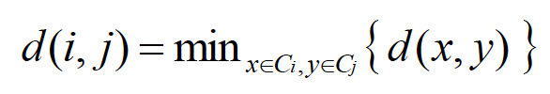

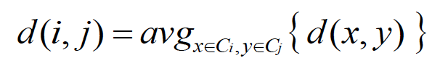
Inter-cluster distances
Three widely used ways of defining the inter-cluster distance, i.e., the distance between two separate clusters, are
single linkage method (nearest neighbor):
complete linkage method (furthest neighbor):
average linkage method (unweighted pair-group average):

Slide 26
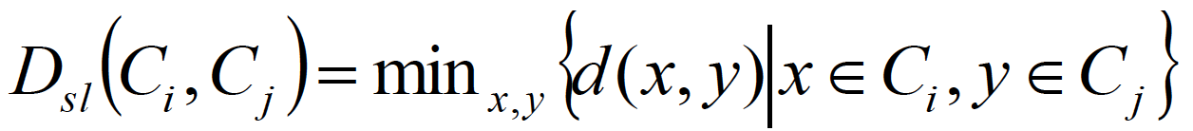
Distance between two clusters
Single-link distance between clusters C_{i} and C_{j} is the minimum distance between any object in C_{i} and any object in C_{j}
The distance is defined by the two most similar objects

Slide 27
Single-link clustering: example
Determined by one pair of points, i.e., by one link in the proximity graph.
1
2
3
4
5

Slide 28
Single-link clustering: example
5
1
3
5
2
1
2
3
6
4
4
Nested Clusters
Dendrogram

Slide 29
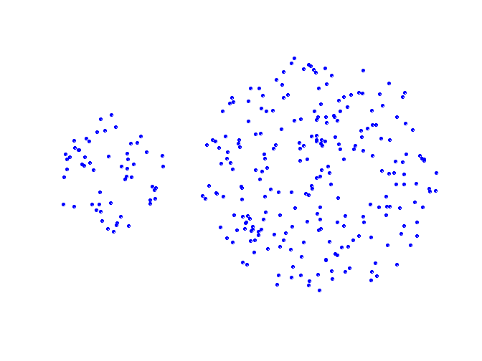
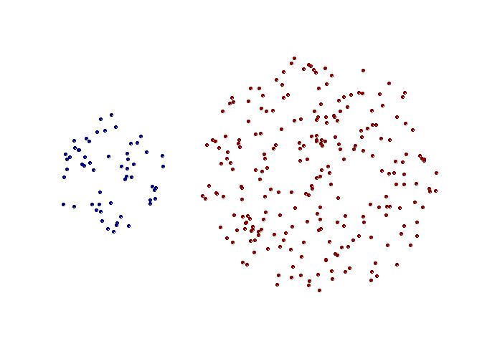
Strengths of single-link clustering
Original Points
Two Clusters
Can handle non-elliptical shapes

Slide 30
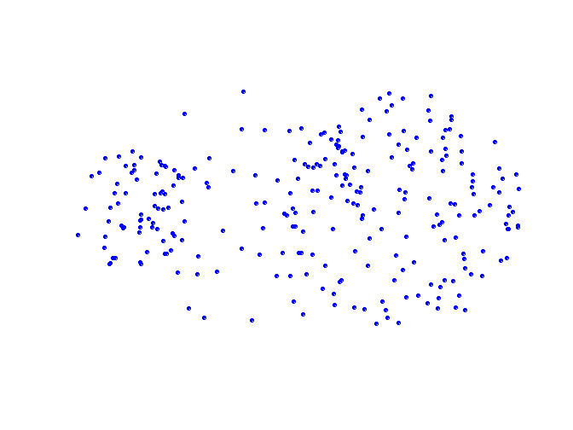
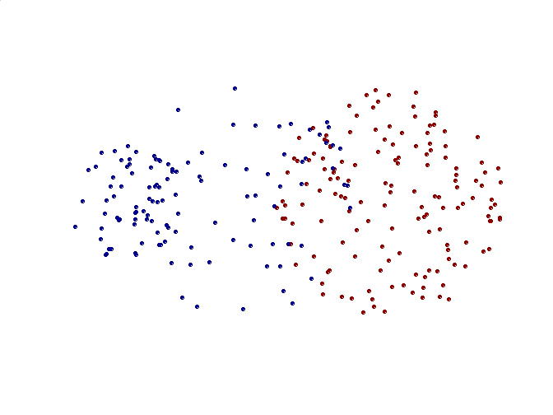
Limitations of single-link clustering
Original Points
Two Clusters
Sensitive to noise and outliers
It produces long, elongated clusters

Slide 31
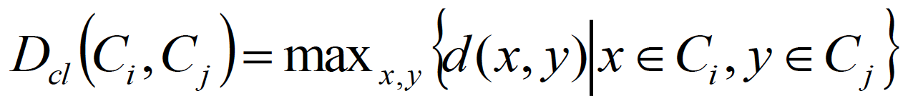
Distance between two clusters
Complete-link distance between clusters C_{i} and C_{j} is the maximum distance between any object in C_{i} and any object in C_{j}
The distance is defined by the two most dissimilar objects

Slide 32
Complete-link clustering: example
Distance between clusters is determined by the two most distant points in the different clusters
1
2
3
4
5

Slide 33
Complete-link clustering: example
4
1
2
5
5
2
3
6
3
1
4
Nested Clusters
Dendrogram

Slide 34
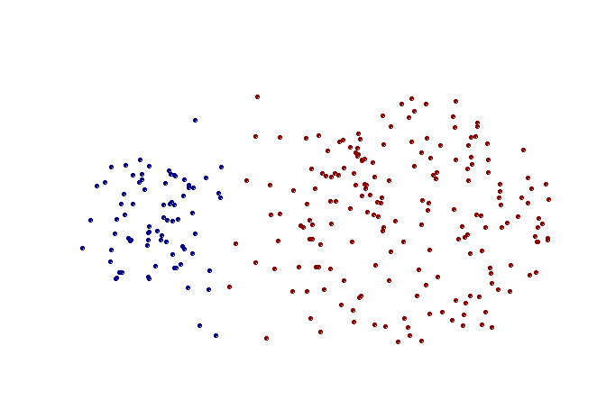
Strengths of complete-link clustering
Original Points
Two Clusters
More balanced clusters (with equal diameter)
Less susceptible to noise

Slide 35
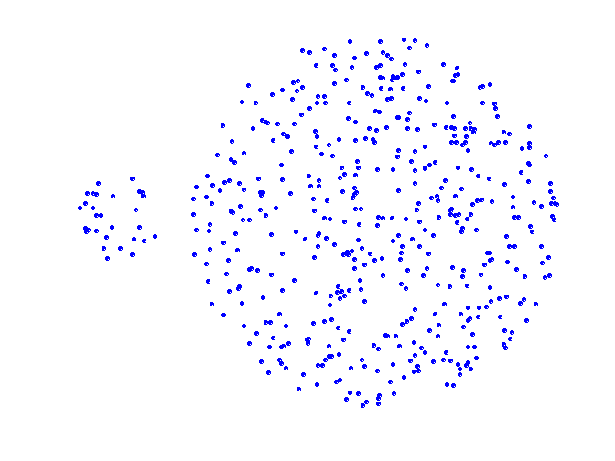
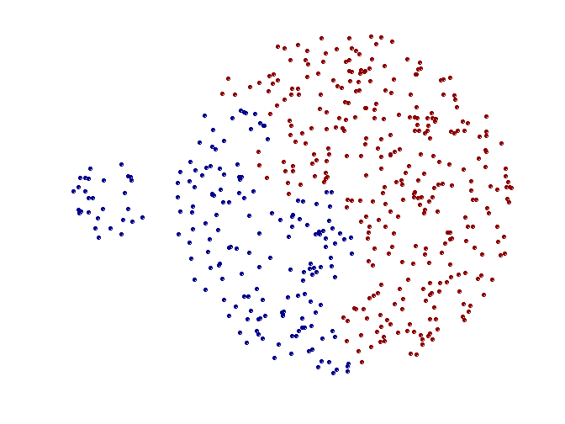
Limitations of complete-link clustering
Original Points
Two Clusters
Tends to break large clusters
All clusters tend to have the same diameter – small clusters are merged with larger ones

Slide 36
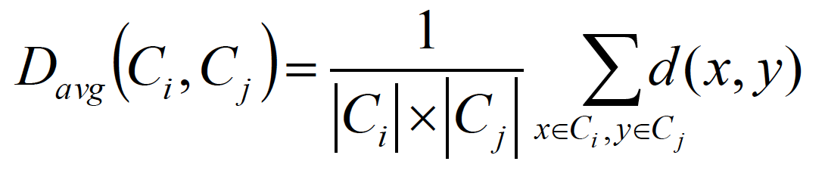
Distance between two clusters
Group average distance between clusters C_{i} and C_{j} is the average distance between any object in C_{i} and any object in C_{j}

Slide 37
Average-link clustering: example
Proximity of two clusters is the average of pairwise proximity between points in the two clusters.
1
2
3
4
5

Slide 38
Average-link clustering: example
5
4
1
2
5
2
3
6
1
4
3
Nested Clusters
Dendrogram

Slide 39
Average-link clustering: discussion
Compromise between Single and Complete Link
Strengths
Less susceptible to noise and outliers
Limitations
Biased towards globular clusters

Slide 40
Distance between two clusters
Centroid distance between clusters C_{i} and C_{j} is the distance between the centroid r_{i} of C_{i} and the centroid r_{j} of C_{j}

Slide 41
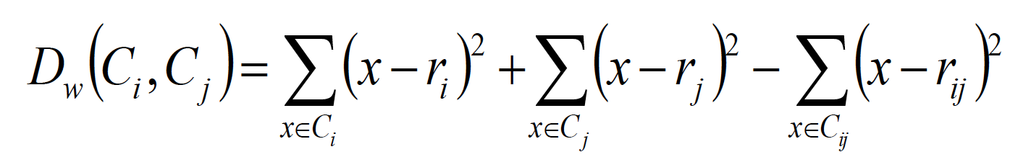
Distance between two clusters
Ward’s distance between clusters C_{i} and C_{j} is the difference between the total within cluster sum of squares for the two clusters separately, and the within cluster sum of squares resulting from merging the two clusters in cluster C_{ij}
r_{i}: centroid of C_{i}
r_{j}: centroid of C_{j}
r_{ij}: centroid of C_{ij}

Slide 42
Ward’s distance for clusters
Similar to group average and centroid distance
Less susceptible to noise and outliers
Biased towards globular clusters
Hierarchical analogue of k-means
Can be used to initialize k-means

Slide 43
Hierarchical Clustering: Comparison
5
1
4
1
3
2
5
5
5
2
1
MIN
2
MAX
2
3
6
3
3
6
1
4
4
4
5
5
1
4
1
2
2
5
2
Ward’s Method
5
2
3
6
Group Average
3
3
6
4
1
1
4
4
3

Slide 44
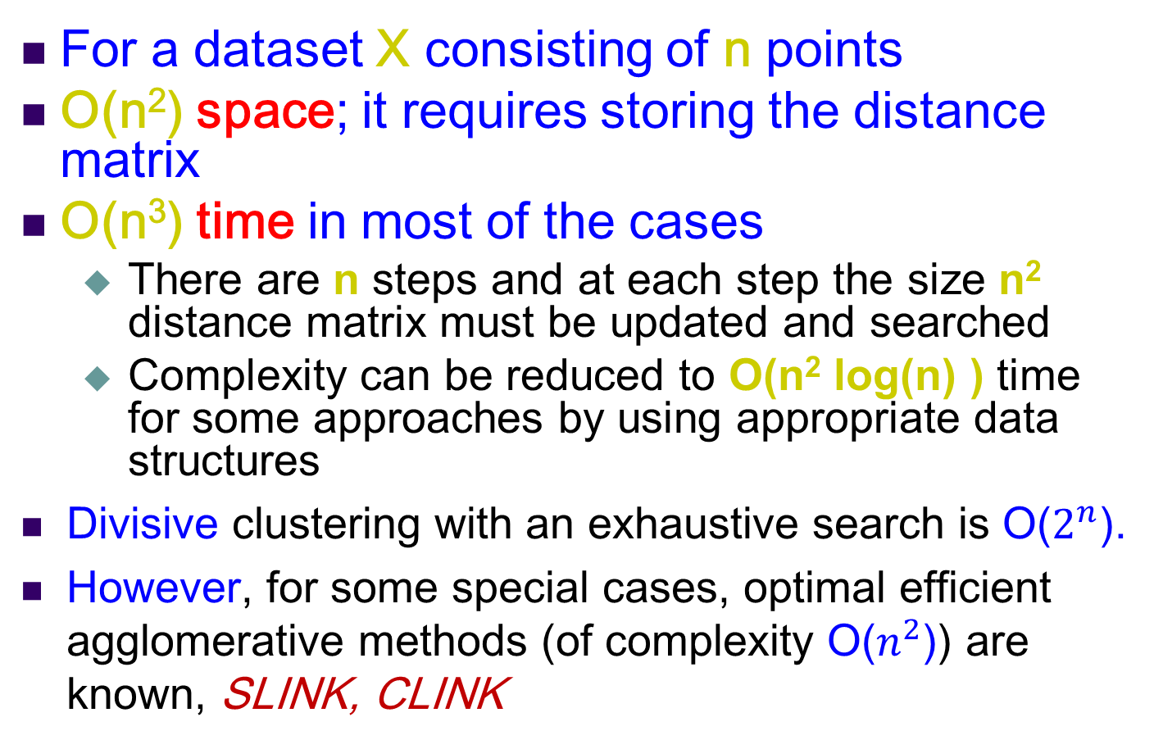
Hierarchical Clustering: Time and Space requirements
For a dataset X consisting of n points
O(n²) space; it requires storing the distance matrix
O(n³) time in most of the cases
There are n steps and at each step the size n² distance matrix must be updated and searched
Complexity can be reduced to O(n² log(n) ) time for some approaches by using appropriate data structures
Divisive clustering with an exhaustive search is O($2^{n}$).
However, for some special cases, optimal efficient agglomerative methods (of complexity O($n^{2}$)) are known, SLINK, CLINK

Slide 45
Divisive hierarchical clustering
Start with a single cluster composed of all data points
Split this into components
Continue recursively
Monothetic divisive methods split clusters using one variable/dimension at a time
Polythetic divisive methods make splits on the basis of all variables together
Any intercluster distance measure can be used
Computationally intensive, less widely used than agglomerative methods

Slide 46
Strengths of hierarchical clustering
Conceptually simple
Theoretical properties are well understood
When clusters are merged/split, the decision is permanent => the number of different alternatives that need to be examined is reduced

Slide 47
Weakness of hierarchical clustering
Merging/splitting of clusters is permanent => erroneous decisions are impossible to correct later
Divisive methods can be computational hard
Methods are not (necessarily) scalable for large data sets

Slide 48
Outline
Cluster Basics
Clustering algorithms
Hierarchical clustering, spectral clustering
k-means, Expectation-Maximization (EM)
DBSCAN
state-of-art algorithms
Cluster Validity
determining the number of clusters
clustering evaluation
Notes:
48

Slide 49
Graph Representation
We can represent the relationships between data points in a graph.

Slide 50
Graph Representation
We can represent the relationships between data points in a graph.
Weight the edges by the similarity between points

Slide 51
Representing data in a graph
What is the best way to calculate similarity between two data points?
Distance based:

Slide 52
Graphs
Nodes and Edges
Edges can be directed or undirected
Edges can have weights associated with them
Here the weights correspond to pairwise affinity

Slide 53
Graphs
Degree
Volume of a set

Slide 54
Graph Cuts
The cut between two subgraphs is calculated as follows

Slide 55
Intuition
The minimum cut of a graph identifies an optimal partitioning of the data.
Spectral Clustering
Recursively partition the data set
Identify the minimum cut
Remove edges
Repeat until k clusters are identified

Slide 56
Graph Cuts
Minimum (bipartitional) cut

Slide 57
Graph Cuts
Minimal (bipartitional) normalized cut.
Unnormalized cuts are attracted to outliers.

Slide 58
Graph definitions
ε-neighborhood graph
Identify a threshold value, ε, and include edges if the affinity between two points is greater than ε.
k-nearest neighbors
Insert edges between a node and its k-nearest neighbors.
Each node will be connected to (at least) k nodes.
Fully connected
Insert an edge between every pair of nodes.

Slide 59
Problem
Identifying a minimum cut is NP-hard.
There are efficient approximations using linear algebra.
Based on the Laplacian Matrix, or graph Laplacian
Notes:
狄多公主圈地传说，是目前知道的最早涉及Isoperimetric problem（等周长问题）的，具体为如何在给定长度的线条下围出一个最大的面积，也可理解为，在给定面积下如何使用更短的线条，而这，也正是谱图聚类想法的端倪，如何在给定一张图，拿出“更短”的边来将其“更好”地切分。而这个“更短”的边，正是对应了spectral clustering中的极小化问题，“更好”地切分，则是对应了spectral clustering中的簇聚类效果。
————————————————
版权声明：本文为CSDN博主「杨铖」的原创文章，遵循CC 4.0 BY-SA版权协议，转载请附上原文出处链接及本声明。
原文链接：https://blog.csdn.net/yc_1993/article/details/52997074

Slide 60
Spectral Clustering
Construct an affinity matrix
 | A | B | C | D
A | .4 | .2 | .2 | 0
B | .2 | .5 | .3 | 0
C | .2 | .3 | .6 | .1
D | 0 | 0 | .1 | .1
A
D
.2
.2
.1
B
C
.3

Slide 61
Spectral Clustering
Construct the graph Laplacian
Identify eigenvectors of the affinity matrix

Slide 62
Spectral Clustering
K-Means on eigenvector transformation of the data.
Project back to the initial data representation.
k-eigen vectors
Each Row represents a
data point in the eigenvector
space
n-data points

Slide 63
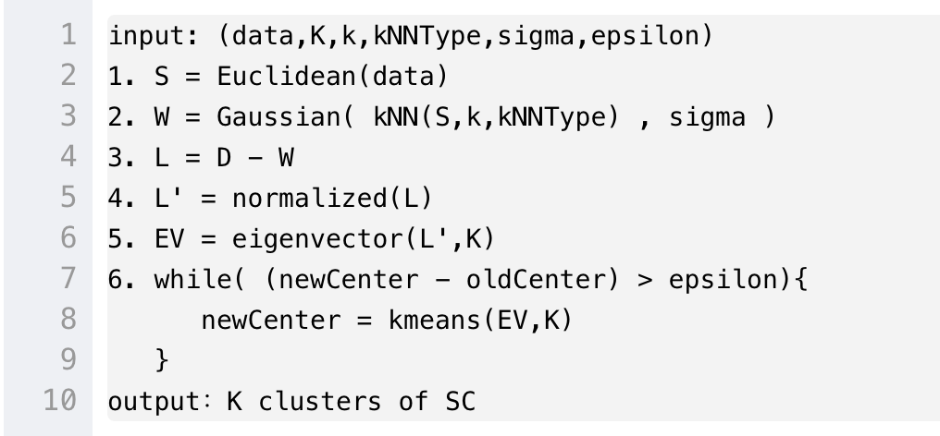
伪代码
Spectral clustering的pseudo-code有很多种，最常用的normalized版本（Ncut）
1.构造S矩阵(similarity matrix)，同时指定要聚类的簇数k；
2.利用S矩阵构造W矩阵(adjacent matrix)；
3.计算拉普拉斯矩阵L，其中L=D-W；
4.对L矩阵标准化 ；
5.计算normalize后的L矩阵的前k个特征向量，按特征值升序排列；
6.对k个向量组成的矩阵的行进行看kmeans/GMM聚类；
7.将聚类结果的各个簇分别打上标记，对应上原数据，输出结果。

Slide 64
Overview: what are we doing?
Define the affinity matrix
Identify eigenvalues and eigenvectors.
K-means of transformed data
Project back to original space

Slide 65
Why does this work?
How does this eigenvector decomposition address this?
if we let f be eigen vectors of L, then the eigenvalues are the cluster objective functions
cluster assignment
Cluster objective function – normalized cut!

Slide 66
Normalized Graph Cuts view
Minimal (bipartitional) normalized cut.
Eigenvalues of the Laplacian are approximate solutions to mincut problem.

Slide 67
The Laplacian Matrix
L = D-W
Positive semi-definite
The lowest eigenvalue is 0, eigenvector is
The second lowest contains the solution
The corresponding eigenvector contains the cluster indicator for each data point
Notes:
谱聚类最早于1973年被提出，当时Donath 和 Hoffman第一次提出利用特征向量来解决谱聚类中的f向量选取问题，而同年，Fieder发现利用倒数第二小的特征向量，显然更加符合f向量的选取

Slide 68
Using eigenvectors to partition
Each eigenvector partitions the data set into two clusters.
The entry in the second eigenvector determines the first cut.
Subsequent eigenvectors can be used to further partition into more sets.

Slide 69
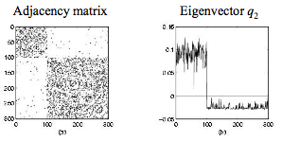
Example
Dense clusters with some sparse connections

Slide 70
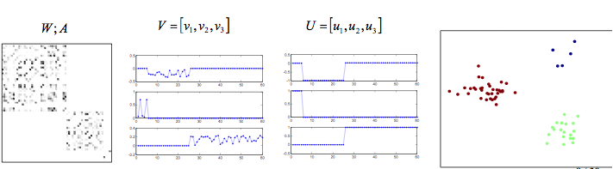
3 class Example
Affinity matrix
eigenvectors
row normalization
output
Notes:
http://ranger.uta.edu/~chqding/Spectral/spectralA.pdf page 8

Slide 71
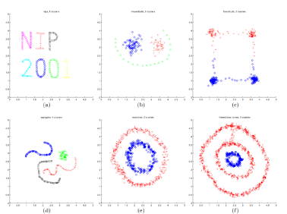
Example [Ng et al. 2001]

Slide 72
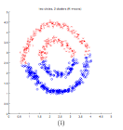
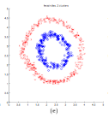
k-means vs. Spectral Clustering
K-means
Spectral Clustering

