Slide 1
Big Data Analysis and Mining
Bayes Classifier &
KNN
Qinpei Zhao 赵钦佩
qinpeizhao@tongji.edu.cn

Slide 2
Things We’d Like to Do
Spam Classification
Given an email, predict whether it is spam or not
Medical Diagnosis
Given a list of symptoms, predict whether a patient has disease X or not
Weather
Based on temperature, humidity, etc… predict if it will rain tomorrow

Slide 3
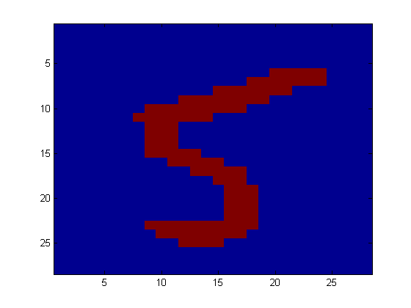
Application
Digit Recognition
X₁,…,X_{n} ∈ {0,1} (Black vs. White pixels)
Y ∈ {5,6} (predict whether a digit is a 5 or a 6)
Classifier
5

Slide 4
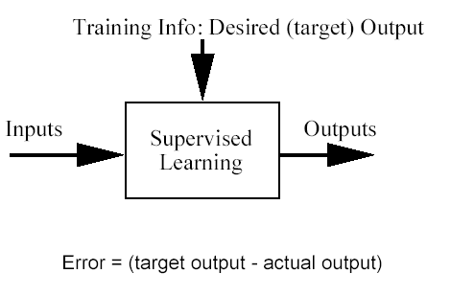

Classification problem
Training data: examples of the form (d,h(d))
where d are the data objects to classify (inputs)
and h(d) are the correct class info for d, h(d)$∈${1,…K}
Goal: given dnew, provide h(dnew)

Slide 5
Bayesian Classification
A statistical classifier: performs probabilistic prediction, i.e., predicts class membership probabilities
Foundation: Based on Bayes’ Theorem.
Performance: A simple Bayesian classifier, naïve Bayesian classifier, has comparable performance with decision tree and selected neural network classifiers

Slide 6


Conditional probability
If A and B are two events, the probability of event A when we already know that event B has occurred is defined by the relation
This conditional probability P[A|B] is read:
the “conditional probability of A conditioned on B”, or simply
the “probability of A given B”

Slide 7

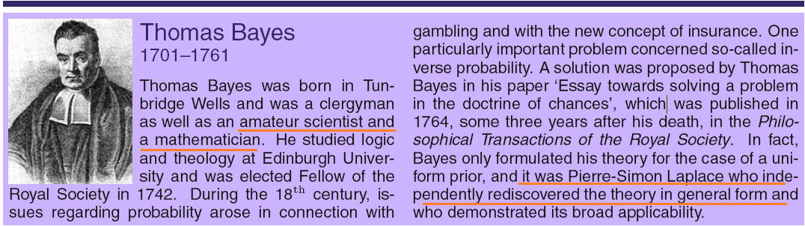
Bayes Theorem
P(A) and P(B) are the probabilities of A and B without regard to each other. (prior)
P(A|B), a conditional probability, is the probability of observing event A given that B is true. (posteriori)

Slide 8
Example of Bayes Theorem
Given:
A doctor knows that meningitis causes stiff neck 50% of the time
Prior probability of any patient having meningitis is 1/50,000
Prior probability of any patient having stiff neck is 1/20
If a patient has stiff neck, what’s the probability he/she has meningitis?

Slide 9
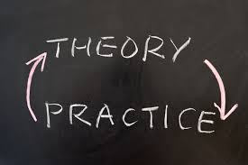
Practice
The entire output of a factory is produced on three machines. The three machines account for 20%, 30%, and 50% of the output, respectively. The fraction of defective items produced is this: for the first machine, 5%; for the second machine, 3%; for the third machine, 1%. If an item is chosen at random from the total output and is found to be defective, what is the probability that it was produced by the third machine?

Slide 10
Naïve Bayes Classifiers
Consider each attribute and class label as random variables
Given a record with attributes (A₁, A₂,…,A_{n})
Goal is to predict class C
Specifically, we want to find the value of C that maximizes P(C| A₁, A₂,…,A_{n} )
Can we estimate P(C| A₁, A₂,…,A_{n} ) directly from data?

Slide 11
Naïve Bayes Classifiers
Approach:
compute the posterior probability P(C | A₁, A₂, …, A_{n}) for all values of C using the Bayes theorem
Choose value of C that maximizes P(C | A₁, A₂, …, A_{n})
Equivalent to choosing value of C that maximizes P(A₁, A₂, …, A_{n}|C) P(C)
How to estimate P(A₁, A₂, …, A_{n} | C )?
prior
posteriori
likelihood
evidence

Slide 12
Naïve Bayes Classifiers
Assume independence among attributes A_{i} when class is given:
P(A₁, A₂, …, A_{n} |C) = P(A₁| C_{j}) P(A₂| C_{j})… P(A_{n}| C_{j})
Can estimate P(A_{i}| C_{j}) for all A_{i} and C_{j}.
This is a simplifying assumption which may be violated in reality
The classifier that uses the Naïve Bayes assumption and computes the MAP hypothesis is called Naïve Bayes classifier
MAP: maximum a posterior

Slide 13
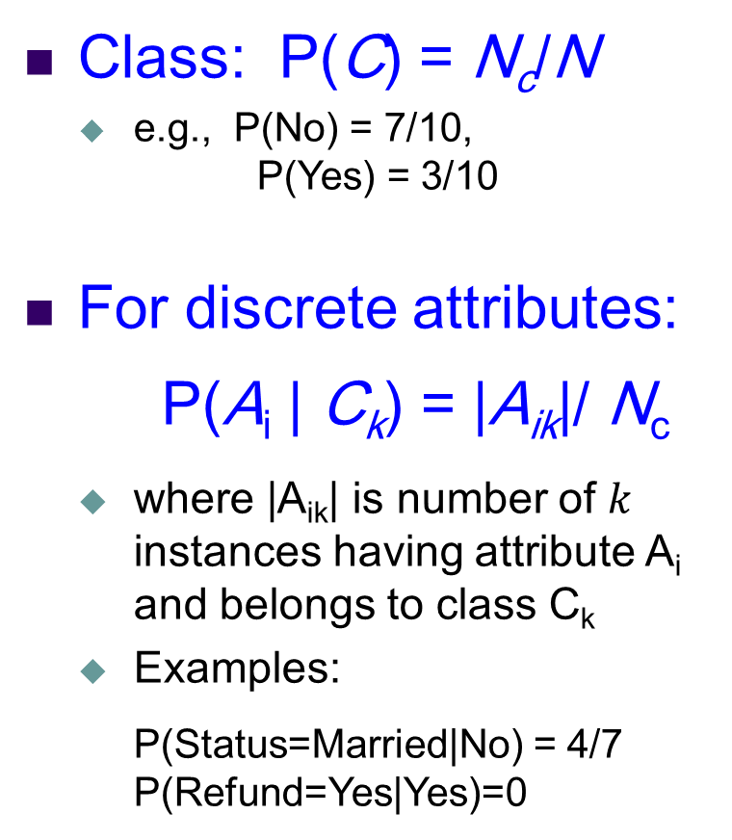
How to Estimate Probabilities from Data?
Class: P(C) = N_{c}/N
e.g., P(No) = 7/10, P(Yes) = 3/10
For discrete attributes: P(A_{i} | C_{k}) = |A_{ik}|/ N_{c}
where |A_{ik}| is number of $k$ instances having attribute A_{i} and belongs to class C_{k}
Examples:
P(Status=Married|No) = 4/7 P(Refund=Yes|Yes)=0

Slide 14
How to Estimate Probabilities from Data?
For continuous attributes:
Discretize the range into bins (Bernoulli-distributed)
one ordinal attribute per bin
violates independence assumption
Two-way split: (A < v) or (A > v)
choose only one of the two splits as new attribute
Probability density estimation:
Assume attribute follows a normal distribution
Use data to estimate parameters of distribution (e.g., mean and standard deviation)
Once probability distribution is known, can use it to estimate the conditional probability P(A_{i}|c)

Slide 15
Gaussian naïve Bayes - continuous
Normal distribution:
One for each (A_{i},c_{i}) pair
For (Income, Class=No):
If Class=No
sample mean = 110
sample variance = 2975

Slide 16
Training Dataset
Class:
C1:buys_computer = ‘yes’
C2:buys_computer = ‘no’
New Data:
X = (age <=30,
Income = medium,
Student = yes
Credit_rating = Fair)
Notes:
16

Slide 17
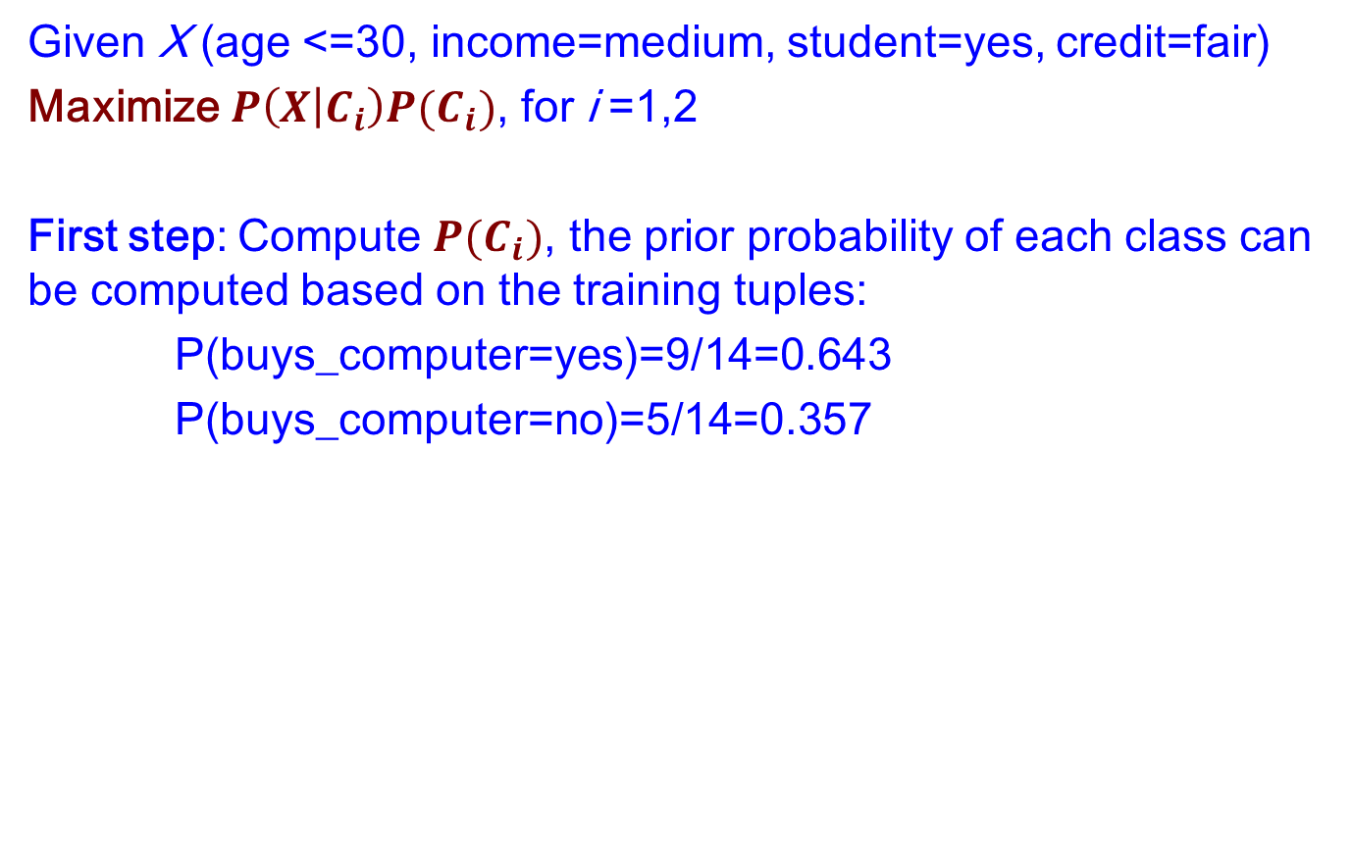
An Example
Given X (age <=30, income=medium, student=yes, credit=fair)
Maximize $P\left(X | C_{i}\right)P(C_{i})$, for i =1,2
First step: Compute $P(C_{i})$, the prior probability of each class can be computed based on the training tuples:
P(buys_computer=yes)=9/14=0.643
P(buys_computer=no)=5/14=0.357

Slide 18
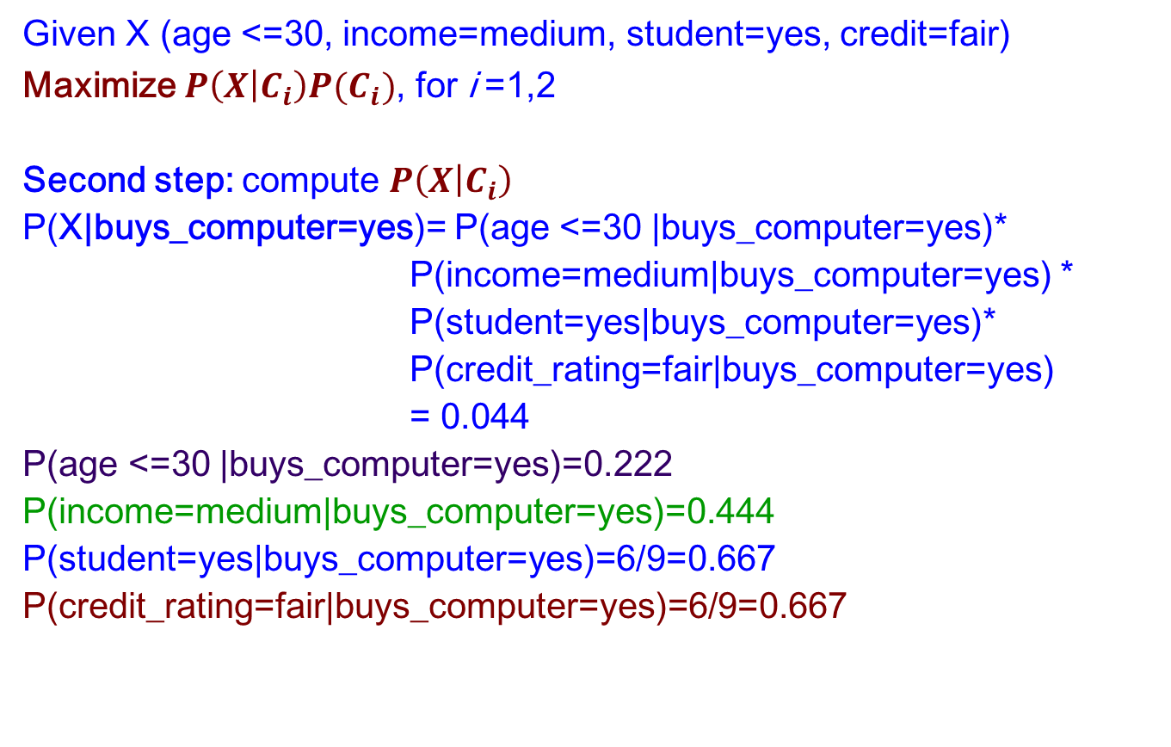
An Example
Given X (age <=30, income=medium, student=yes, credit=fair)
Maximize $P\left(X | C_{i}\right)P(C_{i})$, for i =1,2
Second step: compute $P\left(X | C_{i}\right)$
P(X|buys_computer=yes)= P(age <=30 |buys_computer=yes)*
P(income=medium|buys_computer=yes) *
P(student=yes|buys_computer=yes)*
P(credit_rating=fair|buys_computer=yes)
= 0.044
P(age <=30 |buys_computer=yes)=0.222
P(income=medium|buys_computer=yes)=0.444
P(student=yes|buys_computer=yes)=6/9=0.667
P(credit_rating=fair|buys_computer=yes)=6/9=0.667

Slide 19
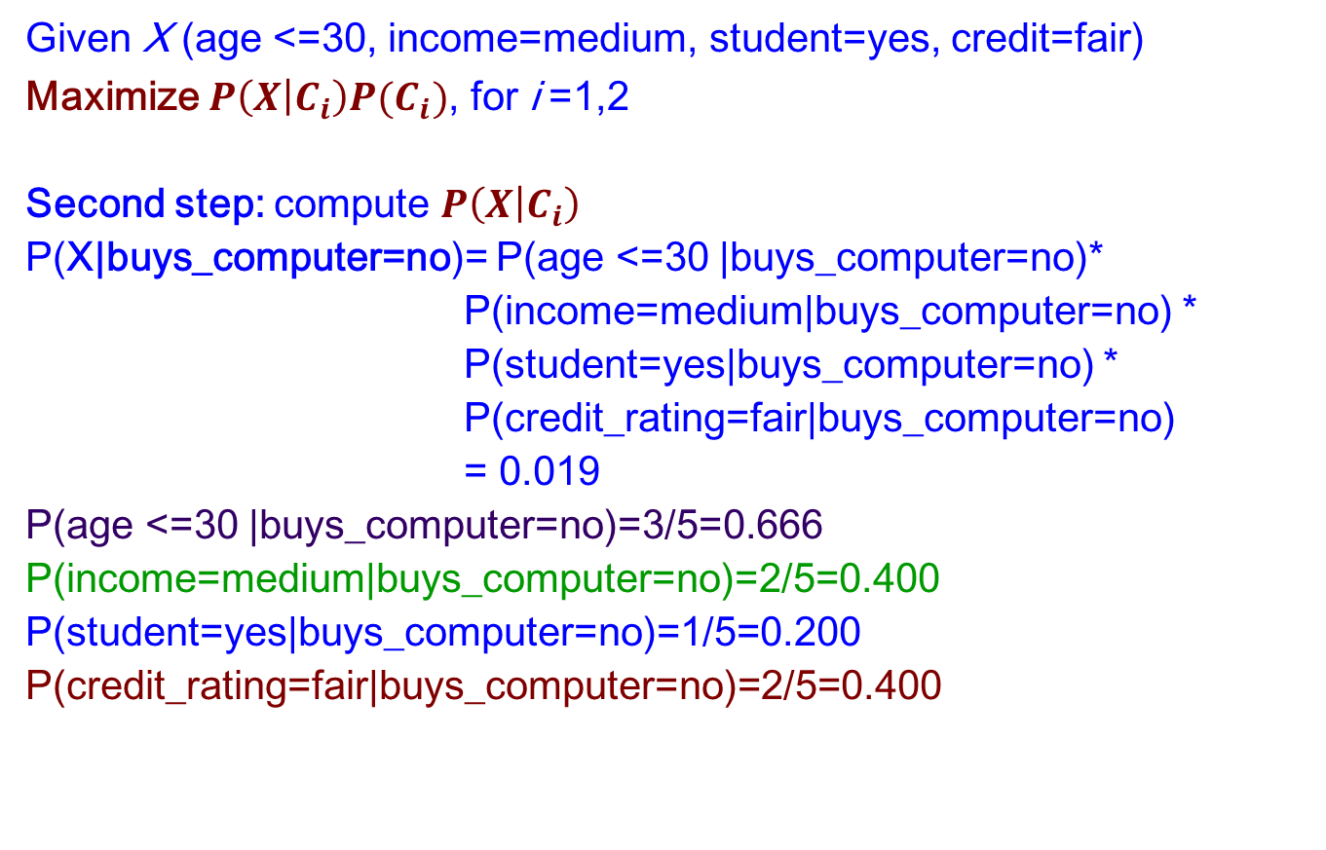
An Example
Given X (age <=30, income=medium, student=yes, credit=fair)
Maximize $P\left(X | C_{i}\right)P(C_{i})$, for i =1,2
Second step: compute $P\left(X | C_{i}\right)$
P(X|buys_computer=no)= P(age <=30 |buys_computer=no)*
P(income=medium|buys_computer=no) *
P(student=yes|buys_computer=no) *
P(credit_rating=fair|buys_computer=no)
= 0.019
P(age <=30 |buys_computer=no)=3/5=0.666
P(income=medium|buys_computer=no)=2/5=0.400
P(student=yes|buys_computer=no)=1/5=0.200
P(credit_rating=fair|buys_computer=no)=2/5=0.400

Slide 20
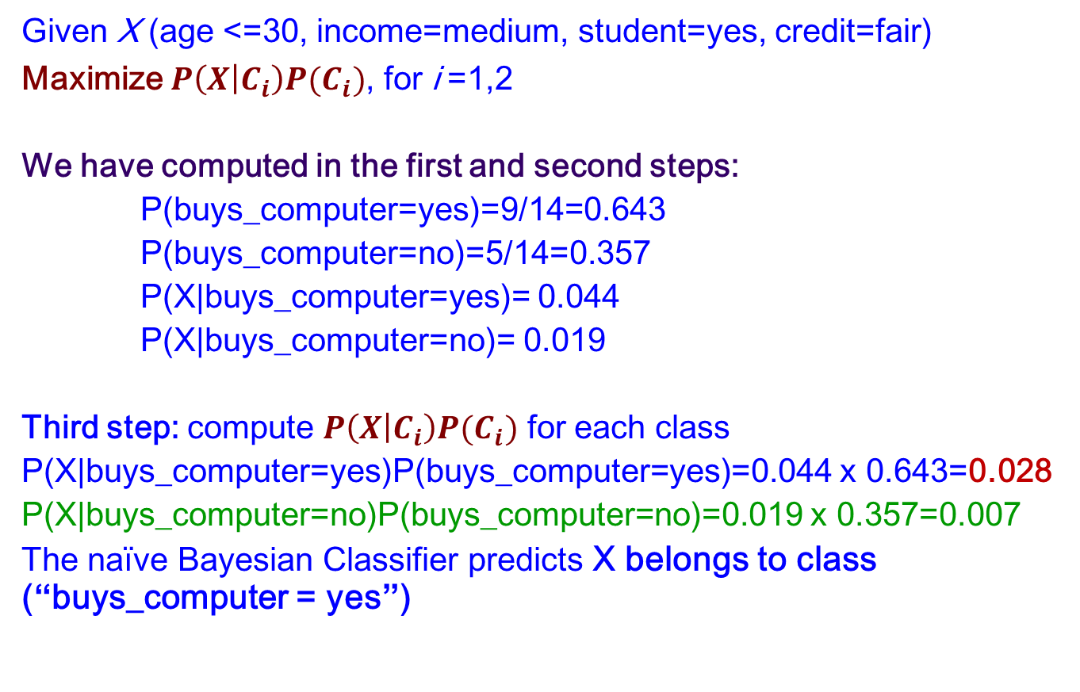
An Example
Given X (age <=30, income=medium, student=yes, credit=fair)
Maximize $P\left(X | C_{i}\right)P(C_{i})$, for i =1,2
We have computed in the first and second steps:
P(buys_computer=yes)=9/14=0.643
P(buys_computer=no)=5/14=0.357
P(X|buys_computer=yes)= 0.044
P(X|buys_computer=no)= 0.019
Third step: compute $P\left(X | C_{i}\right)P(C_{i})$ for each class
P(X|buys_computer=yes)P(buys_computer=yes)=0.044 x 0.643=0.028
P(X|buys_computer=no)P(buys_computer=no)=0.019 x 0.357=0.007
The naïve Bayesian Classifier predicts X belongs to class (“buys_computer = yes”)

Slide 21
Avoiding the 0-Probability Problem
If one of the conditional probability is zero, then the entire expression becomes zero
Probability estimation:
c: number of classes
p: prior probability
m: parameter

Slide 22
Naïve Bayes (Summary)
Advantage
Easy to implement
Good results obtained in most of the cases
Disadvantage
Assumption: class conditional independence, which may cause loss of accuracy
Independence assumption may not hold for some attribute. Practically, dependencies exist among variables
E.g., hospitals: patients: profile: age, family, history etc. Symptoms: fever, cough etc. Disease: lung cancer, diabetes, etc.
Use other techniques such as Bayesian Belief Networks (BBN)

Slide 23
Remember
Bayes’ rule can be turned into a classifier
Maximum A Posteriori (MAP) hypothesis estimation incorporates prior knowledge; Max Likelihood (ML) doesn’t
Naive Bayes Classifier is a simple but effective Bayesian classifier for vector data (i.e. data with several attributes) that assumes that attributes are independent given the class.
Bayesian classification is a generative approach to classification

Slide 24
K-nearest neighbourhood (KNN)
Basic idea:
If it walks like a duck, quacks like a duck, then it’s probably a duck
Compute Distance
Test Record
Training Records
Choose k of the “nearest” records

Slide 25
K-nearest neighbourhood (KNN)
Requires the following:
A set of labeled records
Proximity metric to compute distance/similarity between a pair of records
e.g., Euclidean distance
The value of k, the number of nearest neighbors to retrieve
A method for using class labels of K nearest neighbors to determine the class label of unknown record (e.g., by taking majority vote)

Slide 26

How to Determine the class label of a Test Sample?
Take the majority vote of class labels among the k-nearest neighbors
Weight the vote according to distance
weight factor, $w = 1/d2$

Slide 27
Nearest Neighbor Classification…
Data preprocessing is often required
Attributes may have to be scaled to prevent distance measures from being dominated by one of the attributes
Example:
height of a person may vary from 1.5m to 1.8m
weight of a person may vary from 90lb to 300lb
income of a person may vary from $10K to $1M
Time series are often standardized to have 0 means a standard deviation of 1

Slide 28
Nearest Neighbor Classification…
Choosing the value of k:
If k is too small, sensitive to noise points
If k is too large, neighborhood may include points from other classes

Slide 29
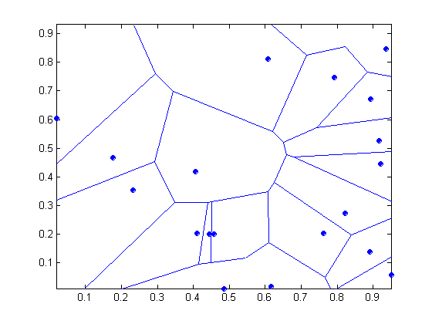
Nearest-neighbor classifiers
Nearest neighbor classifiers are local classifiers
They can produce decision boundaries of arbitrary shapes.
1-nn decision boundary is a Voronoi Diagram

Slide 30
Improving KNN Efficiency
Avoid having to compute distance to all objects in the training set
Multi-dimensional access methods (k-d trees)
Fast approximate similarity search
Locality Sensitive Hashing (LSH)
Condensing
Determine a smaller set of objects that give the same performance
Editing
Remove objects to improve efficiency

Slide 31

Evaluating classifiers
How well can a classifier be expected to perform on novel data?
Choice of performance measure
How close is the estimated performance to the true performance?
Comparing classifiers

Slide 32
Measuring classifier performance
Natural performance measure for classification problems: error rate or accuracy
Higher accuracy does not necessarily imply better performance on target task
Implicit assumption: the class distribution among examples is relative balanced
Biased in favor of the majority class

Slide 33
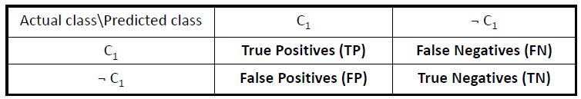

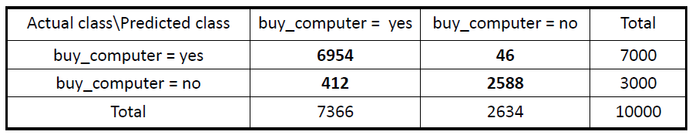
Confusion Matrix
Contingency table (confusion matrix)
TP: number of true positives
FP: number of false positives (result positive, reality is not)
TN: number of true negatives
FN: number of false negatives (result negative, reality true)

Slide 34
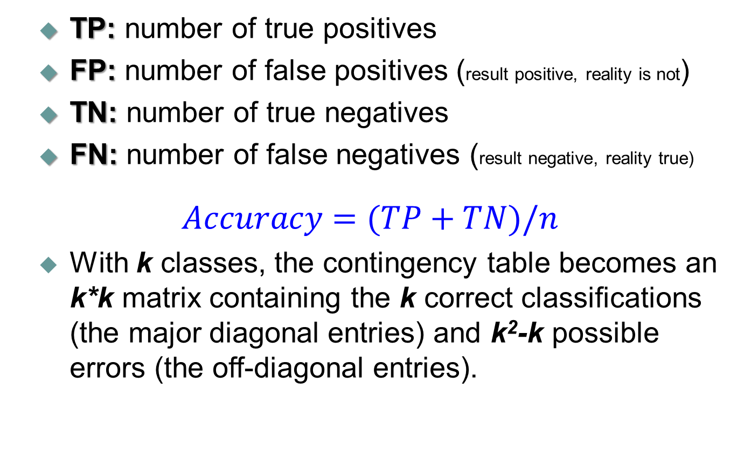
Accuracy
TP: number of true positives
FP: number of false positives (result positive, reality is not)
TN: number of true negatives
FN: number of false negatives (result negative, reality true)
$$Accuracy=(TP+TN)/n$$
With k classes, the contingency table becomes an k*k matrix containing the k correct classifications (the major diagonal entries) and k²-k possible errors (the off-diagonal entries).

Slide 35
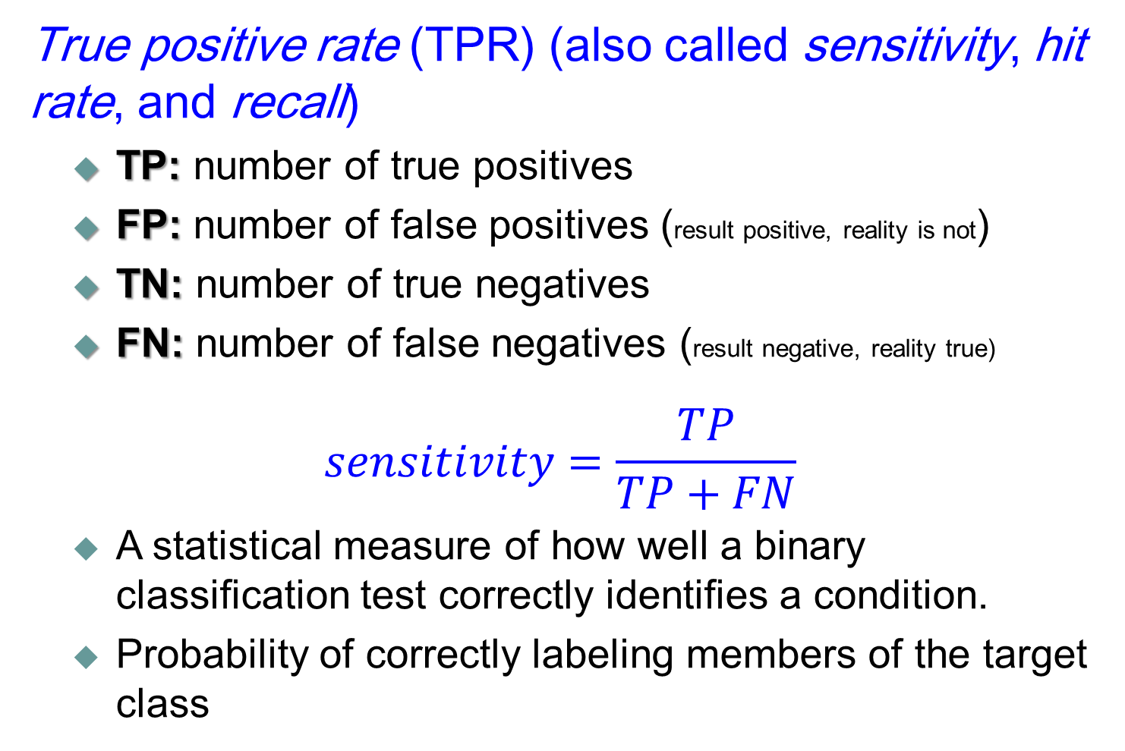
True Positive rate (sensitivity, recall)
True positive rate (TPR) (also called sensitivity, hit rate, and recall)
TP: number of true positives
FP: number of false positives (result positive, reality is not)
TN: number of true negatives
FN: number of false negatives (result negative, reality true)
$$sensitivity=\frac{TP}{TP+FN}$$
A statistical measure of how well a binary classification test correctly identifies a condition.
Probability of correctly labeling members of the target class

Slide 36
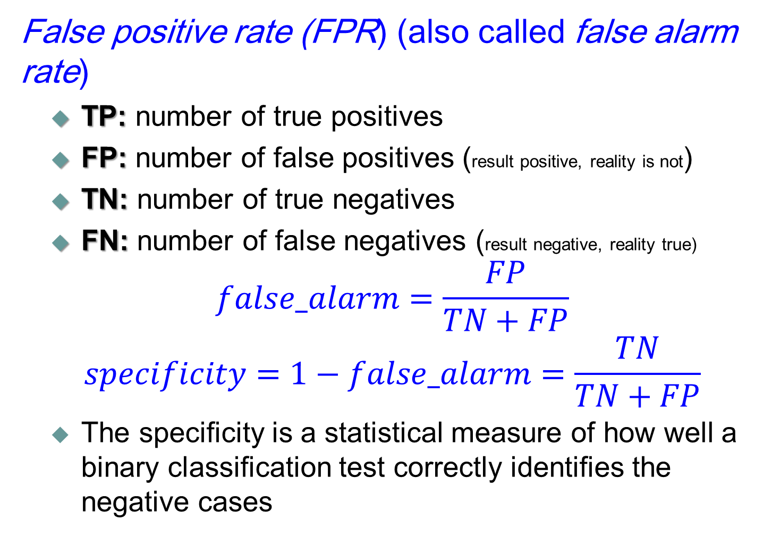
False positive rate (false alarm)
False positive rate (FPR) (also called false alarm rate)
TP: number of true positives
FP: number of false positives (result positive, reality is not)
TN: number of true negatives
FN: number of false negatives (result negative, reality true)
$$false_alarm=\frac{FP}{TN+FP}$$
$$specificity=1−false_alarm=\frac{TN}{TN+FP}$$
The specificity is a statistical measure of how well a binary classification test correctly identifies the negative cases

Slide 37
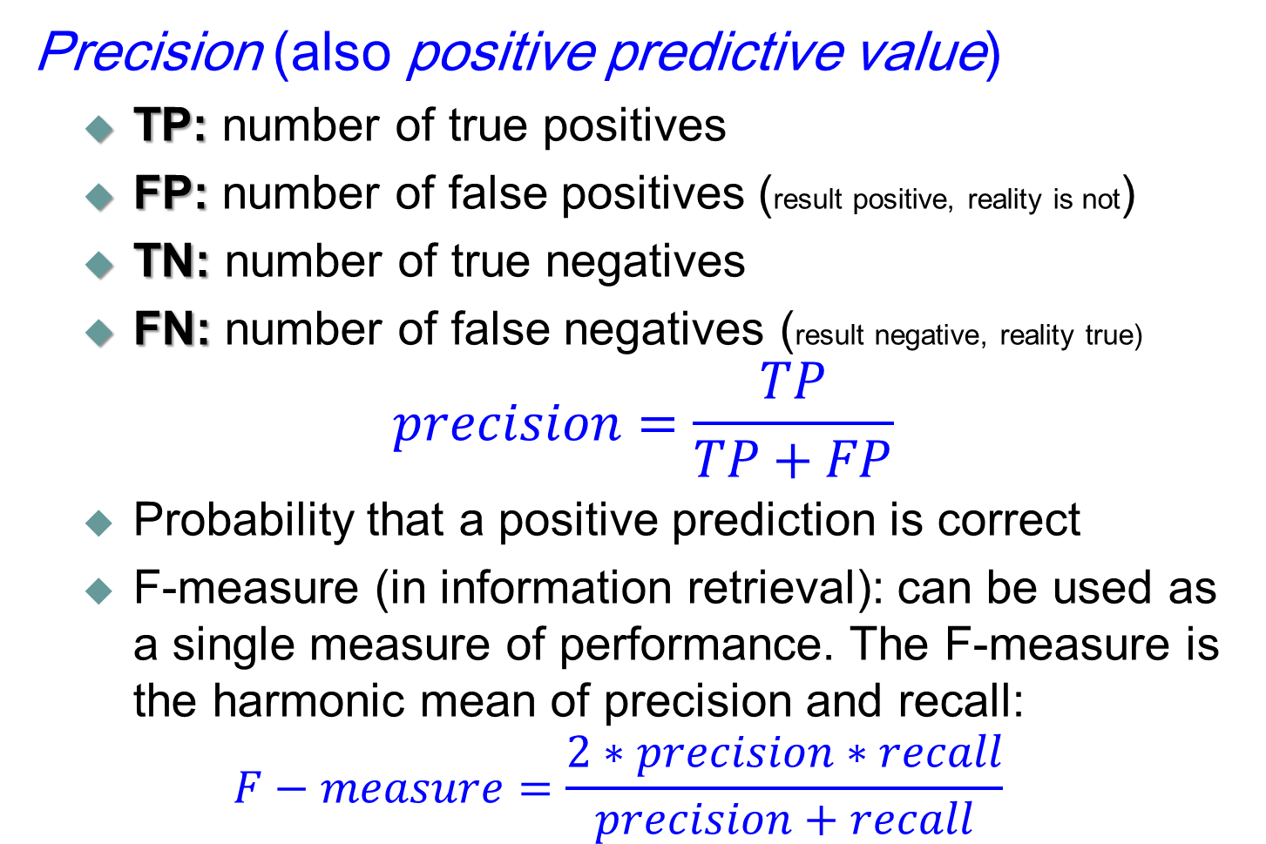
Precision
Precision (also positive predictive value)
TP: number of true positives
FP: number of false positives (result positive, reality is not)
TN: number of true negatives
FN: number of false negatives (result negative, reality true)
$$precision=\frac{TP}{TP+FP}$$
Probability that a positive prediction is correct
F-measure (in information retrieval): can be used as a single measure of performance. The F-measure is the harmonic mean of precision and recall:
$$F−measure=\frac{2∗precision∗recall}{precision+recall}$$

Slide 38
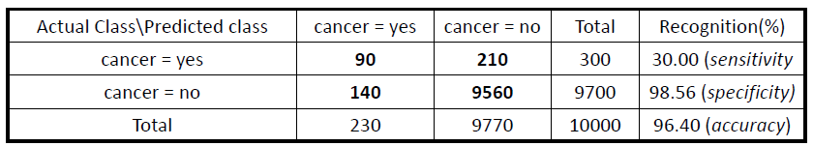
Example
Precision = ?
Recall = ?
90/230 = 39.13%
90/300 = 30.00%

Slide 39

Measures
TP, FP, TN, FN provide the relevant information
No single measure tells the whole story
A classifier with 90% accuracy can be useless if 90% of the population does not have cancer and the 10% that do are misclassified by the classifier
Use of multiple measures recommended
Beware of terminological confusion in the literature!
Eg., specificity sometimes refers to precision
When you write: provide the formula in terms of TP etc.
When you read: check the formula in terms of TP etc.

Slide 40
ROC curve
Receiver Operating Characteristics (ROC) graphs have long been used in signal detection theory to depict the tradeoff between hit rates and false alarm rates over noisy channel
Recent years have seen an increase in the use of ROC graphs in the machine learning community
A useful technique for organizing classifiers and visualizing their performance
Especially useful for domains with skewed class distribution and unequal classification error cost.

Slide 41
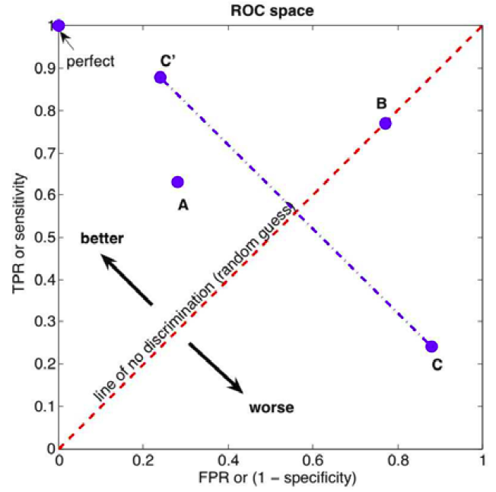
ROC Space
ROC curve is a plot of TPR against FPR which depicts relative trade-offs between benefits (true positives) and costs (false positives).

Slide 42
ROC curve
A discrete classifier produces an (FPR, TPR) pair corresponding to a single point in ROC space.
Some classifier, such as a Naïve Bayes or a neural network, naturally yield an instance probability or score, a numeric value that represents the degree to which an instance is a member of a class.
Such a ranking or scoring classifier can be used with a threshold to produce a discrete classifier
Plotting the ROC point for each possible threshold value results in a curve.

Slide 43
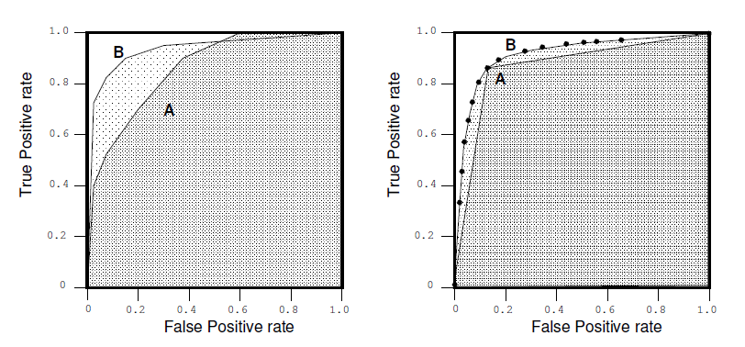

ROC curve
ROC curves offer a more complete picture of the classifier’s performance
To compare classifiers we may want to reduce ROC performance to a single scalar value representing expected performance
A common method is to calculate the area under the ROC curve

