Slide 1
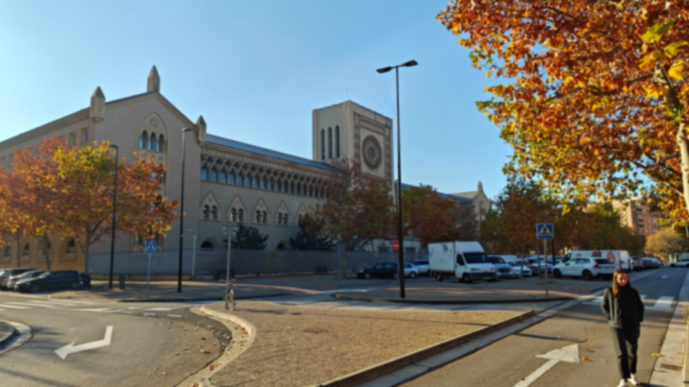
Building the Zaragoza´s Seminar with SFM techniques.
Computer Vision – Final Assignment
Diego Méndez Carter – 960616

Slide 2
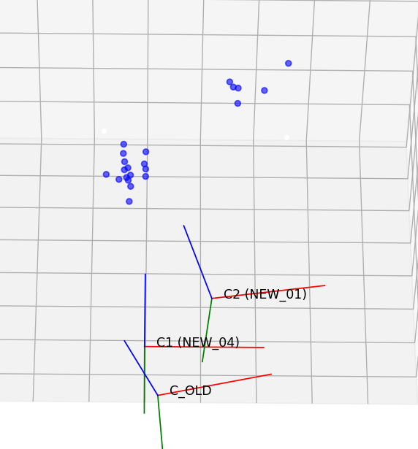
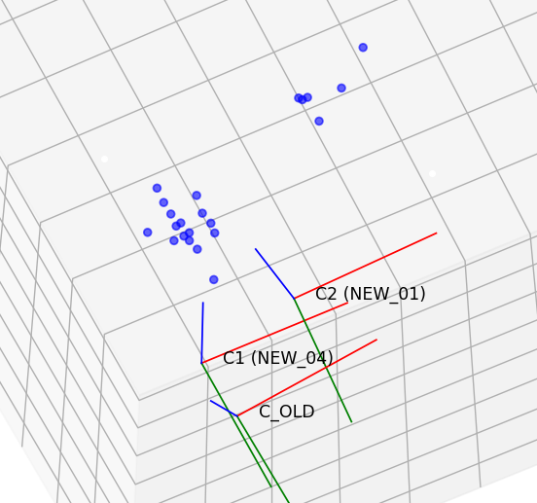


3D reconstruction
Computed the pose [R|t] camera within the modern world frame
Feature correspondences between the old photo and two modern images
Achieved: 71 inliers, reprojection error ~2.37 pixels

Slide 3
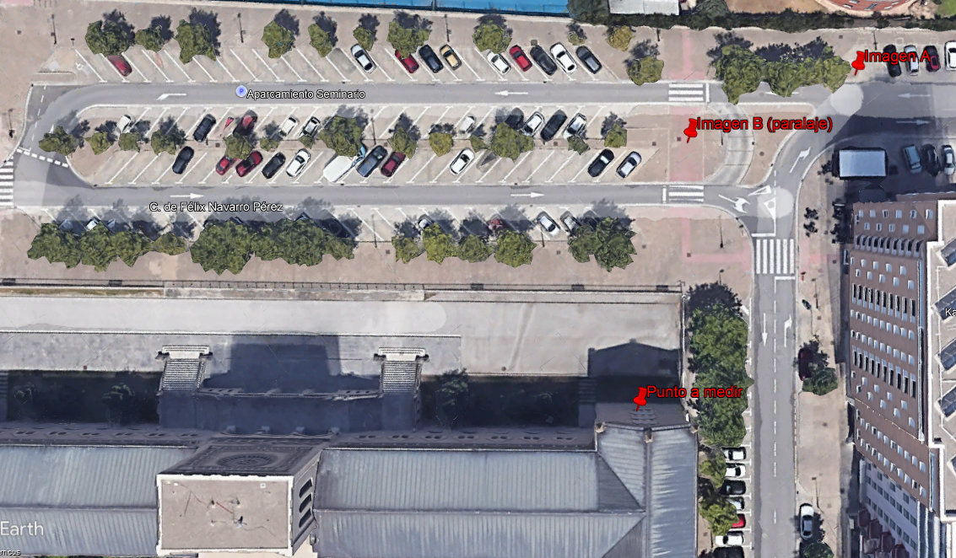

Slide 4
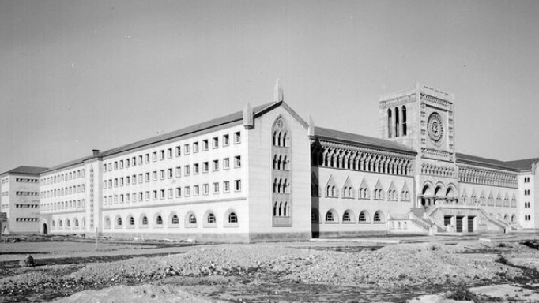
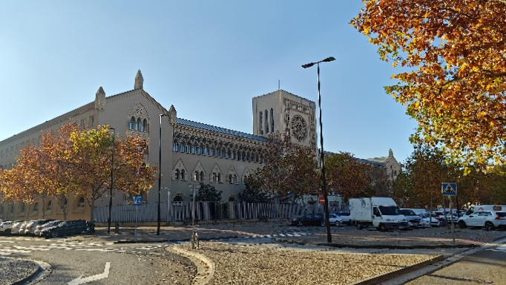
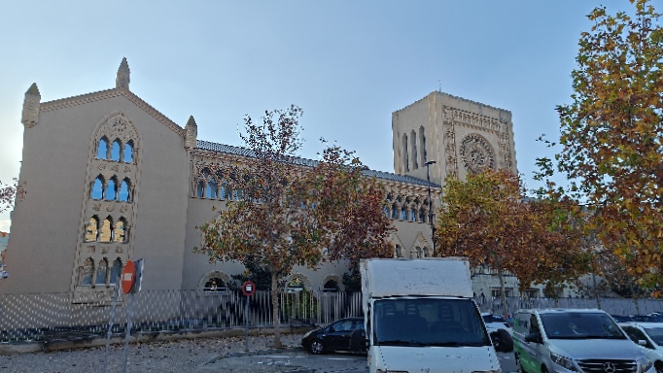

Old Image – Approx. 1950
Base image – Image 1
Image to parallax – Image 2
After calibration we obtain images of 682 X 384 pixels. For maintain the exact dimensions at everything, we need to change the dimension of the old camera and force it to the dimensions of the used photography's.
We have some difference on the matrix, in theory should be cx = 682/2 = 341 -> cy = 384/2 = 192, This means the center is aligned to the left . Also, we have squared pixels due to fx and fy.

Slide 5
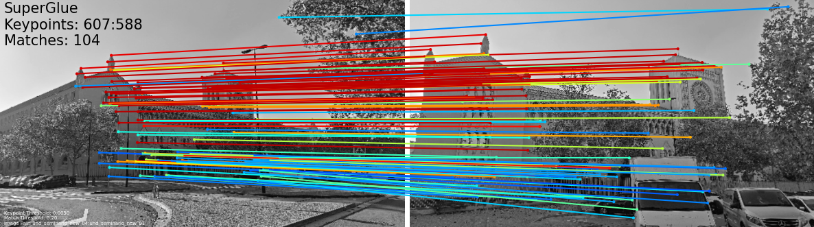
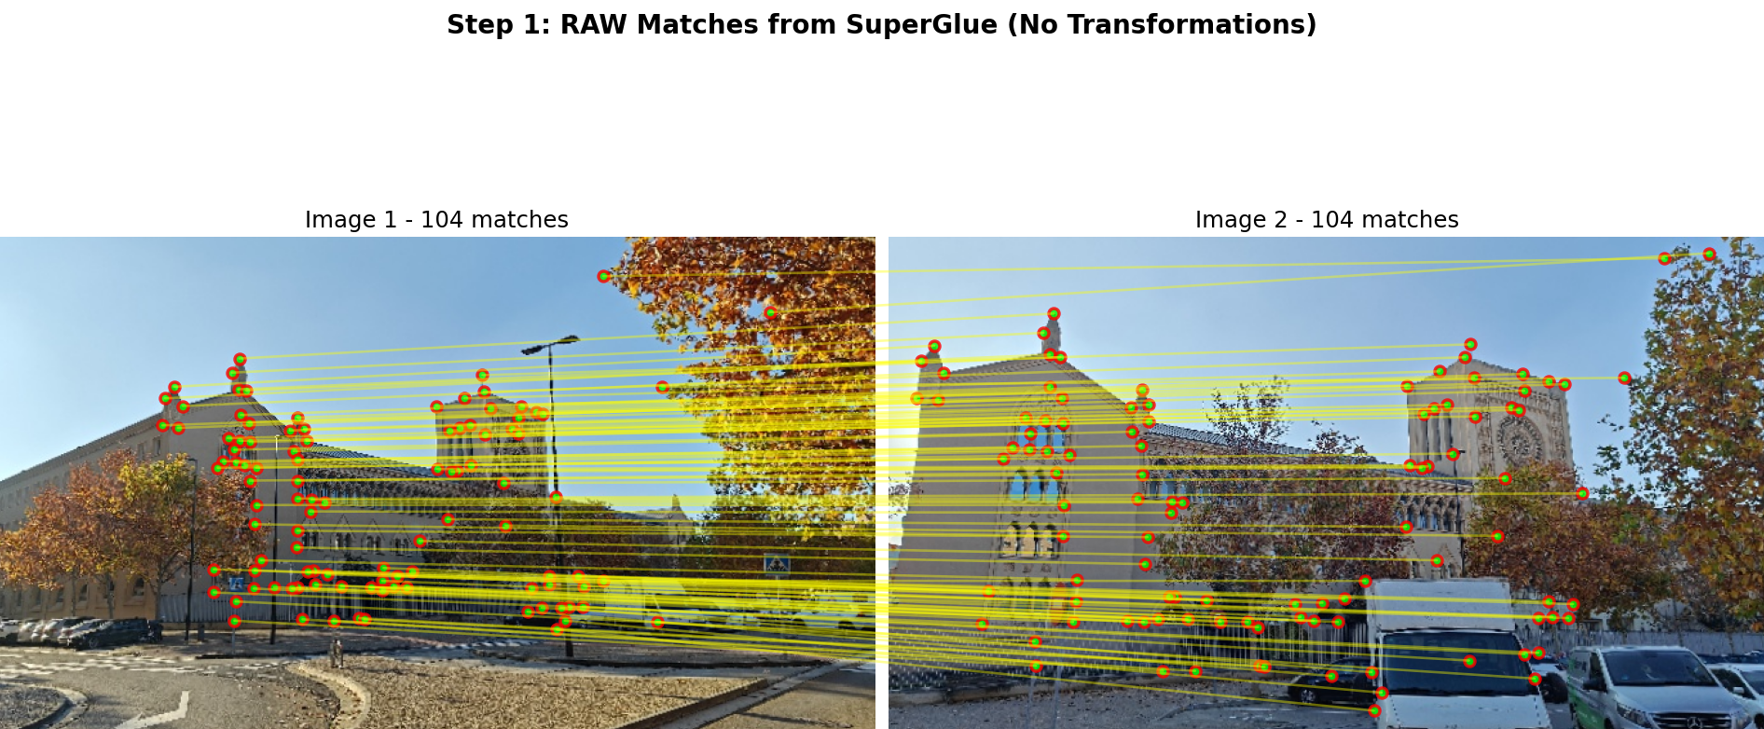

Slide 6
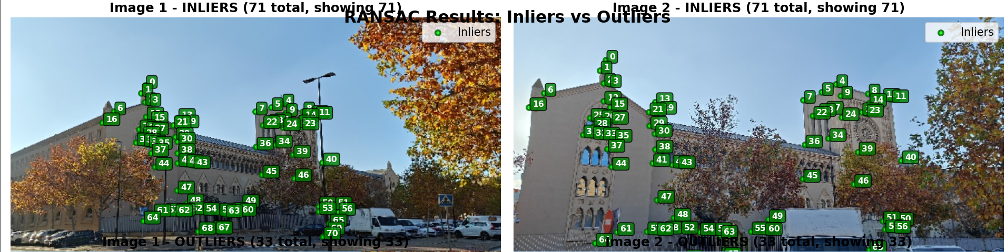
Input
Matches SuperGlue: kpts1, kpts2 (filtered score ≥ 0.7)- Parameters: 100,000 times, threshold = 1.5 px (tolerance)
Total points: 104
Inliers: 71 (68.3%)
Outliers: 33 (31.7%)
Number of points: 104
RANSAC iterations: 100000
Inlier threshold: 1.5 px
Output – F matrix and Best inliers Mask

Slide 7
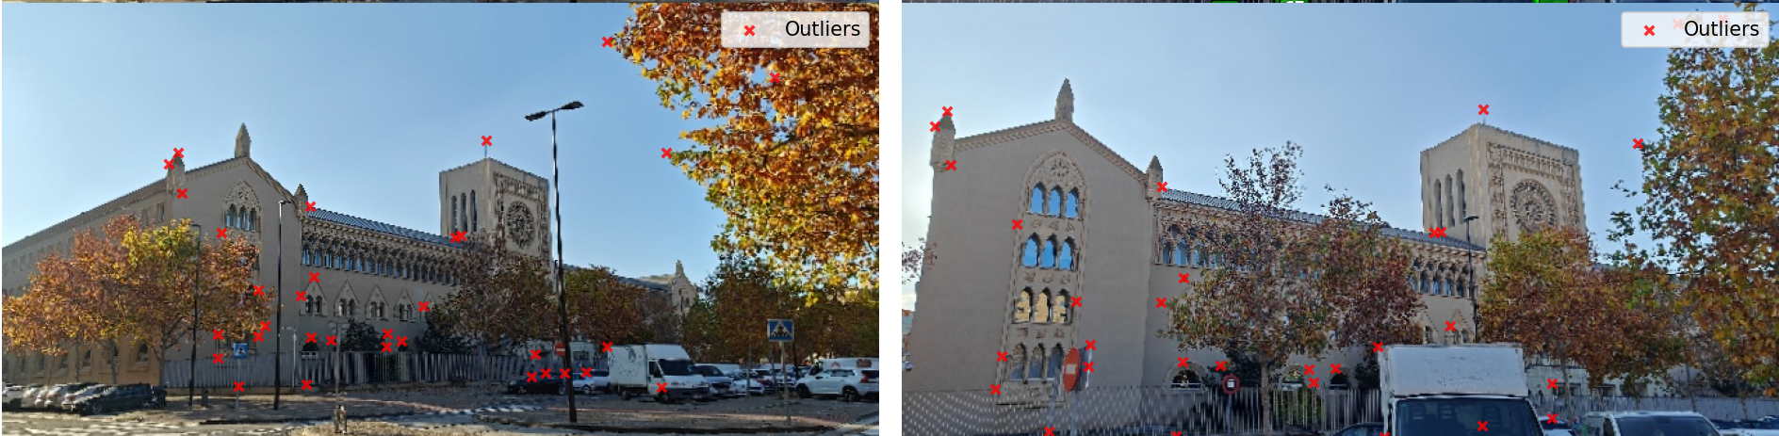
Outliers: 33 (31.7%)
Because of the tolerance we also discarded some good inliers, however we discard a lot of false positives as the leaves of the trees and some spots on the cars that are not related.
A good example are these points

Slide 8
INPUT: F (from RANSAC) + x1 and X2 inliers
Proces to obtain the pose of the second camera
Step | Function | Input | Output | What It Does
1 | ransac_fundamental() | • kpts1, kpts2 (N×2) • iterations, threshold | • F (3×3) • inlier_mask (N,) | Find best F matrix Classify inliers/outliers
2 | Filter operation | • kpts1, kpts2 • inlier_mask | • x1_inliers (M×2) • x2_inliers (M×2) | Extract only valid matches M = number of inliers
3 | fundamental_to_essential() | • F (3×3) • K (3×3) | • E (3×3) | E = K^T · F · K
4 | decompose_essential_matrix() | • E (3×3) | • 4 solutions: (R,t) | Generate 4 possible poses using SVD decomposition
5 | select_correct_pose() | • K (3×3) • x1_inliers, x2_inliers • 4 solutions | • (R_best, t_best) • X3D (M×3) • P1, P2 (3×4) | Test each pose: 1. Triangulate 2. Check Z>0 3. Pick best

Slide 9
Reprojection Error Calculation
Step | Operation | Code | Input Shape | Output Shape | What It Does
1 | Convert to Homogeneous | X_h = np.column_stack([X3D, np.ones(len(X3D))]) | (N, 3) | (N, 4) | Add 1's: [X,Y,Z] → [X,Y,Z,1]
2 | Project 3D → 2D | x_proj_h = (P @ X_h.T).T | (N, 4) | (N, 3) | P·X → [u·w, v·w, w]
3 | Normalize to Pixels | x_projected = x_proj_h[:, :2] / x_proj_h[:, 2:3] | (N, 3) | (N, 2) | [u·w/w, v·w/w] → [u, v]
4 | Compute Distance | errors = np.linalg.norm(x_observed - x_projected, axis=1) | (N, 2) | (N,) | √(Δu² + Δv²)

Slide 10
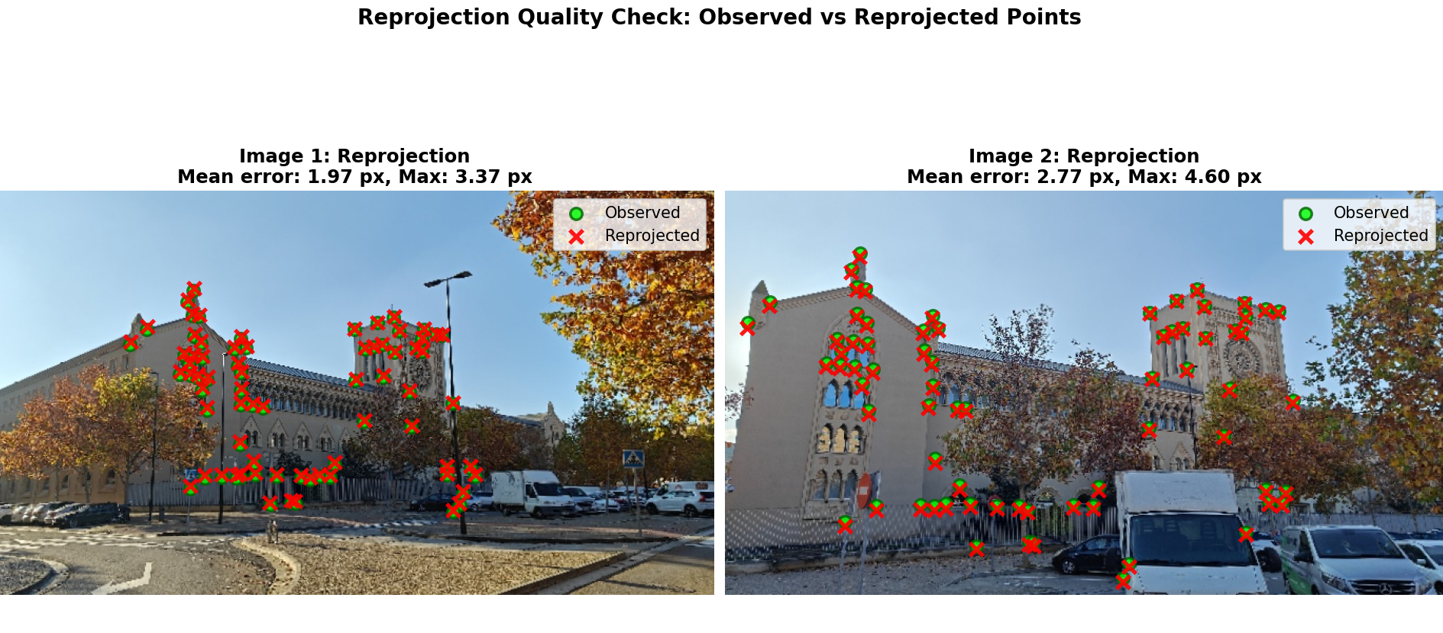
The reconstruction is validated by projecting the 3D points back to 2D and comparing with original detections: Green circles = Original SuperGlue detections, Red X's = Where 3D points project back to images, Yellow lines = Reprojection error (shorter = better)

Slide 11
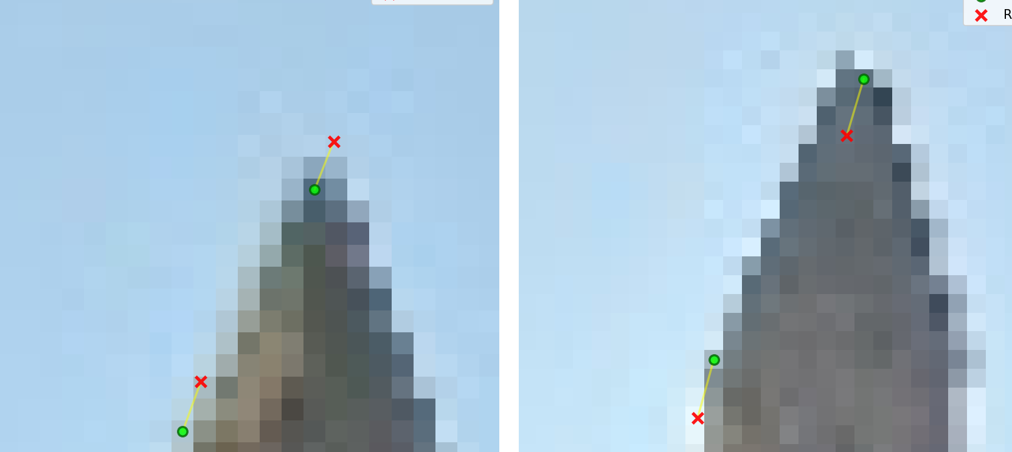
Camera 1:
RMSE: 2.110 px
Mean: 1.969 px
Median: 2.077 px
Max: 3.373 px
Camera 2:
RMSE: 2.960 px
Mean: 2.767 px
Median: 2.910 px
Max: 4.605 px

Slide 12
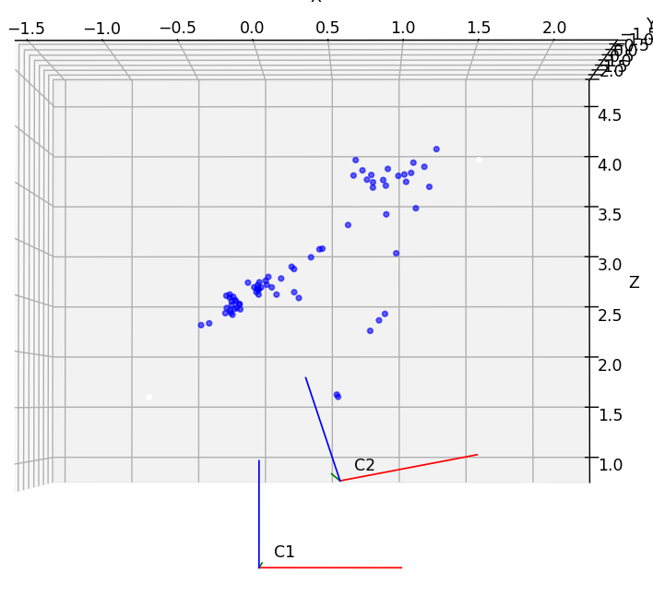
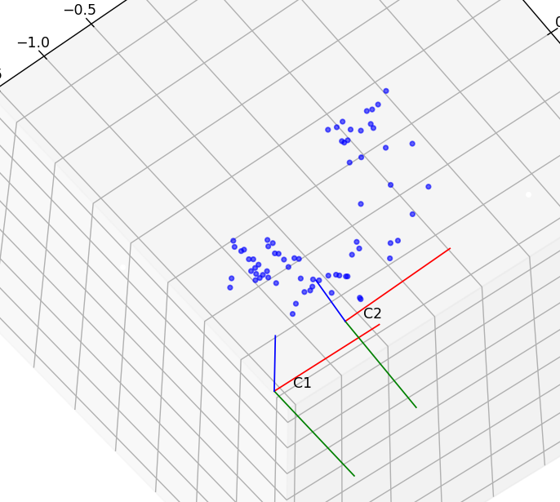
3D reconstruction with the two camera poses
71 - 3D points reconstructed │• Mean reprojection error: 2.43 px │

Slide 13
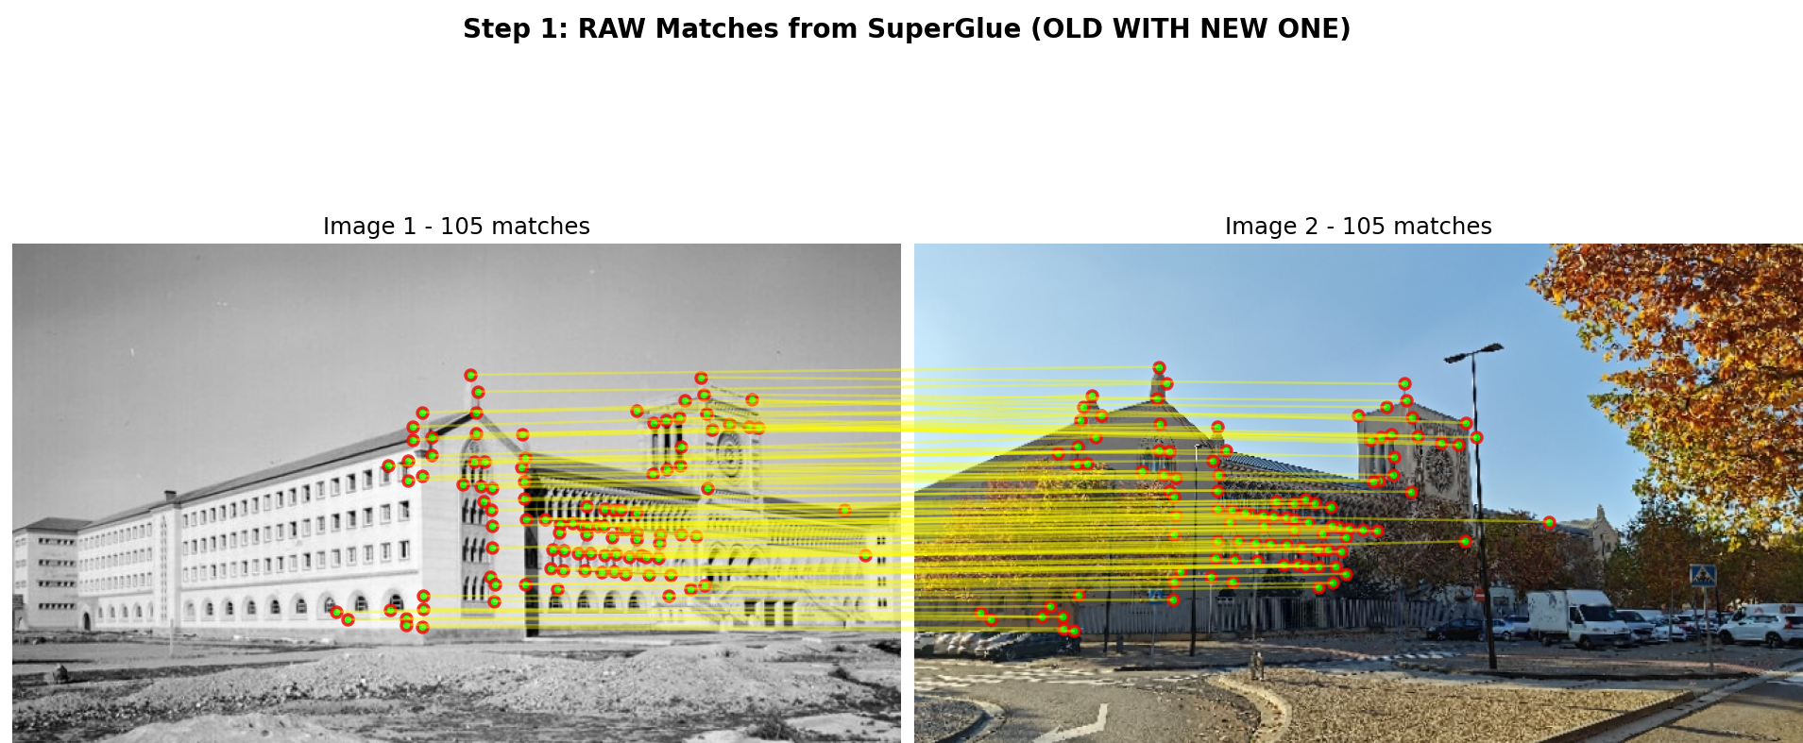

Slide 14
OLD ←SuperGlue→ NEW_04
Matches between OLD and NEW_04
Find common matches: kptsOld2 (in NEW_04) ≈ x1_inliers (in NEW_04)
2D-3D correspondences: - kptsOld1: 2D points in OLD image - X3D_common: corresponding 3D points (from model)
RANSAC-PnP (DLT) → P_old
Decompose P_old → K_old, R_old, t_old

Slide 15
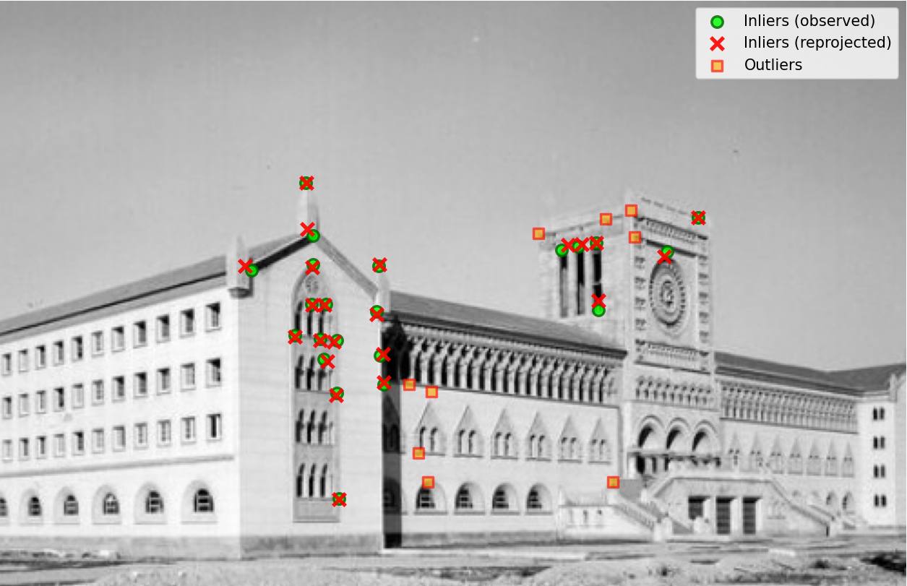
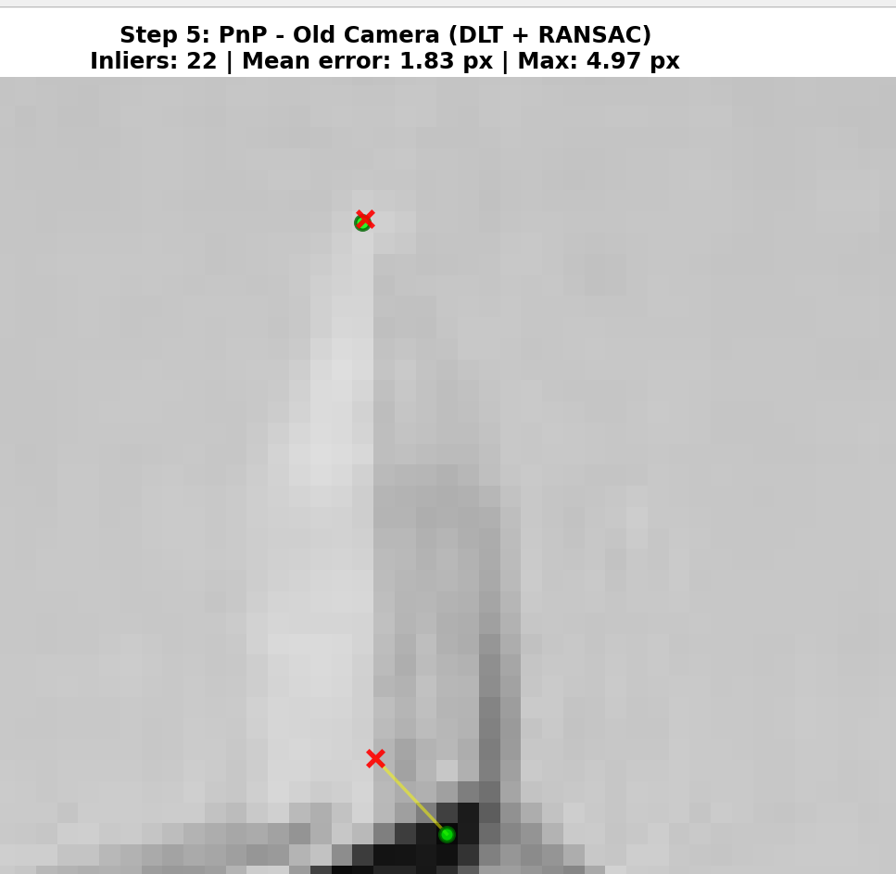
Reprojection error with inliers in between the three images
OLD ←SuperGlue→ NEW_04
Matches between OLD and NEW_04
Find common matches: kptsOld2 (in NEW_04) ≈ x1_inliers (in NEW_04)
2D-3D correspondences: - kptsOld1: 2D points in OLD image - X3D_common: corresponding 3D points (from model)
RANSAC-PnP (DLT) → P_old
Decompose P_old → K_old, R_old, t_old
Key step: Normalizes data first (centers and scales points) to ensure numerical stability, then solves and denormalizes.

Slide 16
3D reconstruction

Slide 17
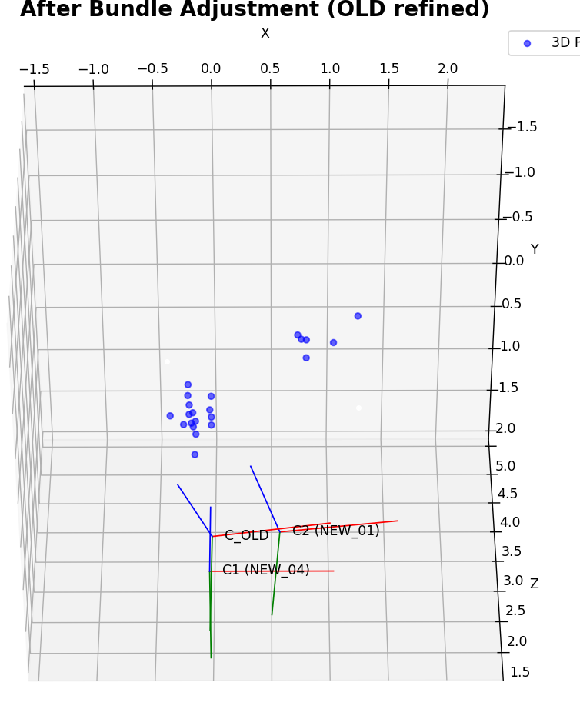
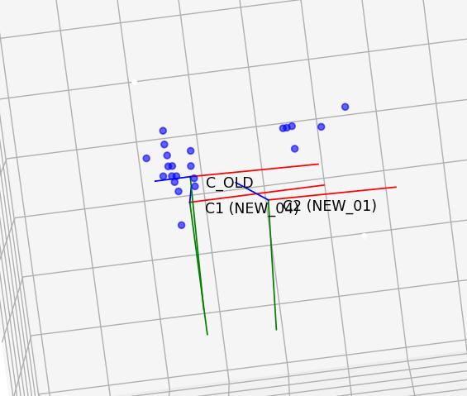
Just makes better it position towards the original camera; however, the bundle adjustment didn’t give me the expected result after comparing with VGGT.

Slide 18
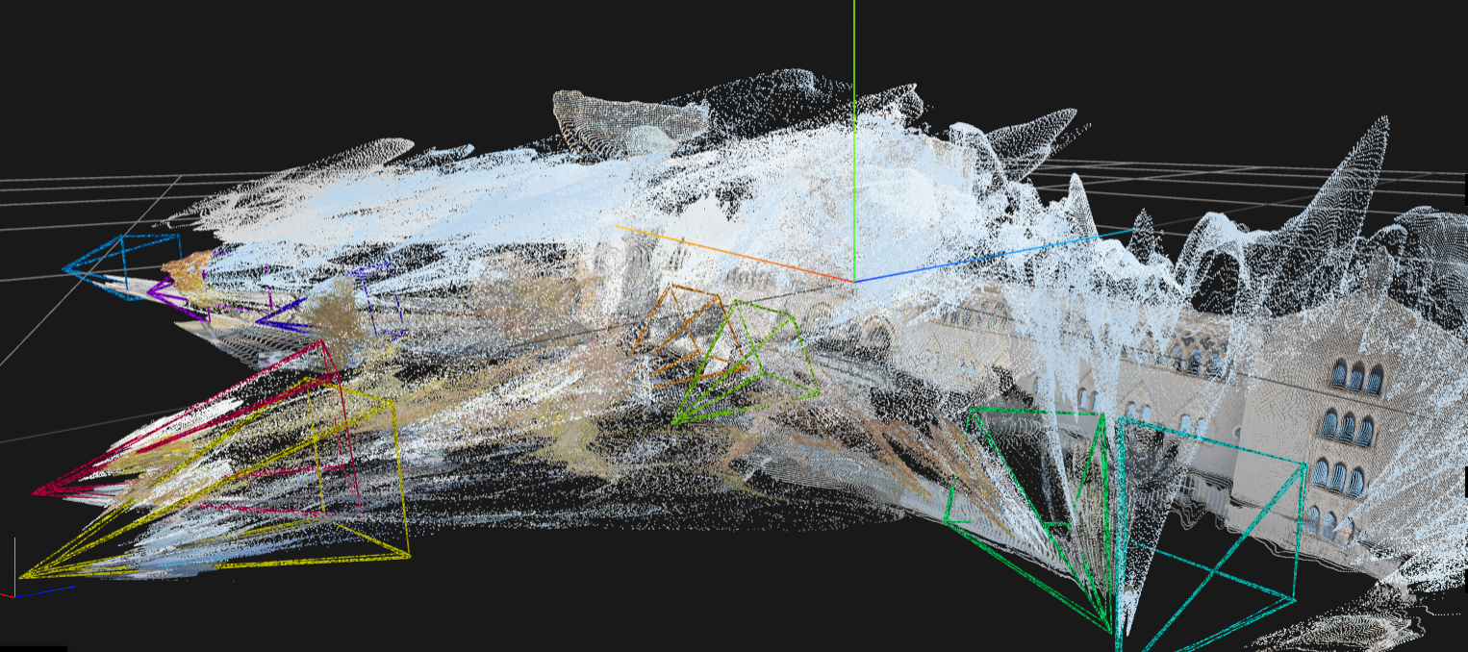
Parallax camera (New)
OLD camera
Base camera (New)
VGGT reconstruction with 8 photographs of different sizes.

Slide 19
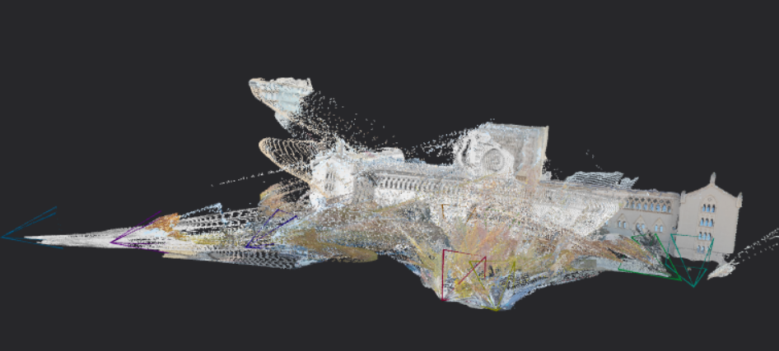
Parallax camera (New)
OLD camera
Base camera (New)

Slide 20
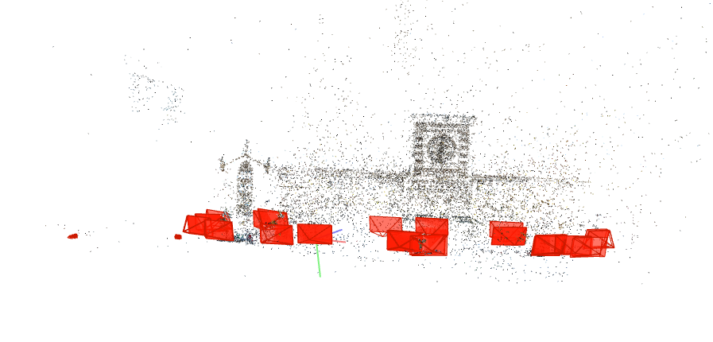
Our cameras
We ran COLMAP with 103 photos. But in the end, it could not make any good matches with the old camera. So, it didn’t process it at I was expecting.

Slide 21
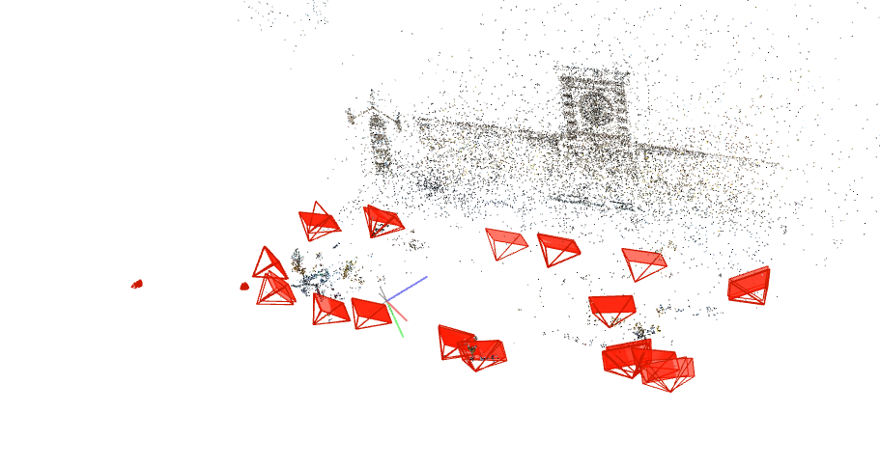
Our cameras

Slide 23
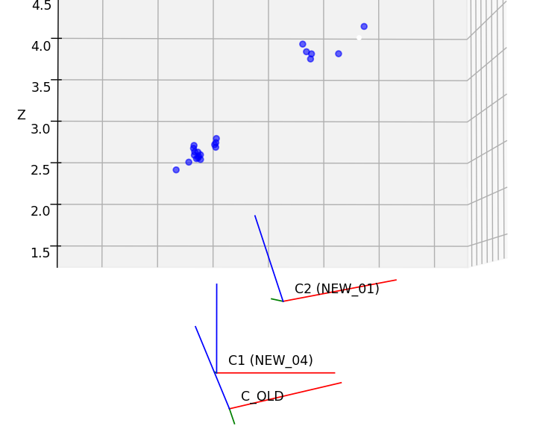
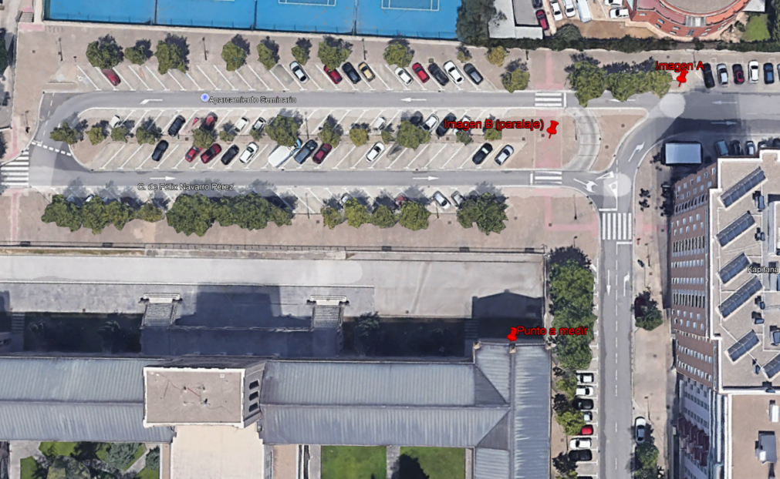
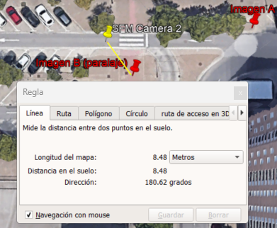



Slide 24
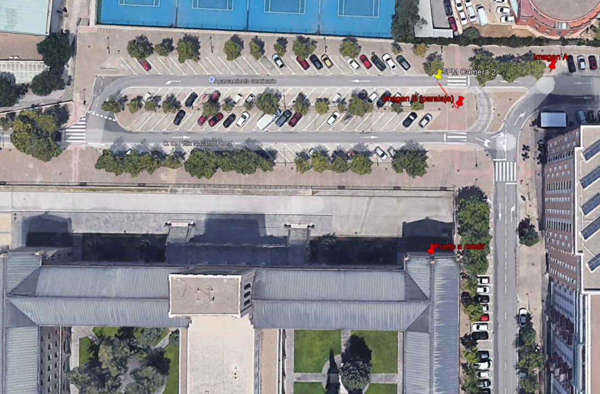
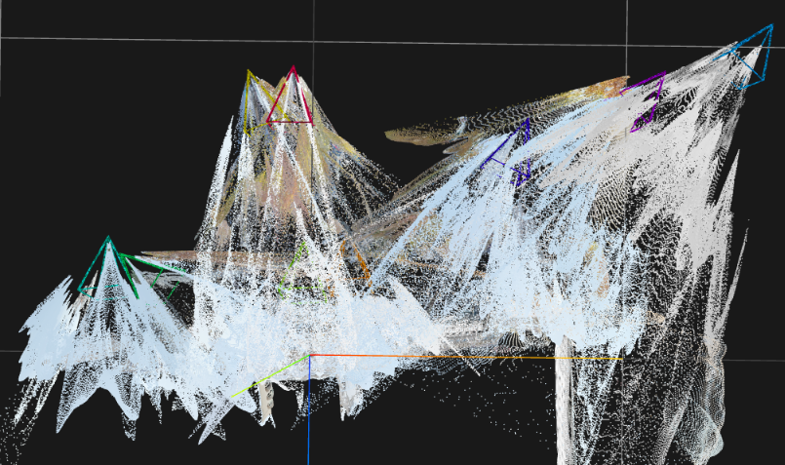
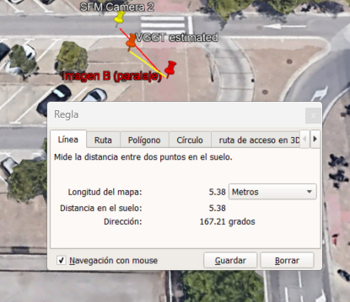


Slide 25
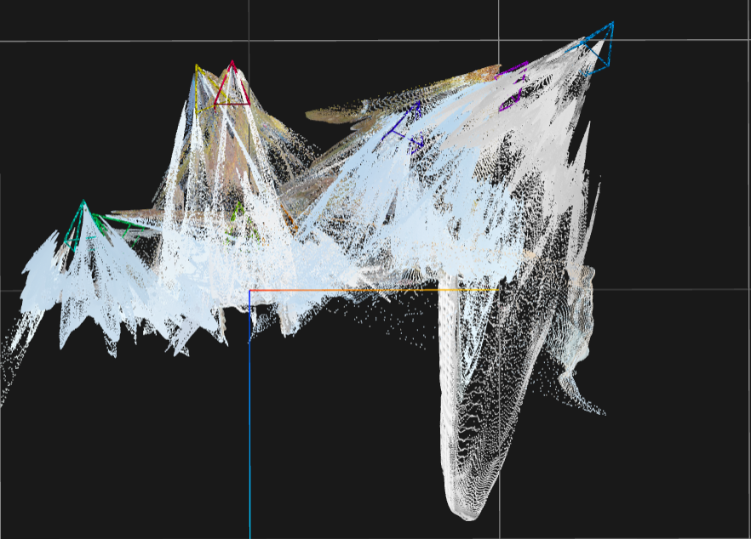

Slide 26
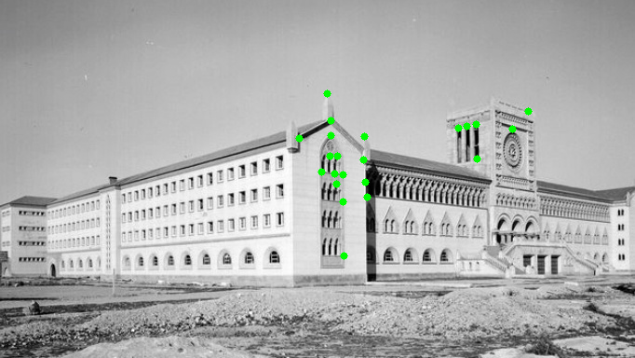
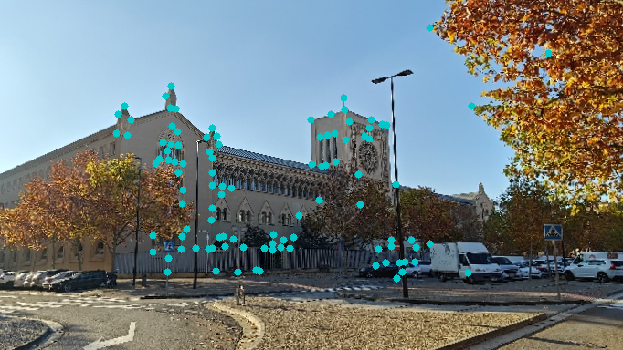
To analyze temporal changes, I compared feature matches between image pairs. Green points indicate features that remained stable across the year gap primarily architectural elements. However, the modern pair shows 71 matches while the historical modern pair shows only 22 matches. This reduction is not a limitation but rather evidence of significant environmental change, particularly vegetation growth that occludes the scene. The reduced number of cross-temporal matches speaks to the magnitude of change: fewer stable features mean more scene evolution. The 22 surviving matches were sufficient to successfully localize the old camera, demonstrating that core architectural features remained consistent despite environmental changes.

Slide 28
Conclusions and future work
Despite different camera intrinsic parameters (K), we successfully reconstructed the building some good 3D of the building.
We localized a good approximation of the camera using only 22 inliers, well above the theoretical minimum of 6 points required for PnP
Validation against COLMAP and VGGT showed strong agreement, confirming the accuracy of our implementation
A good immediate improvement would be the implementation of an homography with the base new image and the old one.

