Slide 1
INTERNSHIP PROJECT PRESENTATION
CodTech IT Solutions

Slide 2
COMPANY INTRODUCTION
CodTech IT Solutions
Company Snapshot
• 8+ years of experience
• 1500+ projects completed
• 1000+ happy clients
• 750+ skilled team members
Key Highlights
• Google, Microsoft, and AWS partnerships
• MSME, AICTE, MCA, ISO 9001:2015 certifications
• Services: Web, mobile, marketing, UI/UX
• Focus: professional digital solutions that drive growth

Slide 3
TASK 1 - ETL PIPELINE DEVELOPMENT
CodTech IT Solutions
Objective
• Built an ETL pipeline in Python
• Removed duplicates and handled missing values
• Scaled numeric columns
Implementation
• Encoded categorical columns
• Saved transformed output as CSV
• Tools: pandas, scikit-learn, StandardScaler, SimpleImputer, OneHotEncoder

Slide 4
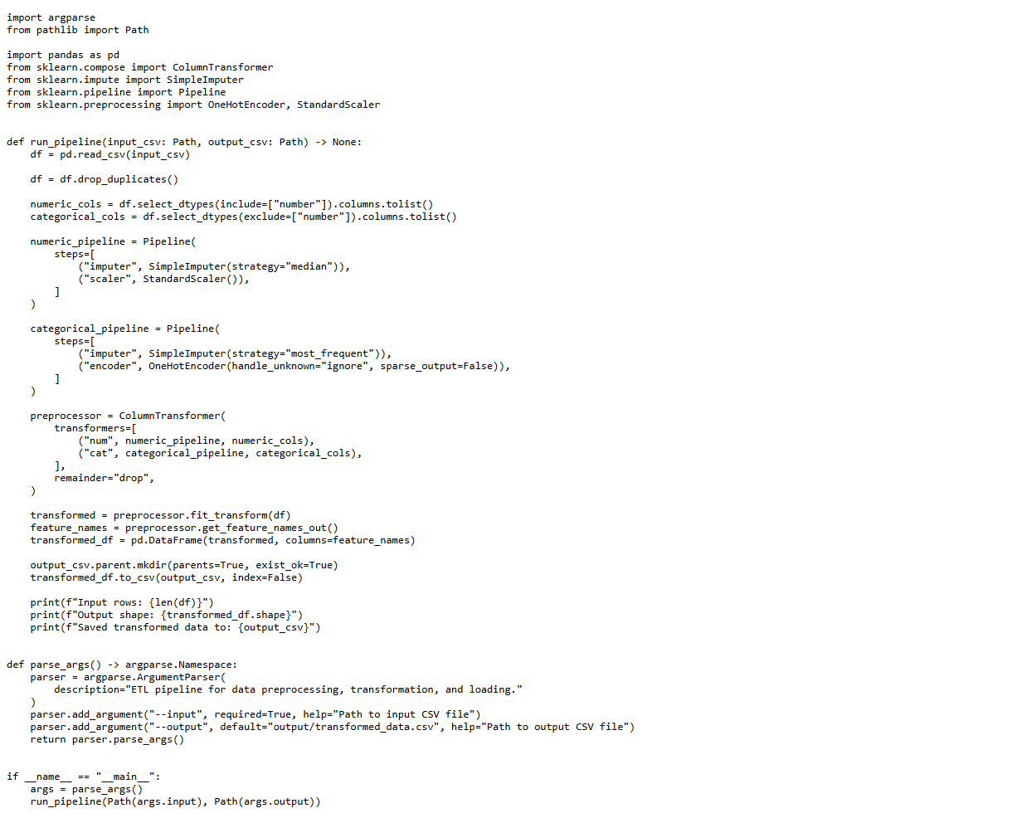
TASK 1 SCREENSHOT
CodTech IT Solutions
ETL pipeline code screenshot showing preprocessing, transformation, and loading steps.

Slide 5
TASK 2 - DEEP LEARNING PROJECT
CodTech IT Solutions
Model
• CNN-based digit classification on MNIST
• Conv2D + MaxPooling layers
• Dense layer with dropout
Outputs
• Generated training curves
• Created confusion matrix output
• Tools: TensorFlow/Keras, NumPy, Matplotlib, scikit-learn

Slide 6
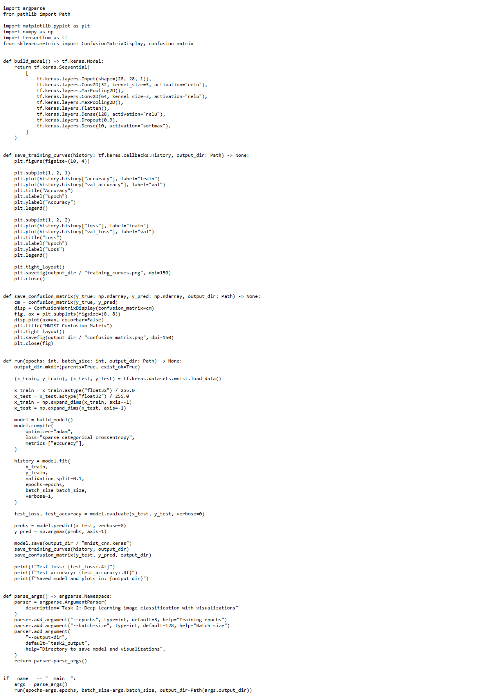
TASK 2 SCREENSHOT
CodTech IT Solutions
Deep learning code screenshot showing the CNN model architecture and evaluation functions.

Slide 7
TASK 3 - E-COMMERCE PRODUCT PAGE
CodTech IT Solutions
Features
• Interactive product gallery with real images
• Thumbnail navigation and image counter
• Customer reviews and rating summary
Tech Stack
• Add to cart, wishlist, and review form
• Responsive layout for desktop and mobile
• Tools: HTML5, CSS3, JavaScript, Unsplash images

Slide 8
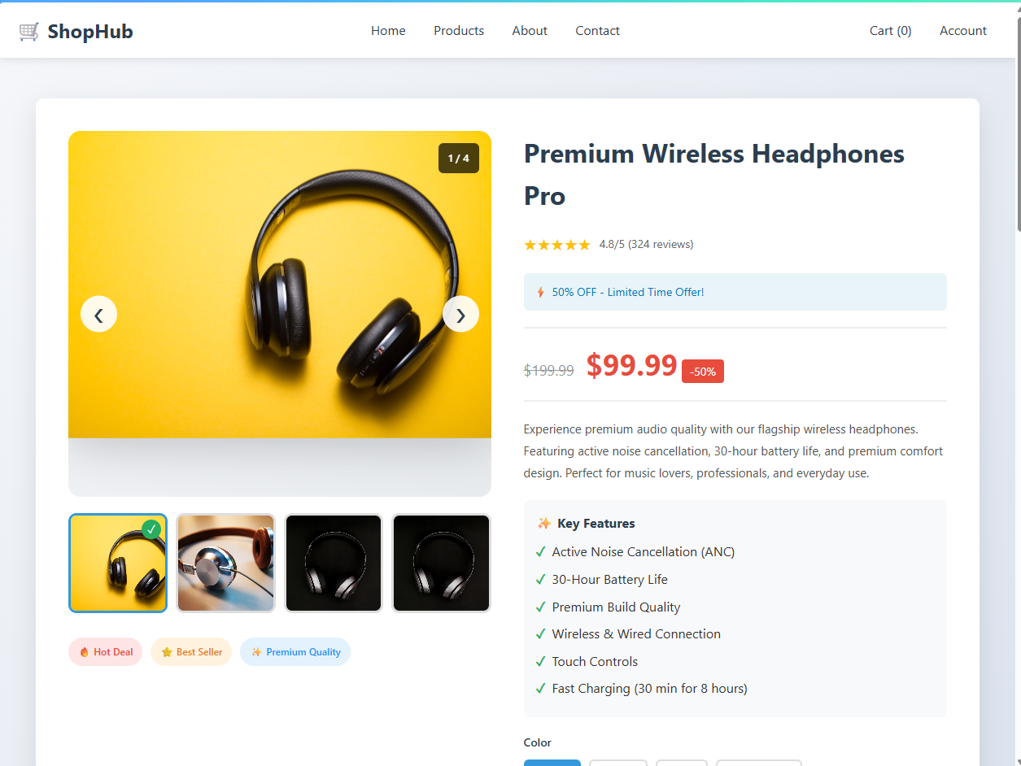
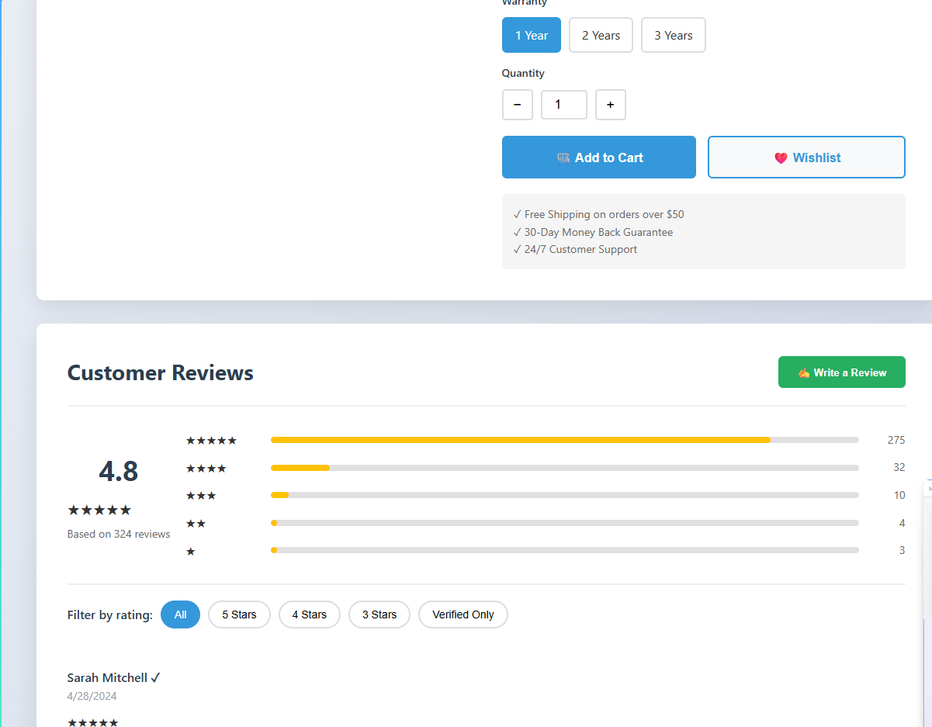
TASK 3 SCREENSHOT
CodTech IT Solutions
Interactive product page screenshot showing the gallery, product details, and review section.

Slide 9
TOOLS & TECHNOLOGIES USED
CodTech IT Solutions
Programming
• Python
• pandas, NumPy
• scikit-learn
• TensorFlow/Keras
Development Tools
• HTML5, CSS3, JavaScript
• VS Code
• Git and GitHub
• PowerPoint via python-pptx

Slide 10
PROJECT SUMMARY
CodTech IT Solutions
• Task 1: ETL pipeline development
• Task 2: Deep learning image classification
• Task 3: E-commerce product page design
• Learned data processing, ML, and frontend development
• Internship work completed for CodTech IT Solutions

