Slide 1

AI Circuit Architect
From a plain-English idea to a structured KiCad starting point — designed by a society of agents
Qwen Hackathon · Track: Agent Society

Slide 2
A schematic is slow to start — and one LLM cuts corners
The manual way
A single LLM
Blank-page problem
Fast, but shallow
Turning an idea into a structured KiCad project takes an experienced engineer.
One pass gives a plausible answer — and skips the unglamorous essentials.
Hours before the real work
Misses safety / review items
Sheet hierarchy, power domains, interfaces — all by hand.
Reverse-polarity, overcurrent, reset/clock — gone in 1 of every 2 designs.
Easy to forget the boring bits
No one checks its work
Protection, debug access, review items slip through under time pressure.
Nothing challenges the first draft or asks what's missing.
Our take: a small team of agents that argue → a structured, reviewed starting point you finish in KiCad.
AI Circuit Architect
2 / 9

Slide 3
Two heads beat one — and we measured it
+3.2
Per design · coverage delta (multi − single)
Motor + safety
+2
more design concerns surfaced than a single LLM — on average, across 5 diverse hard designs (live Qwen).
Precision analog
+2
Multi-agent team
Battery IoT
+4
11.6 / 12
Medical wearable
+5
Single agent
8.4 / 12
Industrial gateway
+3
Coverage = engineering concern surfaced as work, scored by a deterministic 12-point rubric.
↑ the gap widens with complexity
AI Circuit Architect
3 / 9

Slide 4
A team, not a prompt — six specialist agents
Each stage has one job and its own model tier. Work hands off left to right; reviewers can send it back.
RQ
AR
DC
AB
PE
PC
›
›
›
›
›
Requirements
Architect
Design Critic
Arbitration
PCB Engineer
PCB Critic
qwen-plus
qwen-plus
qwen-max
qwen-max
qwen-plus
qwen-max
Juniors (qwen-plus) propose; senior reviewers (qwen-max) hold them to account — and demand rework.
A stateless orchestrator coordinates them; you can run it one-click or sign off each stage.
AI Circuit Architect
4 / 9

Slide 5
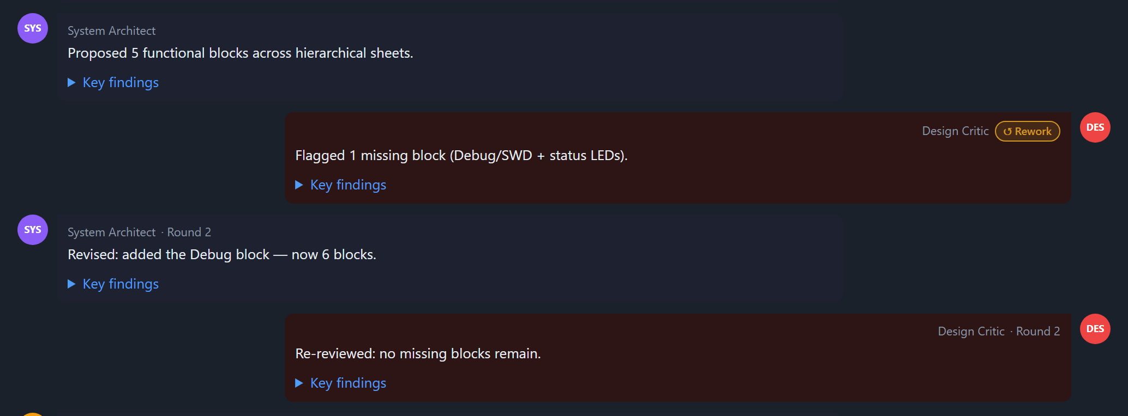
When agents disagree, the design gets better
Our system is not a pipeline. The Critic challenges the Architect, who reworks — live, in rounds.
1
Round 1 — Design Critic
Flags a gap: the Architect's 5 blocks miss a Debug / SWD + status-LED block.
2
↺ Rework — System Architect
Reacts to the critique and revises: adds the Debug block → 6 blocks.
Live Agent-Society view · the Critic → Architect rework round
Round 2 — Design Critic
3
Re-reviews the revision: no missing blocks remain. Conflict resolved.
This negotiation loop — not a single pass — is what raises coverage.
AI Circuit Architect
5 / 9

Slide 6
Measured on a deterministic rubric — not vibes
One 12-point engineering rubric scores both teams the same way — no LLM judging itself.
What a single agent most often skipped
Average coverage
across the 5 live designs — caught by the Critic / Arbitration
11.6 / 12 multi
Reverse-polarity protection
5×
Overcurrent / fuse protection
4×
8.4 / 12 single
Docs & explicit uncertainty
3×
Surge / ESD on power input
2×
The team's edge isn't cleverness — it's the review step that refuses to forget the unglamorous essentials.
Clock source
2×
AI Circuit Architect
6 / 9

Slide 7
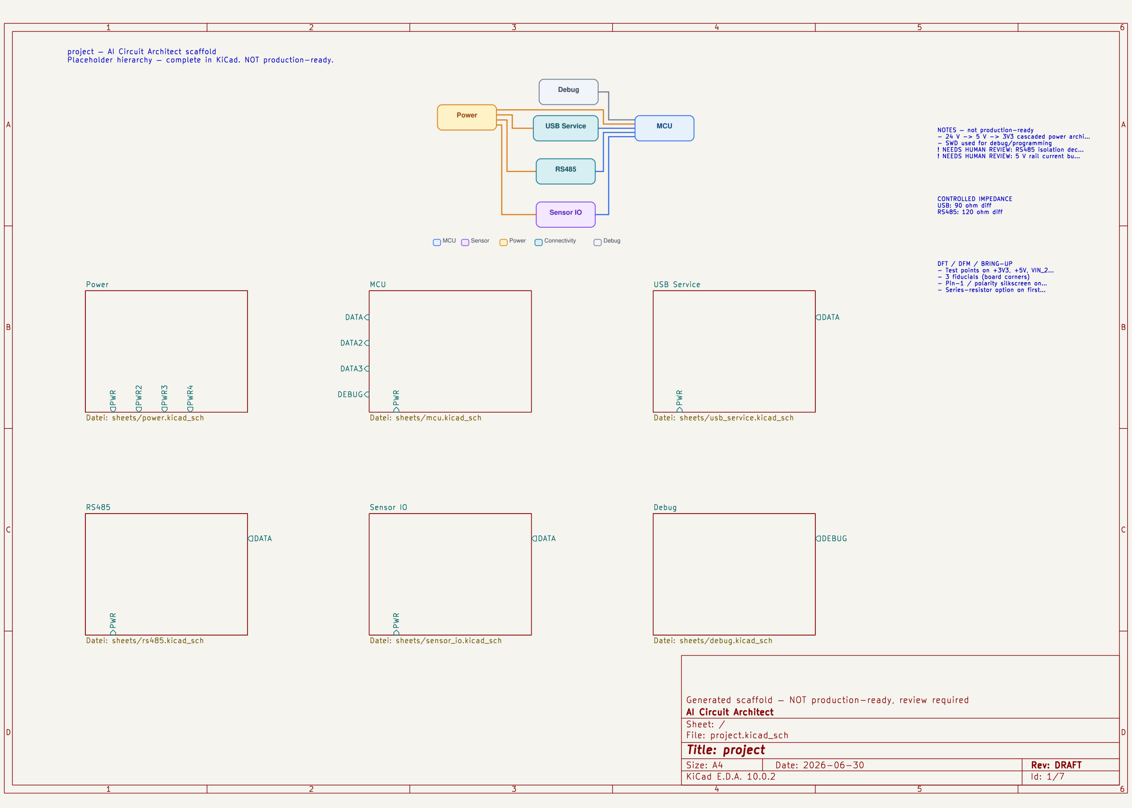
What you actually get — a structured KiCad start
✓ Opens in KiCad 10 · structural ERC clean
Hierarchical KiCad scaffold
Sheets, power-port symbols, sheet pins and an embedded block diagram — opens & passes structural checks.
PCB-readiness pack (prep)
Net classes, constraints (.kicad_dru), candidate parts, floorplan zones, a DFT/DFM checklist.
PDF report + KiCad ZIP
A shareable report and the full project, downloadable in one click.
An engineering scaffold, not a finished design — placeholder blocks the engineer completes. No production claims; a human stays responsible.
AI Circuit Architect
7 / 9

Slide 8
AI prepares, the human decides
You stay in control
Built with
Approve, re-run or stop — per agent
Qwen
Every stage is shown before the next one runs.
qwen-plus / qwen-max, OpenAI-compatible API
One-click or step-by-step
FastAPI + Alpine.js
Auto-run to watch the team, or sign off each stage yourself.
Python backend, live single-page UI (ELK diagrams)
Audience personas
KiCad-CLI 10
Professional / Student / Maker re-tones every explanation.
Real open / export / structural-ERC validation
WeasyPrint · Docker
PDF report; one-image deploy
AI Circuit Architect
8 / 9

Slide 9
Three jury criteria, one society of agents
✓
Decomposition & roles
Six specialist agents, each with a job and a model tier.
+3.2
✓
Conflict resolution
A real Critic → Architect rework loop, resolved in rounds.
more engineering concerns surfaced — the case for a society of agents over a single model.
✓
Measured efficiency
+3.2 coverage points over a single agent (live, 5 designs).
From a plain-English idea to a structured KiCad start — reviewed by a society of agents.
AI Circuit Architect
9 / 9

