Slide 1
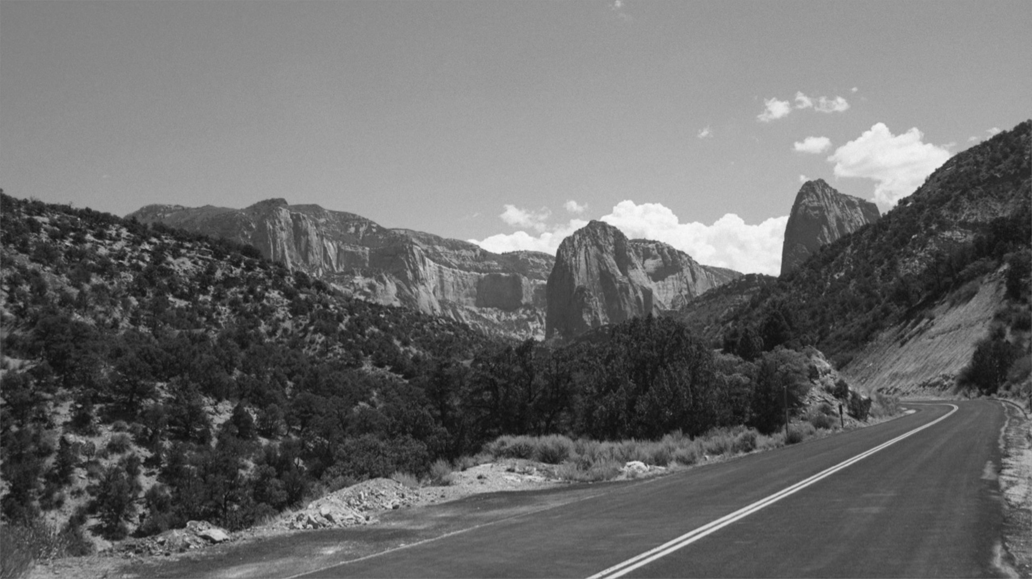

Front End Development workshop
WEEK TWO: CSS BASICS

Slide 2
Week TWO
Intro (10 mins)
How Does CSS Work? (10 mins)
Targeting
Cascade
Common CSS Attributes (10 mins)
Layout
Text
Styling our page / live coding session (30 mins)

Slide 3
Review
Tentative timeline:
HTML – basics
CSS – basics
HTML – advanced
CSS - advanced (mobile-first, breakpoints)
Heroku / JS (jQuery) - basics

Slide 4
How Does CSS Work?
CSS pairs HTML with style attributes
Cascading Style Sheet
Cascading - How a browser reads the file and applies it to a website
Style - Consists of style attributes you can apply to HTML elements
Sheet - It’s a file
Browsers have their own default stylesheets

Slide 5
How Does CSS Work?
Cascade: Given two attributes, the last one wins
p {
color: red;
}
p {
color: green;
}
Your <p> elements will be green-colored.

Slide 6
How Does CSS Work?
Specificity: Given two attributes, the more specific one wins
p {
font-size: 16px;
}
footer p {
font-size: 12px;
}
The <p> elements in your <footer> element will be 12px big.

Slide 7
How Does CSS Work?
Ways to target HTML Elements:
Name - h1
Class - .location
ID - #photos
Pseudo-selectors - a:hover

Slide 8
How Does CSS Work?
Combos:
body h1 { … }
p.location { … }
main#photos { … }
#photos.myClass { … }
main #photos { … }

Slide 9
Common CSS Attributes
Layout:
display
padding
margin
float
width
height

Slide 10
Common CSS Attributes
Layout:
display: block;
padding
margin
float
width
height

Slide 11
Common CSS Attributes
Layout:
display: block;
padding: 30px 20px 30px 20px;
margin
float
width
height

Slide 12
Common CSS Attributes
Layout:
display: block;
padding: 30px 20px 30px 20px;
margin: 5px 10px 5px 10px;
float
width
height

Slide 13
Common CSS Attributes
Layout:
display: block;
padding: 30px 20px 30px 20px;
margin: 5px 10px 5px 10px;
float: left; (and clearfix)
Width
height

Slide 14
Common CSS Attributes
Layout:
display: block;
padding: 30px 20px 30px 20px;
margin: 5px 10px 5px 10px;
float: left; (and clearfix)
width: 100%;
height

Slide 15
Common CSS Attributes
Layout:
width: 100%;
height: 30px;
display: block;
padding: 30px 20px 30px 20px; (clockwise)
margin: 5px 10px 5px 10px;
float: left; (and clearfix)
Notes:
Padding = inside the element
Margin = outside the element
Float = aligns the element (left, center, right)

Slide 16
Common CSS Attributes
Text:
color
font-family (more in week 4)
font-size
line-height
text-align

Slide 17
Let’s build!
Live coding / working session:
Page Layout
Header
Main
Aside
Footer

Slide 18
Homework
Complete the layout of your page using CSS.
Use the “week two” folder (available on Github) example as a guide.

Slide 19
References
Browsers
Chrome
Text editors (IDE’s)
Sublime Text (https://www.sublimetext.com/download)
Repositories
Github (https://github.com/glenelkins/front-end-workshop)
Local environment
python -m SimpleHTTPServer 8000

