Slide 1
USING Data Science TO FIND LOCATIONS TO OPEN A ice cream shop IN Salvador
Deise Côrtes

Slide 2

Introducion - Salvador
Salvador is the 4th biggest city in Brazil
Warm weather
50 km of beaches
Popular touristic destination

Slide 3
Problem
Where to open a ice cream shop in Salvador ?

Slide 4
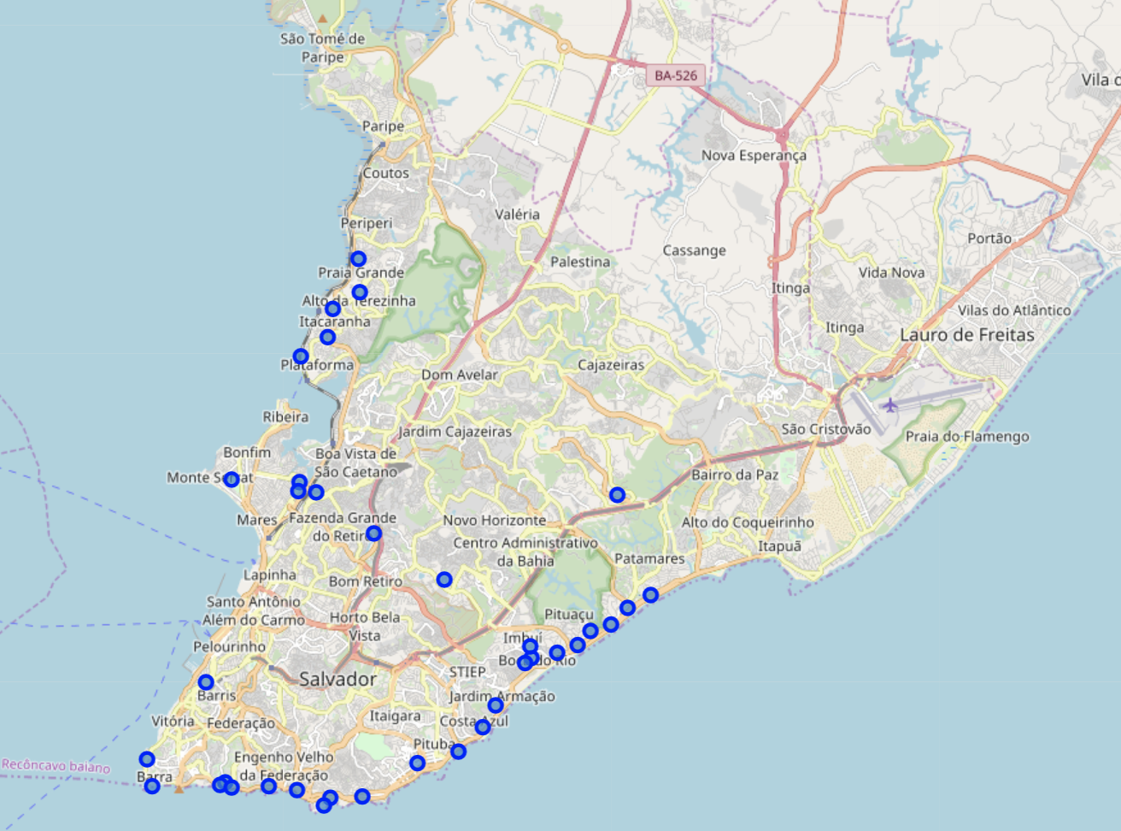
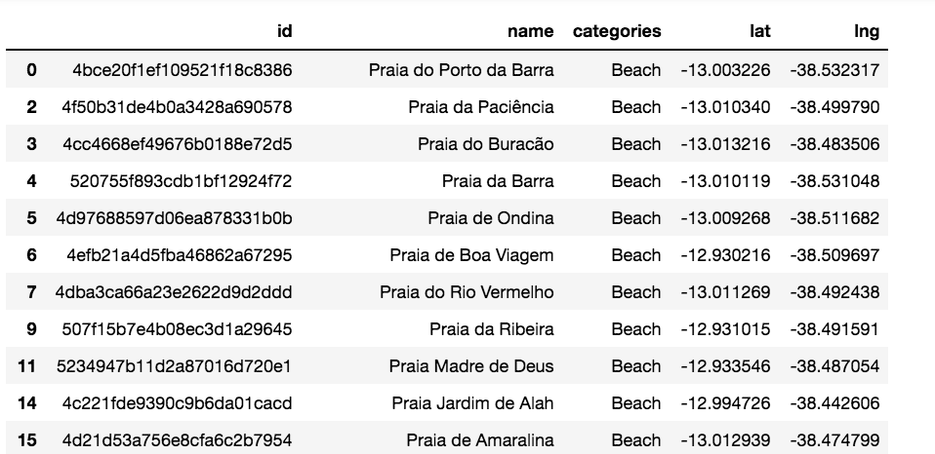
Data
FourSquare

Slide 5
Methodology
Create a dataframe with name, latitude, longitude for each beach
For each beach:
Locate ice cream shops close up to 300 meters
Create a list of beaches lacking ice cream shop

Slide 6
Results
25 beaches were identified, lacking a close ice cream shop

