Slide 1
Circulatory System

Slide 2
Introduction to Circulatory System
It is a network that moves blood around the body.
It carries oxygen and nutrients to cells and removes waste.

Slide 3
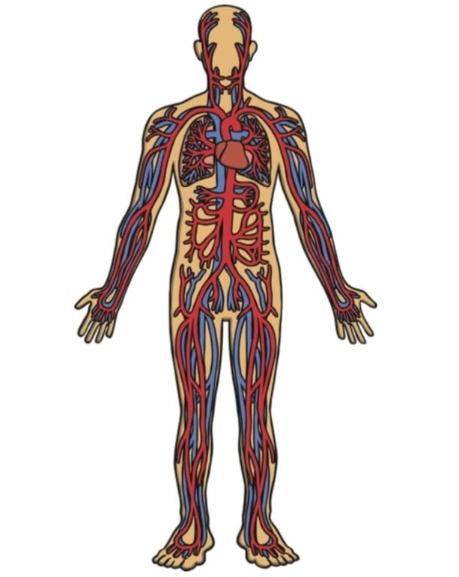
Circulatory System includes
The circulatory System is divided into three major parts:
The Heart
The Blood
The Blood Vessel

Slide 4
The Heart
The Heart pump blood.
Left side of the heart receives blood from lungs.
Right side of the heart receives blood from other parts of body.

Slide 5
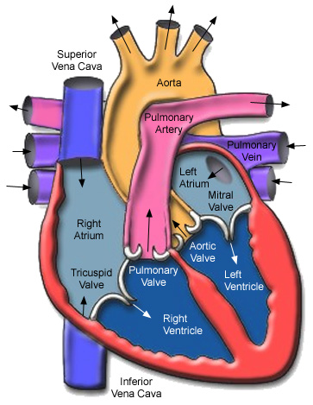
Structure of heart

Slide 6
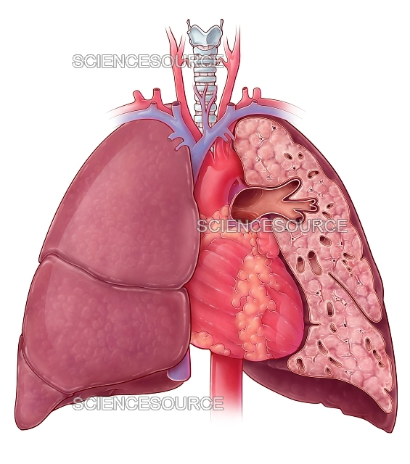
Structure of heart

Slide 7
Facts
Our heart size – our fist
It is the only organ that never rest
Your heart beats about 100,000 times a day.
Blood travels about 60,000 miles a day.

Slide 8
The Blood
Blood play a major role.
The blood is red-coloured fluid.
They carry oxygen, nutrients and waste products.

Slide 9
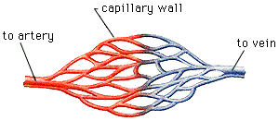
The Blood Vessels
Arteries – carry blood AWAY from heart to other parts of body.
Veins – Carry blood BACK to the heart.
Capillaries – Very fine branches of branches of arteries

Slide 10
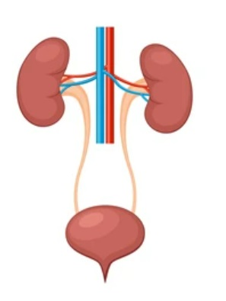
EXCRETORY SYSTEM

Slide 11
EXCRETORY SYSTEM ORGANS
The human excretory system
organs include:
  A pair of kidneys
  A pair of ureters
  A urinary bladder
  A urethra

Slide 12
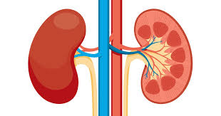
KIDNEY
Bean shaped organ
There are two pairs of kidneys
Filter harmful wastes and excess salt

Slide 13
The urine is transferred from the kidney to the urinary bladder by ureter.
Urinary bladder is the place where urine is stored temporavaryly.
The thin tube called urethra lets the urine out of the body.

Slide 14
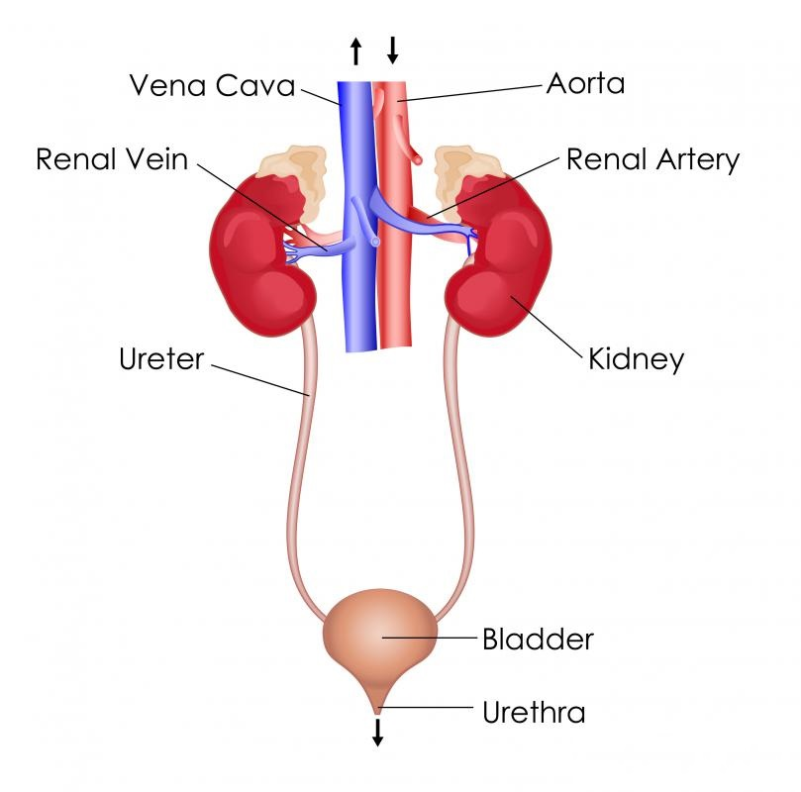
EXCRETORY SYSTEM

Slide 15
THANK YOU ALL

