Slide 1
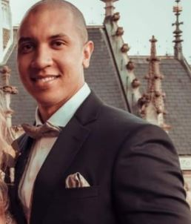

Durham College – WebD6201 Deivid William Rodrigues dos Santos ID: 100731640 S m hasibur Rahman ID:100765652

