Slide 1
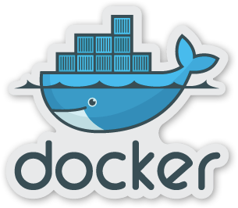
Docker Deep Dive
Creating Images with Dockerfiles

Slide 2

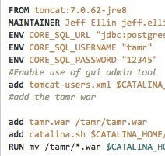
Dockerfile Basics
•
Docker Images are built from a base image.
•
Base Images are built up using simple instructions such as
Run a command.
Add a file or directory.
Create an environment variable.
What process to run when launching a container from this image.

Slide 3

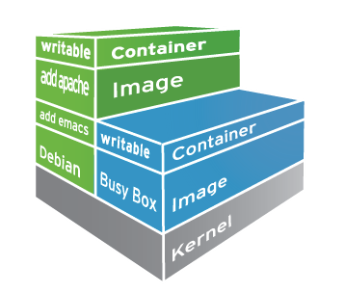
Docker Images
•
Docker images are read only templates from which containers are launched from
•
Each image consists of a series of layers using the union file system
•
When you change an image a new layer is created.

Slide 4


FROM
the FROM instruction sets the Base Image for subsequent instructions. As such, a valid Dockerfile must have FROM as its first instruction. The image can be any valid image – it is especially easy to start by pulling an image from the Public Repositories.
FROM java:8-jre

Slide 5

ENV
The ENV instruction is also useful for providing required environment variables specific to services you wish to containerize, such as Postgres’s PGDATA.
ENV TOMCAT_MAJOR 8
ENV TOMCAT_VERSION 8.0.26

Slide 6


RUN
The RUN instruction will execute any commands in a new layer on top of the current image and commit the results. The resulting committed image will be used for the next step in the Dockerfile.
RUN apt-get update && apt-get install -y \
bzr \ cvs \ git \
mercurial \ subversion

Slide 7

ADD and Copy
The Add and Copy commands can be used to add files to the container.
For Add if source file is a tar file the file will be extracted.
Add allows source file to be a URL
Use a trailing slash to indicate a directory vs a file.
COPY hom* /mydir/ COPY hom?.txt /mydir/
# adds all files starting with "hom"
# ? is replaced with any single character

Slide 8

EXPOSE
The EXPOSE instructions informs Docker that the container will listen on the specified network ports at runtime. Docker uses this information to interconnect containers using links (see the Docker User Guide) and to determine which ports to expose to the host when using the -P flag.
EXPOSE 8080

Slide 9

WORKDIR
The WORKDIR instruction sets the working directory for any RUN, CMD, ENTRYPOINT, COPY and ADD instructions that follow it in the Dockerfile.
It can be used multiple times in the one Dockerfile. If a relative path is provided, it will be relative to the path of the previous WORKDIR instruction.
WORKDIR $CATALINA_HOME

Slide 10



CMD
The main purpose of a CMD is to provide defaults for an executing container.
Can be overridden with arguments to docker run CMD ["catalina.sh", "run"]

Slide 11


Building an Image
A Dockerfile that contains a set of instructions that tell Docker how to build our image. The Dockerfile can be used to generate an image stored on your local system.
Docker daemon does actual build process. Contents of current context (folder) is sent to the daemon. Reduce build overhead by using .dockerignore files.
Each Instruction creates a new layer in the image. The cache from previous builds is used as much as possible.
docker build -t jellin/tamr:v2 .

Slide 12

Deploying an Image
In order to share your image you can push it to a Docker Repository. Images can then be pulled from another host.
Use the internal docker registry for private images.
Use Docker Hub for public images.
docker tag jellin/tamr:v2 fe-build.tamrfield.com:jellin/tamr:v2 docker push fe-build:jellin/tamr:v2
docker pull fe-build:jellin/tamr:v2

Slide 13
Show some Examples

Slide 14

A Word on Volumes
Docker volumes are containers for data.
Can be shared between containers
Can be mapped to specific directories on the host.
•
By Default removing the container does not remove the volume. (can lead to disk wastage due to orphaning volumes)
•
Data outside of a volume is kept in the union file system and is lost when the container is deleted.

Slide 15
Dockerfile Best Practices
•
use .dockerignore to avoid adding unnecessary files to your image
•
Don’t run apt-update on a single line. This will cause caching issues if the referenced archive gets updated, which will make your subsequent apt-get install fail without comment.
•
Avoid installing unecessary packages

Slide 16

Always use version tags in FROM statements. Avoid :latest
•
•
Avoid run + commit, use a Dockerfile instead
•
Installing ssh into a container is not clever
•
One Process per container
•
Leverage and understand the cache

Slide 17


References
•
Dockerfile Best Practices https://docs.docker.com/articles/ dockerfile_best-practices/

