Slide 1
Web Scraping
Mobile DNA
DS 636
Prof. Jaini Bhavsar
Presented by
Dejoe John - dj324
Manan Shah - ms3452
Tejas Warishe - tw338

Slide 2
AGENDA
01
Introduction
03
Analysis + Visualization
What is web scraping?
Goals
Publication Trends Over Time
Top 10 Corresponding Authors
Top 10 Keywords
02
Web Scrape
04
Closing
Steps to perform web scraping
Explanation of our code
Challenges
Questions
Thank You

Slide 3
01
Introduction

Slide 4
Introduction
What is Web Scraping?
Process of extracting data from web pages.
Retrieving HTML content and parsing it to extract information (text, images, links, etc.)
Web scraping is part of data scraping that only deals with data from webpages, whereas data scraping is from a wider range of data extraction techniques from different sources.

Slide 5
Goals
Web scrape all publications from Mobile DNA journal
Perform Analysis and develop visualizations
Publication Trends Over Time
Top 10 Corresponding Authors
Top 10 Keywords

Slide 6
02
Web scraping

Slide 7






Step 1
Step 2
Step 3
Step 4
Step 5
Install Required Libraries Use install.packages() in R to install libraries such as rvest for web scraping.
Read HTML Content Use functions provided by the httr library to fetch HTML content of the web page. This content will be stored in a variable for further processing.
Identify CSS Selector
Use Chrome DevTools to identify the CSS selector for the desired fields we want to scrape. This selector will help locate the specific elements containing the data we need.
Extraction Function
Custom function that used the CSS selector to extract key fields from HTML content. The function will use methods provided by the web scraping library to select and extract data from specific HTML elements.
Combine Data in Data Frame After extracting required fields, combine them into structured data frame. Organizes the extracted data into rows and columns for easy analysis.
Step 6
Perform Analysis
Use data analysis and visualisation libraries like ggplot2 to perform analysis. Create graphs, charts, or statistical summaries to gain insights from the data.

Slide 8
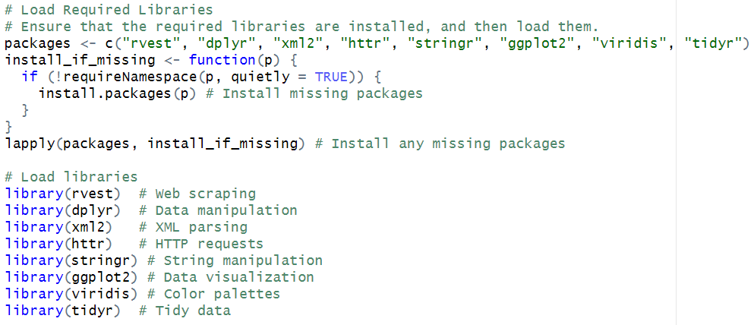
Code
Installs and loads libraries
rvest - For Web scraping
dplyr - For data manipulation
xml2 - for parsing HTML/XML Documents
httr - for HTTP requests
stringr - for string manipulation
ggplot2 - for data visualization
viridis - for color palettes in visualizations
tidyr - for reshaping and organizing data

Slide 9
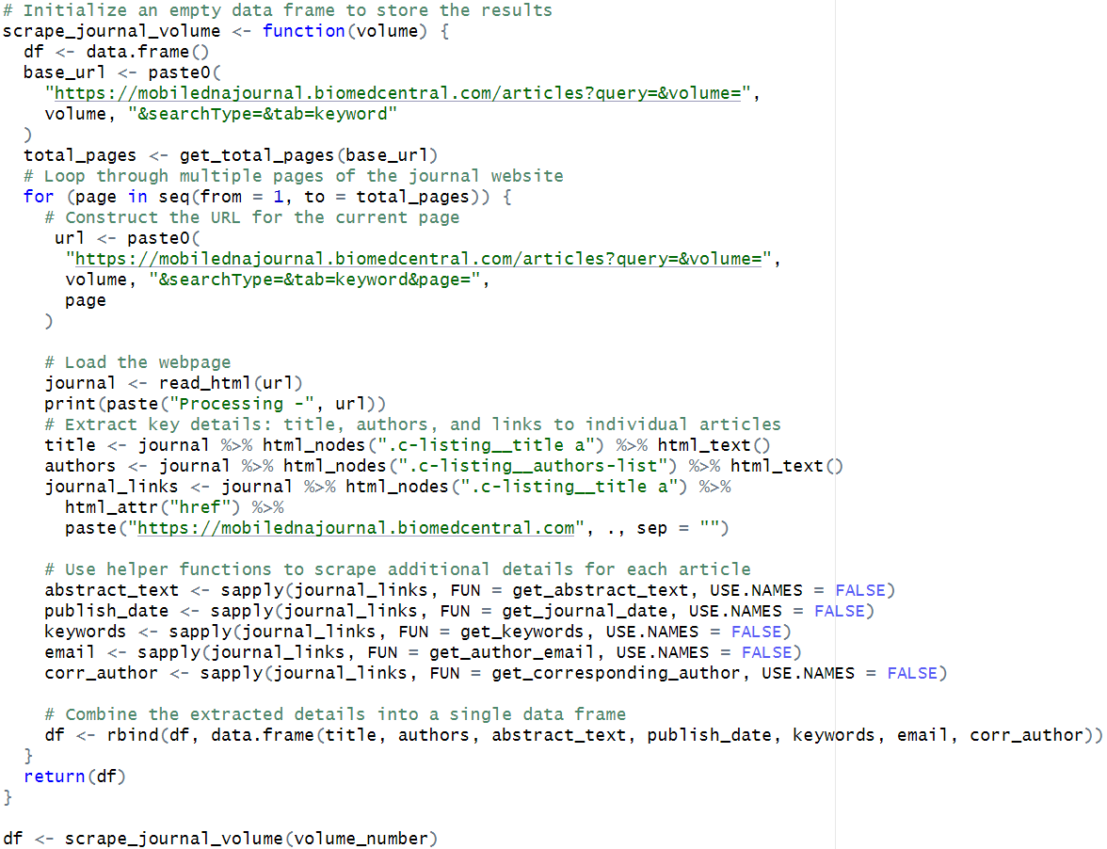
Code
Dynamic URLs – build URLs dynamically using page numbers to navigate through journal pages.
Loop through pages — iterate through multiple pages of journal site to collect data.
Website parsing – Uses the `read_html` function to load each webpage and extract specific elements.
Key Data extracted: Title, Authors, Abstract, Publication Date, Keywords, Corresponding Author and Email

Slide 10
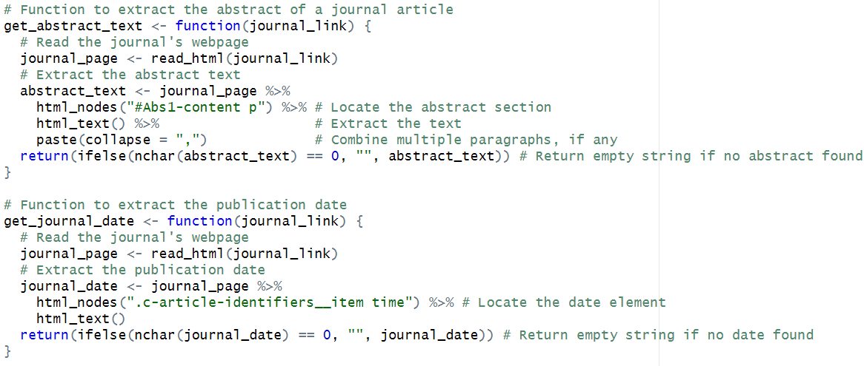
Code
get_abstract_text
Extracts the abstract (summary) of the journal article.
Locate the HTML node for the abstract #Abs1-content p
Extract and combine all paragraphs into a single string using html_text() and paste(collapse = ",")
get_journal_date
Fetches the publication date of the article.
Use the CSS selector .c-article-identifiers__item time to locate the time/date information.
Extract the date text using html_text.
Similarly, we extract corresponding author, author email, and keywords.

Slide 11
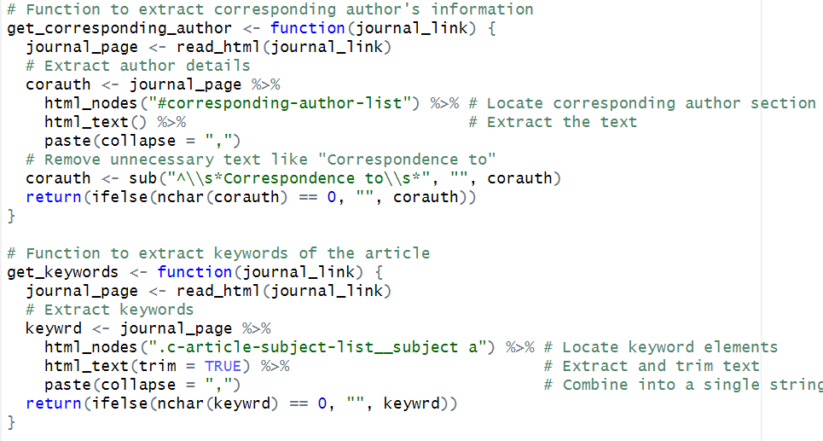
Code
get_corresponding_author
Fetches the details of the corresponding author listed on the article
Locate the corresponding author section using the CSS selector #corresponding-author-list.
Extract the text with html_text and combine any multiple entries with paste.
get_keywords
Collects the keywords associated with the article, which describe the main topics or themes.
Identify the CSS selector for keywords (.c-article-subject-list__subject a) and extract their text using html_text.
Combine all keywords into a single string with paste(collapse = ",").

Slide 12
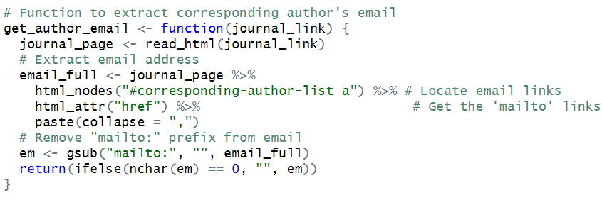
Code
get_author_email
Fetches the email address of the corresponding author listed on the article page.
Locate email links in the corresponding author section using the CSS selector #corresponding-author-list a.
Extract the email links (mailto: attributes) with html_attr("href").
Combine multiple emails into a single string with paste.

Slide 13
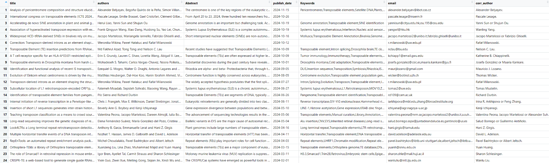
Code
df <- rbind(df, data.frame(title, authors, abstract, publish_date, keywords, email, corr_author))

Slide 14
03
Analysis
Visualization

Slide 15
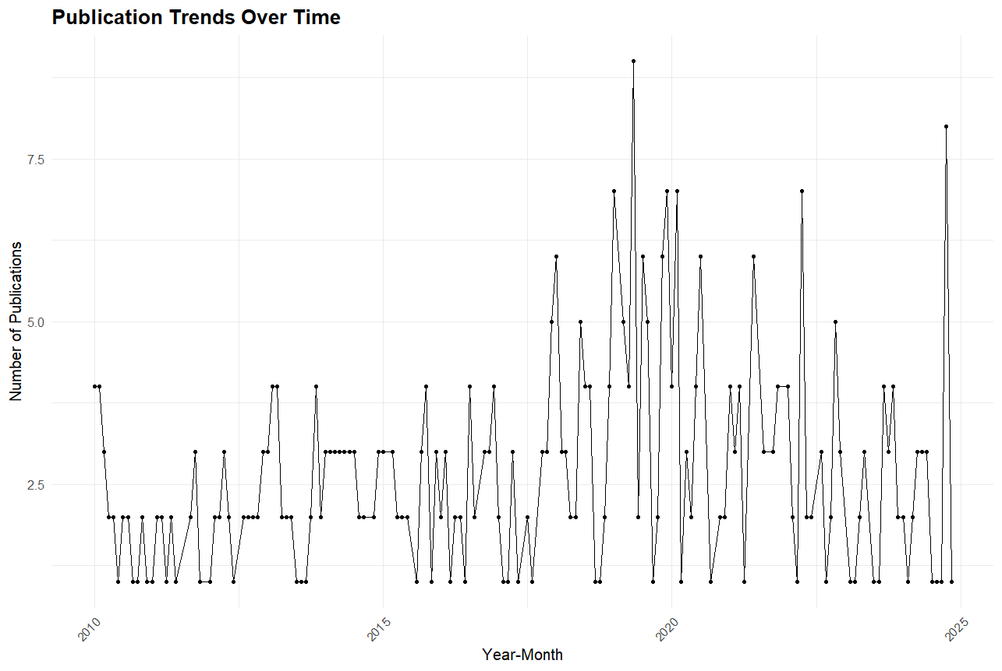
Analysis - 1
Publication Trends over Time
Prepare the data for visualization. Convert 'Year-Month' to a Date object. Group data by 'Year-Month'. Count the number of publications for each 'Year-Month'
publication_trends <- df %>%
mutate(year_month = as.Date(paste0(format(publish_date, "%Y-%m"), "-01"))) %>%
group_by(year_month) %>% summarise(Count = n())
Create a line plot
ggplot(publication_trends, aes(x = year_month, y = Count)) +
geom_line(size = 0.5) +
geom_point(size = 1) +
labs(title = "Publication Trends Over Time",
x = "Year-Month",
y = "Number of Publications",
color = "Publication Count") +
theme_minimal() +
theme(axis.text.x = element_text(angle = 45, hjust = 1),
plot.title = element_text(size = 14, face = "bold"),
legend.position = "right")

Slide 16
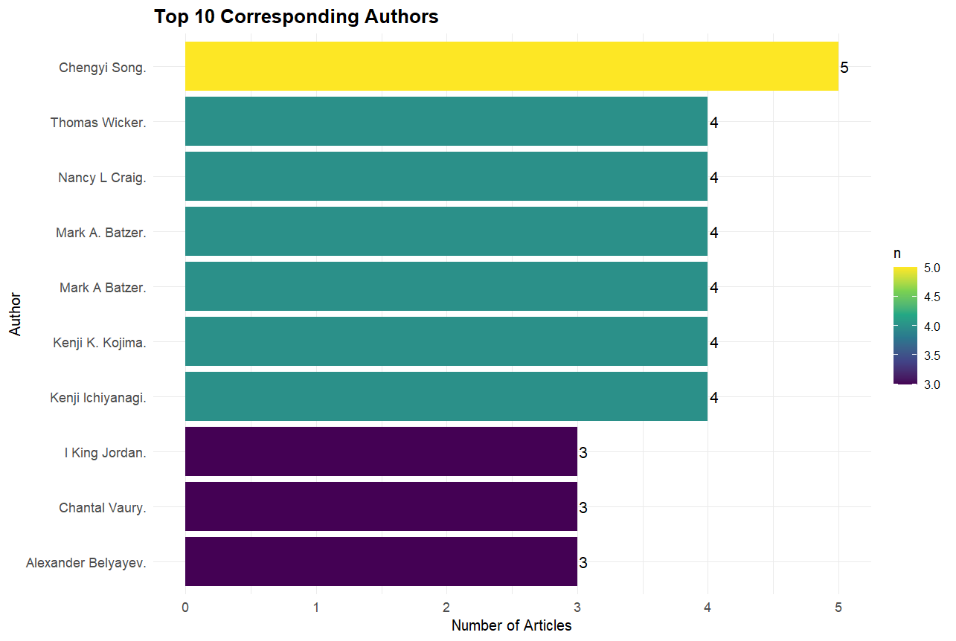
Analysis - 2
Top 10 Corresponding Authors
Count the number of articles for each corresponding author, sorted in descending order. Removes empty null values.
author_counts <- df %>%
count(corr_author, sort = TRUE) %>%
filter(corr_author != "") %>%
head(10)
Plot the horizontal bar chart
ggplot(author_counts, aes(x = reorder(corr_author, n), y = n, fill = n)) +
geom_bar(stat = "identity") +
geom_text(aes(label = n), hjust = -0.2, size = 4) +
coord_flip() +
scale_fill_viridis_c(option = "D") +
labs(title = "Top 10 Corresponding Authors", x = "Author", y = "Number of Articles") +
theme_minimal() +
theme(axis.text.x = element_text(size = 10),
axis.text.y = element_text(size = 10),
plot.title = element_text(size = 14, face = "bold"))

Slide 17
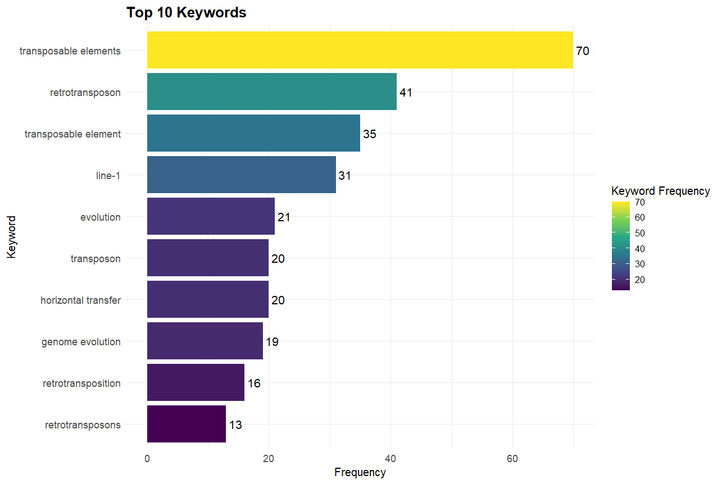
Analysis - 3
Keyword Frequency
Split keywords into a list for counting, Trim whitespace, Convert to lowercase, Remove empty or invalid entries
keyword_list <- unlist(strsplit(paste(df$Keywords, collapse = ","), ","))
keyword_list <- str_trim(keyword_list)
keyword_list <- tolower(keyword_list)
keyword_list <- keyword_list[!keyword_list %in% c("", "n/a")]
Count the frequency of each keyword, Tabulate frequencies, Rename columns, Sort by count (descending)
keyword_counts <- as.data.frame(table(keyword_list)) colnames(keyword_counts) <- c("Keyword", "Count") keyword_counts <- keyword_counts[order(-keyword_counts$Count), ] print(keyword_counts)
Plot the horizontal bar chart
ggplot(keyword_counts[1:10, ], aes(x = reorder(Keyword, Count), y = Count, fill = Count)) +
geom_bar(stat = "identity") +
geom_text(aes(label = Count), hjust = -0.2, size = 4) +
scale_fill_viridis_c(option = "D") +
coord_flip() +
labs(title = "Top 10 Keywords", x = "Keyword", y = "Frequency", fill = "Keyword Frequency") +
theme_minimal()

Slide 18
04
Closing

Slide 19
Challenges
Difficult to extract data and create reusable methods that loop through different pages of the website.
Figuring out CSS selectors to extract appropriate data.
Some of the data were not being extracted, and gave null values.

Slide 20
Contributions
Scraping Article Data - Dejoe
Data Cleaning and Preprocessing - Tejas
Data Analysis and Visualization - Manan
Report and Insights - Tejas

Slide 21

Questions?

Slide 22
THANK YOU
Dejoe, Manan, Tejas

