Slide 1
Client Reporting & Analytics Business Review
Population Health Insights & Illustrative Member Engagement Analysis Prepared for: Client Population Health & Program Leadership
Prepared by: Deja Davis
August 2026

Slide 2
The analysis identifies measurable population-health burden and a clear opportunity to improve member follow-up
POPULATION HEALTH Obesity represented the highest average prevalence among the four analyzed CDC measures at 37.63%, followed by high blood pressure at 33.54%.
GEOGRAPHIC CONTEXT Population-health burden varied geographically, while obesity and physical inactivity showed a strong positive association (r ≈ 0.83).
MEMBER FOLLOW-UP In the synthetic cohort, 463 of 600 members (77.2%) had follow-up data.
CLIENT OPPORTUNITY Follow-up ranged from 60.8% among low-engagement members to 94.2% among high-engagement members, identifying lower-engagement members as the clearest outreach opportunity.

Slide 3
The analysis combines population-level CDC context with a separate 600-member synthetic cohort
The analysis combines public population-health data with a separate synthetic member cohort.
PUBLIC HEALTH CONTEXT
CDC public API data
Four cardiometabolic measures
State-level prevalence analysis
Population-level external context
SYNTHETIC MEMBER ANALYSIS
600 enrolled members
463 with follow-up
77.2% follow-up coverage
Engagement segmentation: Low / Medium / High
Enrollment → approximately 6-month follow-up
Important: The synthetic member cohort is illustrative and is not linked to CDC records or real DarioHealth patient data.

Slide 4
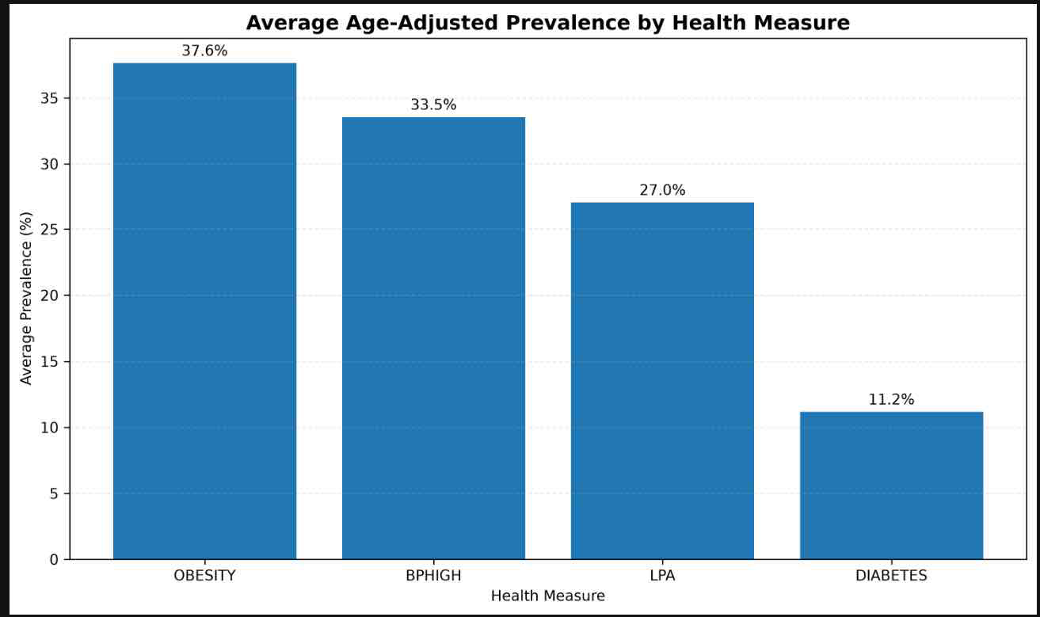
Obesity represents the highest average prevalence across the four analyzed cardiometabolic measures
Cardiometabolic burden varies meaningfully across the four population-health measures analyzed.
Average prevalence
Obesity — 37.63%
High blood pressure — 33.54%
Physical inactivity — 27.02%
Diabetes — 11.17%
Client implication: The population-health context supports prioritizing cardiometabolic risk monitoring while recognizing meaningful variation across measures and geographies.

Slide 5
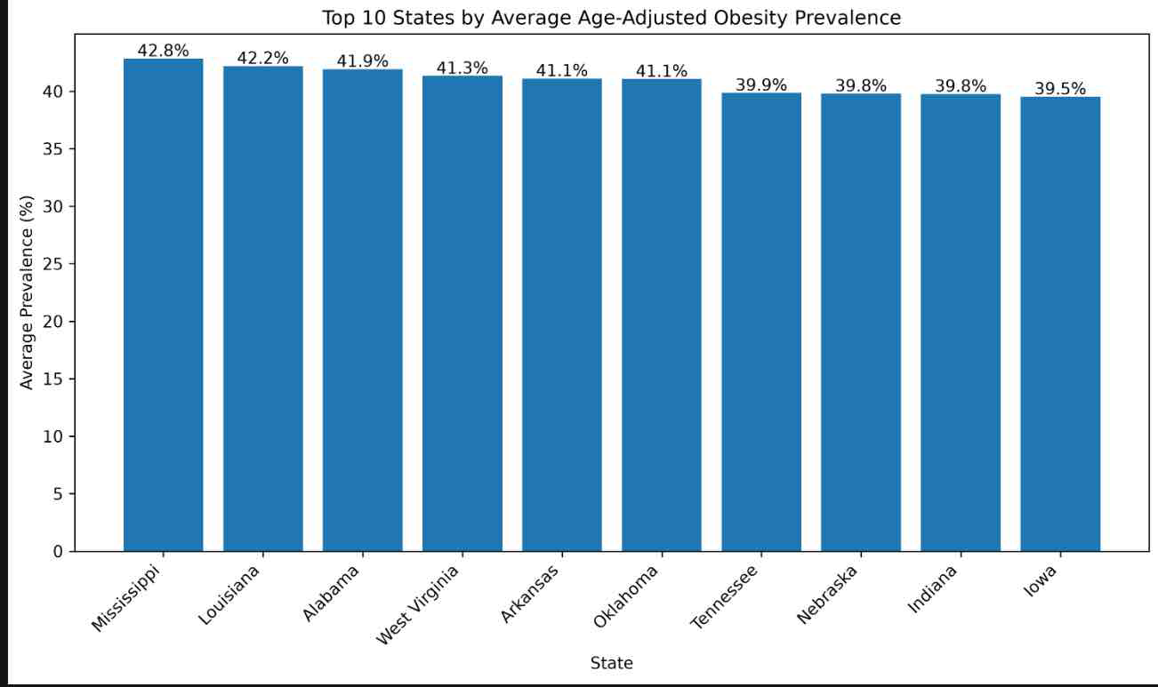
Geographic variation identifies populations that may warrant greater program attention
Geographic variation identifies populations that may warrant greater program attention. The highest-prevalence states cluster within a relatively narrow range, suggesting geographically targeted monitoring rather than a single extreme outlier.
These CDC estimates provide external population-health context and should not be interpreted as outcomes for the synthetic member cohort.

Slide 6
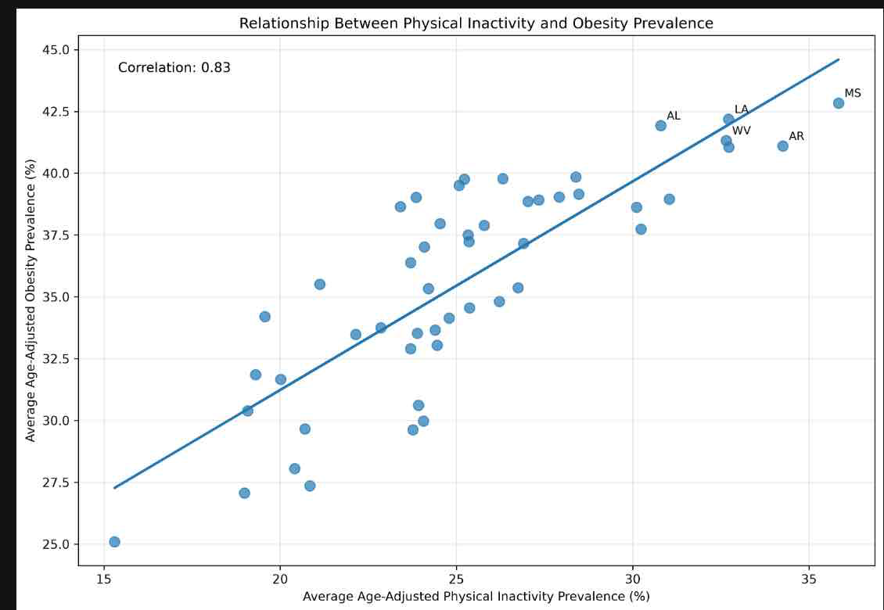
Higher physical inactivity is strongly associated with higher obesity prevalence across the analyzed population data.
r ≈ 0.83
Strong positive association
States with higher physical inactivity prevalence tended to also have higher obesity prevalence.
This is a descriptive ecological association and does not establish causality or individual-level risk.

Slide 7
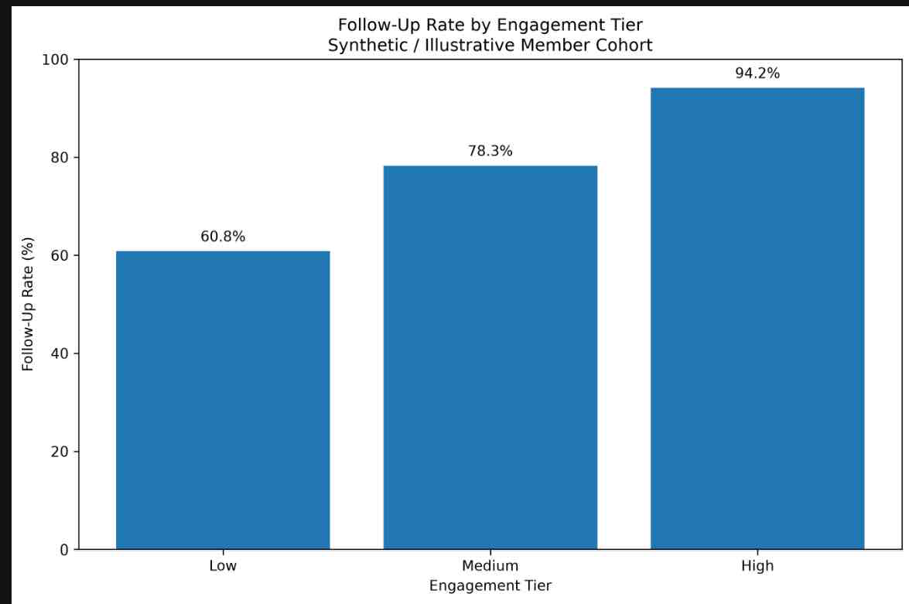
Follow-up coverage increases substantially across higher engagement tiers in the synthetic cohort
Follow-up coverage was 77.2%, with meaningful variation across engagement segments
463 / 600
members had follow-up
77.2%
overall follow-up coverage
Low engagement: 118/194 — 60.8% Medium: 184/235 — 78.3% HigLower-engagement members had substantially lower follow-up coverage, identifying a potential target for proactive outreach.h: 161/171 — 94.2%
“Higher engagement was associated with higher follow-up completion in the synthetic cohort.” We should not claim engagement caused the improvement.
Synthetic/illustrative data; association should not be interpreted as evidence that engagement caused improved follow-up

Slide 8
Nearly one in four enrolled members lack follow-up, limiting outcome interpretation
Big numbers:
600 enrolled ↓ 463 follow-up ↓ 137 without follow-up
That's 22.8% without follow-up.
Reporting only the 463 members with follow-up could overstate performance if members with missing follow-up differ systematically from thosClient reporting should therefore show both the enrolled/intent-to-treat denominator and the follow-up/completer population.e retained.
Incomplete follow-up limits outcome interpretation and should be treated as a reporting finding—not hidden.
Translate findings into action: identify lower-engagement members for targeted outreach, monitor follow-up rates by engagement segment, establish recurring client KPIs, and use population-health context to inform program priorities.

Slide 9

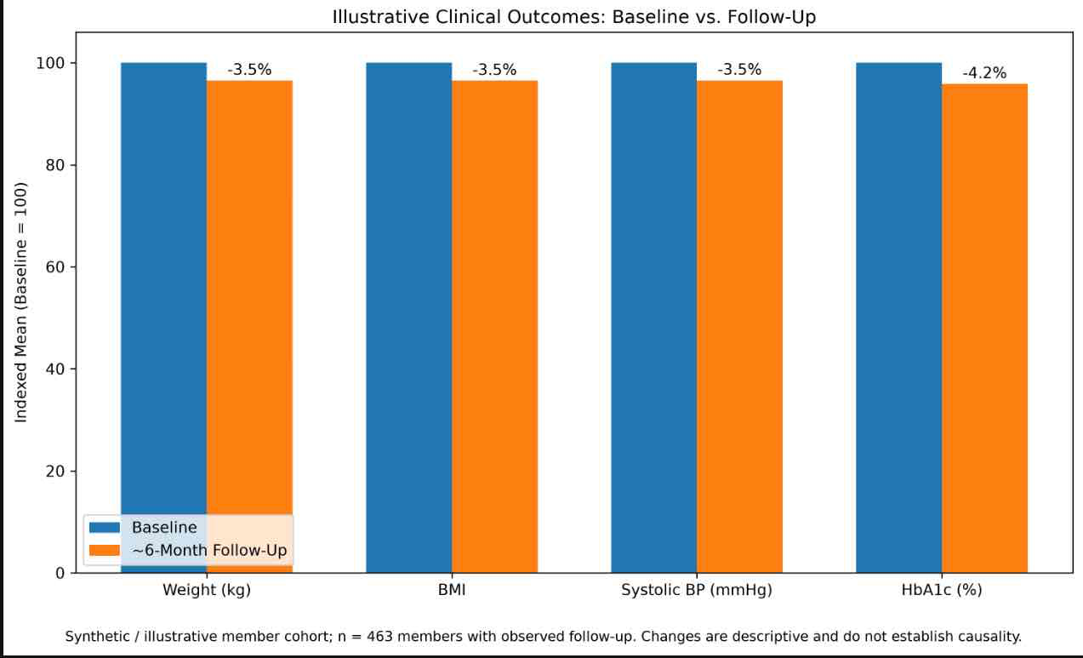
ILLUSTRATIVE CLINICAL OUTCOMES
Among members with observed follow-up, all four illustrative clinical measures improved from baseline to approximately six months.
OBSERVED CHANGE
Weight: −3.41 kg (−3.49%) BMI: −1.19 (−3.51%) Systolic BP: −4.74 mmHg (−3.46%) HbA1c: −0.28 percentage points (−4.20%)
Client implication: The illustrative cohort shows directionally favorable changes across weight, BMI, blood pressure, and glycemic control among members with follow-up.
463 of 600 members had observed follow-up (77.2%). Results are descriptive and should not be interpreted as causal program effects.

Slide 10
Targeted outreach and recurring segment monitoring can address the largest observed follow-up gap.
Targeted outreach and recurring segment-level monitoring can turn these findings into client action.
2. MONITOR
Establish recurring reporting for enrollment, engagement, follow-up coverage, missingness, and outcomes by segment.
1. TARGET
Prioritize lower-engagement members for proactive outreach, since this segment demonstrated the lowest illustrative follow-up coverage (60.8%).
3. INFORM
Use external population-health and geographic context alongside client-specific data to inform program priorities—not as a substitute for member-level outcomes.

Slide 11
The framework is reproducible and client-ready, but synthetic data and missing follow-up limit interpretation
The framework is reproducible and client-ready, while synthetic data and descriptive analysis appropriately limit interpretation.
LIMITATIONS
Member cohort is synthetic
No real patient data
Descriptive analysis
Missing follow-up
Population data cannot establish individual-level effects
Association ≠ causation
Potential confounding/self-selection into engagement No control/comparison group
NEXT STEPS
Apply framework to validated client data
Define clinical thresholds/outcomes
Validate baseline → follow-up change longitudinally.
Compare ITT and completer results
Monitor segment-level performance longitudinally
METHODOLOGY
CDC public API
Python ETL + validation
Processed analytical datasets
Streamlit reporting
Automated QA checks

