Slide 1

VUE GAME STORE
Dejan Simonovski 211039
Angel Risteski 211095

Slide 2
Featured games
Snake
Feeling nostalgic yet?
Hangman
The game we all played at school
Memory game
A fun game to exercise your memory
Tic-tac-toe
Play with a friend!

Slide 3
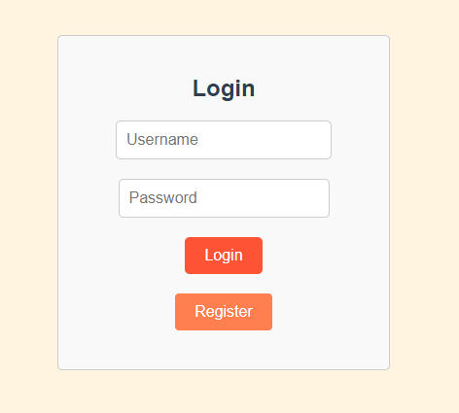
Keeping track is simple
Our app features a login system to not forget your high score on certain games. This is all accomplished using localStorage which stores data locally in the browser. Adding a database would be as easy as editing auth.js and nothing more.

Slide 4
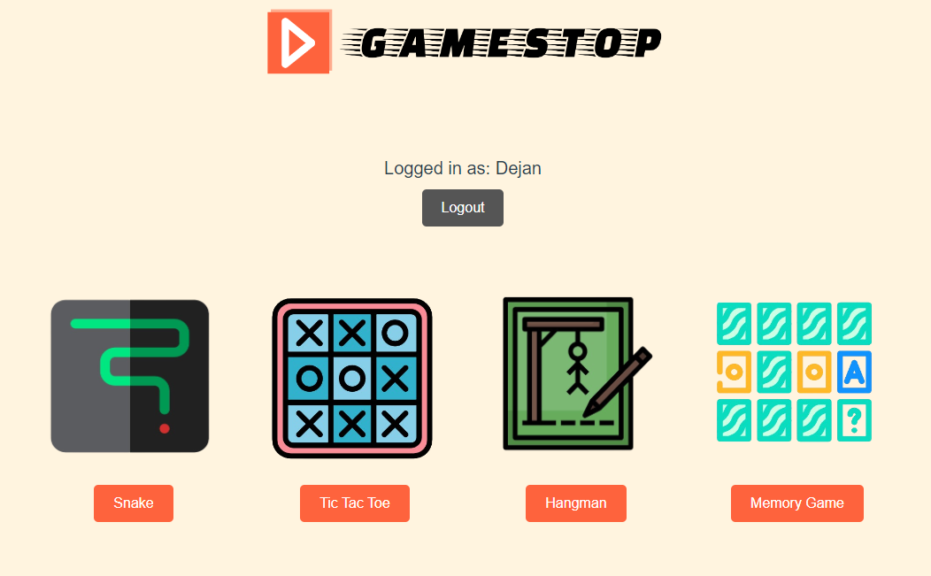
We talked about which games, we talked about the login system. When do we get to see the website?
Now.

Slide 5
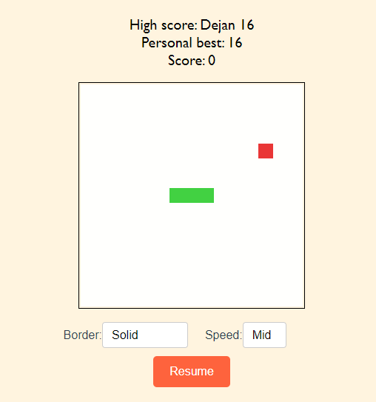
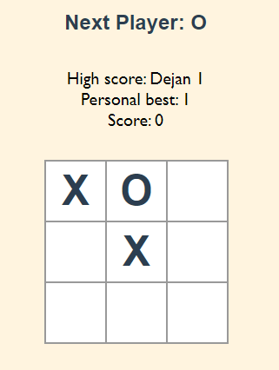
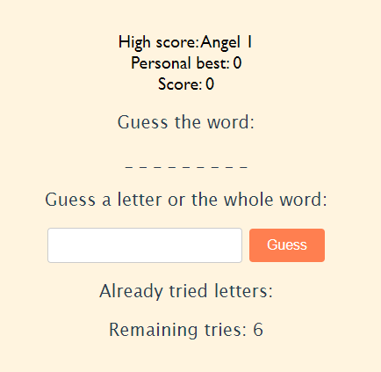
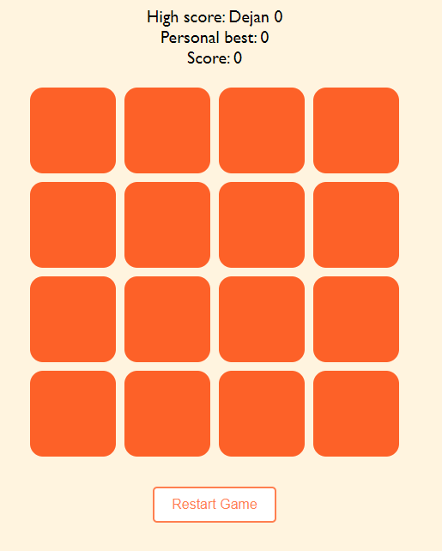
Lets go through the details
N
O
T
I
C
E
S
O
M
E T H I N G
?

Slide 6
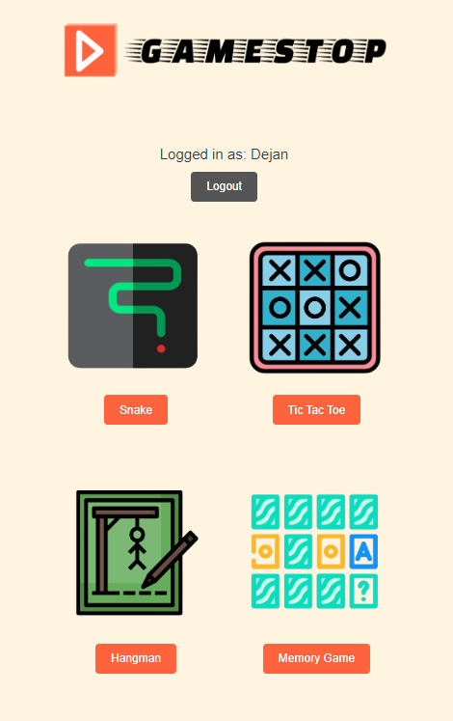

Optimization and design
Design
The design is responsive and adapts to the users screen size.
User-friendly interface for easy navigation.
All the games require login to be accessed.
Is there a current user? Great!

Slide 7
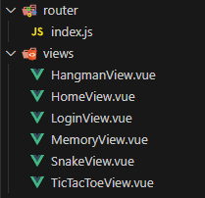
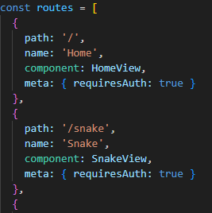
Optimization and design
Optimizations
Shared score system between all the games.
Use of the Vue router view system to Integrate login access to pages.

Slide 8
Thank you!

