Slide 1
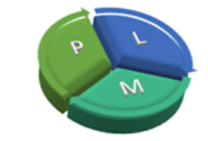
PROJECT LIFECYCLE MANAGEMENT
Alan, Christian, Manav, Rachit, Tandhy, Vipul, Yuvaraj

Slide 2
INTRODUCTION
Can capture the various stages of a Project Lifecycle.
Allows you to concentrate on the task at hand without having to bother about keeping things in sync with other tasks.
Does not require the installation of any software and the use of it is governed only by the need to register with them for free access to their facilities.
Can be used for commercial software development as well as any open source project.

Slide 3
FEATURES AND HIGHLIGHTS
Agile methodology.
Release & Iteration planning.
Collaboration Features.
Captures Business Requirements in form of User Story.
Workflow keeping track of the state of the User Story/Task.
Team Members can communicate via the system.

Slide 4
PLM PHASES
App Setup – Create application and enter additional app attributes.
Team Member Setup – Add Team member and assign roles to the Team Member
Create User Story – Gather Business Requirements. Define Release
Create Task – Tasks can be classified as Business Analyst Task, Development Task, Testing Task.
Release – Package and make the release.
GO live – System is ready to be released to production.
App setup
Team Member setup
Create User Story
Create Task
Go Live
Release

Slide 5
SOFTWARE ARCHITECTURE
User Interface (HTML 5, Kendo, JQuery, RequireJS, Bootstrap)
Service Authentication/Authorization
REST Services
Business Logic
Data Access
MySQL Database

Slide 6
SOFTWARE ARCHITECTURE
User Interface
Model View View Model (MVVM) pattern.
MVVM separates UI and back end.
Kendo framework (JQuery library) used for MVVM.
Elements of MVVM pattern include :
Model : This is the same as the classic MVC pattern, the model refers to a domain model or the data access layer.
View : The view refers to all the elements displayed by the GUI.
View Model : as a specialized aspect of what would be a controller (in the MVC pattern) that acts as a converter that changes model information into view information and passes commands from the view into the model. The view model exposes public properties, commands, and abstractions.

Slide 7
SOFTWARE ARCHITECTURE
Key reasons for choosing MVVM pattern :
Follow up : Patterns and best practices will actually slow down initial development and that's often a hard sell to management and engineering alike.
For example, if you follow MVVM properly, you should be able to make very drastic changes to the display logic, such as swapping out an entire view, with no impact on the data and business logic.
It helps you in separating GUI and program logic; mixing them can result in very hard to maintain applications, especially when your project grows with time.

Slide 8
SOFTWARE ARCHITECTURE
Pros of using MVVM architecture :
View is isolated from the model.
ViewModel does not manipulate controls directly.
Using MVVM leads to benefits on it's own that have nothing to do with the platform technology including the increased testability that comes from taking logic that might be lumped into the View otherwise.
Cons of using MVVM architecture :
Data binding may be difficult to debug.
Data binding may cause performance issues.
Command binding requires custom components.

Slide 9
SOFTWARE ARCHITECTURE
Service
Tiered architecture : is a client server architecture in which presentation, application processing, and data management functions are logically separated.
It is different from the MVC design as in a tiered architecture the client tier never communicates with the data tier. They must pass through the middle tiers.
Authentication.
username and password ! session token.
Authorization.
session token and project ID ! access granted/denied.
Business layer, Data access layer, Database layer.

Slide 10
IMPLEMENTATION (UI)
Common reusable client framework including RequireJs, Kendo, Bootstrap.
Asynchronous Module Definition(AMD) for Javascript Modules, module API supported by RequireJs.
MVVM Design Pattern used to manage the Model, View, ViewModel.
Most of logic is executed on the client side and Service interactions are made via the REST calls.
Service Oriented Architecture(SOA) pattern where in all data is exposed via services.
User Authentication based on service tokens.

Slide 11
PROJECT MANAGEMENT
The overall aim of our project was to create a fully functional , quality product within the time and resource constraints.
This was achieved by having the PM assign us roles and communicating regularly with all the team members. For this apart from the weekly team meetings we also used Skype and Google hangouts.
Roles and responsibilities were clearly defined which helped us in completing the work within the deadline.

Slide 12
RISK ANALYSIS AND MANAGEMENT
The PM was notified in case of problems and this was communicated to the entire group.
We made sure that the initial design of our project is simple and user-friendly and additional features were added during the development process.

Slide 13
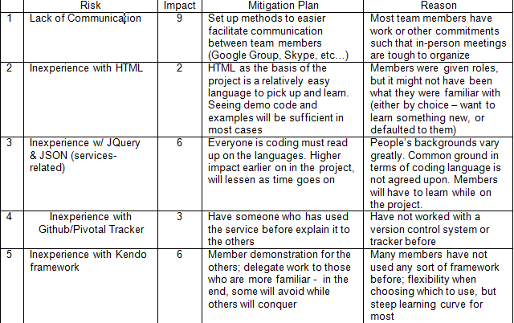
RISK ANALYSIS

Slide 14
REQUIREMENT ANALYSIS
For specifying the user stories we used Pivotal Tracker. By analyzing the general requirements of this project and what a customer would expect we came up with some of these user stories :
Users register themselves using under a username and password which are stored securely on a server
The system will allow registered users to log in given correct credentials
Upon logging in, the system displays a view specific to the user’s role
A registered user may create a new project, in turn making them the PL

Slide 15
ANALYZING AND ESTIMATING USER STORIES
The user stories we came up with had to be analyzed and estimated so as to have a proper flow during the development.
The priority assigned to a story affects when the work will be done to implement that requirement.
Developers are responsible for estimating the effort required to implement the user stories.

Slide 16
USER STORIES FOR 1st ITERATION
Feature to register users to the system
Log-in ID and password fields on the main page.
Only registered users can log in and access will be restricted based on user roles.
Dashboard view to see the list of tasks assigned to a member

Slide 17
USER STORIES FOR 2nd ITERATION
Project : Create, Update, View projects
Iteration :Create, Update, View iterations under a project
User Story : Create, Update, View user stories under an iteration
Task : Create, Update, View tasks under a user story

Slide 18
QUALITY ASSURANCE
Quality metrics are an objective, verifiable number. Unlike subjective data, the number is both quantifiable and can be confirmed
The potential downside to quality metrics is that the data may be poor : while the numbers look good, they may be measuring the wrong thing, or capturing the information in a way that mars the resulting information.

Slide 19
QUALITY METRICS
For maintaining the progress of our project we evaluated and kept a record of the following items :
Total Lines of Code: the value of this property is a number, which reflect the total implemented line of coding on each task.
Total number of functions: the value of this property is a number of functions, which define in each task.
Man hours: the value of this property is a number of hours, starting from 0, which a member requires to finish the task.

Slide 20
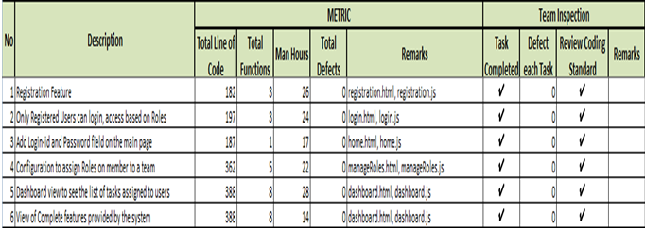
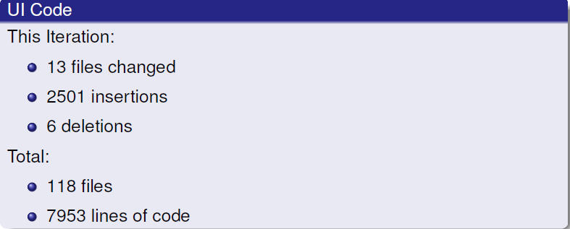
Metrics for 1st 2nd and 3rd Iterations

Slide 21
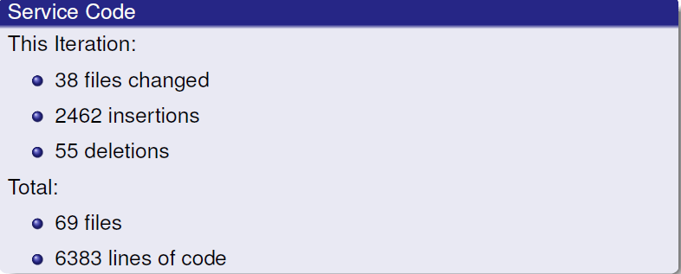
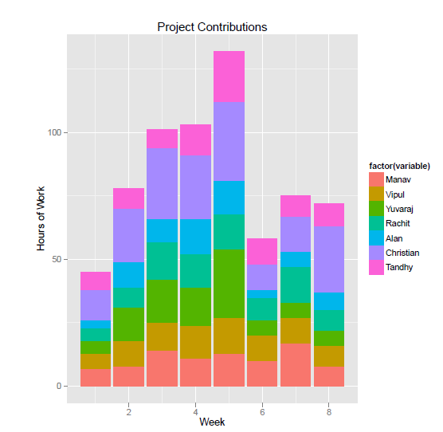

Slide 22
UI: 11 files changed, 718 insertions(+), 212 deletions(-)
Service: 7 files changed, 336 insertions(+), 6 deletions(-)

Slide 23
QUALITY EVALUATION AND PROCESS IMPROVEMENT
Verify that your data provides a view of your complete business cycle.
Check if your quality metrics make sense to your customer. Your customers don't view your product the same way you do. Understand how customers use and identify your product
Verify that quality metrics track all the development work.
Re-orient your quality metrics to your business goals, as necessary. This can be particularly difficult if you have robust quality metrics that successfully measure an entirely different set of information.

Slide 24
DEVELOPMENT TOOLS USED
Git / GitHub for version control and issue tracking.
Pivotal Tracker for requirement analysis.
Google Group for communication.
JUnit for service testing.
Selenium for UI testing.

Slide 25
DEPLOYMENT TOOLS USED
Apache Tomcat
Apache Ant
MySQL

Slide 26
PROJECT FUNCTIONALITY REVISITED
Register – Completed.
Login – Completed.
Manage projects – Needed user management.
Create iterations – Completed.
Manage user stories – Completed.
Manage tasks – Completed.
Reduce the number of roles.
Only project manager can edit user stories and developers can comment but not add/delete.
Iteration will be handled by release page: release number, project id, release start date, release end date, create release, save release.
Tasks: owner of user story will be creating and assigning the tasks, task description, task assigned to, status.

Slide 27
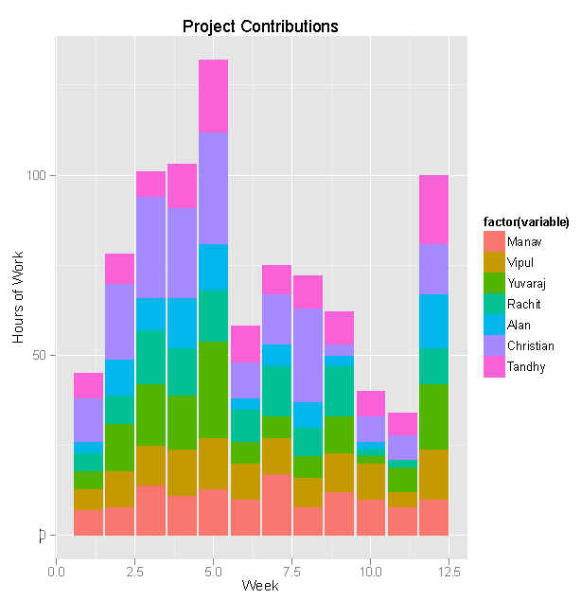

Slide 28
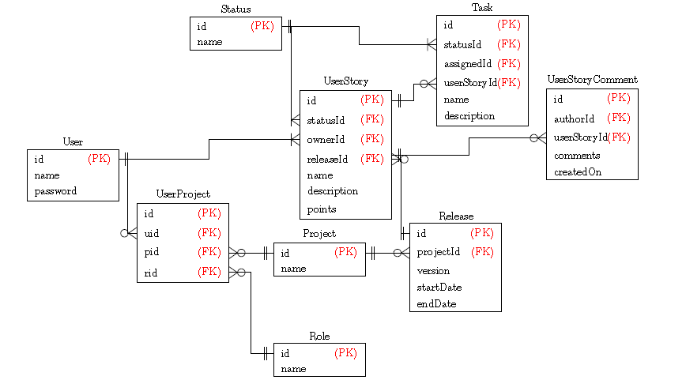
DATABASE DESIGN

Slide 29
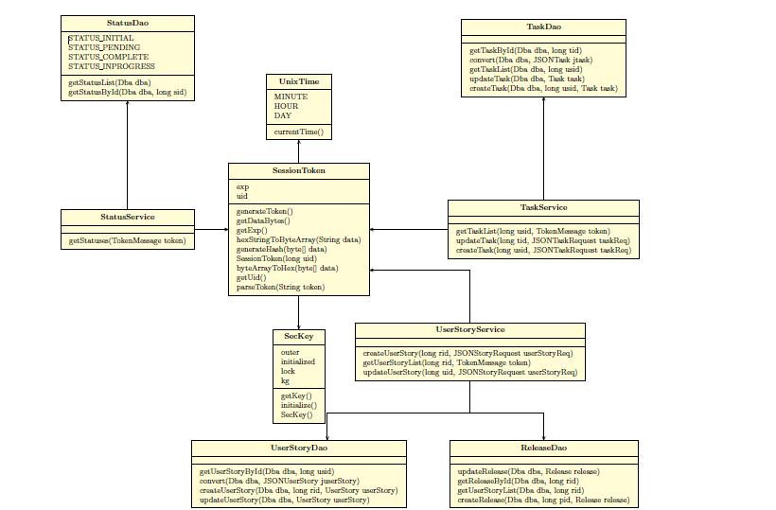
CLASS DIAGRAM

Slide 30
TESTING
Tools
UI : Selenium
Services : JUnit
Techniques
Function Testing
Domain Testing

Slide 31
TESTING
WHO
Self
Team
WHEN
Self Inspection
Team Inspection
HOW
Running sets of activity

Slide 32
Metrics
32 test cases
8 UI
Defect Priority
Defect Severity
Defect Type
Code Defect Type

Slide 33
Defect Severity
Severity | Iteration 1 | Iteration 2 | Iteration 3
Minor | 0 | 3 | 7
Trivial | 0 | 3 | 2
Major | 0 | 4 | 4
Notes:
Iteration 1:
Minor: 0
Trivial : 0
Major : 0
Iteration 2:
Minor: #1, #4, #5,
Trivial: #7, #9, #13
Major: #3, #8, #10, #11,
Iteration 3:
Minor: #20, #19, #18, #16, #5, #4, #1
Trivial: #14, #11,
Major: #17, #15, #11, #10,

Slide 34
Defect Priority
Priority | Iteration 1 | Iteration 2 | Iteration 3
Urgent | 0 | 2 | 2
High | 0 | 3 | 2
Medium | 0 | 4 | 2
Low | 0 | 2 | 6
Notes:
Iteration 1:
Urgent : 0
High : 0
Medium : 0
Low : 0
Iteration 2:
Urgent : #3, #10
High : #1, #13, #8
Medium : #7, #9, #11
Low : #4, #5
Iteration 3:
Urgent : #17, #10
High : #15, #1
Medium : #19, #11
Low : #20, #18, #16, #14, #5, #4,

Slide 35
Defect Type
Type | Iteration 1 | Iteration 2 | Iteration 3
Bug | 0 | 3 | 2
Enhancement | 0 | 5 | 5
Invalid | 0 | 2 | 5
Notes:
Iteration 1:
Bug :
Enh :
Invalid :
Iteration 2:
Bug : #13, #3, #10
Enh : #1, #4, #5, #7, #8,
Invalid : #9, #11
Iteration 3:
Bug : #17, #10
Enh : #20, #18, #5, #1, #14,
Invalid : #19, #16, #11, #15, #11

Slide 36
Defect Code Type
Code Type | Iteration 1 | Iteration 2 | Iteration 3
Syntax | 0 | 7 | 8
Logical | 0 | 2 | 3
Data | 0 | 1 | 1
Notes:
Iteration 1:
Syntax:
Logical :
Data:
Iteration 2:
Syntax: #1, #4, #5, #7, #9, #10, #11
Logical : #3, #8
Data: #13
Iteration 3:
Syntax: #20, #17, #14, #11, #10, #5, #4, #1
Logical : #19, #18, #15,
Data: #16

Slide 37
CONCLUSION
PLM is a product for project management and collaboration between project team members.
The entire project will be manageable from the dashboard.
It will enable an efficient and clearer workflow between multiple teams.
For Agile teams that want to get moving quickly, this tool is just right and hard to beat.
For larger projects and teams, additional software would be needed to allow team collaboration and document sharing. Also notable is the usability, which, for a web-based client, is exceptionally high.

Slide 38
CONCLUSION
Pros
Freeware.
Quick start.
Good task management.
Collaboration in real-time.
Cons
From the perspective of a project manager, personnel utilization control is difficult.
For exchanges among larger teams, important collaboration features are lacking, such as document sharing.

Slide 39
LESSONS LEARNED
Communication
Steady progress across the iteration.
Consider limitations and time constraints to determine the project functionality.

Slide 40

Thank You

Slide 41
Project Lifecycle Management Software Demo

