Slide 1
Preview of Authtest application for 2fa
Dejana Stevanović August 2017

Slide 2
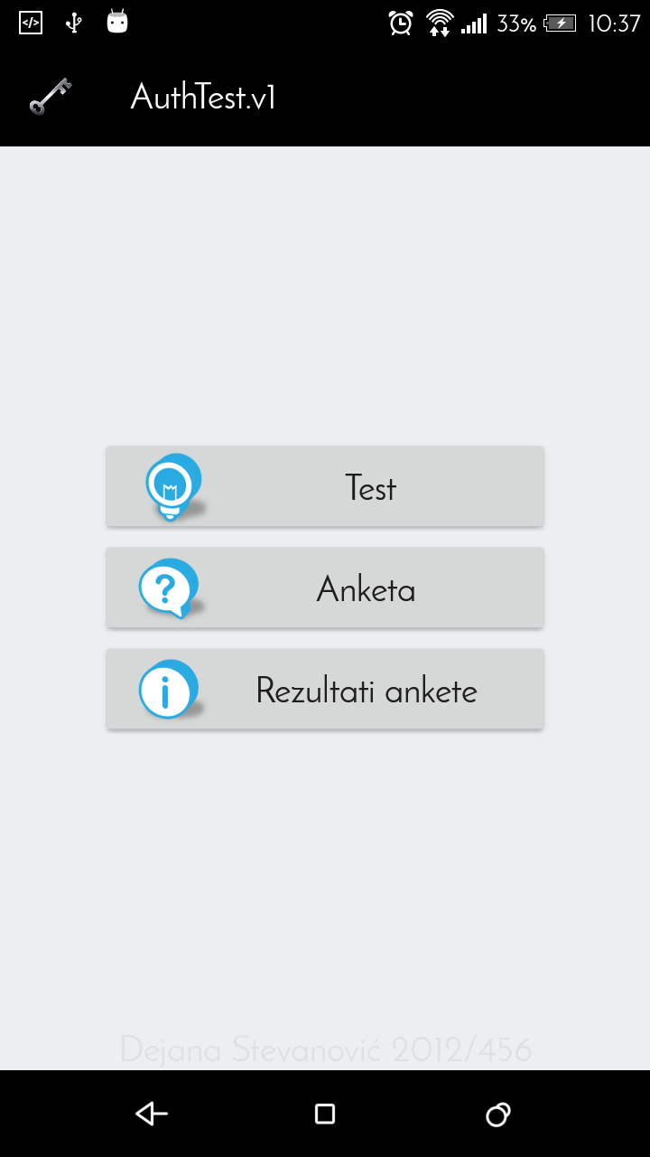
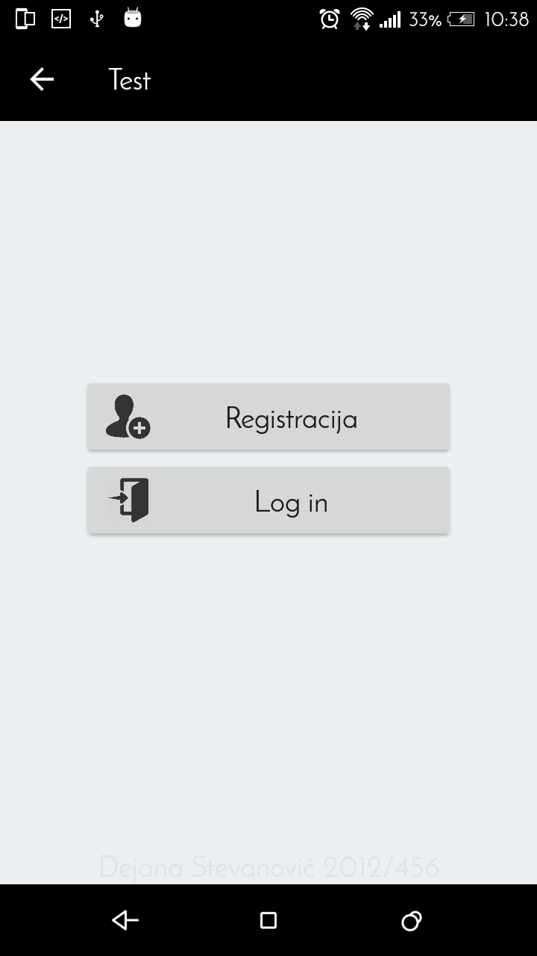
Start screen

Slide 3
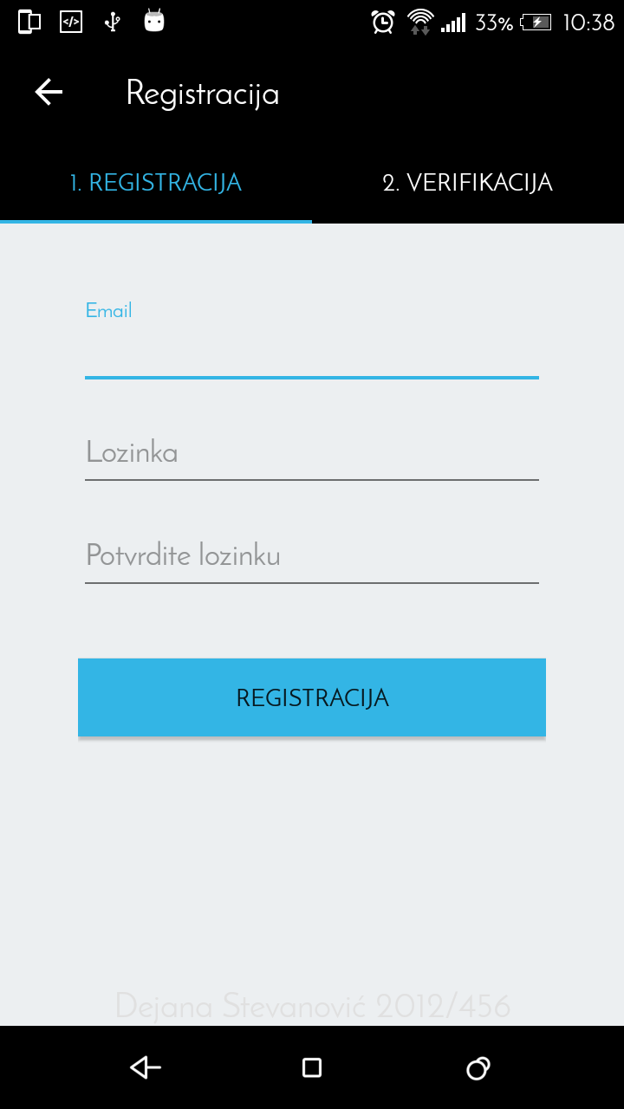
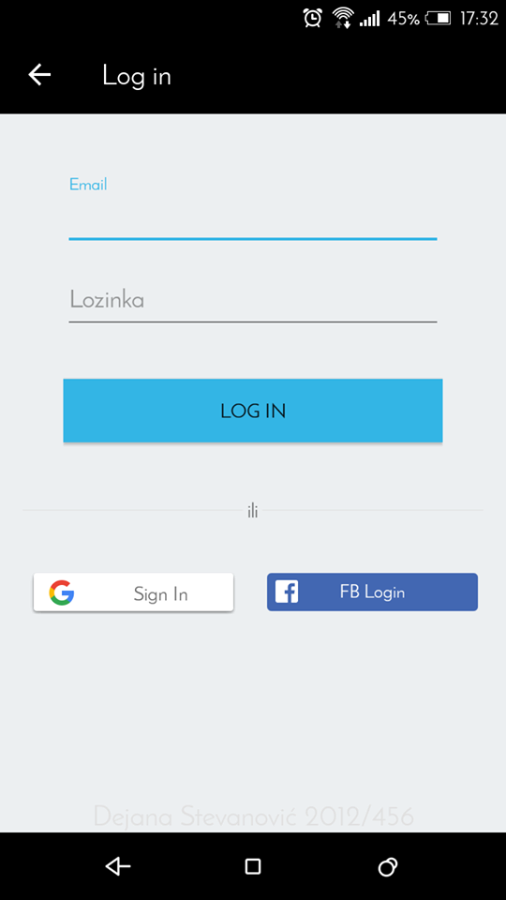
First step(registrarion AND login)

Slide 4
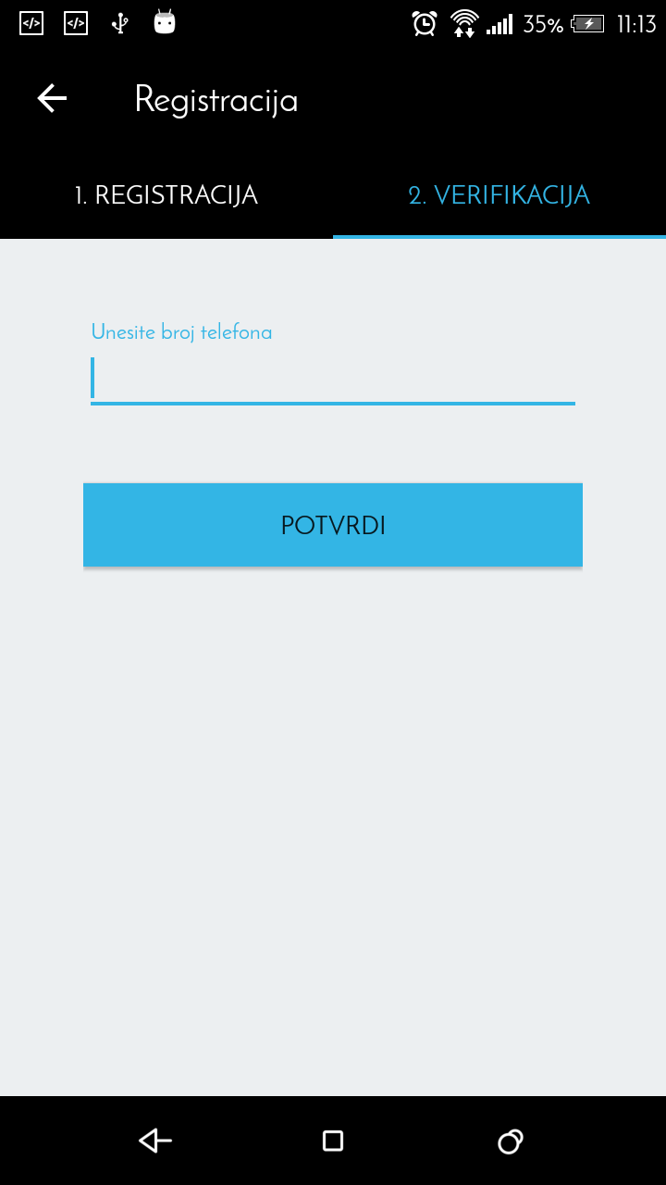
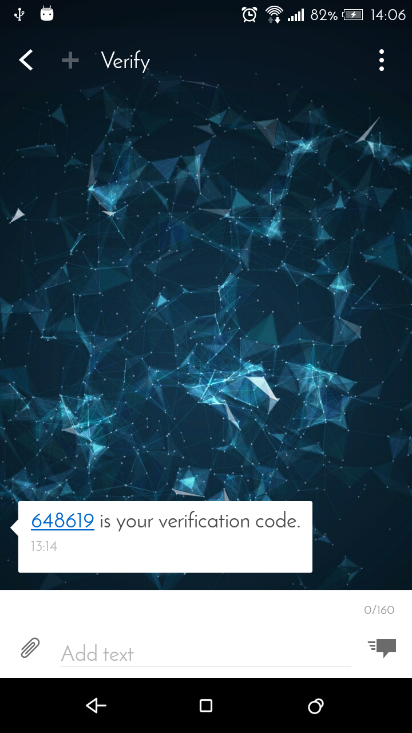
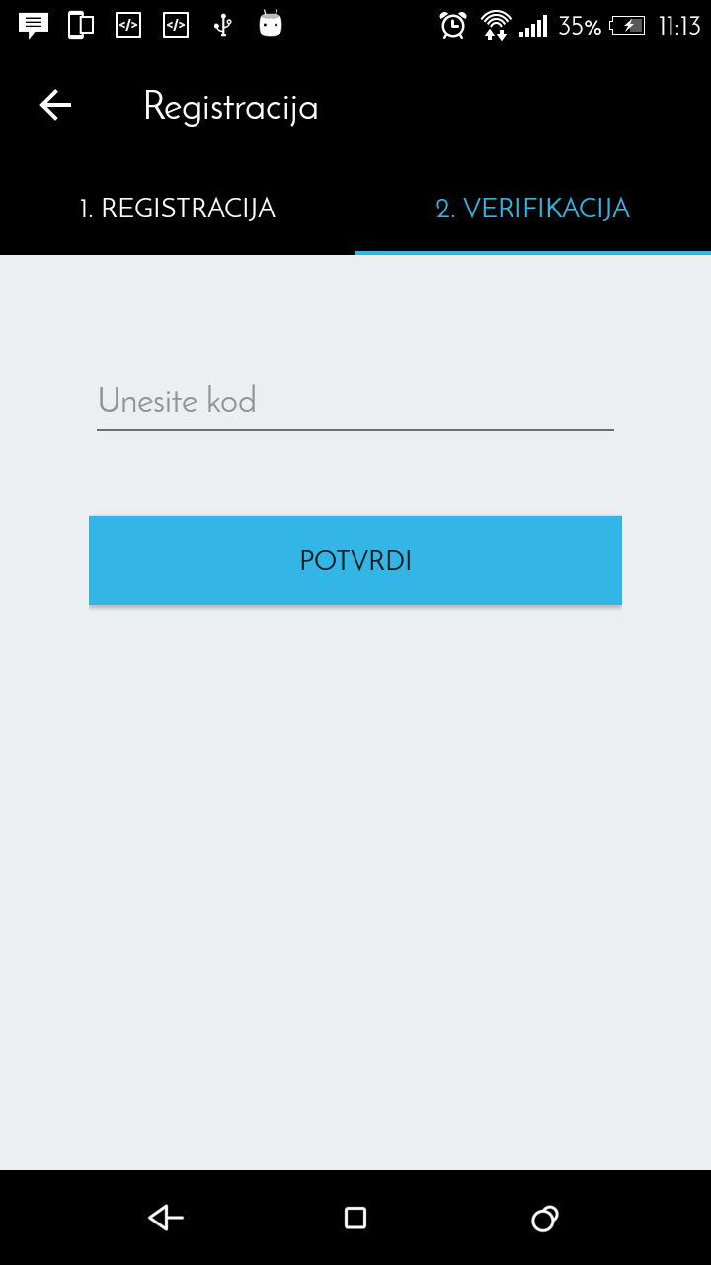
sms token

Slide 5
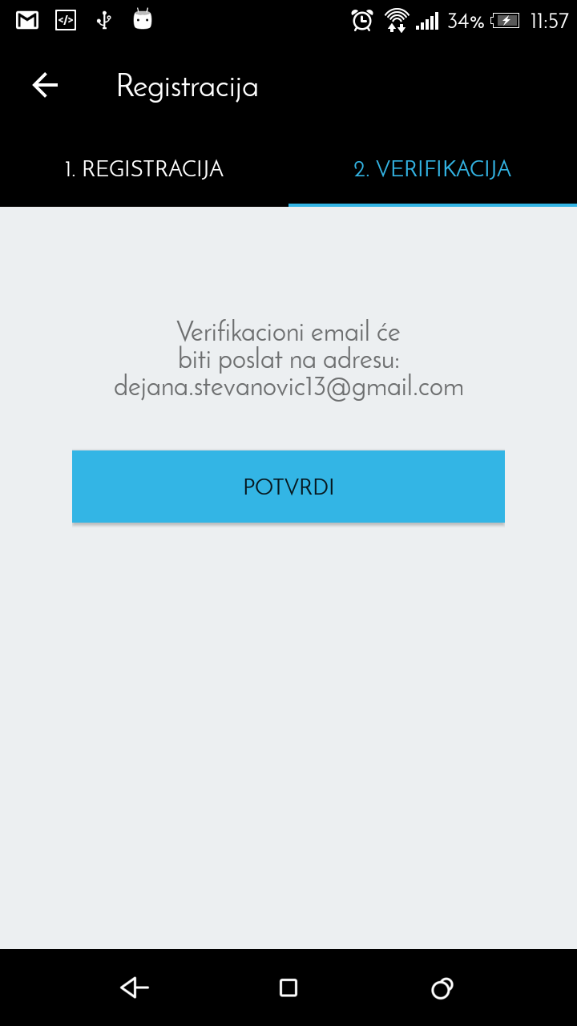
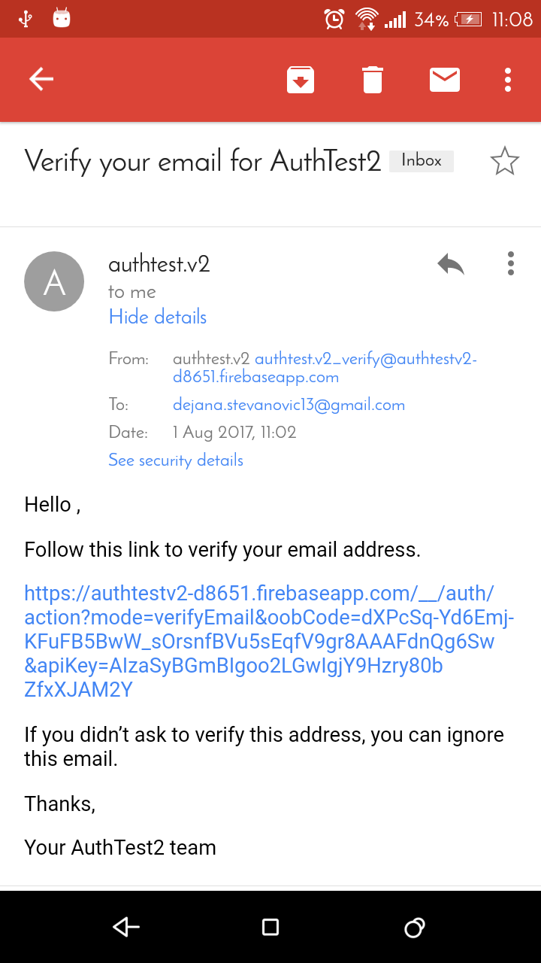
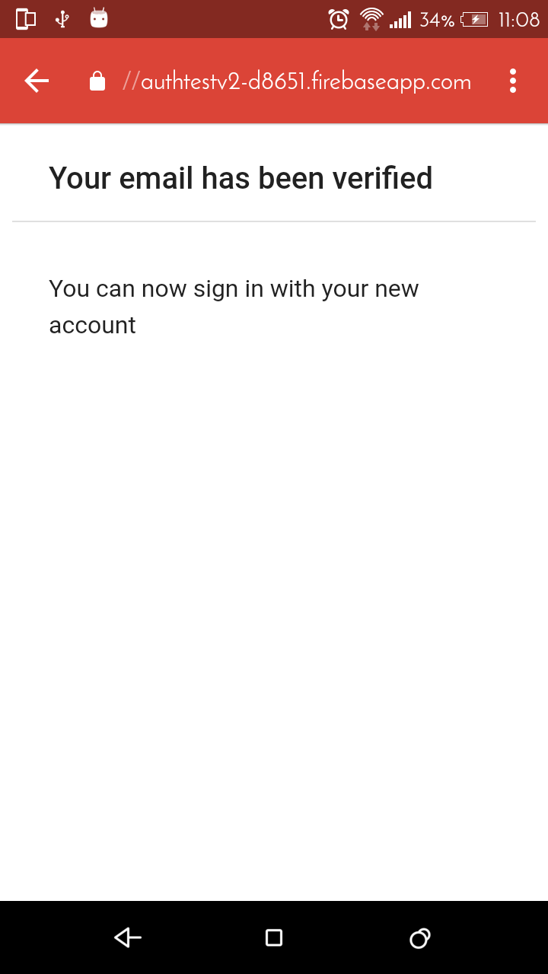
EMAIL VERIFICATION

Slide 6
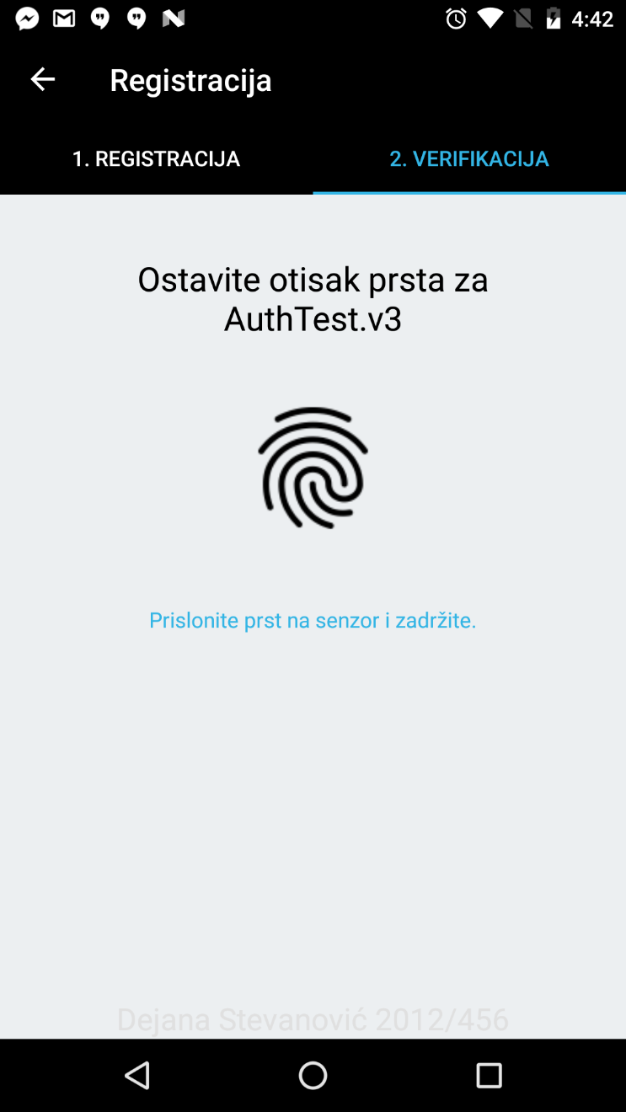
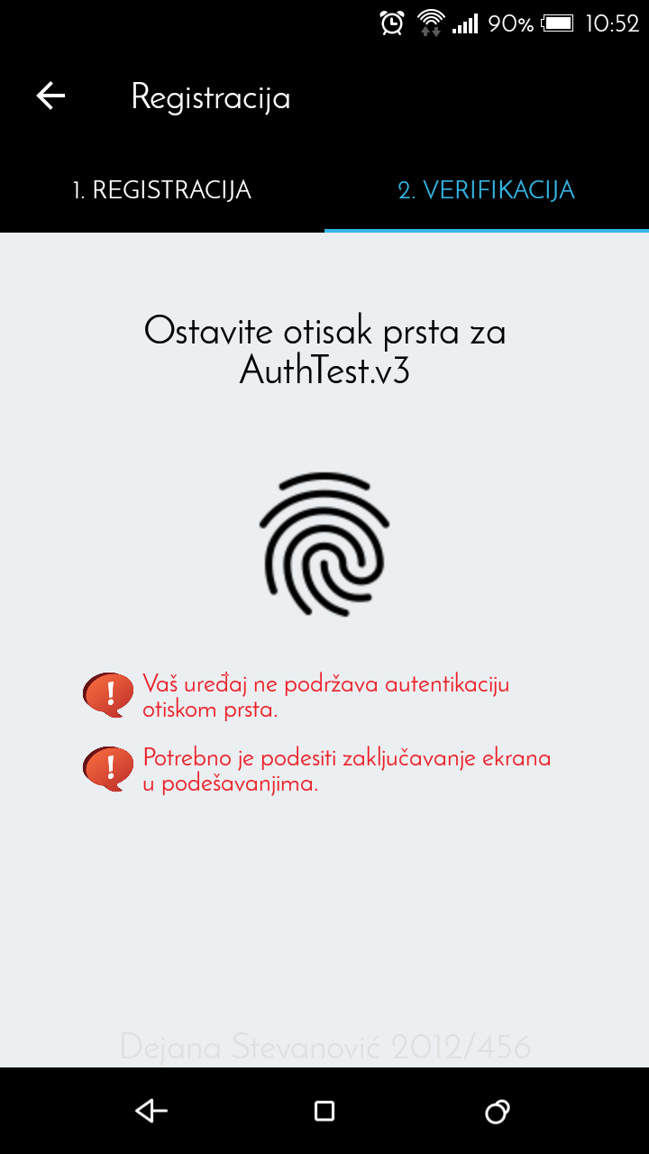
FINGERPRINT VERIFICATION

Slide 7
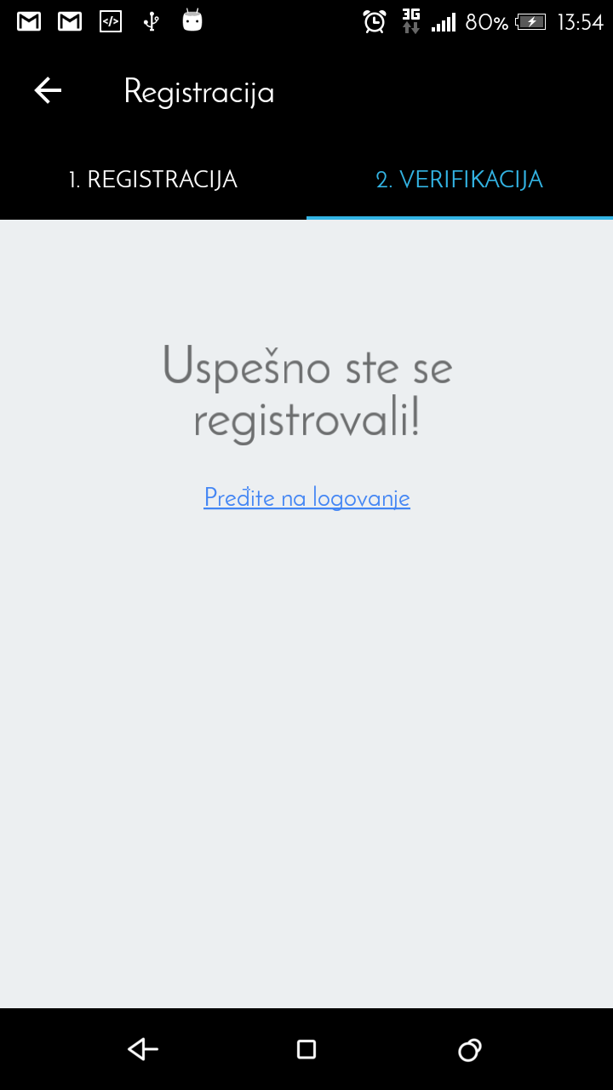
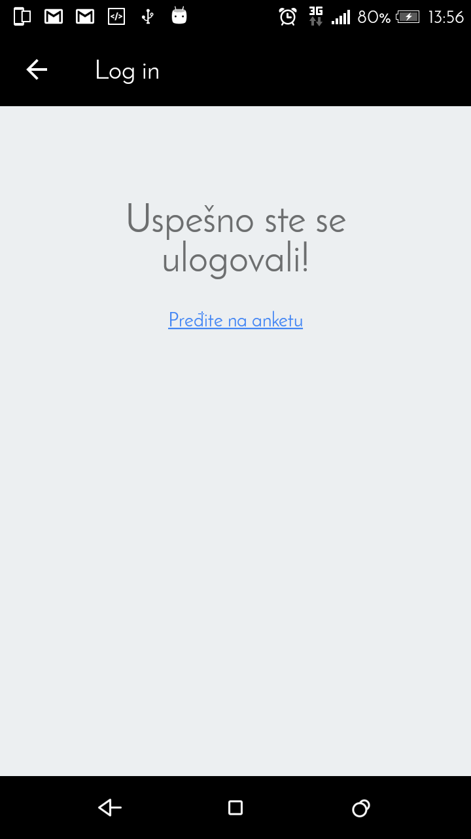
END OF REGISTRATION/LOGIN

Slide 8
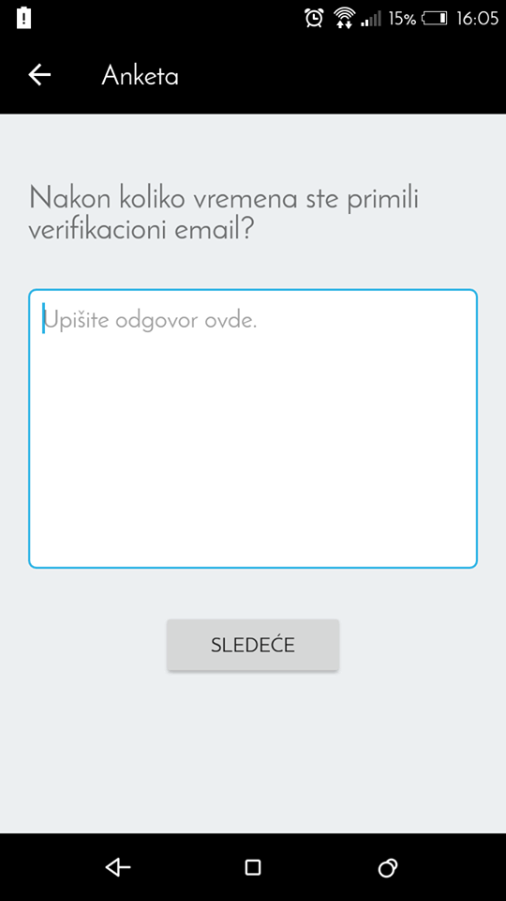
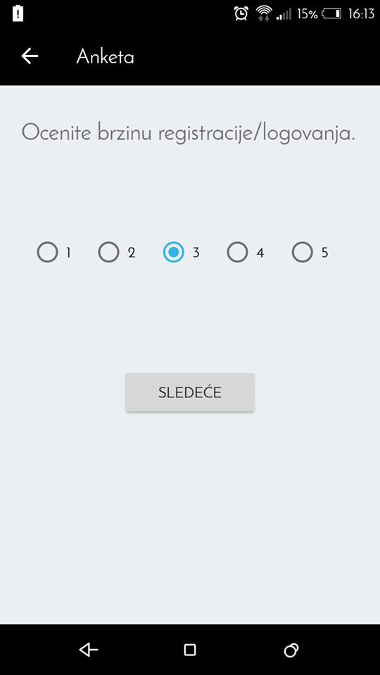
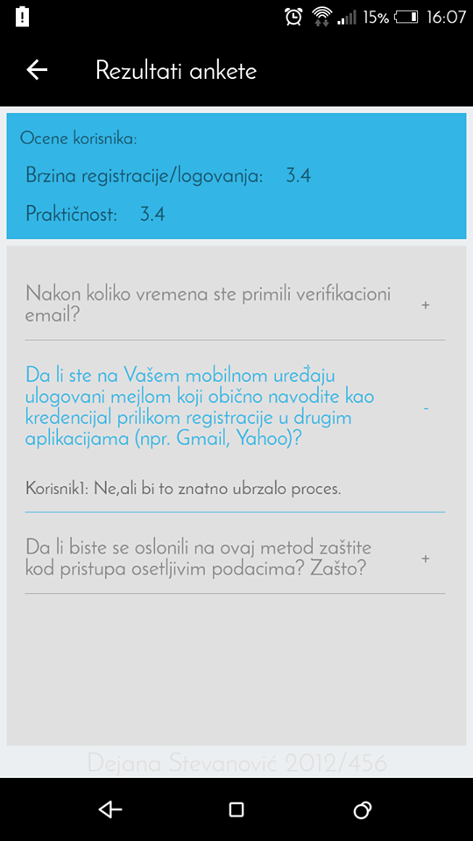
THE SURVEY AND PREVIEW OF USERS’ FEEDBACK

Slide 9
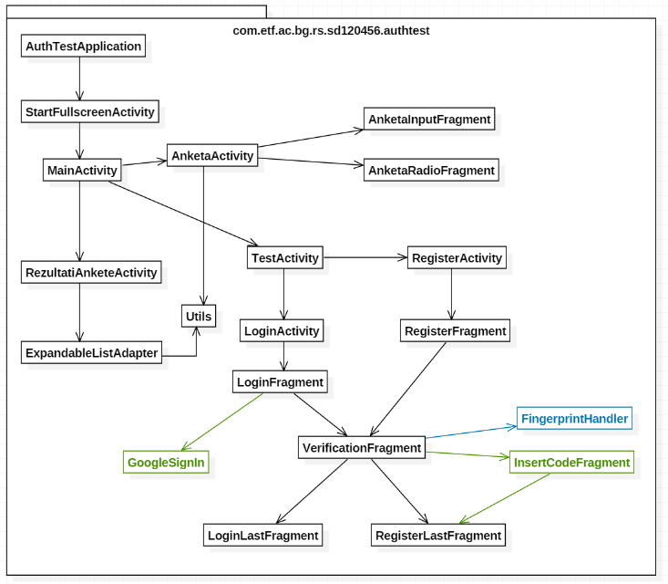
CLASS DIAGRAM
AuthTest.v1
AuthTest.v3

Slide 10
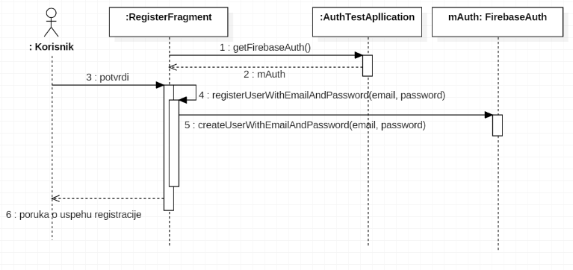
REGISTRATION SEQUENCE DIAGRAM

Slide 11
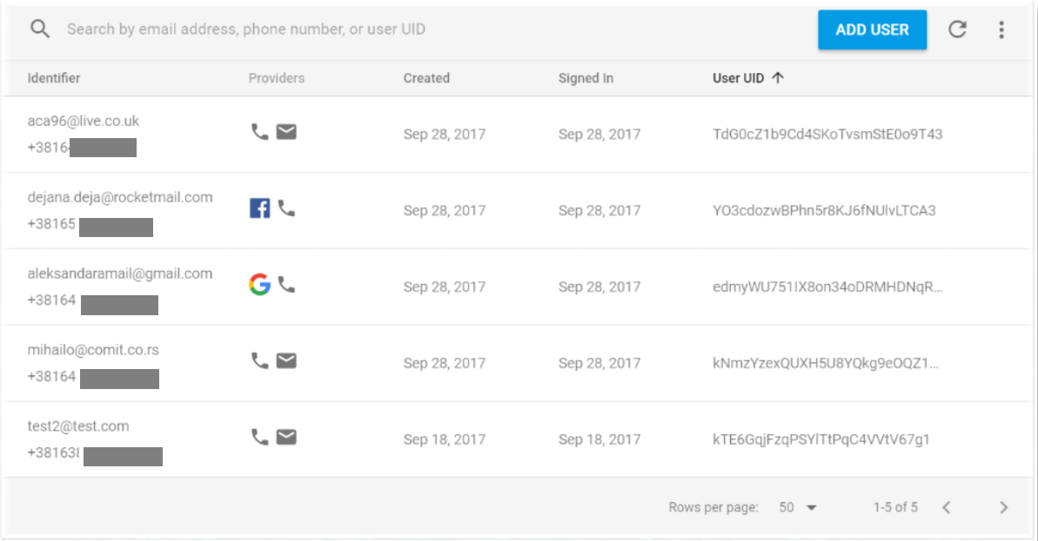
Firebase console - authentication

Slide 12
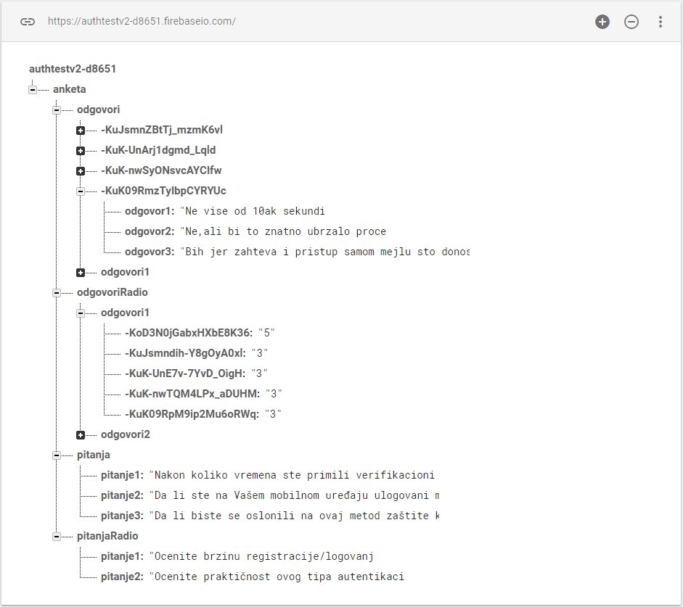
Firebase CONSOLE REALTIME DATABASE

Slide 13
Examples of usage:
SMS token:
- CHAT app
- Social network app
Email verification:
- NEWS app
- Apps with subscribe option
Fingerprint verification:
- Online payment
- Often verifications in app

