Slide 1
optimization of fine-grained cnc application by tilling in VECTOR, TREE and Operator dimensions Dejan Grubišić Zoran Budimlić

Slide 2
Contents
Goals of the Project
InnerProduct and how it works in CnC
Tilling in Vector, Tree and Operation dimension
Challenges in Tilling
Results

Slide 3
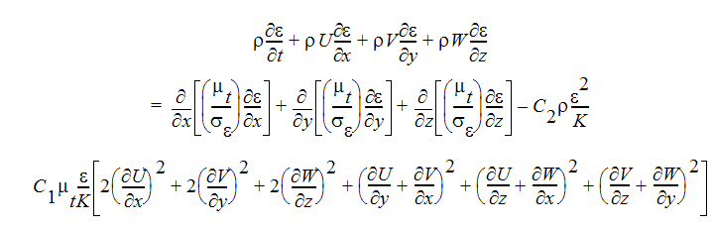
Goals of the project
Accelerating calculations between complicated scientific functions in quantum physics, chemistry…
MADNESS - Multiresolution, Adaptive Numerical Environment for Scientific Simulation
Intel CnC - Intel Concurrent Collections
Notes:
Turbulent Energy Dissipation (TED) Equation:
MADNESS (multiresolution adaptive numerical environment for scientific simulation)
is a high-level software environment for solving integral and differential equations in many dimensions that uses adaptive and fast harmonic analysis methods with guaranteed precision that are based on multiresolution analysis and separated representations.
Intel CNC
Is designed for creating parallel applications, but not for expressing parallelism explicitly. In CnC the programmer declaratively specifies the dependencies among computation units, but does not in any way indicate how those are to be met. It is specifically designed for addressing the coordination among potentially parallel computation units and data.

Slide 4
MADNESS
High-level software environment for solving integral and differential equations
Many dimensions
Guaranteed precision
Notes:
Represents function with trees
Defines multiple operations between trees ( Unary: Spectral Transformations, Integration | Binary: addition, multiplication, innerProduct
Uses adaptive and fast harmonic analysis methods

Slide 5
CNC
Declerative task oriented model
Efficiency - algorithm with minimal scheduling constraints
Single Assignment – No data races
Scalability - wide range of configurations from small multicore systems to large clusters
Notes:
CNC declerative functional Task oriented model for parallel programming
Unlike often used OpenMP+MPI CNC is based on task-based programming,
User expresses the data and control-flow relations between tasks, offering the runtime maximal freedom to place and schedule tasks.

Slide 6
CNC
tag_name.put();
…
Step::execute{
data_in.get();
Do computation…
data_out.put();
}
CONTROL TAG
COMPUTATION STEP
DATA IN
DATA OUT
Notes:
CNC declerative functional Task oriented model for parallel programming

Slide 7
Starting point
Inner-Product fine-grained CnC application written by Mahdi, researcher from Stony Brook University
Main goals
Implementing a tiled version of Inner-Product by tiling in vector, tree and operator dimension
Finding an optimal amount of computation that should be done by one Step

Slide 8
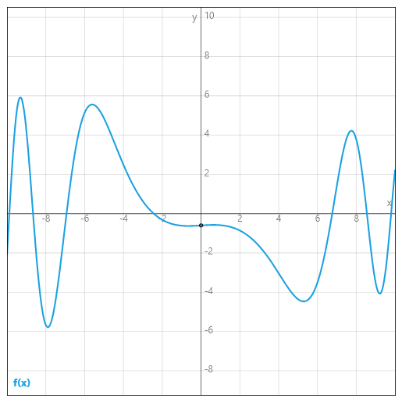
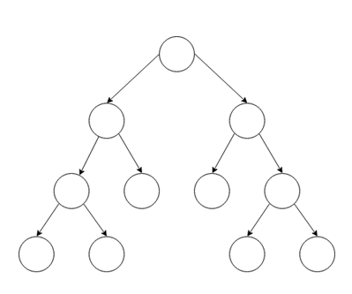
Inner-Product basic implementation
Represent analogue function with tree

Slide 9
Inner-Product basic implementation
Represent analogue function with tree

Slide 10
Inner-Product basic implementation
Represent analogue function with tree

Slide 11
Inner-Product basic implementation
Represent analogue function with tree

Slide 12
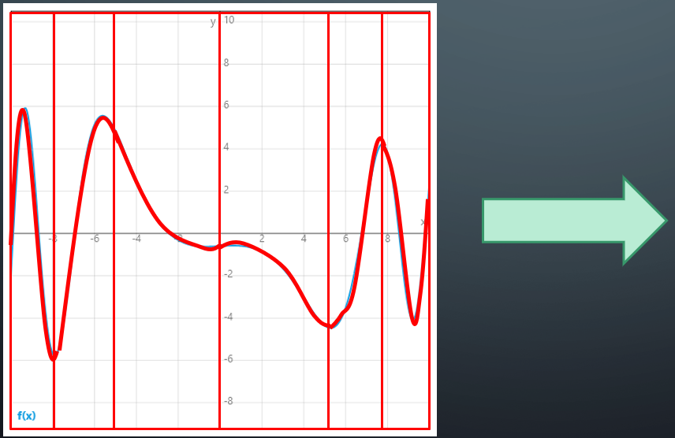
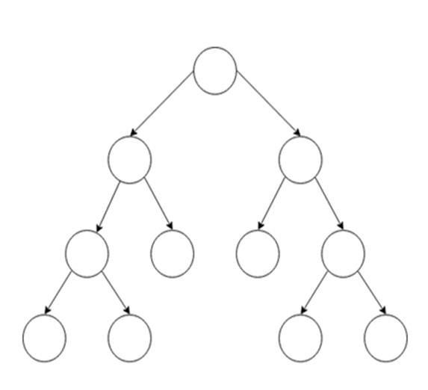
Inner-Product basic implementation
Approximate each interval with polynomial of degree k

Slide 13
Inner-Product basic implementation
Transform representation into desired form

Slide 14
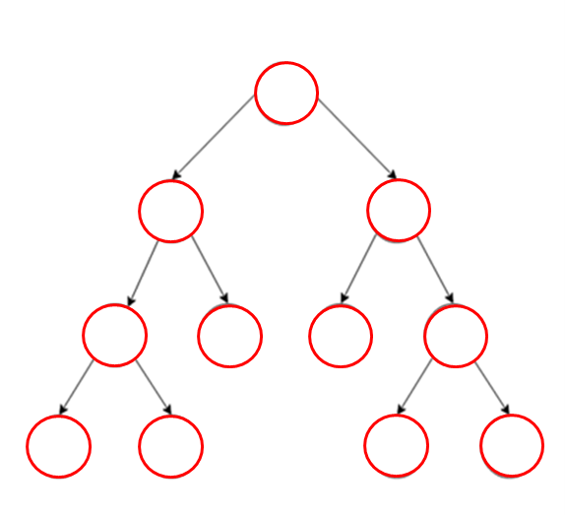
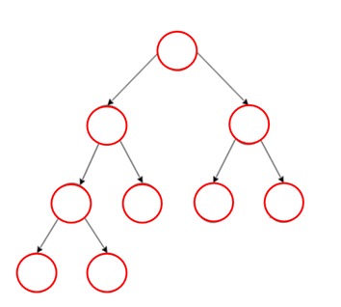
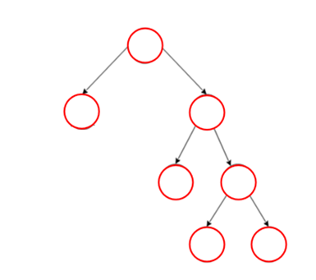
Inner-Product basic implementation
Calculate Inner-Product between each node on the same position in the tree
Function f0
Function f1
Function f2

Slide 15
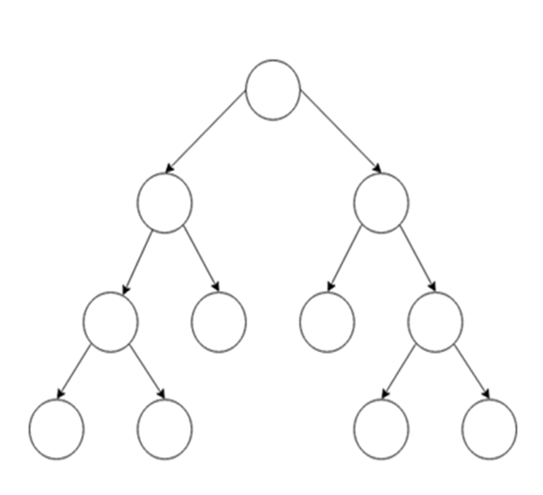
Inner-Product basic implementation
Calculate Inner-Product between each node on the same position in the tree
Function f0
Function f1
Function f2

Slide 16
Inner-Product basic implementation
Calculate Inner-Product between each node on the same position in the tree
Function f0
Function f1
Function f2

Slide 17
Inner-Product basic implementation
Calculate Inner-Product between each node on the same position in the tree
Function f0
Function f1
Function f2

Slide 18
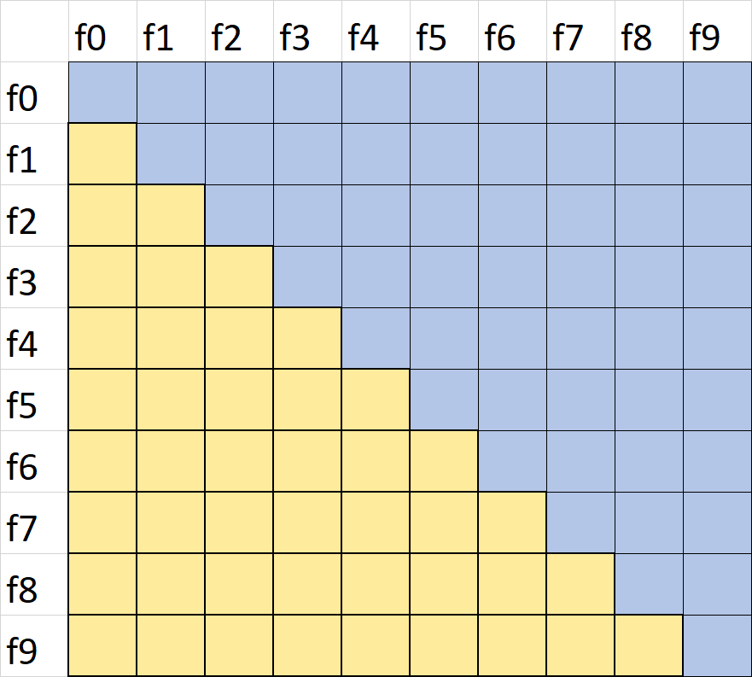
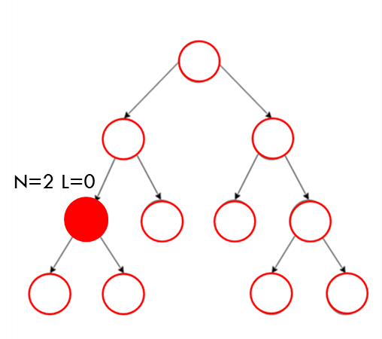
Inner-Product basic implementation
For every node-position in some tree there will be table on the right
When node from f2 appears it will prescribe inner-product between itself and all functions right to it
Inner-product will be calculated only if data that it consumes appears eventually
Notes:
Let’s say that I have node on position in the tree f2. We need to multiply that node position with all corresponding node of other functions. The problem is that some of other functions might not have that node in their tree. Shape of trees could be vastly different. So if I multiplying something with tree that doesn’t even have corresponding node, what the result should be? Original implementation just ignore that results (zero is neutral for adding).
Monday: CnC enable us to prescribe step and if there is no input data, the step will not be executed
Thursday: Explain CnC also…
Conceptually we are not creating red task, but rather only green ones.

Slide 19

Inner-Product basic implementation
< P >
Project Step – Refine function

Slide 20
Inner-Product basic implementation
< P >
< P >
Project Step – Refine function

Slide 21
Inner-Product basic implementation
Project Step – Refine function
< P >
< P >
< P >
< P >
Leaf!
L

Slide 22
Inner-Product basic implementation
Project Step – Refine function
Compress Step – Transform coefficients in frequential domain
Inner-Product
< C, I >
L
L
L
L
L
<P>
<P>
<P>
<P>
<P>
<P>

Slide 23
Inner-Product basic implementation
Project Step – Refine function
Compress Step – Transform coefficients in frequential domain
Inner-Product
L
L
L
L
L
< C, I >
< C, I >
< C, I >
L
L
L
L
<P>
<P>
<P>
<P>

Slide 24
Inner-Product basic implementation
Project Step – Refine function
Compress Step – Transform coefficients in frequential domain
Inner-Product
< C, I >
L
L
L
L
L
L
L
L
L
< C, I >
< C, I >
< C, I >
< C, I >

Slide 25
Inner-Product basic implementation
Project Step – Refine function
Compress Step – Transform coefficients in frequential domain
Inner-Product
L
< C, I >
< C, I >
L
L
L
L
L
L
L
L

Slide 26
Inner-Product basic implementation
Project Step – Refine function
Compress Step – Transform coefficients in frequential domain
Inner-Product
< C, I >
< C, I >
L
L
L
L
L
L
L
L
L

Slide 27
Inner-Product basic implementation
< C, I >
< C, I >
Project Step – Refine function
Compress Step – Transform coefficients in frequential domain
Inner-Product
L
L
L
L
L
L
L
L
L

Slide 28
Inner-Product basic implementation
< C, I >
Project Step – Refine function
Compress Step – Transform coefficients in frequential domain
Inner-Product
L
L
L
L
L
Finish !
L
L
L
L

Slide 29
Inner-Product basic implementation
Basic Inner-Product implementation in CnC is written intuitively by user of CnC
It is the finest grained implementation which creates maximal amount of tasks
Large number of tasks introduce overhead in task creation

Slide 30
Main goals:
Implementing a tiled version of Inner-Product by tiling in vector, tree and operator dimension
Decrease number of task, increase granularity of computation
Find not only an optimal amount of computation, but optimal shape as well
Notes:
Decrease number of task, increase granularity of computation: Means that we want to create bigger tasks instead of bunch of small ones Find not only an optimal amount of computation, but optimal shape as well that should be done by one Step

Slide 31
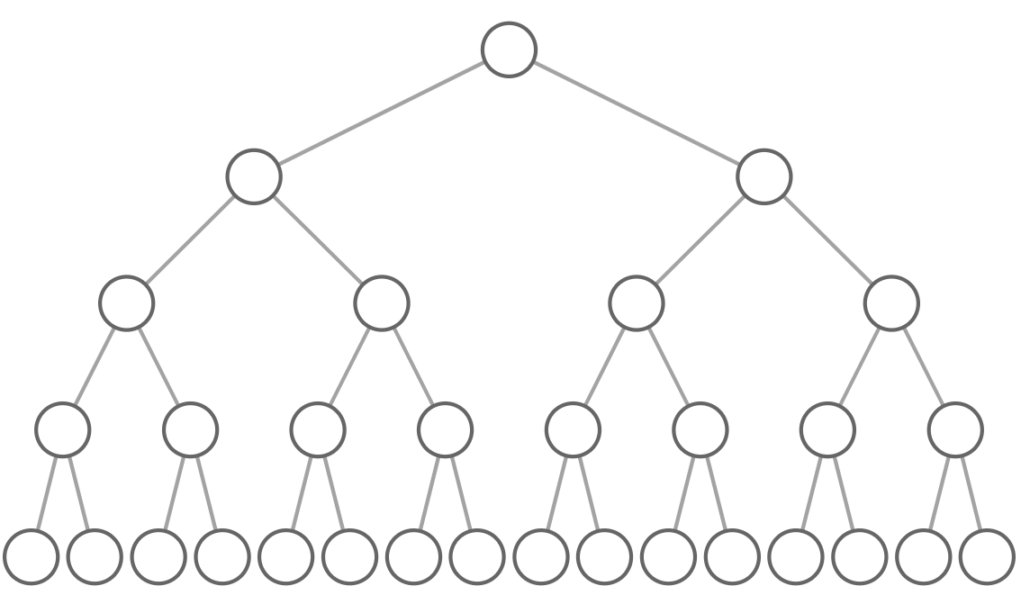
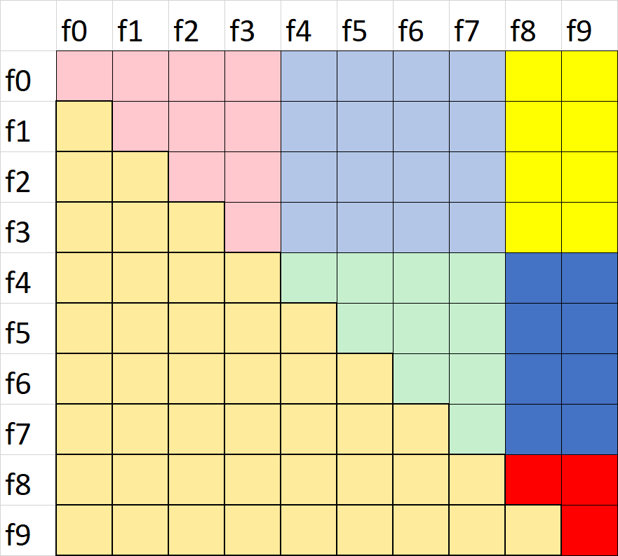
How tiles are arranged…
TREE Dimension VECTOR Dimension

Slide 32
What is tiling in operator dimension ?
Project Step
is TOP DOWN
Compress Step
is BOTTOM UP
InnerProduct
is NEUTRAL
Notes:
In more general case this tilling turns out to be very important, because there could be a large sequence of operation, and with fusing operations together we avoid to create temporal results between steps, but rather we use local results as input in another operation
Say about tilling up down, many operatior

Slide 33
Challenges in tiling
How can you efficiently traverse through tree in Project Step(Refinement) ?
Communication between children subtrees and parents?
How do you know if some node in a subtree will eventually appear or not?
Notes:
How can you efficiently traverse through tree in Project Step(Refinement) ?
How to convey the information from children Subtrees to parent Subtree, if you don’t know the shape of tree in advance ?
How do you know whether some node in a subtree will eventually appear or not, if the vector-tiled Inner-Product should be executed ?
Trees are different

Slide 34
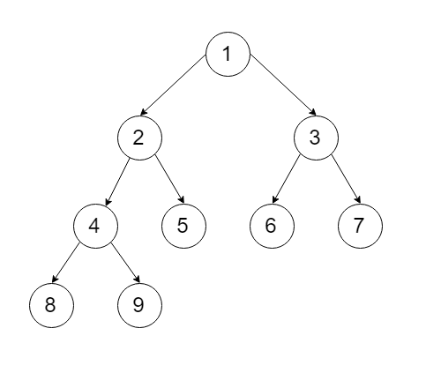
How can you efficiently traverse through tree in Project Step(Refinement) ?
L=0
Vacancies list:
Subtree
once you find a leaf, put the position from most left node L in the list and double it with every next level
Merge more intervals if they are consecutive
L=0
L=1
L=0
L=1
L=2
L=3
L=0
L=1

Slide 35
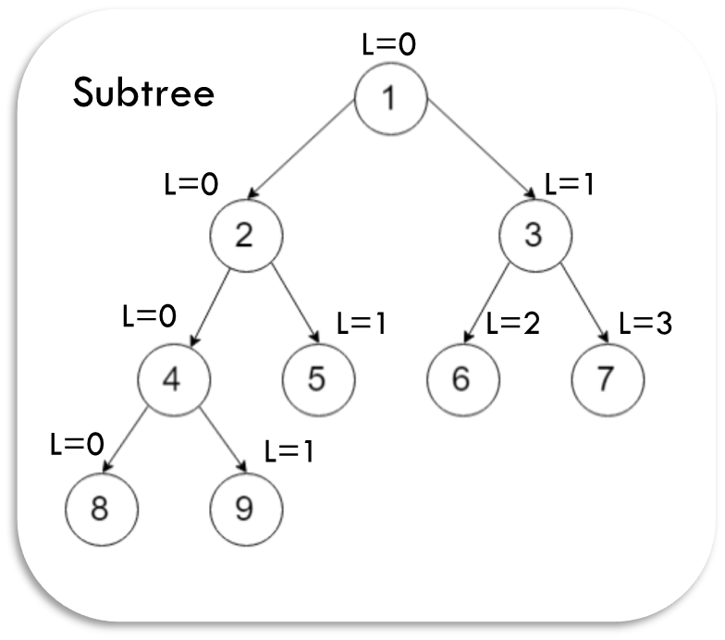
How can you efficiently traverse through tree in Project Step(Refinement) ?
Next Level
Vacancies list:
{ (1, 1) (2, 2) (3, 3) }
{ (2, 3) (4, 5) (6, 7) }
Merge { (2, 7) }

Slide 36





How can you efficiently traverse through tree in Project Step(Refinement) ?
Vacancies list:
Subtree
Cnt=
2
Completeness counter:
Every time you find a leaf, increment counter for the number of last level-places below leaf
Once counter reach $2^{DEPTH}$ tree has all leaves

Slide 37
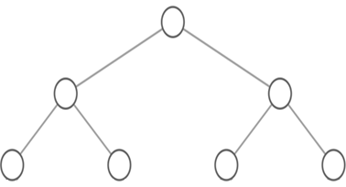
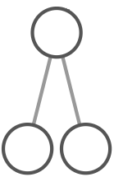
Communication between children subtrees and parents?
ID 0
Project Step
Every subtree gets unique ID
Compress Step
Children should provide information to their parents
ID 1
ID 2
ID 3
ID 4
Notes:
Every time when you prescribe new subtree, look at the size of the vector, set ID of new subtree and allocate desired memory for it
Provide information about parent ID

Slide 38
How do you know if some node in a subtree will eventually appear or not?

Slide 39
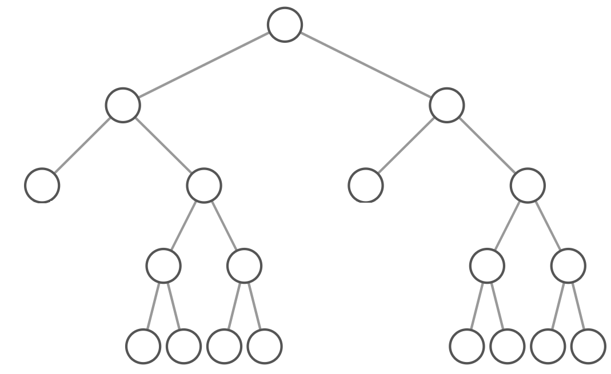
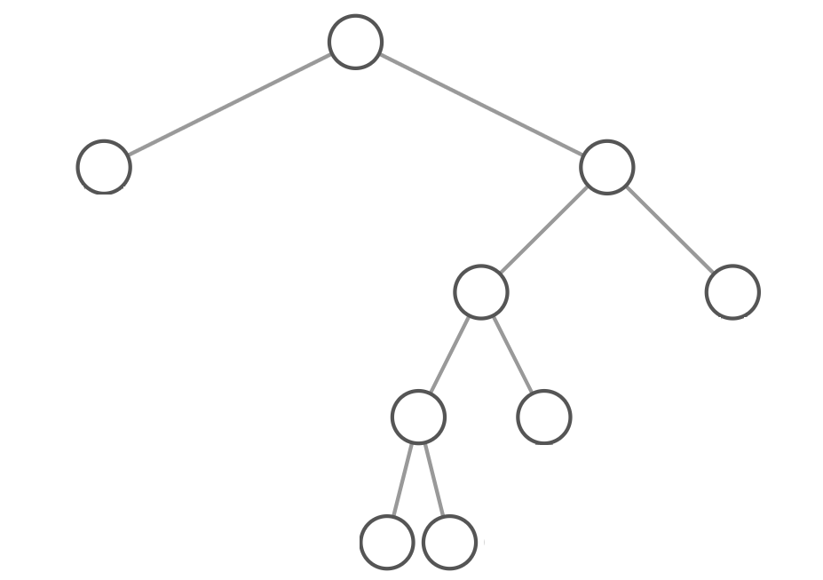
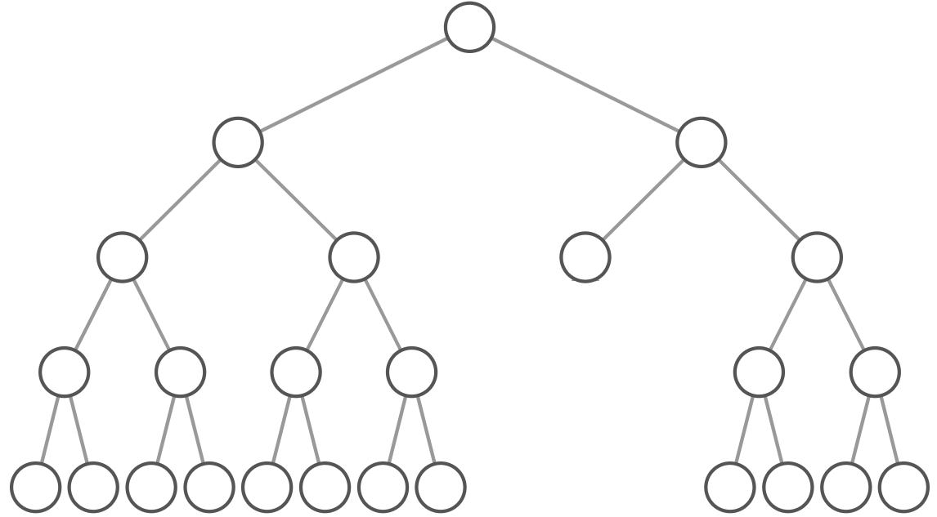
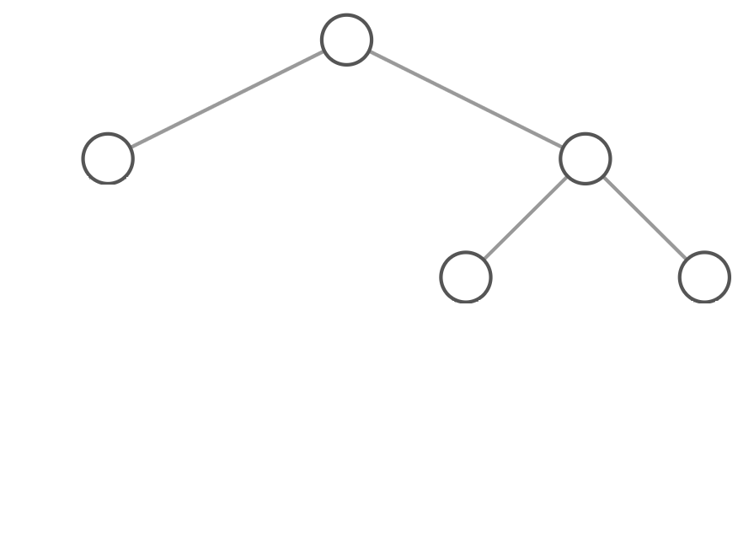

How do you know if some node in a subtree will eventually appear or not?
Function 0
Function 1
Function 2
Function 3

Slide 40

How do you know if some node in a subtree will eventually appear or not?
Problem with the question
We assumed that Refining and Compress Step are done independently for each function
Solution
Do sequentially Refining and Compress for the tile of functions
Put each step information which subtree is there

Slide 41

How do you know if some node in a subtree will eventually appear or not?
Tile Project and Compress step in vector dimension
Function 0
Function 1
Function 2
Function 3
Notes:
Project Step gets the information which subtree exists for that tile and produces list of nodes for every subtree

Slide 42
RESULTS

Slide 43
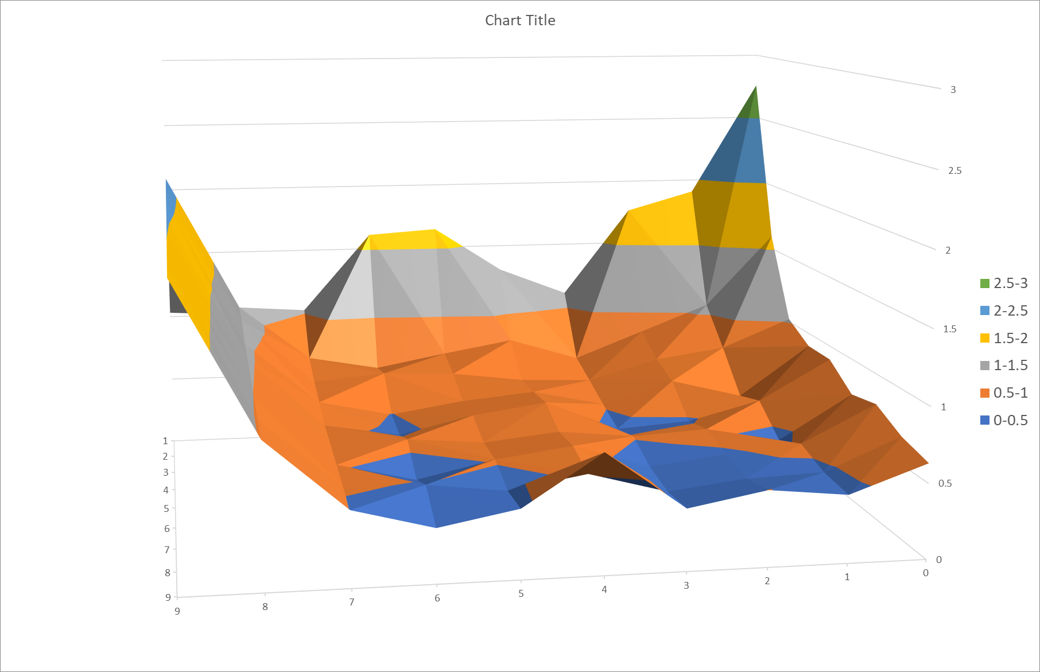
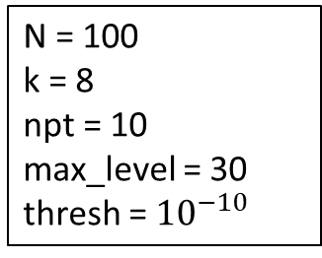
N = 100
k = 8
npt = 10
max_level = 30
thresh = ${10}^{−10}$
Time Analysis for different tile
Minimum = 0.35 s
Vec = 9 Tree = 6
Speedup = x4.45
Vector size
Subtree size

Slide 44
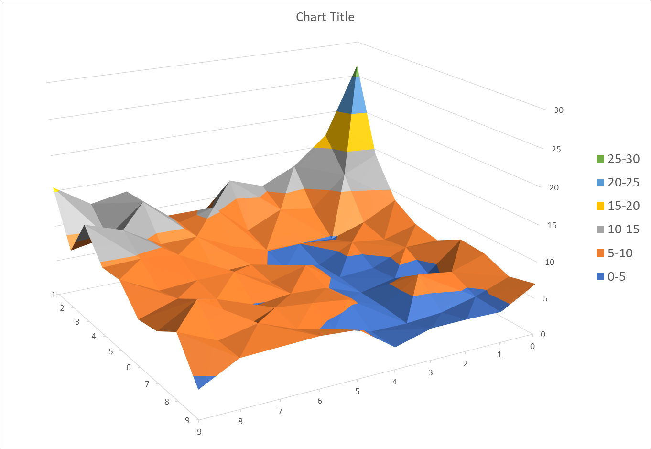

N = 100
k = 8
npt = 10
max_level = 30
thresh = ${10}^{−15}$
Time Analysis for different tile
Speedup = x5.51
Minimum = 2.9 s
Vec = 8 Tree = 3
Vector size
Subtree size

Slide 45
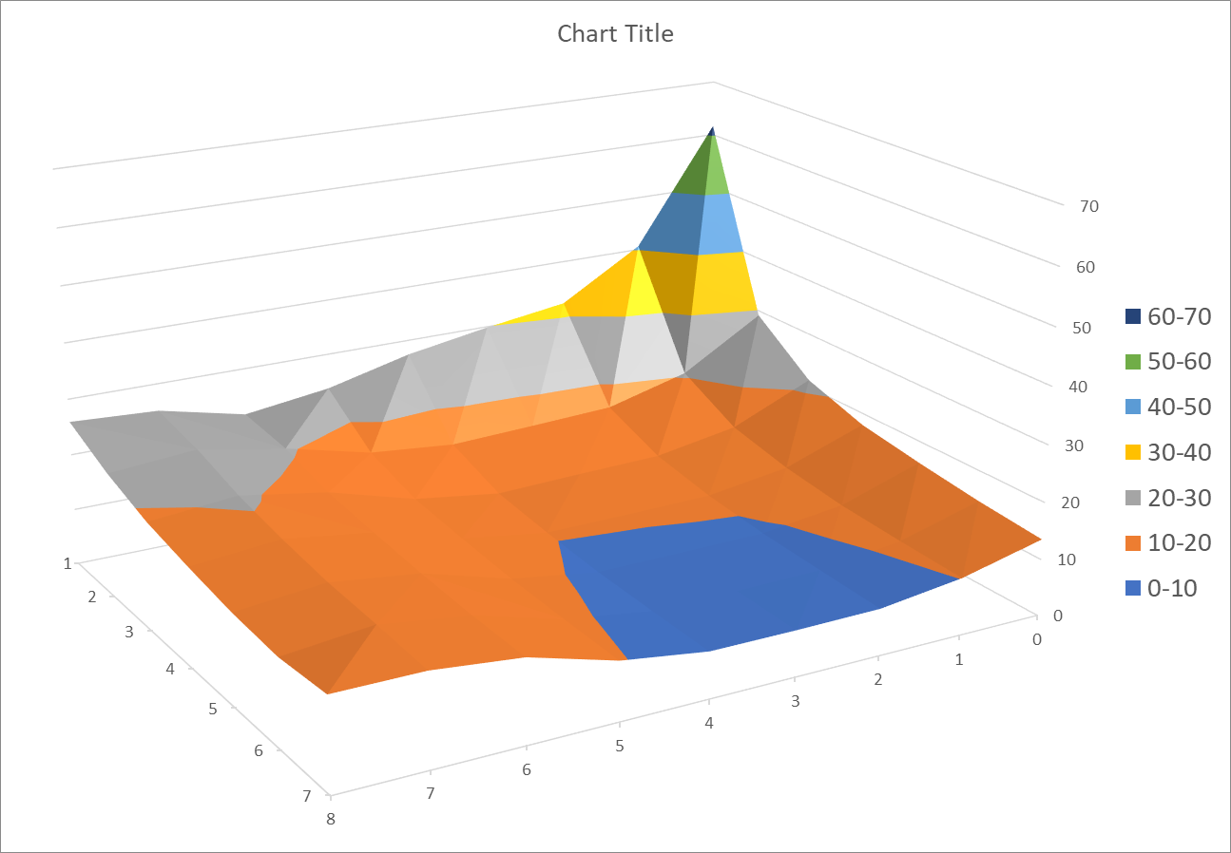

N = 150
k = 8
npt = 10
max_level = 30
thresh = ${10}^{−15}$
Time Analysis for different tile
Speedup = x4.6
Minimum = 8.03 s
Vec = 3 Tree = 7
Vector size
Subtree size

Slide 46
Conclusions
CnC programs could be effectively tiled to improve performance
Interesting shape of tiles in more dimensions
Tilling of data will even more increase speedup

Slide 47
Further research
Implementing automatic Tiling managed by Runtime
Implementation of other operators
Method of fusing in operators together
Implementation of multi variable functions tilling
Notes:
1) Add: refine all subtrees in vector tile to look the same, so as to have simpler computation in automatic implementation
Take advantage of approximate nature of problem match subtrees and made computation even more simpler (Complete tiles)

Slide 48
Q&A?

