Slide 1






RGB-D Workshop on
3D Perception in Robotics
Organizers:
Dejan Pangercic, Jürgen Sturm,
Michael Beetz, Daniel Cremers, Wolfram Burgard
Date and Place:
Friday afternoon (13:00-18:00), Room 4
IAS
Intelligent
Autonomous
Systems
Computer Vision and Pattern Recognition

Slide 2
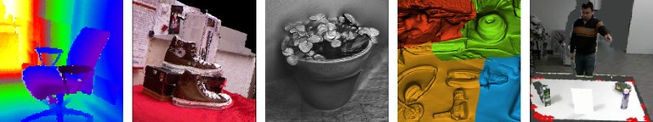
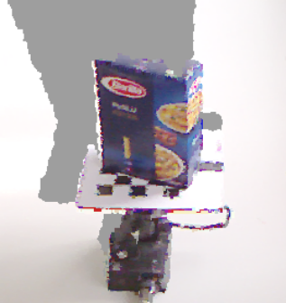
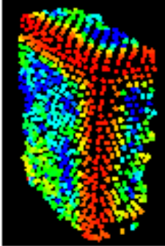
Wrap-up
RGB-D information facilitates with perception problems in robotics:
  Interest points and feature descriptors
  Simultaneous localization and mapping
  Collision avoidance and visual navigation
  Object recognition and localization
  Datasets
  Discussion

Slide 3
Upcoming RGB-D Events
Workshops
  RSS Workshop on RGB-D: Advanced Reasoning with Depth Cameras (27.6.2011)
  RSS Tutorial on 3D Point Cloud Processing (1.7.2011)
  ICCV Workshop on Consumer Depth Cameras for Computer Vision (12.11.2011)
Summer Schools and Challenges
  ICRA Challenge: Solutions in Perception (9.-13.05.2011)
  BRICS Research Camp “From 3D robot sensing to 3D models” (23.-27.05.2011)

Slide 4
Discussion
Scope and impact of RGB-D in robotics
Does RGB-D really improve the accuracy, robustness, stability?
Limits of current RGB-D technology (outdoor, transparency, ..)
Open-source in RGB-D perception
Community-building in RGB-D perception? How can computer vision learn from solutions in robotics? What solutions exist in the field of computer vision?

Slide 5
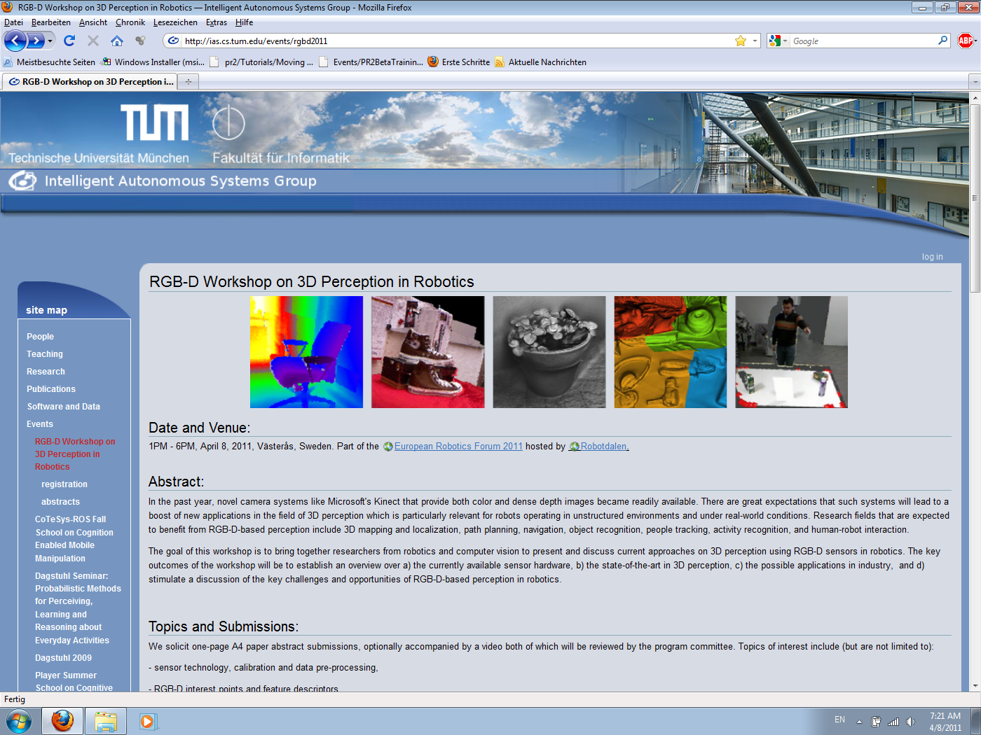
Workshop Website http://ias.cs.tum.edu/events/rgbd2011)
Online proceedings (pdf)
Contact information
Workshop agenda

Slide 6
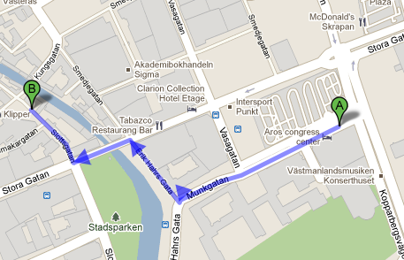
Thank you!
Thanks to all the speakers, poster presenters, demos, lively discussion, …
å Restaurant
Slottsgatan 6
72216 Västerås

