Slide 1






RGB-D Workshop on
3D Perception in Robotics
Organizers:
Dejan Pangercic, Jürgen Sturm,
Michael Beetz, Daniel Cremers, Wolfram Burgard
Date and Place:
Friday afternoon (13:00-18:00), Room 4
IAS
Intelligent
Autonomous
Systems
Computer Vision and Pattern Recognition

Slide 2
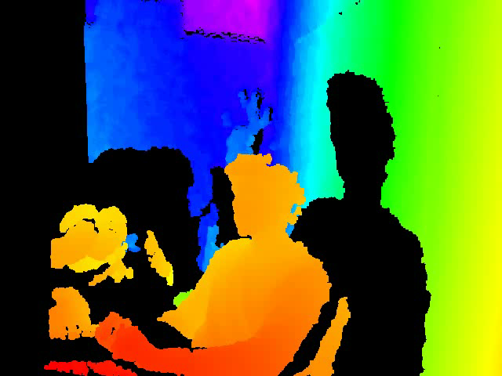
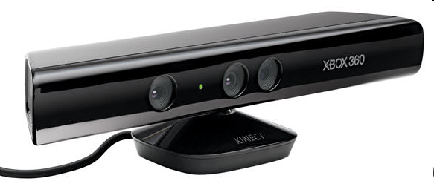
Motivation
New and inexpensive sensors provide color (RGB) and depth (D) images at video frame rates
This allows for novel approaches in perception!
Microsoft Kinect
RGB-D Workshop on 3D Perception in Robotics (Friday afternoon, Room 4)

Slide 3
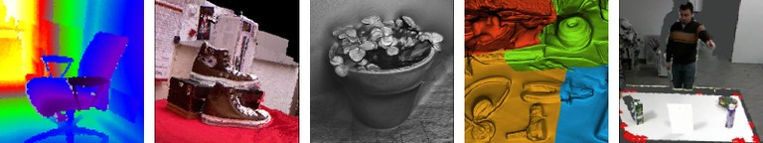
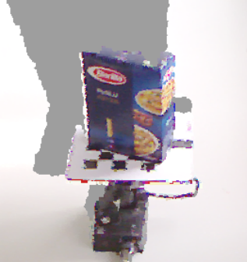
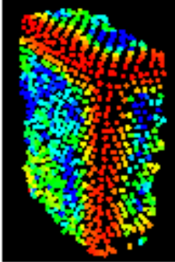
Topics covered by this workshop:
Sensor models and calibration
2.5D interest points and feature descriptors
3D reconstruction
Simultaneous localization and mapping (visual SLAM)
Object recognition and localization
8 talks, 6 posters, and several live demos!
RGB-D Workshop on 3D Perception in Robotics (Friday afternoon, Room 4)

