Slide 1






RGB-D Workshop on
3D Perception in Robotics
Organizers:
Dejan Pangercic, Jürgen Sturm,
Michael Beetz, Daniel Cremers, Wolfram Burgard
Date and Place:
Friday afternoon (13:00-18:00), Room 109
IAS
Intelligent
Autonomous
Systems
Computer Vision and Pattern Recognition

Slide 2
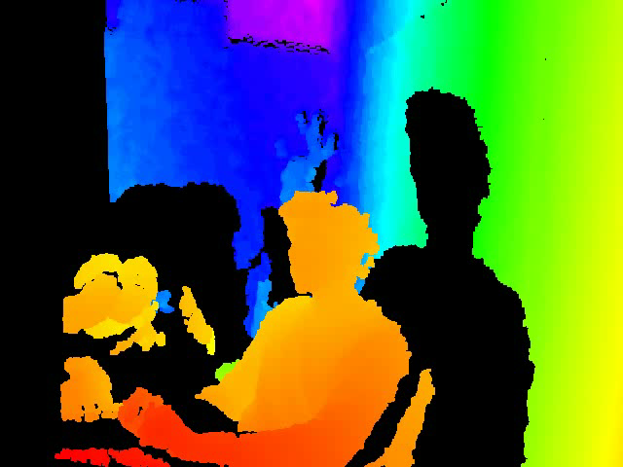
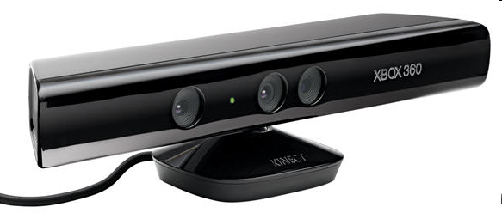
Motivation
New sensors provide color (RGB) and depth (D) video
This allows for novel approaches to perception in robotics!
RGB-D Workshop on 3D Perception in Robotics (Friday afternoon, Room 4)

Slide 3
How does the Kinect sensor work?
“stereo” Baseline
Infrared
pattern
projector
Infrared
camera
Color
camera

Slide 4
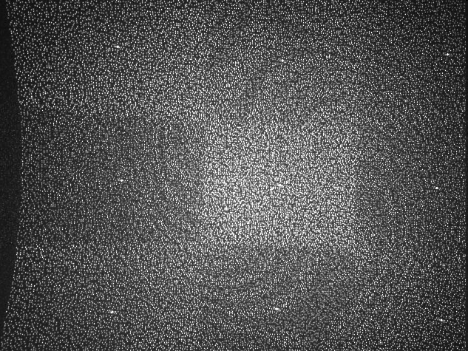
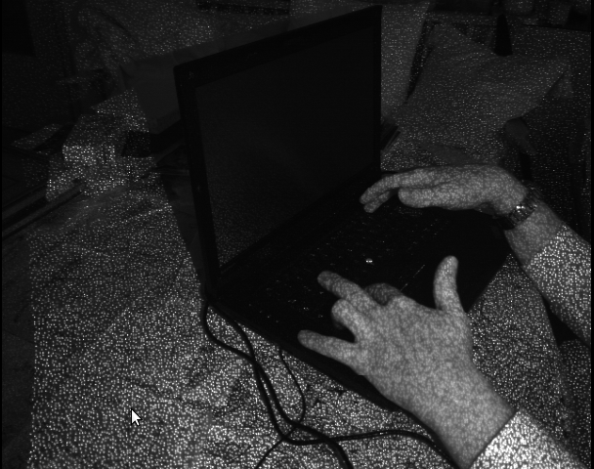
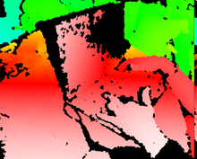
How does the Kinect sensor work? (2)
Infrared pattern (projected, known)
Infrared image (projectively distorted)
Standard
block matcher
(7x7)
Disparity image
Depth image
(color encodes distance from camera)

Slide 5
RGB-D Sensors
Tilting laser scanner + color camera
Stripe laser + color camera
Time-of-flight (SwissRanger)
Stereo camera (Bumblebee, Videre)
Projected Texture Stereo (as used in PR2)
Structured light (Primesense/Kinect)

Slide 6
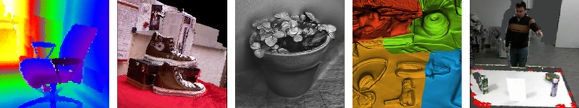
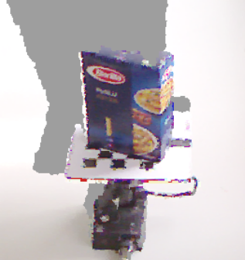
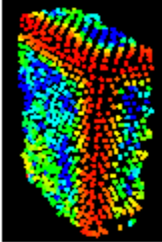
Challenges
How can RGB-D sensing facilitate in solving hard perception problems in robotics?
  Interest points and feature descriptors?
  Simultaneous localization and mapping?
  Collision avoidance and visual navigation?
  Object recognition and localization?
  Human-robot interaction?
8 talks, 6 posters, several live demos thereof!

Slide 7
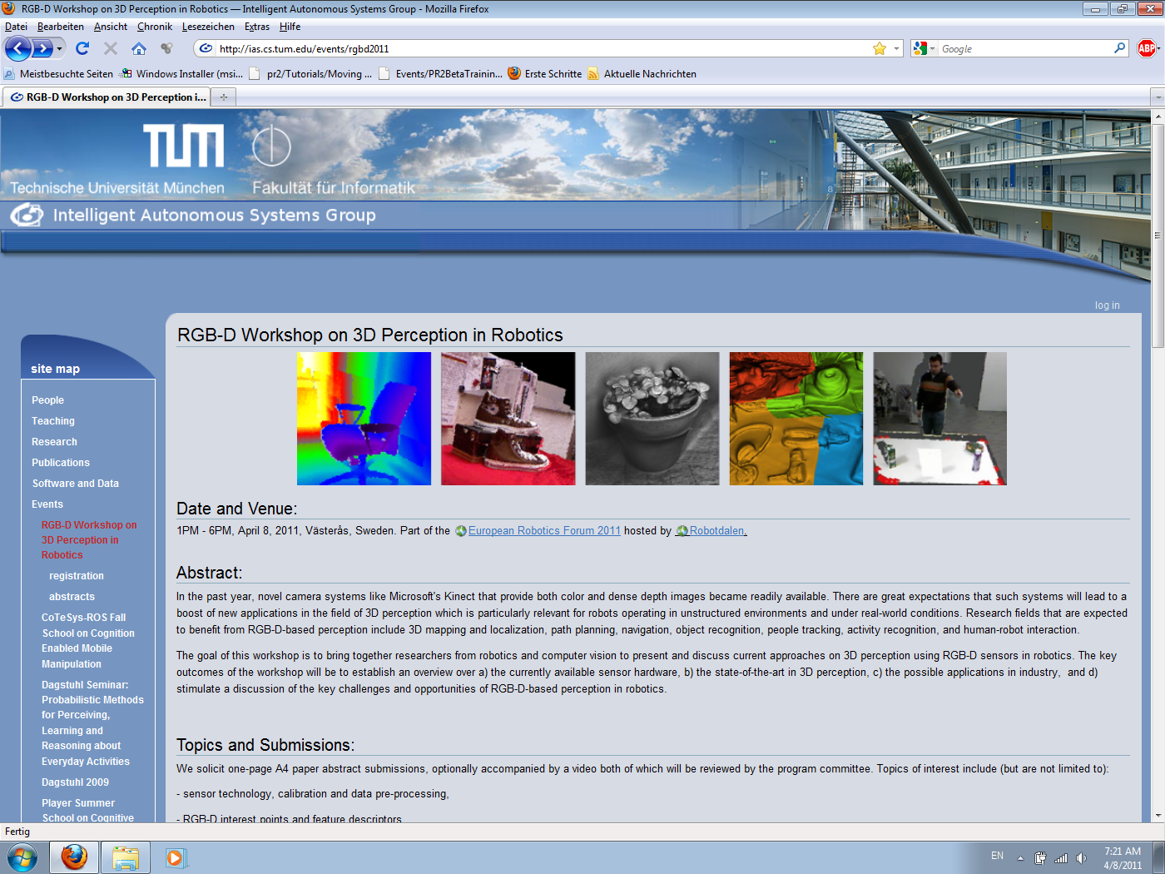
Workshop Website http://ias.cs.tum.edu/events/rgbd2011)
Online proceedings (pdf)
Contact information
Workshop agenda

Slide 8
Agenda
(see also: http://ias.cs.tum.edu/events/rgbd2011)
13:00 – 15:00 3D reconstruction, tracking,
visual SLAM
15:00 – 15:30 Coffee break
15:30 – 16:30 Poster and demo session
16:30 – 17:40 Feature descriptors and object recognition
17:40 – 18:00 Wrap-up and discussion
18:30 – Dinner at restaurant

Slide 9
Speakers
Invited Talks:
30 min = 25 min talk + 5 min questions
Contributed Talks:
20 min = 15 min talk + 5 min questions

Slide 10
Agenda (first block)
1:00PM Welcome/Introduction
1:05PM Invited talk: Richard Newcombe - Live Dense Reconstruction with a Single Moving Camera
1:35PM Contributed Paper: FAB-MAP 3D: Topological Mapping with Spatial and Visual Appearance (R. Paul and P. Newman)
1:55PM Contributed Paper: A test bench to improve registration using RGB-D sensors (F. Pomerleau, S. Magnenat, F. Colas, M. Liu, R. Siegwart)
2:15PM Contributed Paper: Real-time 3D visual SLAM with a hand-held RGB-D camera (N. Engelhard, F. Endres, J. Hess, J. Sturm, W. Burgard)
2:35PM Contributed Paper: Acting and Interacting in the Real World (J. Bohg, N. Bergstrom, M. Bjorkman, D. Kragic)
2:55PM Poster/demo overview

Slide 11
Agenda (Poster Session)
3:30PM Demos + Poster session (1h)
2D/3D Object Categorization for Task Based Grasping (M. Madry, D. Song, D. Kragic)
The Articulated Scene Model: Model-less Priors for Robot Object Learning (A. Swadzba, N. Beuter, S. Wachsmuth, F. Kummert)
Autonomous Corridor Flight of a UAV Using an RGB-D Camera (S. Lange, N. Suenderhauf, P. Neubert, S. Drews, P. Protzel)
Outdoor terrain traversability analysis for robot navigation using a time-of-flight camera (G. De Cubber, D. Doroftei, H. Sahli, Y. Baudoin)
2.5D Local Feature Matching System (E. Strachan, J.P. Siebert)
Evaluation of 3D Model Accuracy for Automated Unloading of Containers (A. Kirchheim, W. Echelmeyer, T. Stoyanov, A. Louloudi, M. Magnusson, A. Lilienthal)

Slide 12
Agenda (second block)
3:30PM Demos + Poster session (1h)
4.30 Invited talk: Kevin Lai - RGB-D Object Dataset and RGB-D Object Recognition, Detection and Pose Estimation
5:00PM Contributed Paper: RGB-D object recognition and localization with clutter and occlusions (F. Tombari, S. Salti, L. Di Stefano)
5:20PM Contributed Paper: Efficient surface and feature estimation in RGBD (Z.-C. Marton, D. Pangercic, M. Beetz)
5:40PM Plenum Discussion (20min)
6.00PM End of Workshop

