Slide 1
NodeJS

Slide 2
What is it?
A platform built on Chrome’s JavaScript runtime environment
An asynchronous event driven framework
Designed for scalable network applications

Slide 3
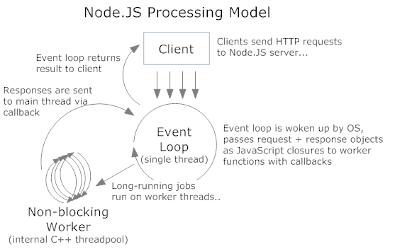
Event model

