Slide 1
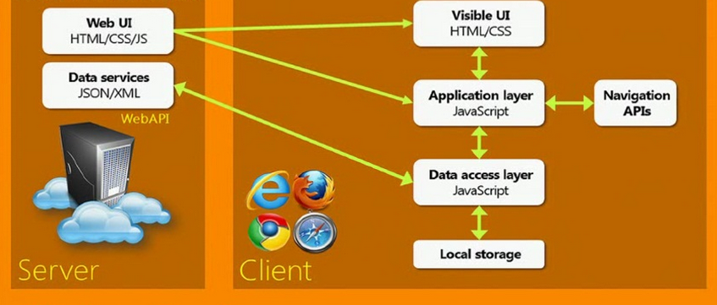
The Single Page App (SPA)
JavaScript does everything (well, almost)
Angular, Ember, React, Backbone etc …

