Slide 1
Why JavaScript?
Why do you need/want to learn this language?

Slide 2
Our view of JS - PAST
It’s quirky!
Looks like a static typed language, but its NOT!
Do more on the server, less JS the better…
Browser compatibility && IE = Chaos.
Sugar on top of server forms, but only if we have to!
Not working? Good luck debugging and finding the typo!
Lack of structure, modular, testable and maintainable code

Slide 3
Our view of JS - Present
Html (web) without JavaScript? You’re kidding right ? ☺
So many great editors. WebStorm, Sublime, Atom, Brackets, VS
So many amazing open source frameworks
Browser support improving. But still a battle..
JavaScript on the server. Why not?
Fast, powerful

Slide 4
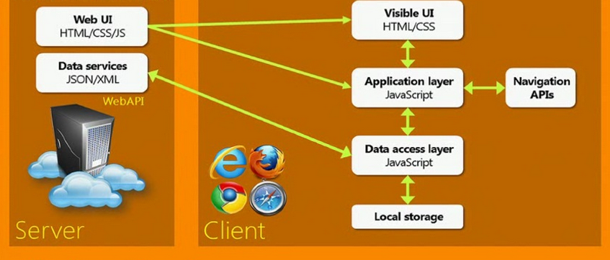
The Single Page App (SPA)
JavaScript does everything (well, almost)
Angular, Ember, React, Backbone etc …

Slide 5
Basics - Primitives
Numbers
Arrays
Strings
Null vs Undefined

Slide 6
Objects, Functions and Prototypes
JavaScript uses prototypes
Object literals == JSON
Accessing properties with arrays

Slide 7
Closures
What is ‘this’?
The window object

Slide 8
Timeouts, intervals & callbacks

