Slide 1
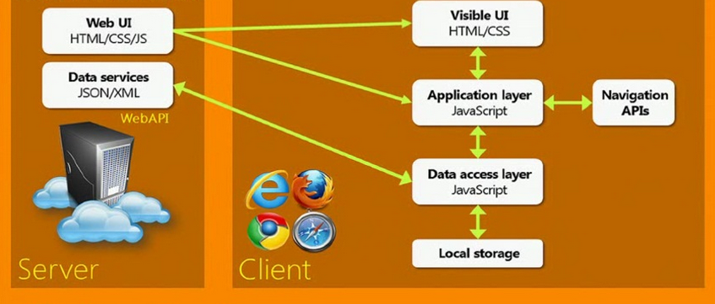
The Single Page App (SPA)
JavaScript does everything (well, almost)
Angular, Ember, React, Backbone etc …

Slide 2
Angular JS
Full MVC (model-view-controller) framework
Modules
Views = two-way binding
Routing
Controllers (no UI logic)
Widgets = directives

Slide 3
Demo

