Slide 1
Big Mountain Resort Ticket Price Analysis
Jianxiong Chen
Nov 13, 2021

Slide 2
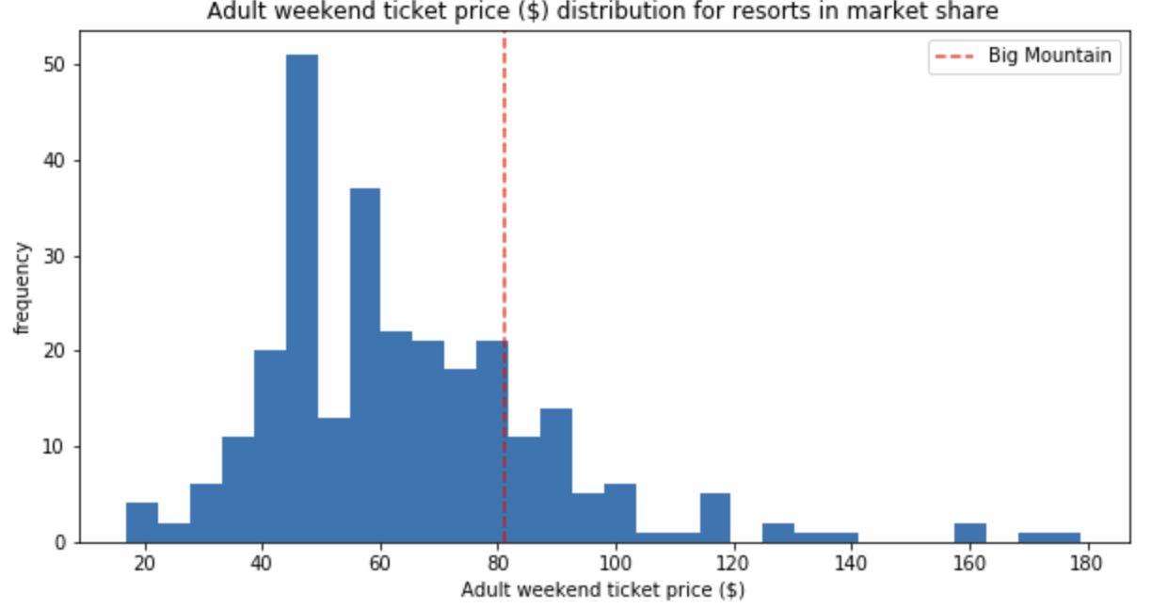
Problem Identification
What is the right ticket price to maximize Big Mountain Resort’s revenue/profit?
- Current price is $81.00 based on the strategy of charging a premium above the average price of resorts in its segment.
- The goal of this project is to build a data-driven model by analyzing data from more than 300 resorts to determine the most optimized ticket price for Big Mountain Resort.

Slide 3
Recommendation and Key Findings
Big Mountain Resort should increase the ticket price by $4.48 to $85.48 to increase the revenue and profit.
Big Mountain resort can consider adding a run, increasing the vertical drop by 150 feet, and installing an additional chair lift, which can support the ticket price to be further increased by $1.99.

Slide 4
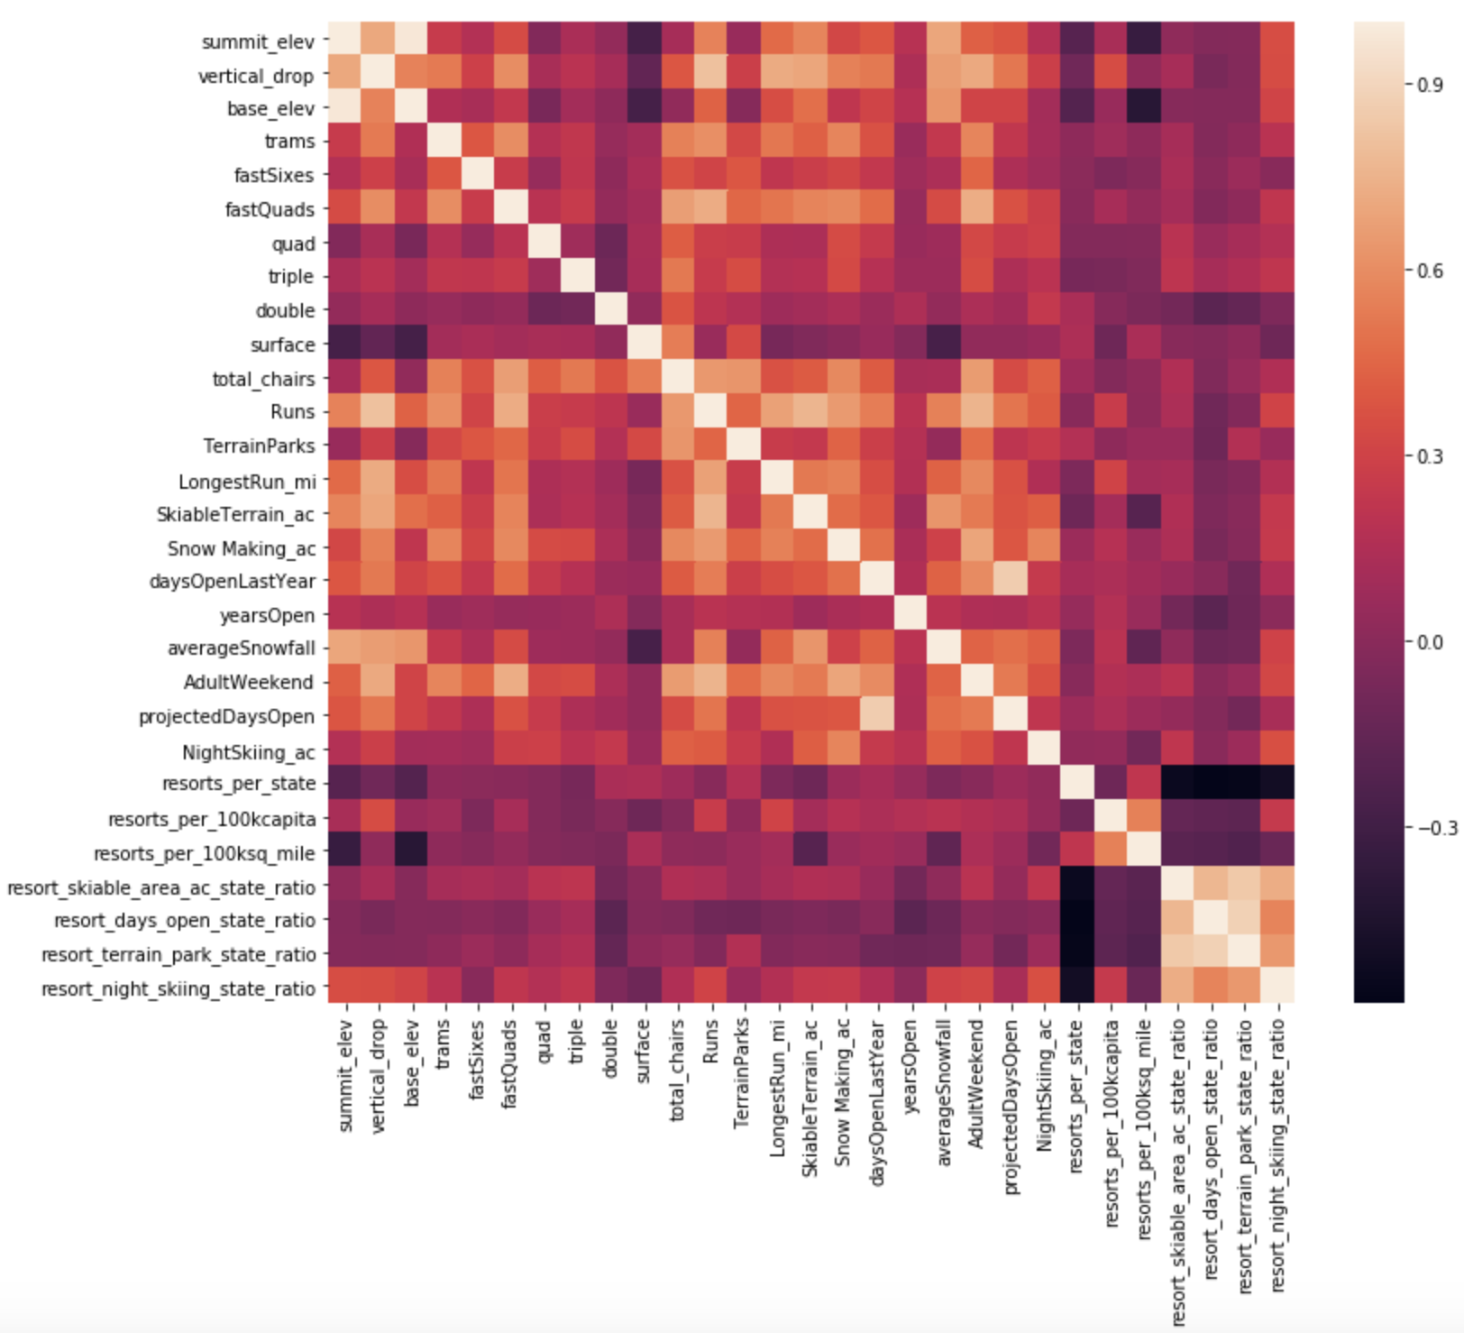
Model Results and Analysis: Input Data
The input data starts with 330 rows and 27 columns
After cleaning, 277 rows and 25 columns left.
Each row represent a resort, and each column represent a feature.
The feature to be predicted is “AdultWeekend” which present the adult ticket price in the weekend.
Ticket Price,
the feature to be modeled and predicted

Slide 5
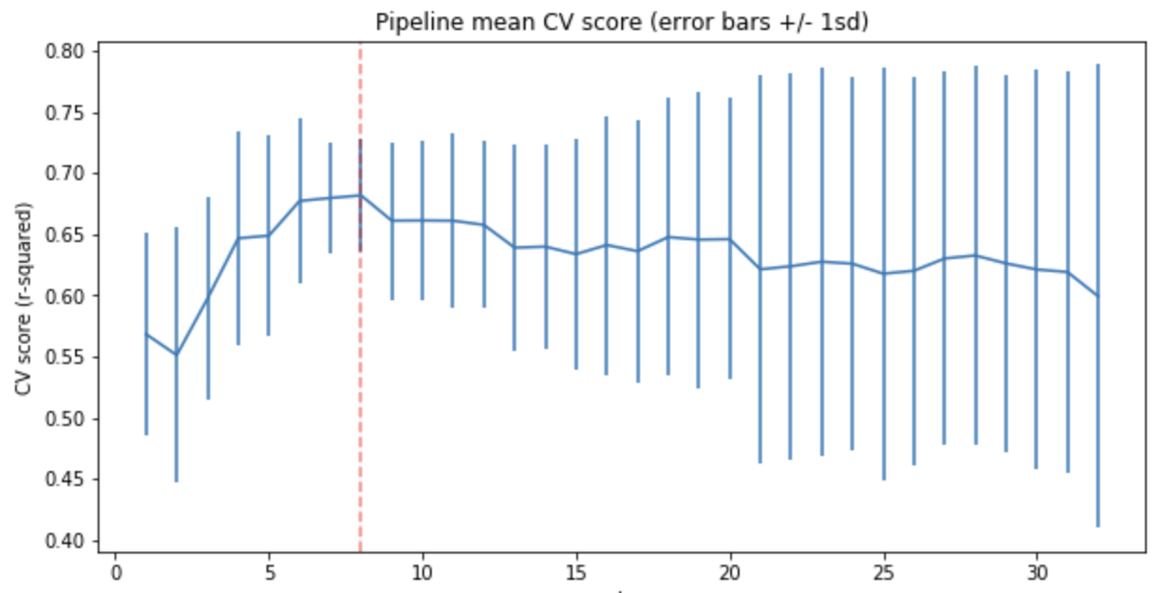
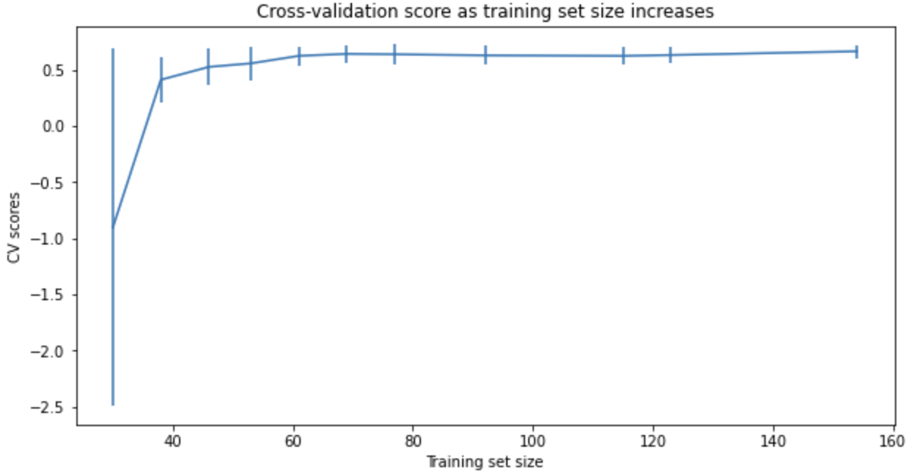
Model Results and Analysis: Model Selection
- Random forest regression model is selected over Linear regression model because of a lower cross-validation mean absolute error, and less variability.
- Eight features are selected to build the random forest regression model.
- It is also confirmed that the training dataset size is sufficient.

Slide 6
Modeling Results and Conclusion
The predicted price using the model and features of Big Mountain Resort is $95.87. Considering that the expected mean absolute error is $10.39. We recommend the ticket price to be $85.48.
Different scenarios are tested to understand how to invest on the facilities to better support the ticket price. We recommend increasing the vertical drop by 150 feet, and installing an additional chair lift, which can support the ticket price to be further increased by $1.99.

