Slide 1
Quality Transformation Strategy for Fintech App
Youverify
Diagnosing Crashes and Ensuring Cross-Device Consistency
Abioye Habib – QA Engineer

Slide 2
The Challenge (Current State)
Current Issues:
Frequent Application Crashes (Stability).
01
Inconsistent User Experience across iOS/Android/Web (UI/UX).
02
High User Churn due to lack of trust in financial transactions.
03
Goal: Reach 99.9% Crash-Free sessions and 100% Functional Consistency.

Slide 3
Phase 1 – Diagnostic Approach
Data-Driven Investigation:
Crash Analytics:
Log Analysis:
Environment Comparison:
User Heatmaps:
Use Sentry or Firebase Crashlytics to pull stack traces.
Audit backend logs (ELK Stack) to find failed API handshakes.
Audit differences between Staging and Production.
Use Hotjar or FullStory to see exactly where users are clicking before a crash.

Slide 4
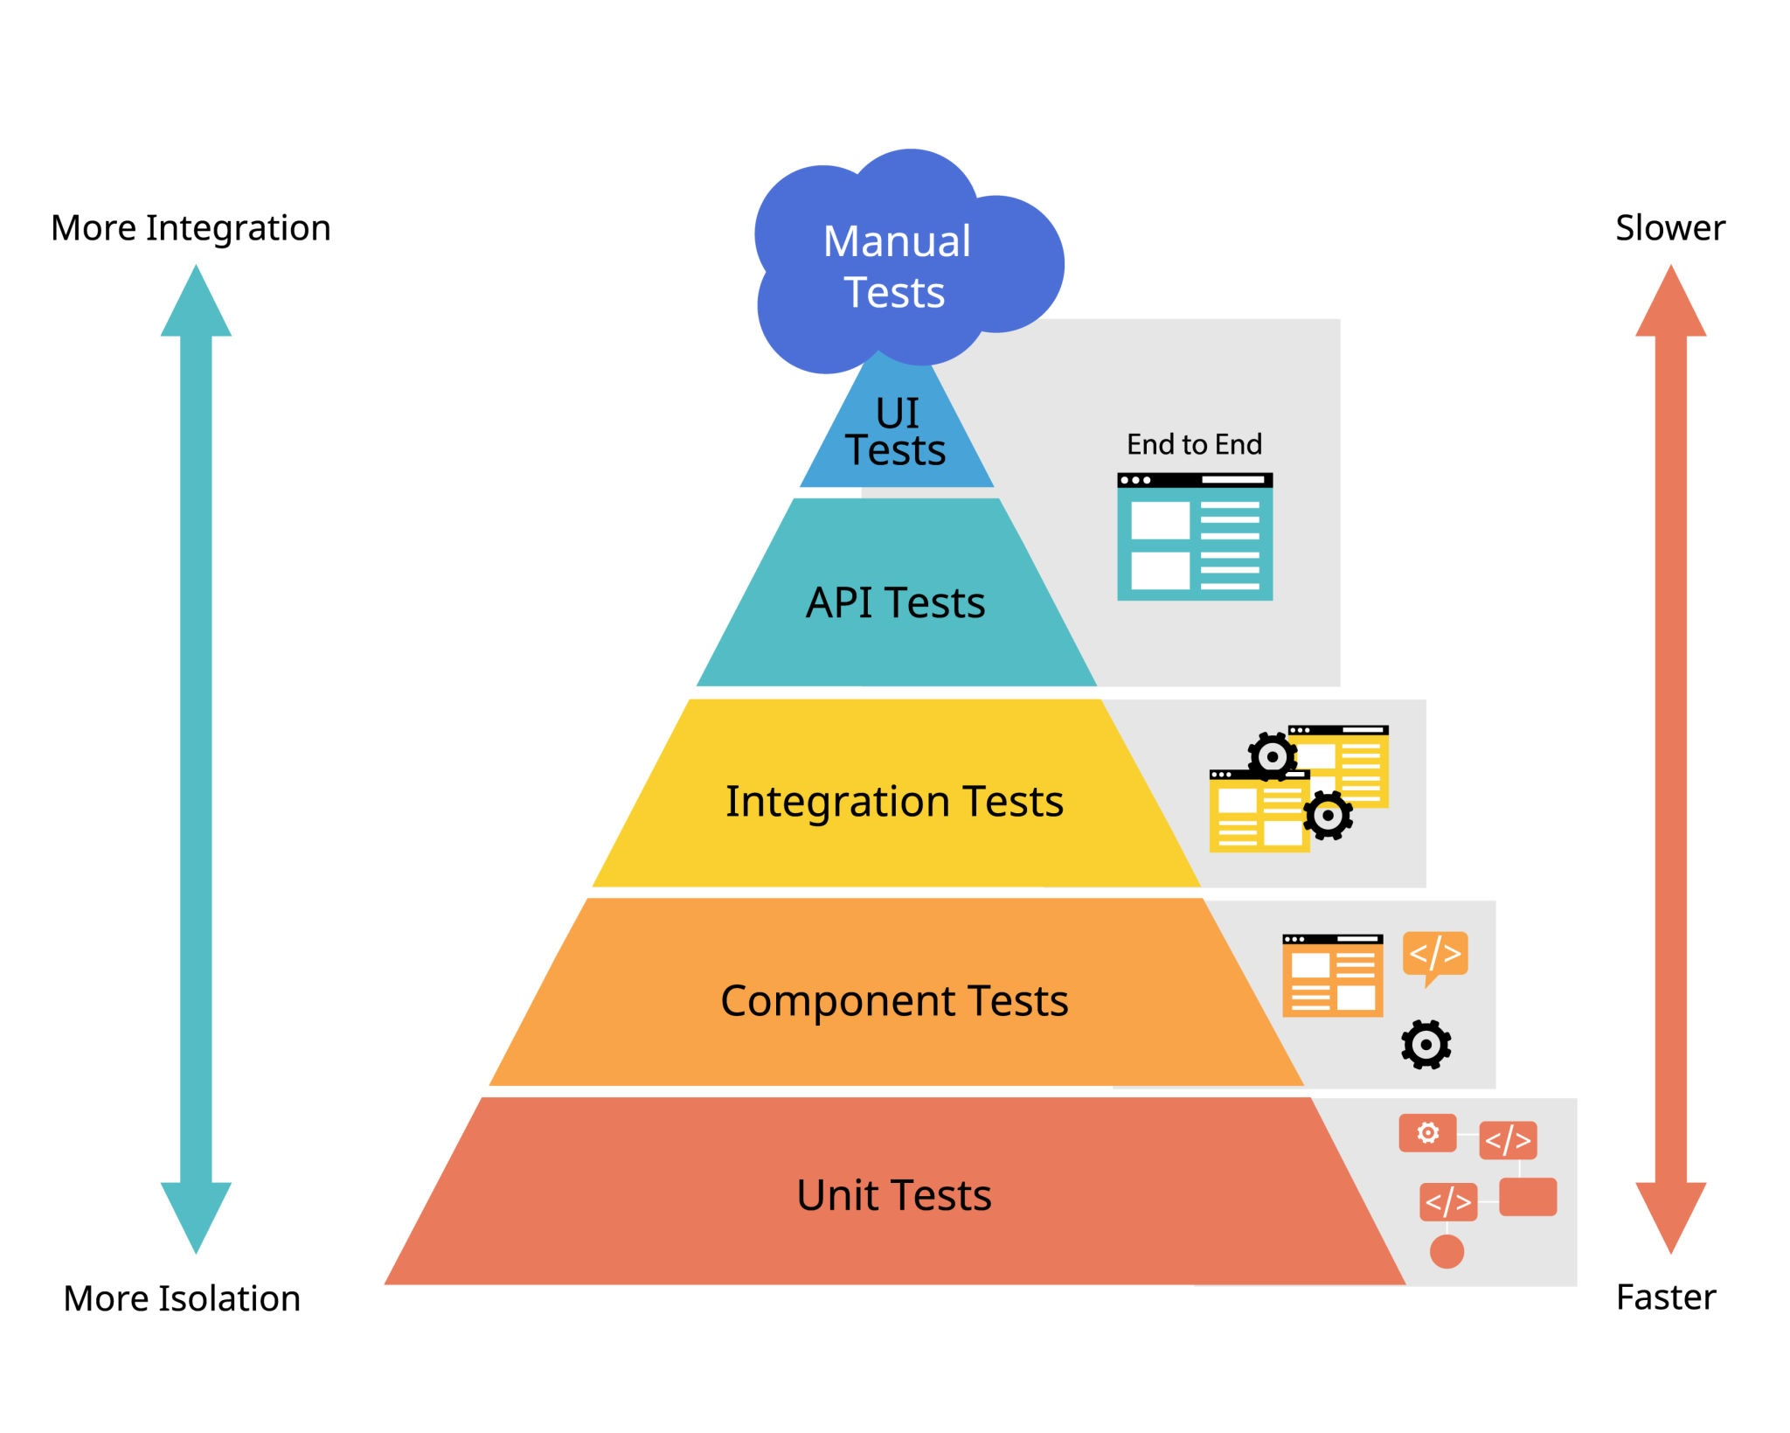
Date
The Test Strategy (The Pyramid)
Unit Tests (60%): Validating core fintech logic (Interest calcs, currency conversion).
Integration Tests (30%): Ensuring the Frontend, Payment Gateway, and Database communicate correctly.
E2E UI Tests (10%): High-value user journeys (Onboarding, Sending Money).

Slide 5
Date
Addressing Device Inconsistency
Cloud Device Farm: Implement BrowserStack or LambdaTest to run tests on 2000+ real device/OS combinations.
Visual Regression Testing: Use Applitools or Percy to automatically detect if a button is "off-pixel" on an iPhone SE vs. a Galaxy S24.
Responsive Breakpoint Audit: Enforce strict CSS standards for mobile, tablet, and desktop views.

Slide 6
Date
Automated Testing Framework
Framework: Cypress (Web) / Appium (Mobile).
CI/CD Integration: Tests run automatically on GitHub Actions or Jenkins.
Shift-Left: Testing starts at the "Requirement" phase, not at the end of development.

Slide 7
Manual & Exploratory Testing
Ad-hoc Testing: Dedicated "Bug Bashes" where the team tries to break new features.
Accessibility (A11y): Ensuring the app is usable for users with visual impairments (Crucial for Fintech inclusivity).
Localization (L10n): Checking that currency symbols and date formats change correctly by region.

Slide 8
Performance & Stress Testing
Load Testing: Simulating 10,000+ concurrent users to ensure the "Core Banking System" doesn't buckle.
Stress Testing: Finding the "Breaking Point" to establish auto-scaling rules for servers.
Tooling: k6 or JMeter.

Slide 9
Recommendations for Long-term Quality
Code Review Culture: Mandatory QA review of "Testability" before code merge.
Observability: Moving from "Reactive" (fixing bugs users report) to "Proactive" (fixing bugs the logs show before users notice).
Zero-Debt Policy: Dedicating 20% of every "Sprint" to fixing technical debt and bugs.

Slide 10
Conclusion & Next Steps
Immediate Action (Next 48 Hours): Implement Sentry and identify the Top 3 crash causes.
Short Term (2 Weeks): Automate the "Happy Path" (Login -> Transfer -> Logout).
Long Term (3 Months): achieve 90% automated regression coverage.
Closing Quote: "In Fintech, Quality is not just a feature; it is the foundation of Trust."

