Slide 1
An Intelligent Traffic Light System for Urban Intersections Using Deep Reinforcement Learning
A Case Study of Lagos Traffic
Oluwadamilola Samson Oladejo | 21120612543
Computer and Information Sciences Department School of Science and Technology, Pan-Atlantic University Supervisor: [Supervisor's Name] July 2026
Notes:
Good day, panel. My name is Oluwadamilola Oladejo. My final year project is an intelligent traffic light system that uses deep reinforcement learning to control signals adaptively, using one of the busiest junctions in Ikeja, Lagos, as a case study. Over the next ten minutes I will cover the problem, my approach, my results, and the honest conclusions.

Slide 2
Introduction — Background
• Lagos is ranked among the most traffic-congested cities in the world (traffic index ~354).
• Commuters lose several hours daily; congestion costs the economy an estimated ₦4 trillion/year.
• Congestion also raises fuel use, emissions and air pollution across the city.
• Most Lagos junctions run on FIXED-TIME signals — pre-set timers that ignore live traffic.
• Advances in AI and reinforcement learning create an opportunity for adaptive signal control.
Intelligent Traffic Light System using Deep Reinforcement Learning
2
Notes:
Lagos is consistently ranked among the world's worst cities for traffic. Beyond the daily frustration, congestion has huge economic, environmental and health costs. A key reason is that most signals here are fixed-time — they run on timers and cannot react to actual traffic. Meanwhile, AI and reinforcement learning have matured enough to offer a smarter, adaptive alternative. That is the opportunity this project explores.

Slide 3
Problem Statement
• Fixed-time signals do not respond to real-time traffic variation.
– This causes unnecessary delays in off-peak periods and worsens congestion at peak.
• They cannot adapt to changing demand or give priority to emergency vehicles.
• There is a need for a signal controller that adjusts timing from real-time conditions —
– using affordable, accessible technology suited to a city like Lagos.
Intelligent Traffic Light System using Deep Reinforcement Learning
3
Notes:
The core problem is simple: a fixed timer is blind. It gives the same green whether a road is empty or jammed. This wastes time off-peak and makes jams worse at peak, and it cannot prioritise an ambulance. The need, therefore, is an adaptive controller that decides from live conditions — and ideally one that can run on low-cost hardware.

Slide 4
Aim and Objectives
Aim: To model and evaluate an intelligent traffic light system that adjusts signal timing from real-time traffic conditions using reinforcement learning.
• Review existing fixed-time and AI-based traffic light systems.
• Develop a traffic state representation and reward function from camera-style data.
• Implement a Deep Q-Network (DQN) controller to optimise traffic in simulation.
• Build a realistic SUMO simulation of a real intersection with vehicles and demand patterns.
• Integrate camera-based vehicle detection using computer vision (YOLO).
Intelligent Traffic Light System using Deep Reinforcement Learning
4
Notes:
The aim was to model and evaluate an adaptive, RL-based traffic light system. I broke this into five objectives: review the field; design the state and reward; implement a DQN controller; build a realistic SUMO model of a real junction; and integrate YOLO-based vehicle detection so the same controller can run on a camera feed.

Slide 5
Research Questions
• Can a DQN controller reduce vehicle delay and queues versus fixed-time control at a real junction?
• How does it compare against an OPTIMISED fixed timer (Webster) and an ACTUATED controller?
• Does the learned policy GENERALISE across different and unseen demand patterns?
• Under what conditions (demand, signal type) is reinforcement-learning control most beneficial?
Intelligent Traffic Light System using Deep Reinforcement Learning
5
Notes:
These questions guided the work. First — does RL actually beat a fixed timer at a real junction? Second — and more demanding — how does it compare against a Webster-optimised timer and an actuated controller, not just a naive one? Third — does it generalise rather than memorise? And fourth — where exactly is it worth using? I made a point of answering the last two honestly.

Slide 6
Literature Review
• Fixed-time & Webster control: simple and widely used, but blind to real-time demand.
• Actuated control: sensor-based and reactive (serve the longest queue) — strong but rule-based.
• Reinforcement learning: DQN, PressLight (max-pressure), PDLight (dynamic duration) — state of the art.
• Research gap:
– most RL studies use abstract/synthetic networks and weak baselines.
– few validate on a real, geometry-faithful Lagos junction against strong baselines (Webster + actuated)
– using an accumulated-delay metric.
Intelligent Traffic Light System using Deep Reinforcement Learning
6
Notes:
Classical control spans fixed-time, Webster-optimised timing, and actuated control. On the AI side, DQN and pressure-based methods like PressLight and PDLight are state of the art. But most RL papers test on synthetic grids and compare only against weak fixed timers. The gap I target is a rigorous, honest evaluation on a real, validated Lagos junction, against strong baselines, using a delay metric that reflects real driver experience.

Slide 7
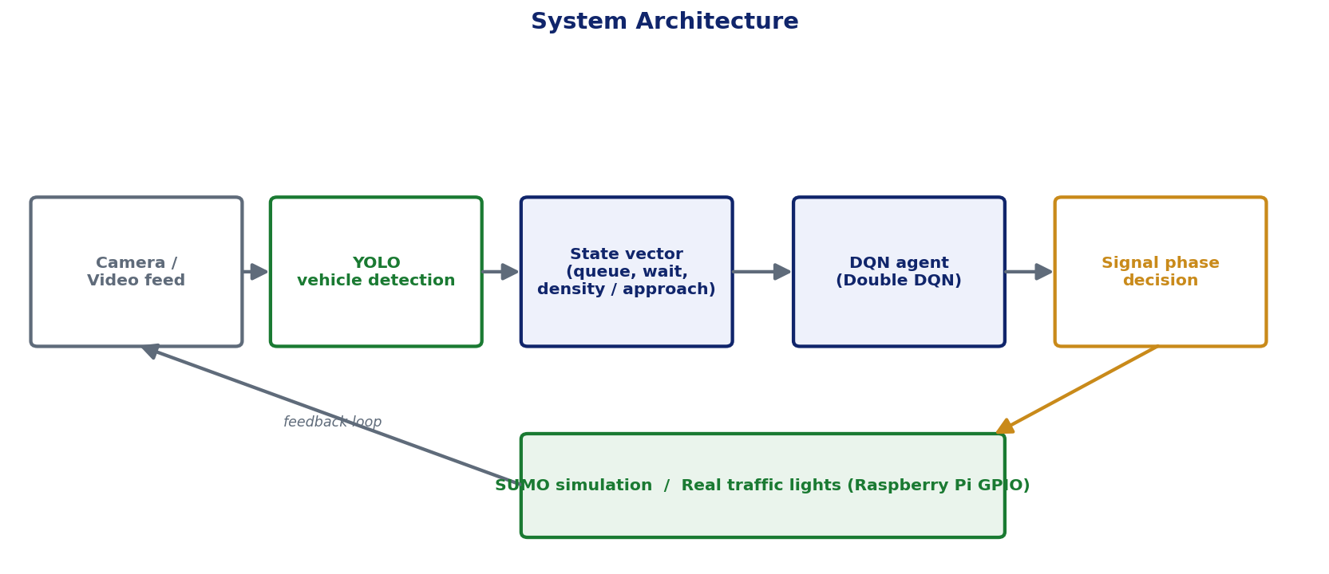
Methodology & System Architecture
• Simulator: SUMO + TraCI (microscopic).
• Junction: Obafemi Awolowo Way × Allen Ave, Ikeja — from OpenStreetMap, validated vs satellite.
• Perception: YOLO vehicle detection.
• Controller: Double DQN + prioritised replay.
• Baselines: fixed-time, Webster, actuated.
Intelligent Traffic Light System using Deep Reinforcement Learning
7
Notes:
My method combines three things. SUMO, a microscopic simulator, provides the training environment via the TraCI interface. The junction is a real one in Ikeja, exported from OpenStreetMap and corrected against satellite imagery. YOLO provides vehicle detection for live use. The controller is a Double DQN with prioritised replay. As the diagram shows, the camera or simulator produces a state, the DQN chooses a phase, and that drives the signal — a closed feedback loop. I compare against three baselines, including the strong ones.

Slide 8
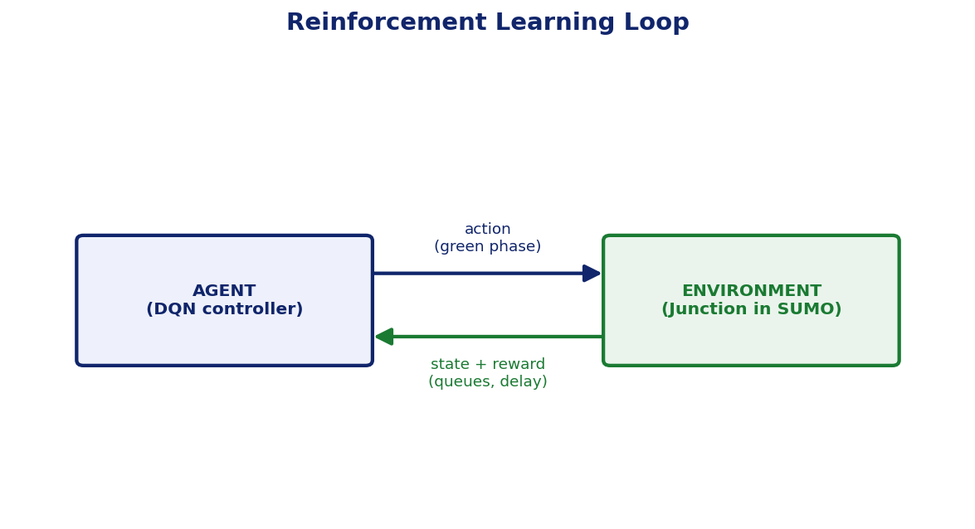
System Design & Implementation
• State (14 features): queue, accumulated wait, density per approach + current phase.
• Action: choose the green phase (2-phase or 4-phase signal).
• Reward: −(queue + weighted accumulated wait) − switch penalty.
• Learning: ε-greedy exploration, target network, γ = 0.99.
• Stack: Python, PyTorch, Ultralytics YOLO, SUMO; Raspberry Pi + GPIO for deployment.
Intelligent Traffic Light System using Deep Reinforcement Learning
8
Notes:
On design: the agent observes 14 numbers — queue, accumulated waiting time and density for each approach, plus the current phase. Its action is which phase to make green. The reward penalises queues and accumulated delay, with a small penalty for switching to avoid unsafe flicker. Learning uses standard DQN machinery. The whole thing is built in Python with PyTorch, YOLO and SUMO, and is designed to deploy on a Raspberry Pi driving real lights through its GPIO pins.

Slide 9
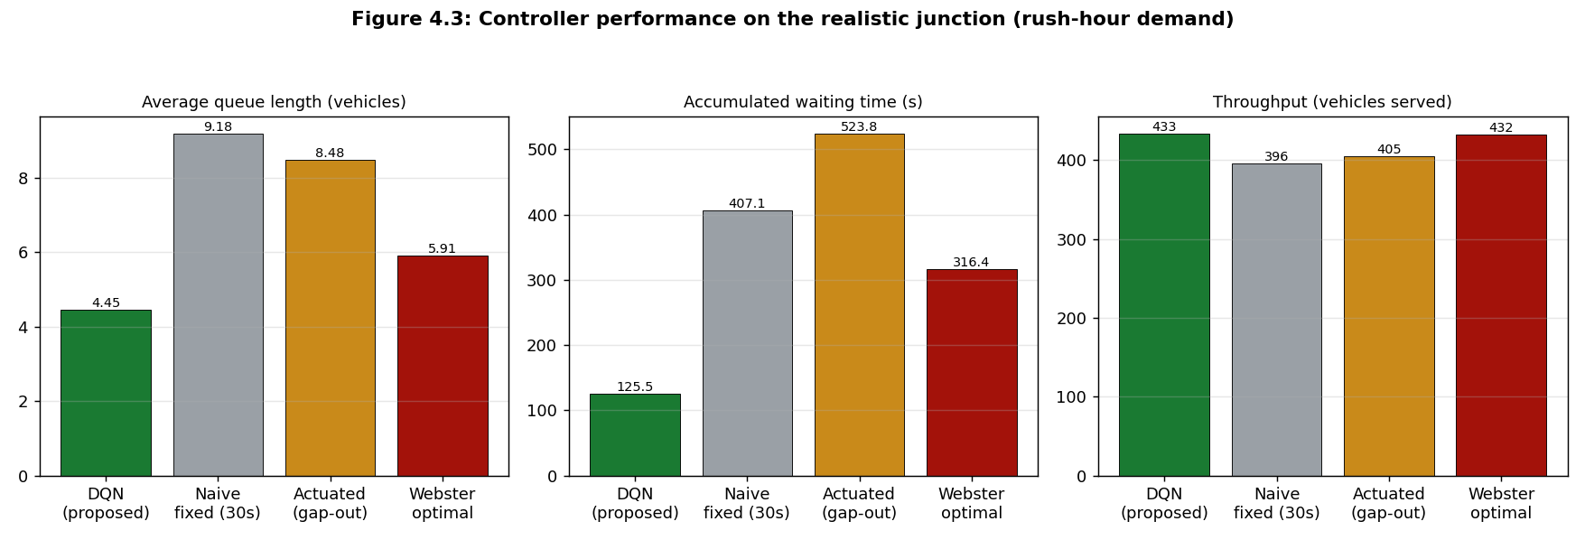
Results — Two-Phase Control
• On a CONVENTIONAL two-phase signal, the DQN beat EVERY baseline.
• Rush-hour accumulated delay reduced by:
– −69% vs naive fixed-time
– −60% vs Webster-optimal
– −76% vs actuated control
• Lower queues AND higher throughput.
Intelligent Traffic Light System using Deep Reinforcement Learning
9
Notes:
Here are the headline results on the two-phase signal. The chart shows queue, accumulated delay and throughput for each controller under rush-hour demand. The DQN — the green bar — has the lowest queue and delay and the highest throughput. Against the naive timer it cuts delay by 69 percent, against an optimised Webster timer by 60 percent, and against a competent actuated controller by 76 percent. Crucially it wins on all demand patterns, not just this one.

Slide 10
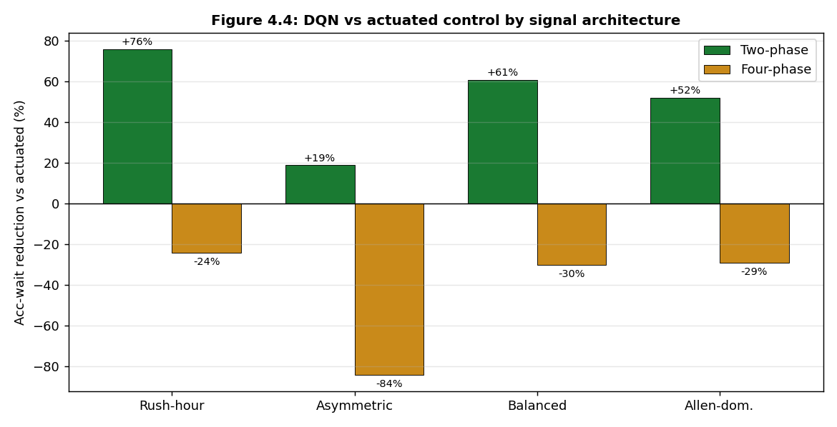
Results — Effect of Signal Architecture
• Two-phase: DQN beats fixed-time, Webster AND actuated (all demand).
• Four-phase (protected): DQN beats fixed-time & Webster everywhere…
– …but a near-optimal actuated controller stays ahead.
• Honest, literature-consistent boundary —
– even PressLight & PDLight did not beat actuated at a single junction.
Intelligent Traffic Light System using Deep Reinforcement Learning
10
Notes:
This slide is about honesty and nuance. The chart compares the DQN against the actuated controller for both signal types. On two-phase signals — the green bars — the DQN wins everywhere. On four-phase protected signals — the amber bars — it still beats fixed-time and Webster, but the actuated controller is better. I even implemented the state-of-the-art PressLight and PDLight methods, and they did not beat actuated at a single junction either. That matches the literature, which says their advantage appears across coordinated networks. Reporting this boundary makes the result trustworthy.

Slide 11
Discussion
• The DQN's advantage is REAL-TIME RESPONSIVENESS — it never wastes green on an empty approach.
• Gains are largest under imbalanced/variable demand; smallest under balanced, steady demand.
• For protected 4-phase junctions, a simple actuated rule is already near-optimal.
• Findings align with traffic-engineering theory and meet all five project objectives.
• Practical guidance: deploy RL on conventional two-phase junctions under heavy Lagos peak demand.
Intelligent Traffic Light System using Deep Reinforcement Learning
11
Notes:
Why does it work? Because the agent reacts to the live state and never wastes green on an empty road. Its gains are biggest exactly where fixed timers struggle — imbalanced, variable demand. Where demand is balanced or the signal is a saturated four-phase one, the simple actuated rule is already near-optimal. All of this is consistent with traffic theory, and it gives a clear deployment message: use RL on two-phase junctions under heavy, imbalanced peak demand, which is exactly the Lagos case.

Slide 12
Challenges and Limitations
• Policy collapse: the agent first learned to serve one approach only.
– Diagnosed as a state–reward mismatch (partial observability); fixed by exposing accumulated wait in the state.
• Simulation-based evaluation; demand estimated, not measured at the junction.
• Single junction studied — corridor (multi-junction) coordination not addressed.
• Actuated control superior on four-phase signals; YOLO accuracy not yet quantified in the field.
Intelligent Traffic Light System using Deep Reinforcement Learning
12
Notes:
The main technical challenge was a policy collapse: the agent learned to serve only one approach and starve the other. I traced this to a subtle flaw — the reward penalised accumulated delay, but the state only showed instantaneous delay, so the agent was punished for something it could not see. Exposing accumulated delay in the state fixed it. Honest limitations: it is simulation-based with estimated demand; it is a single junction; actuated wins on four-phase; and I have not yet measured YOLO's accuracy in the field.

Slide 13
Conclusion
• On two-phase control, the DQN cut accumulated delay by 16–76% versus fixed-time, Webster AND actuated — on every demand pattern.
• On four-phase control, it beat fixed-time and Webster; a gap-out actuated controller remained best.
• Its core advantage is responsiveness to real-time variation that no fixed plan can match.
• Reinforcement learning is most valuable for two-phase junctions under heavy, imbalanced Lagos peak traffic.
Intelligent Traffic Light System using Deep Reinforcement Learning
13
Notes:
To conclude: on conventional two-phase control my agent reduced accumulated delay by between 16 and 76 percent against fixed-time, Webster and actuated baselines, on every demand pattern. On four-phase control it beat the fixed timers, while actuated remained best. Its advantage is responsiveness. The clear, honest takeaway is that reinforcement learning is most valuable for two-phase junctions under the heavy, imbalanced demand that defines Lagos rush hour.

Slide 14
Recommendations & Future Work
• Collect field data: run the project's own YOLO on junction footage to obtain measured demand.
• Extend to corridor (multi-agent) control along Obafemi Awolowo Way — where pressure RL should win.
• Add a throughput-aware / max-pressure term to the reward.
• Robust perception: fine-tune detection for okada and keke under Lagos conditions.
• Hardware pilot: supervised Raspberry Pi + GPIO deployment with a fixed-time safety fallback.
• Implement and evaluate emergency-vehicle preemption.
Intelligent Traffic Light System using Deep Reinforcement Learning
14
Notes:
For future work: first, use my own YOLO module on real footage to replace estimated demand with measured counts. Second, extend to a corridor of signals, where pressure-based RL should finally beat actuated. Third, add a throughput term to the reward. Fourth, harden the vision for motorcycles and tricycles. Fifth, run a supervised hardware pilot. And finally, complete emergency-vehicle priority, which directly addresses the original problem.

Slide 15
References
• Krajzewicz, D., et al. (2012). Recent development and applications of SUMO. Int. J. Adv. Systems & Measurements, 5(3–4), 128–138.
• Mnih, V., et al. (2015). Human-level control through deep reinforcement learning. Nature, 518, 529–533.
• Sutton, R. S., & Barto, A. G. (2018). Reinforcement Learning: An Introduction (2nd ed.). MIT Press.
• Webster, F. V. (1958). Traffic Signal Settings. Road Research Technical Paper No. 39. HMSO.
• Wei, H., et al. (2019). PressLight: Learning max pressure control to coordinate traffic signals. KDD 2019.
• Zhang, C., et al. (2020). PDLight: DRL traffic light control with pressure and dynamic duration. arXiv:2009.13711.
Intelligent Traffic Light System using Deep Reinforcement Learning
15
Notes:
These are the key references in APA format: the SUMO simulator, the original DQN paper by Mnih and colleagues, Sutton and Barto's reinforcement-learning textbook, Webster's classical signal-timing method, and the two state-of-the-art methods I implemented, PressLight and PDLight.

Slide 16
Thank You
Questions & Discussion
Oluwadamilola Samson Oladejo | dejodammy7@gmail.com
Notes:
Thank you for your attention. I am happy to take any questions, and I would be glad to walk through the live simulation, the training curves, or the diagnostic finding in more detail.

