Slide 1
FINAL YEAR PROJECT · DEFENSE
An Intelligent Traffic Light System Using Deep Reinforcement Learning
A Case Study of Lagos Traffic
Oluwadamilola Samson Oladejo · 21120612543
Computer & Information Sciences · Pan-Atlantic University
Supervisor: [Supervisor's Name] July 2026
Notes:
Good day, panel. My name is Oluwadamilola Oladejo. My project is an intelligent traffic light system that uses deep reinforcement learning to control signals adaptively, with a busy junction in Ikeja, Lagos, as the case study. I will cover the problem, my approach, my results, and the honest conclusions.

Slide 2
Introduction — Background
#1
~4 hrs
₦4tn
Lagos: among the world's
most congested cities
lost daily by commuters
in traffic
estimated annual loss
in productivity
Most Lagos junctions use FIXED-TIME signals — pre-set timers that ignore live traffic.
1
Congestion drives higher fuel use, emissions and air pollution.
2
AI and reinforcement learning now make adaptive, self-learning signal control feasible.
3
Intelligent Traffic Light System · Deep Reinforcement Learning
2
Notes:
Lagos is consistently ranked among the world's worst cities for traffic. Commuters lose hours daily and the economy loses trillions of naira, with serious pollution effects. A key reason is that most signals are fixed-time — they cannot react to actual traffic. AI and reinforcement learning now offer a smarter, adaptive alternative, and that is the opportunity this project explores.

Slide 3
Problem Statement
A fixed-time signal is BLIND: it gives the same green whether a road is empty or jammed.
Unnecessary delay off-peak; worse congestion at peak hours.
1
No response to changing demand and no priority for emergency vehicles.
2
Need: an adaptive controller driven by real-time conditions — on affordable hardware.
3
Intelligent Traffic Light System · Deep Reinforcement Learning
3
Notes:
The core problem is that a fixed timer is blind. It gives the same green to an empty road as to a jammed one. This wastes time off-peak, worsens jams at peak, and cannot prioritise an ambulance. So we need an adaptive controller that decides from live conditions, and ideally one that runs on low-cost hardware.

Slide 4
Aim and Objectives
AIM: Model and evaluate an intelligent traffic light system that adjusts signal timing from real-time conditions using reinforcement learning.
Review fixed-time and AI-based traffic light systems.
1
Design a traffic state representation and reward function.
2
Implement a Deep Q-Network (DQN) controller in simulation.
3
Build a realistic SUMO model of a real intersection.
4
Integrate camera-based vehicle detection (YOLO).
5
Intelligent Traffic Light System · Deep Reinforcement Learning
4
Notes:
The aim was to model and evaluate an adaptive, RL-based signal system. I set five objectives: review the field; design the state and reward; implement a DQN controller; build a realistic SUMO model of a real junction; and integrate YOLO vehicle detection so the same controller can run on a camera feed.

Slide 5
Research Questions
Can a DQN reduce delay and queues versus fixed-time control at a real junction?
Q1
How does it compare against an OPTIMISED timer (Webster) and an ACTUATED controller?
Q2
Does the learned policy GENERALISE to different and unseen demand patterns?
Q3
Under which conditions is reinforcement-learning control most beneficial?
Q4
Intelligent Traffic Light System · Deep Reinforcement Learning
5
Notes:
Four questions guided the work. Does RL beat a fixed timer at a real junction? How does it compare to an optimised Webster timer and an actuated controller — not just a naive one? Does it generalise rather than memorise? And where exactly is it worth using? I answered the last two honestly.

Slide 6
Literature Review
Fixed-time & Webster
Actuated control
Reinforcement learning
Simple, widely used — but blind to real-time demand.
Sensor-based; serve the longest queue. Strong but rule-based.
DQN, PressLight, PDLight — state of the art, adaptive.
RESEARCH GAP
Most RL studies use abstract/synthetic networks and weak baselines. Few validate on a real, geometry-faithful Lagos junction against STRONG baselines (Webster + actuated), using an accumulated-delay metric that reflects real driver experience.
Intelligent Traffic Light System · Deep Reinforcement Learning
6
Notes:
Classical control spans fixed-time, Webster timing, and actuated control. On the AI side, DQN and pressure-based methods like PressLight and PDLight are state of the art. But most RL papers test on synthetic grids against weak baselines. My gap is a rigorous, honest evaluation on a real, validated Lagos junction, against strong baselines, with a realistic delay metric.

Slide 7
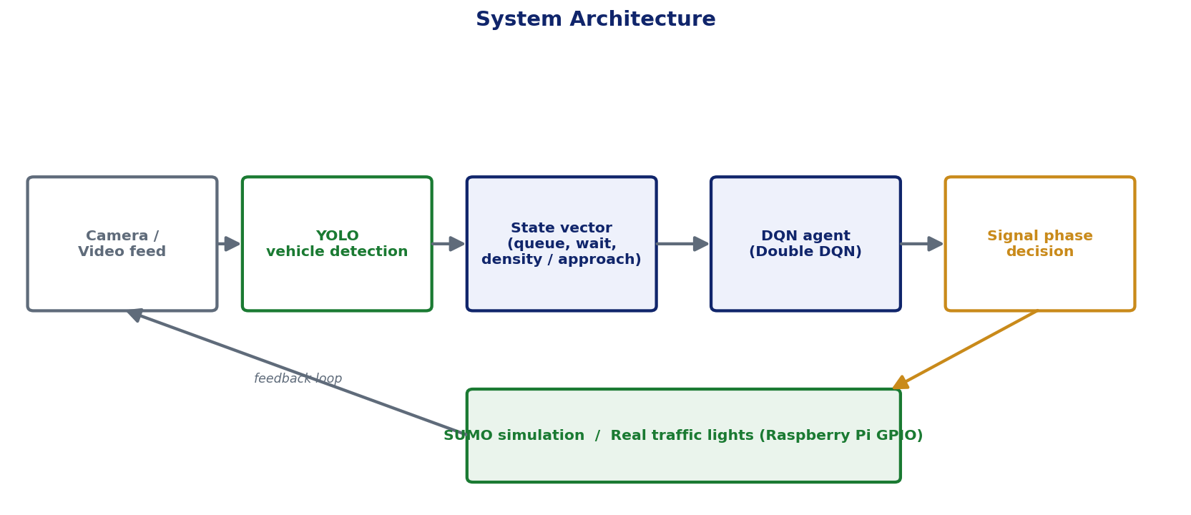
Methodology & System Architecture
SUMO + TraCI
microscopic simulator
Real Ikeja junction
OpenStreetMap, validated vs satellite
YOLO vision
camera-based vehicle detection
Double DQN
+ prioritised experience replay
3 baselines
fixed-time, Webster, actuated
Intelligent Traffic Light System · Deep Reinforcement Learning
7
Notes:
My method combines a microscopic simulator (SUMO via TraCI); a real Ikeja junction exported from OpenStreetMap and corrected against satellite imagery; YOLO for vehicle detection; and a Double DQN controller. As the diagram shows, the camera or simulator produces a state, the DQN chooses a phase, and that drives the signal — a closed feedback loop. I compare against three baselines, including the strong ones.

Slide 8
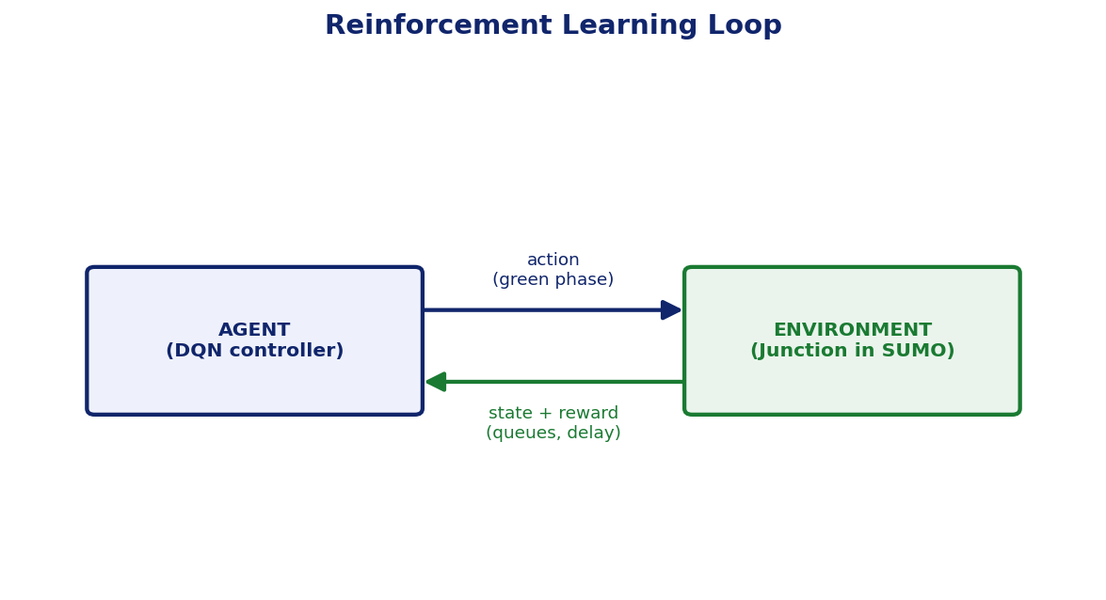
System Design & Implementation
STATE
14 features — queue, accumulated wait, density / approach + phase
ACTION
choose the green phase (2-phase or 4-phase signal)
REWARD
−(queue + weighted accumulated wait) − switch penalty
LEARNING
ε-greedy · target network · γ = 0.99
Stack: Python · PyTorch · YOLO · SUMO · Raspberry Pi/GPIO
Intelligent Traffic Light System · Deep Reinforcement Learning
8
Notes:
The agent observes 14 numbers — queue, accumulated waiting time and density for each approach, plus the current phase. Its action is which phase to make green. The reward penalises queues and accumulated delay, with a small switch penalty to avoid unsafe flicker. It is built in Python with PyTorch, YOLO and SUMO, and designed to deploy on a Raspberry Pi driving real lights via GPIO.

Slide 9
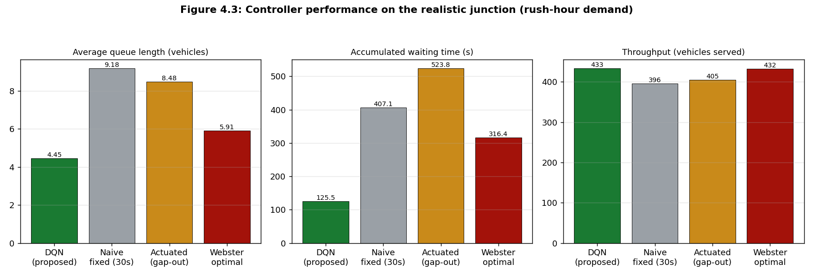
Results — Two-Phase Control
On a conventional two-phase signal, the DQN beat EVERY baseline — lower queues, lower delay, higher throughput.
−69%
delay vs Naive fixed-time
−60%
delay vs Webster-optimal
−76%
delay vs Actuated
Intelligent Traffic Light System · Deep Reinforcement Learning
9
Notes:
Here are the headline two-phase results. The chart shows queue, delay and throughput per controller at rush hour. The DQN has the lowest queue and delay and the highest throughput. It cuts accumulated delay by 69 percent against the naive timer, 60 percent against the optimised Webster timer, and 76 percent against the actuated controller — and it wins on all demand patterns, not just this one.

Slide 10
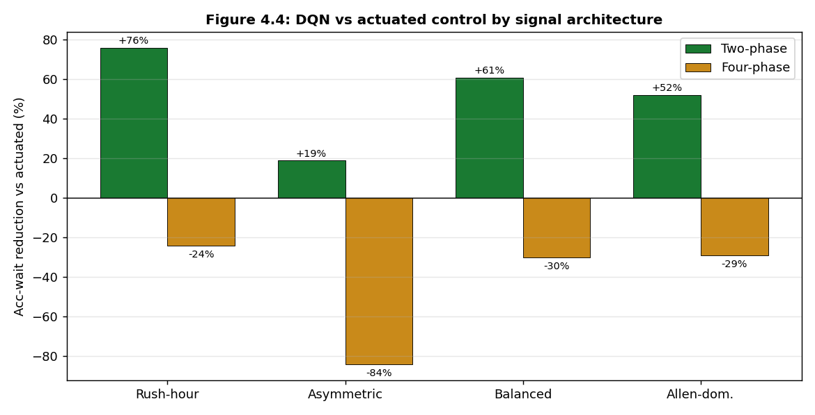
Results — Effect of Signal Architecture
TWO-PHASE
Beats fixed-time, Webster AND actuated — across all demand.
FOUR-PHASE
Beats fixed-time & Webster — but a near-optimal actuated rule stays ahead. Even PressLight & PDLight didn't beat it here. (Honest, literature-consistent.)
Intelligent Traffic Light System · Deep Reinforcement Learning
10
Notes:
This slide is about honest nuance. On two-phase signals — green bars — the DQN wins everywhere. On four-phase protected signals — amber bars — it still beats fixed-time and Webster, but actuated control is better. I even implemented PressLight and PDLight, and they did not beat actuated at a single junction either, which matches the literature. Reporting this boundary makes the result trustworthy.

Slide 11
Discussion
The DQN's edge is REAL-TIME RESPONSIVENESS — it never wastes green on an empty approach.
1
Gains are largest under imbalanced / variable demand; smallest under balanced, steady demand.
2
For protected 4-phase junctions, a simple actuated rule is already near-optimal.
3
Findings align with traffic-engineering theory and meet all five objectives.
4
Deployment guidance: use RL on conventional two-phase junctions under heavy, imbalanced Lagos peak demand.
Intelligent Traffic Light System · Deep Reinforcement Learning
11
Notes:
Why does it work? The agent reacts to the live state and never wastes green on an empty road, so its gains are biggest where fixed timers struggle — imbalanced, variable demand. Where demand is balanced or the signal is a saturated four-phase one, the actuated rule is already near-optimal. This is consistent with theory and gives a clear deployment message: use RL on two-phase junctions under heavy, imbalanced peak demand — exactly the Lagos case.

Slide 12
Challenges & Limitations
KEY CHALLENGE — POLICY COLLAPSE
The agent first learned to serve only one approach. Diagnosed as a state–reward mismatch (partial observability) and fixed by exposing accumulated wait in the state.
Simulation-based; demand estimated, not measured at the junction.
1
Single junction — corridor (multi-junction) coordination not addressed.
2
Actuated superior on 4-phase; YOLO field accuracy not yet quantified.
3
Intelligent Traffic Light System · Deep Reinforcement Learning
12
Notes:
The main challenge was a policy collapse: the agent served only one approach and starved the other. I traced it to a subtle flaw — the reward penalised accumulated delay, but the state only showed instantaneous delay, so the agent was punished for something it could not see. Exposing accumulated delay in the state fixed it. Honest limitations: simulation-based with estimated demand; a single junction; actuated wins on four-phase; and YOLO accuracy is not yet field-measured.

Slide 13
Conclusion
16–76%
4 / 4
Real
delay cut on TWO-PHASE
vs all baselines
demand patterns won
on two-phase
Ikeja junction from
OpenStreetMap
Two-phase: DQN beat fixed-time, Webster AND actuated on every demand pattern.
1
Four-phase: beat fixed-time and Webster; a gap-out actuated controller remained best.
2
Most valuable for two-phase junctions under heavy, imbalanced Lagos peak traffic.
3
Intelligent Traffic Light System · Deep Reinforcement Learning
13
Notes:
To conclude: on two-phase control my agent cut accumulated delay by 16 to 76 percent against every baseline, on every demand pattern. On four-phase it beat the fixed timers while actuated remained best. Its advantage is responsiveness, and the honest takeaway is that RL is most valuable for two-phase junctions under the heavy, imbalanced demand of Lagos rush hour.

Slide 14
Recommendations & Future Work
Collect field data — run the project's YOLO on real junction footage.
Extend to corridor (multi-agent) control along Obafemi Awolowo Way.
1
2
Add a throughput-aware / max-pressure term to the reward.
Robust perception — fine-tune for okada and keke under Lagos conditions.
3
4
Hardware pilot — supervised Raspberry Pi + GPIO with a safety fallback.
Implement and evaluate emergency-vehicle preemption.
5
6
Intelligent Traffic Light System · Deep Reinforcement Learning
14
Notes:
For future work: use my own YOLO on real footage to get measured demand; extend to a corridor of signals where pressure-based RL should finally win; add a throughput term to the reward; harden the vision for motorcycles and tricycles; run a supervised hardware pilot; and complete emergency-vehicle priority, which directly addresses the original problem.

Slide 15
References
Krajzewicz, D., et al. (2012). Recent development and applications of SUMO. Int. J. Adv. Systems & Measurements, 5(3–4), 128–138.
Mnih, V., et al. (2015). Human-level control through deep reinforcement learning. Nature, 518, 529–533.
Sutton, R. S., & Barto, A. G. (2018). Reinforcement Learning: An Introduction (2nd ed.). MIT Press.
Webster, F. V. (1958). Traffic Signal Settings. Road Research Technical Paper No. 39. HMSO.
Wei, H., et al. (2019). PressLight: Learning max pressure control to coordinate traffic signals. KDD 2019.
Zhang, C., et al. (2020). PDLight: DRL traffic light control with pressure and dynamic duration. arXiv:2009.13711.
Intelligent Traffic Light System · Deep Reinforcement Learning
15
Notes:
These are the key references in APA format: the SUMO simulator, the DQN paper by Mnih and colleagues, Sutton and Barto's textbook, Webster's signal-timing method, and the two state-of-the-art methods I implemented — PressLight and PDLight.

Slide 16
Thank You
Questions & Discussion
Oluwadamilola Samson Oladejo
dejodammy7@gmail.com
Notes:
Thank you for your attention. I am happy to take questions, and I can walk through the live simulation, the training curves, or the diagnostic finding in more detail.

