Slide 1
XQuery for Document Management
Empowering the Historian with Advanced Markup Tools
Dan McCreary
October, 2008
Version 0.4

Slide 2
Welcome!
Class Format
  3 Day XQuery Class (read-only application)
  1 Day XForms (read-write forms)
  Short Lectures
  Labs/Hands On
Introduction
Around the Room Introductions
  Name, project
  Any experience with SQL, HTML or XML?
  Any personal objectives for this class

Slide 3
Class Objectives
A student who completes the course will be capable of completing the following tasks:
  author and edit XML files in an XML text editor
  write efficient queries that answer research questions
  write small web pages that enable our less-technical/non-technical staff to query XML files
  write small applications that enable querying and editing knowledge by other staff
  troubleshoot their work and make use of support resources

Slide 4
Class Evaluation
Before you leave on the last day please fill out a class evaluation form
  This helps us make this class better

Slide 5
Student Requirements
Each person has their own laptop or desktop system
Each person has oXygen installed on their system
Each person has a local copy of eXist

Slide 6
Dimensions of Class
Why XQuery
  Comparison of XQuery with alternatives
  Why is XQuery, REST and XForms easier?
Hands-on Labs
  Install local eXist native XML database
  Create basic queries
  Learn XQuery syntax and FLOWR expressions
XQuery and the Documents
  The Text Encoding Initiative (TEI formats)
Querying XML Databases
  Hands on labs

Slide 7
Why This Class
XQuery is a great way to store complex document in a machine-readable format
Part of our movement away from using flat-structures to store hierarchical data
XQuery is a new and innovative standard that
  Uses several advances in Query Language research
  REST and WebDAV interfaces make it VERY easy to use compared to traditional RDBMS managers
  Easy to import any XML data (drag and drop)
  Easy to create web servers (each XQuery is a web service)

Slide 8
Class Materials
Class files in:
  http://www.danmccreary.com/training/xquery/index.xhtml
Get a copy of eXist 1.2 (with new builtin atomic wiki)
  http://www.exist-db.org
  Do not install in C:\Program Files!!
  Use C:/exist
Get a copy of the oXygen editor (30 day trial)
  http://www.oxygenxml.com/download.html
eXist sample data
  Copy to your desktop or home directory
  Create a WebDav folder using MyNetworkPlaces for /db/apps
  drag and drop the faq and terms into apps folder

Slide 9

Reference Book
XQuery
by Priscilla Walmsley
Paperback: 510 pages
Publisher: O'Reilly Media, Inc. (March 30, 2007)
ISBN-10: 0596006349
ISBN-13: 978-0596006341

Slide 10
Common Theme
XQuery and XML databases can be very easy to use
XQuery is a lot like SQL in nature but more powerful

Slide 11
XQuery Quote
I was immediately attracted to XQuery because it has an intuitive syntax that I enjoy using and stretching to its limits. Having spent many years using SQL, XQuery feels familiar, yet much more powerful.
Priscilla Walmsley
http://www.stylusstudio.com/priscilla_walmsley.html

Slide 12
Brief History of XQuery
In 1998 Jonathan Robie and Joe Lapp (then the principal architect of WebMethods) created a language called XQL
In 1998, two query languages, XQL and XML-QL got a lot of interest within the W3C and a working group for XML-based querying languages was formed
The working group selected around 90 use cases and compared the ability of seven advanced query languages to execute them
None of the seven were perfect. Each had some defects
The working we took the best part of each of the seven languages and created the XQuery standard

Slide 13



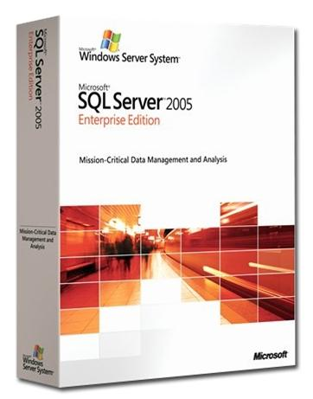

Database Vendors that Support XQuery
eXist (open source)
MarkLogic
IBM DB2 Version 9 “PureXML”
Microsoft SQL Server 2005
Oracle 10g Release 2 Enterprise Edition
+ 50 others…

Slide 14
Overview
XQuery is a new way to query structured information and turn these into services.
XQuery allows non-programmers to quickly create services from almost any machine-readable sources.
This class describes how XQuery can be used to manage metadata and models and provide a foundation for quality management.

Slide 15
No-Shredding!
Relational databases take a single hierarchical document and shred it into many pieces so it will fit in tabular structures
Native XML databases prevent this shreading

Slide 16

Cognitive Styles
The way we solve problems is dependant on the tools we know how to use.
  Shoshana Zuboff (1988)
  In the Age of the Smart Machine
Technology creates:
- new ways of thinking
- new ways of approaching and solving problems
- new sets of "Cognitive Styles"
It is only if we share these cognitive styles that we will be able to create a coherent technology strategy that everyone understands
XQuery and XRX web development is a new way of solving problems
(Note: this is actually the most important slide in the entire class)

Slide 17
How Many of You
… are familiar with a little bit of HTML?
  List, tables
… are familiar with SQL?
..think that creating web services should only be done by “programmers”?
…think that anyone familiar with HTML and SQL (BA, DBA, Testing staff) should be able to a create web services?

Slide 18
A Recurring Pattern
XQuery is easy to learn
XQuery provides large benefits for managing metadata and models

Slide 19
XQuery is Easier To Learn Than XSLT
Studies have shown that XQuery is much easier to learn than XSLT, especially if users have some SQL background
Usability of XML Query Languages.
Joris Graaumans.
SIKS Dissertation Series No 2005-16, ISBN 90-393-4065-X

Slide 20
XQuery and SQL
Many believe that XQuery is the logical “successor” to SQL
SQL returns only tabular data
XQuery returns either tabular or hierarchical data sets
XQuery is a w3c standard with a large library of compatibility tests
eXist has passed over 97% of the compatability tests

Slide 21
High Level Comparison
 | SQL | XSLT | XQuery
Query tabular data | Yes | Yes | Yes
Query hierarchical data | No | Yes | Yes
Easy for people to learn | Yes | No | Yes
The winner!
XQuery can be as easy to learn as SQL but also works with hierarchical data structures.

Slide 22
RDBMS Table
Department | Number | Name | Description
WMN | 557 | Fleece Pullover
ACC | 563 | Floppy Sun Hat
ACC | 443 | Deluxe Travel Bag
MEN | 784 | Cotton Dress Shirt | Our favorite shirt!
Product
Department
Number
Name
Description

Slide 23
Sample XML File
catalog2.xml
<catalog>
<product dept="WMN">
<number>557</number>
<name>Fleece Pullover</name>
</product>
<product dept="ACC">
<number>563</number>
<name>Floppy Sun Hat</name>
</product>
<product dept="ACC">
<number>443</number>
<name>Deluxe Travel Bag</name>
</product>
<product dept="MEN">
<number>784</number>
<name>Cotton Dress Shirt</name>
<desc>Our favorite shirt!</desc>
</product>
</catalog>

Slide 24
Sample XML File
catalog.xml
<catalog>
<product dept="WMN">
<number>557</number>
<name language="en">Fleece Pullover</name>
<colorChoices>navy black</colorChoices>
</product>
<product dept="ACC">
<number>563</number>
<name language="en">Floppy Sun Hat</name>
</product>
<product dept="ACC">
<number>443</number>
<name language="en">Deluxe Travel Bag</name>
</product>
<product dept="MEN">
<number>784</number>
<name language="en">Cotton Dress Shirt</name>
<colorChoices>white gray</colorChoices>
<desc>Our <i>favorite</i> shirt!</desc>
</product>
</catalog>
Matching
Tags

Slide 25


XML File system
XML File system – a way of storing information in XML that can be quickly searched
You can drag and drop almost any files onto this file system
You access it by using the Windows “My Network Places” function
But - You can query the file system like a relational database

Slide 26
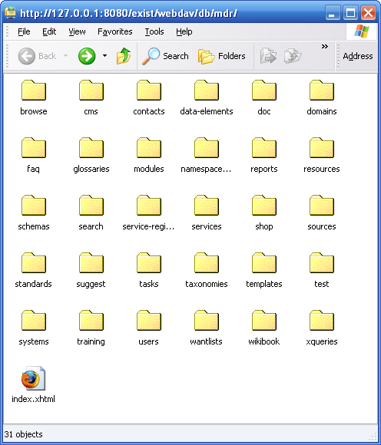
XML File System (continued)
Native XML file systems have folders within folders to help you organize your information
Most file operations are the same (copy, rename, delete etc.)

Slide 27
It is Easy to Import Data Into XQuery
SQL
Analyze data for all parent child relationships and repeating groups
Design logical and physical ER diagrams
For each table create a Data Definition File using a data definition language (DDL)
Create indexes using DDL
Create one table for each set of repeating set of data
Run DDL on database creating tables using the appropriate data types
Create indexes
Create Insert statements
Create separate insert statements for each repeating group
Run Insert statements on primary structures in database
Use primary keys of the first data inserts as foreign keys of dependant data structures
XQuery
Drag XML files into folder

Slide 28
It is as Easy to Query XML Data
SELECT COL1, Col2
FROM TABLE
WHERE COL1=1
for $r in doc(‘t.xml’)//row
where col1=1 return
$r/col1, $r/col2
COL1 | COL2
1 | A
1 | B
1 | C
1 | D
<root>
<row>
<col1>1</col1><col2>A</col2>
</row>
<row>
<col1>1</col1><col2>B</col2>
</row>
<row>
<col1>1</col1><col2>C</col2>
</row>
<row>
<col1>1</col1> <col2>D</col2>
</row>
</root>

Slide 29
SQL is similar to XQuery
Selecting Distinct Values | SELECT DISTINCT | for $r in distinct-values($doc)
Row Restriction | WHERE COL=value | where $r/element=value
Sorting | SELECT C1, C2 FROM TABLE ORDER BY C1 | for $r in $doc/r order by $r/ele

Slide 30
It is Easy to Create A Web Service
Java/JDBC/SQL
Learn Java or find a Java Developer
Install TomCat Web Server
Install AXIS Java Framework
Write a JDBC program that sends SQL queries to a database
Get the results back in Java Result Object structures
Go through the Java Results Structures and use print statements to wrap XML tags around the strings in the result objects
Rename your class files to .jws files
Add the .jws files to the TomCat deploy folders
The WSDL files will automatically be generated
Use WSDL tools to query the web service
XQuery
All XQuerys are web services

Slide 31
Insert/Select/Publish Comparison
SQL
SQL
Java
Tomcat
AXIS
JDBC
XQuery
SQL
XQuery
XQuery
Insert
Query
Web Service
XQuery
Total Effort

Slide 32
The Translation “Pain Chain”
Name:
Street:
City:
Zip:
Web Forms
Objects
RDBMS
From web forms to objects…to SQL inserts…to selects…to objects and back to web forms
  Many format translations…

Slide 33
XForms
XForms stores form data in native XML format in a browser-hosted model (MVC) architecture
browser
html
Database
head
body
model
input
Person
label
FirstName
LastName
Roles
Projects
Project

Slide 34
Shredding Is Bad
Shredding is the process of taking a single XML document and inserting different sections into tables of a relational database
Case Study: Real Estate Contacts
  Many Buyers
  Many Sellers
  Many People
  Many Organizations
  Many Counties
  Many Parcels
  Many Appraisals
  Many Property Type
  Many Use Classifications
  Many Agricultural Programs
  Many Agricultural Programs Types
  Many Tax Classifications
  Many Taxable Values…
  Etc
One Form = 45 distinct insert statements with SQL
One line store() with XQuery

Slide 35
Hands on Lab
If you have your own laptop
  Download exist from http://www.exist-db.org
If you do not have a laptop
  Try the XQuery sandbox on the classroom server
Try to load some sample XRX applications
  faqs
  terms
  item-manager

Slide 36
Just Like Your File Systems
XQuery has:
  Documents – just like a file
  Collections – just like a folder
xquery version "1.0";
let $terms := doc('/db/apps/terms/my-terms.xml')/root
Load a file into a variable
xquery version "1.0";
for $terms := collection('/db/apps/terms/data')/term
Loop through all terms

Slide 37
XQuery FLWOR Expressions
An XQuery FLWOR expression has five parts:
For
Let (zero to many)
Where (optional)
Order (optional)
Return (required)

Slide 38
XPath
XML element selection language
Technically a sub-language
Shared by: XSLT, XQuery, XForms, Schematron, BPML etc
  /html – the root node of the fil
  /html/body/h1 – all header level 1 elements in the body in the file
  //p – All paragraphs ANYWHERE in the file
    Similar to **
html
head
body
h1
p
a

Slide 39
Predicates
Things you add to an XPath expression to limit the selected items
Like a SQL WHERE clause
Find all the preferred terms in the glossary
//term[published-indicator=‘true’]
Return all terms that have published-indicator set to be true.

Slide 40
XQuery is Concise
Michael Key "knight's tour" program
Computes a knight's tour of the chessboard
Complexity analysis
  276 non-comment lines in XSLT 1.0
  159 non-comment lines in XSLT 2.0
  155 non-comment lines in XQuery
See: http://www.stylusstudio.com/xquerytalk/200503/000537.html

Slide 41
XQuery is a “Functional” Language
XQuery (without the updates) does not change data
It extract XML and creates new XML
Can be highly parallelized like Google’s MapReduce algorithm
http://en.wikipedia.org/wiki/Functional_programming
http://en.wikipedia.org/wiki/MapReduce
[Search YouTube Google Class]

Slide 42
Data Types Returned
XQuery can return:
  Text
  CSV
  Tables
  Trees
  Graphs
Serialize options:
See Walmsley p 293
declare option exist:serialize "method=html media-type=text/html indent=yes";
declare option exist:serialize "method=xml media-type=text/xml indent=yes";
declare option exist:serialize "method=text media-type=text/text indent=yes";

Slide 43
Returning Items in an Ordered List
<ol>{
for $term in collection($collection)/term
return
<li>
{$term/name/text()}
</li>
}</ol>

Slide 44
Example of For Over Collection
for $term in collection('/db/apps/terms/data')/term
This line may be omitted for clairity
let $collection := '/db/apps/terms/data’
for $term in collection($collection)/term

Slide 45
XQuery’s Nested Structure
XQuery
Processor
XML
Processor
XQueries have a alternating nested structure
Interleave actual XML output and XQuery instructions

Slide 46
Example of Nested Structure
XQuery version “1.0”;
let $collection := ‘/db/mycollection’
return
<html>
<head><title>My Report</title></head><body><table>
{for $i in collection($collection)/item
return
<tr>
<td> </td>
<td> </td>
</tr>
{$i/name/text()}
{$i/defintion/text()}
}
</table></body></html>
Note that the inner blue XQuery areas always start and end with curly braces { }

Slide 47
Sample XQuery
xquery version "1.0";
(: Example of report on all terms :)
(: make the output XML :)
declare option exist:serialize "method=xhtml media-type=text/xml indent=yes";
<terms>{
(: select only xml documents with “term” as the root element :)
for $term in collection($collection)/term
return
<term>{$term/name/text()}</term>
}
</terms>

Slide 48
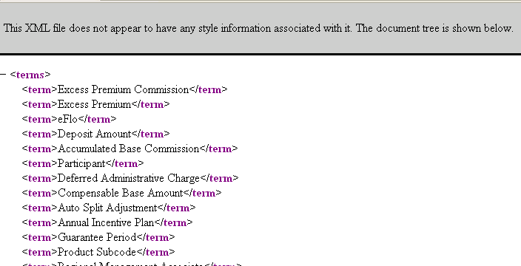
Sample XQuery that returns XML
xquery version "1.0";
(: make the output XML :)
declare option exist:serialize "method=xml media-type=text/xml indent=yes";
let
<terms>{
for $term in collection('/db/apps/terms/data/')/term
let $name := $term/name/text()
return
<term>{$name}</term>
}</terms>
Output:
01-xml.xq

Slide 49
Restricting Within an XPath
xquery version "1.0";
declare option exist:serialize "method=xml media-type=text/xml indent=yes";
let $collection := '/db/apps/terms/data'
return
<results>{
for $term in collection($collection)/term
[compare(substring($term/name/text(), 1), ‘a’)]/term
order by $term
return $term
}</results>
Only find terms that begin with the letter “a”

Slide 50
Restricting Rows by Adding a “Where Clause”
<tbody>{
for $term in collection('/db/mdr/glossaries/data')/Term
where $term/PublishedIndicator/text() = ‘true'
return
<tr>
<td>{$term/TermName/text()}</td>
<td>{$term/Definition/text()}</td>
</tr>
}</tbody>
Square Bracket Notation (usually faster):
for $term in collection('/db/apps/terms/data')/term
[$term/PublishedIndicator/text() = ‘true‘]

Slide 51
Using Complex Logic in Where Clause
You can use any number of and/or statements in the where clause
<tbody>{
for $term in collection('/db/mdr/glossaries/data')/Term
where $term/ClassifierCode/text() = 'System‘
and $term/AssignedToCode/text() = ‘Dave‘
return
<tr>
<td>{$term/TermName/text()}</td>
<td>{$term/Definition/text()}</td>
</tr>
}</tbody>

Slide 52
Content Management “Macros”
<html>
<head>
{cms:import-css-tables()}
</head>
<body>
{cms:header()}
{cms:breadcrumb-glossary()}
XQuery macros are used to import snippets of canned XML or CSS text
Change a single location and the entire web site look-and-feel changes
Similar to server-side includes

Slide 53
Selecting Distinct Values
xquery version "1.0";
declare names exist="http://exist.sourceforge.net/NS/exist";
declare option exist:serialize "method=html media-type=text/html indent=yes";
import module names cms = "http://cms.mdr.danmccreary.com" at "/db/mdr/cms/cms-module.xq";
let $title := 'My Report'
return
<html>
<head>
<title>{$title}</title>
{cms:import-css-tables()}
</head>
<body>
{cms:header()}
{cms:breadcrumb-glossary()}
<h3>Distinct ClassifierCode Values</h3>
<ol>{
for $classifier in distinct-values(collection('/db/mdr/glossaries/data/')/Term/ClassifierCode/text())
return
<li>{$classifier}</li>
}</ol>
</body>
</html>

Slide 54
Sample Results
<results>
<assigned-to-code>dave-p</assigned-to-code>
<assigned-to-code>dennis-w</assigned-to-code>
<assigned-to-code>ken-f</assigned-to-code>
<assigned-to-code>kerek-t</assigned-to-code>
</results>

Slide 55
Combine Outer Distinct Query
xquery version "1.0";
declare names exist="http://exist.sourceforge.net/NS/exist";
declare option exist:serialize "method=html media-type=text/html indent=yes";
import module names cms = "http://cms.metadata.danmccreary.com" at "/db/mdr/cms/cms-module.xq";
let $title := 'My Report'
return
<html>
<head>
<title>{$title}</title>
{cms:import-css-tables()}
</head>
<body>
{cms:header()}
{cms:breadcrumb-glossary()}
<ol>{
for $facilitator in distinct-values(collection('/db/mdr/glossaries/data/')/Term/AssignedToCode/text())
return
<li><b>Facilitator: </b>{$facilitator}<br/>{
for $term in collection('/db/mdr/glossaries/data/')/Term[AssignedToCode=$facilitator]
return
$term/TermName/text()
}</li>
}</ol>
</body>
</html>

Slide 56
Subsequence
What to do when you have over 500 items returned by a query but you only want the first 50 items
Similar to SELECT TOP in SQL
for $term in subsequence($collection, 1, 50)/term
return $term
1 is the starting term
50 is the number of term
for $term in subsequence($collection, $start, $length)/term
return $term

Slide 57
Try it out
http://localhost:8080/exist/rest/db/apps/terms/index.xhtml

Slide 58
Computation and Transformation
All computation is a type of transformation
Compilers
  Transform high-level languages into machine language
Services
  Transform in input request into an output response
Human Brain
  Transform input stimuli into concept recognition via pattern matching
  See On Intelligence by Jeff Hawkins

Slide 59
Sample Program
xquery version "1.0";
declare option exist:serialize "method=xml media-type=text/xml indent=yes";
let $dan := doc('http://teacher:8080/exist/rest/db/home/dan/data.xml')//number/text()
let $class := doc('http://classroom:8080/exist/rest/db/home/dan/data.xml')//number/text()
let $sum := $dan + $mdr
return
<results>
<message>The sum of {$dan} and {$class} is {$sum}</message>
</results>
<results>
<message>The sum of 47 and 14 is 61</message>
</results>

Slide 60
Lab#2
Each person changes the format of the XML file to a non-standard format
Figure out the changes and rerun the total

Slide 61
Part 4: XQuery and Modeling
Why do we store models in XML?
How are models used to gather requirements?
How do we add XML models to our metadata registry?
Analysis of XML Models
  XML Schema
  Schematron
  WSDL
  UDDI
  BPMN
  BPEL
  XForms

Slide 62
Model-Driven Development
model
program
Transforms
program
model
model
program
model
program
All aspects of a system are derived by transformations of specifications
Specifications are stored in models

Slide 63


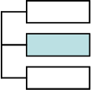





Gathering Requirements
Notepad
MS-Word
MS-Excel
XML Files
XML Schema
WSDL XML Files
BPEL XML Files
XHTML Files
XForms Files
XML Bind statements
XPath Expressions
UML in XMI (complex)
XML Metadata
Data Element
Business
Rules in
Schematron
PowerPoint
MS-Visio
Non-Machine Readable Models
Used To Capture Requirements
Machine Readable Models
Used To Capture Requirements
Requirements can be expressed in two ways:
  Use non-machine readable models – easy to create – hard to verify correctness automatically - but fine for non-testable requirements with no measurable quality metrics
  Use machine-readable models – need tools and training but are easy to verify for correctness and consistency with a metadata registry. Required if you desire the ability to measure requirements gathering quality and plan to use continuous improvement processes

Slide 64




Machine Readable Model Spectrum
PowerPoint
Proprietary
Models
Notepad
MS-Visio
XHTML
BPMN/BPEL
XML Schemas
High
Effort
Effort required to test for correctness
Low
Effort
Different file types have vastly different ability to be queried by a metadata/model registry infrastructure
  Can the document be transformed into XML?
  Can it be sent through a program to clean up the tags (HTML tidy)
  How verbose is the file format?
  Is there documentation available?

Slide 65
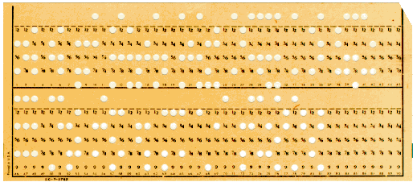
Many Processes Today Are Driven By…
The constraints of yesterday…
Our challenge:
  Ask ourselves the question…
  Do our current method of solving problems with tabular data…
  Reflect the storage of the 1950s…
  Or our actual business requirements?
  What structures reflect the actual business problem?

Slide 66
Class Evaluation
Please fill out a class evaluation form
This helps us find out how to make this class better
Thank You!
- Dan

Slide 67
Questions?

