Slide 1
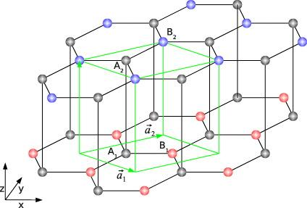
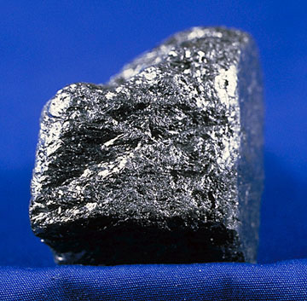
Graphite
Due to its flexible bonding, carbon materials form a series of different structures with an equally large variety of physical properties.
Graphite is one of them, it became well known since the pencil was invented in 1564. It is highly applicable as a tool of writing due to the fact that raphite is made out of stacks of graphene sheets that are weakly coupled by the van der Waals interaction.
The natural lattice structure of graphite is shown on the right figure above, it is constructed by many layers of carbone atom sheets that are in the "honeycomb structure". This layer structure of graphite is also called "Bernal Stacking", which determines its weak coupkled van der Waals interaction.
Interestingly, if these layers are individulely separated from the bulk, it become entirely another material, graphene.

Slide 2
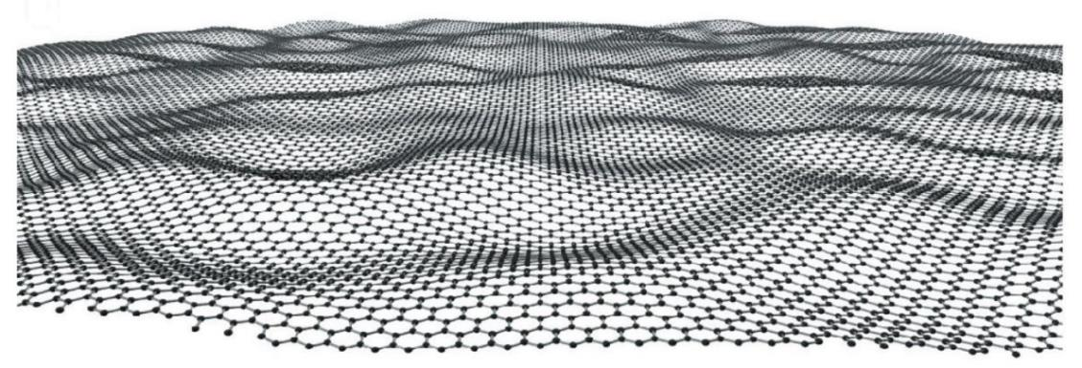
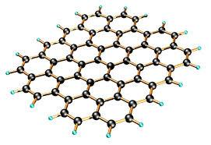
Graphene
Why graphene is completely different material compare to graphite?
Because they have entirely different properties, mechanically and electronically, making graphene one of the most amazing and attractive material in the world.
It is the thinnest compound known to man at one atom thick, the lightest material known (with 1 square meter coming in at around 0.77 milligrams), the strongest compound discovered (between 100-300 times stronger than steel and with a tensile stiffness of 150,000,000 psi), the best conductor of heat at room temperature (at (4.84±0.44) × 10^3 to (5.30±0.48) × 10^3 W·m−1·K−1) and also the best conductor of electricity known (studies have shown electron mobility at values of more than 15,000 cm2·V−1·s−1). Other notable properties of graphene are its unique levels of light absorption at πα ≈ 2.3% of white light, and its potential suitability for use in spin transport.
What I do?
I studied the transition threashold between the two materials: the common material-graphite to the amazing super conductor-graphene.

Slide 3
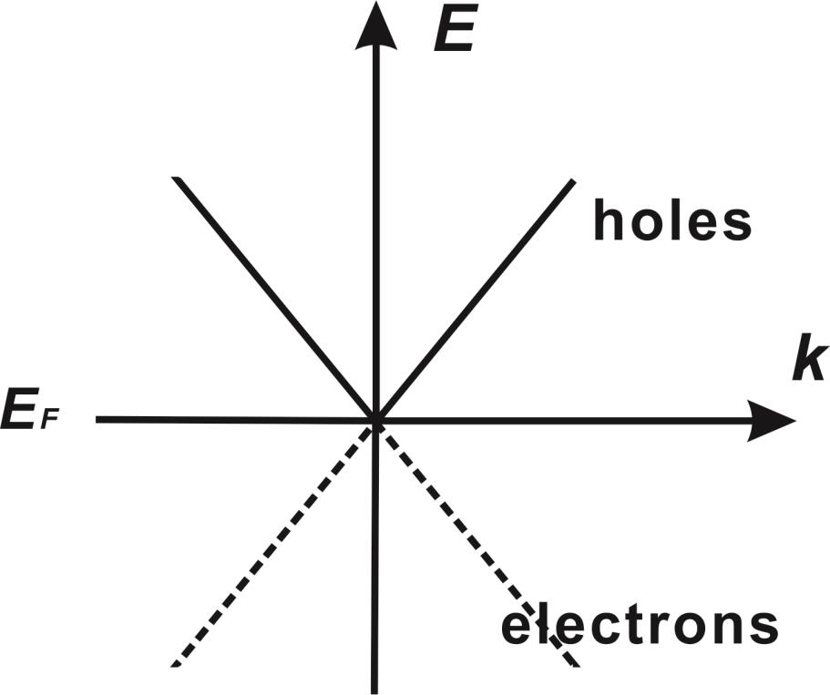
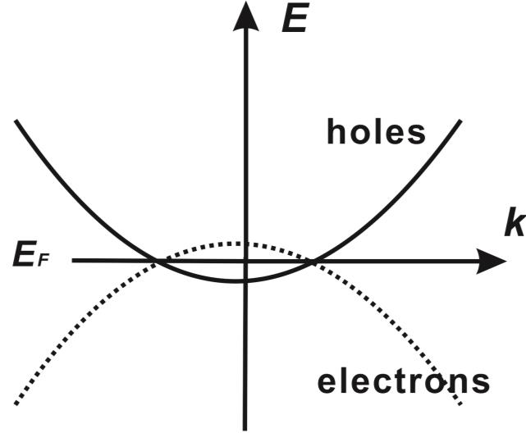
Frome graphite to Graphene
The above are two energy band structure of graphite(left) and graphene(right)
You do not need to know what exactly band structure, just keep in mind that it is a very important mathematical tool to understand material. You can see they are different.
You may say, of course they are different, one is a stack of layer and ther other is just one layer. But what if I tell you these two data are both calculated from a single layer, one is a separated frees-tanding layer, while the other is a latyer that is coupling with a stack of other carbon layers.
So, obviously, it is the couplling that makes them so different. The singular point at the right figure determines all the amazing properties that described above.
So how and when this transition happen?

Slide 4
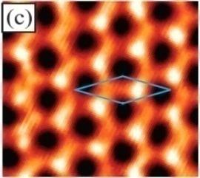
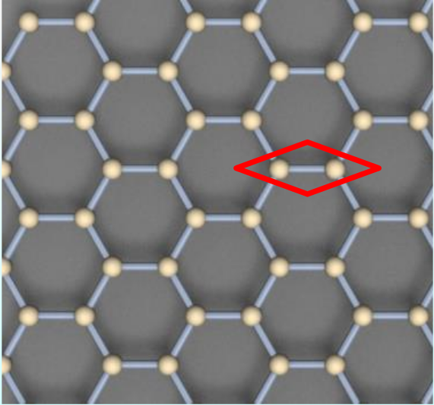
STM image on graphene
The left photo is STM image taken on graphene, again, never mind you don't know what is STM. It is just a experimental facility that allows us to see the atoms on the surface of materials, sounds amazing, isn't it? Seeing atoms with just couple angstroms (trillionths of a meter)
From the figure we can clearly see the honeycomb structure of a single carbon layer. The right figure is the modeling honeycomb lattice of graphene. See how the two images are similar to each other.

Slide 5
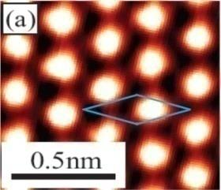
STM image on graphite
While this one was taken on the surface of graphite, meaning the top carbon atom layer is sitting on the bulk graphite. You can see the obvious different structure by comparing with the right figure. Now the structure become triangle, one of the carbon atom is dispeared from our view.
From band structure and the real space image, we can see the obvious different between these two material. So how that happens?

Slide 6
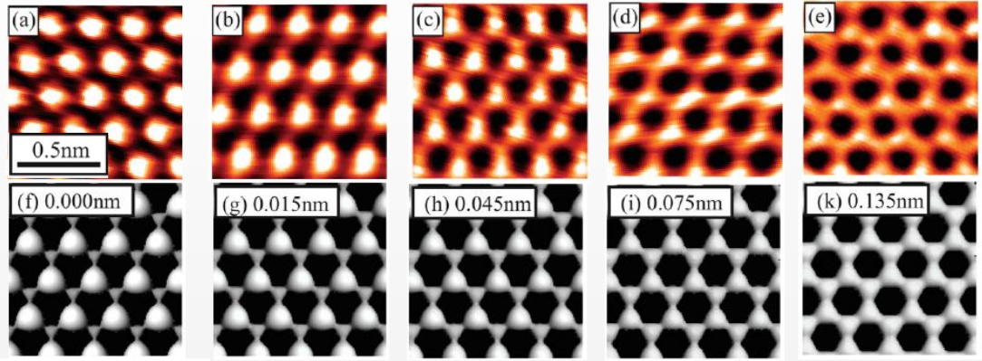
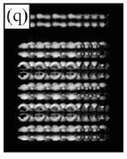
Transition
As a layer is gradually separated from the bulk, the lattice is changed gradually from triangle to hexagonal.
Above figures quantify the transtion, the upper row is real space STM image on graphite, the second row is theoretical modelling of STM image as the top layer is moving away from the bulk.

Slide 7
Graphi

Slide 8
Graphi

Slide 9
Graphi

Slide 10
Graphi

