Slide 1

Chataus
Chat bot
Uses google voice assistant (Dialogflow)
Interact with user in a natural conversation
Recommends products and product bundles

Slide 2
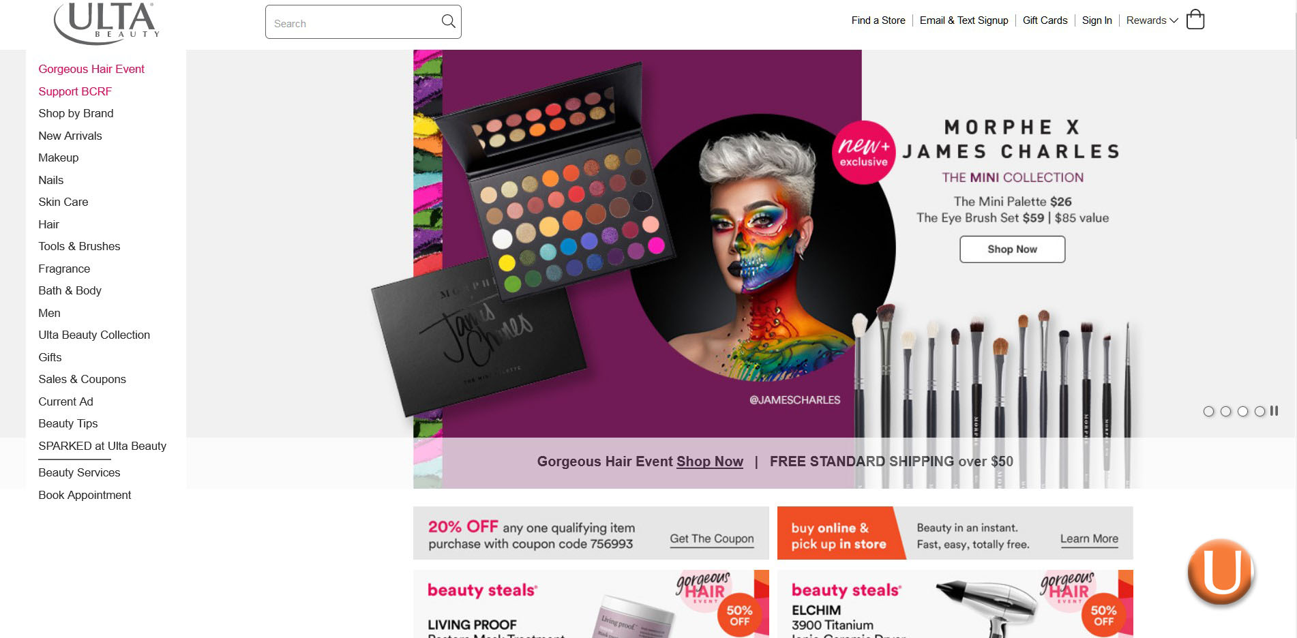
Chataus

Slide 3
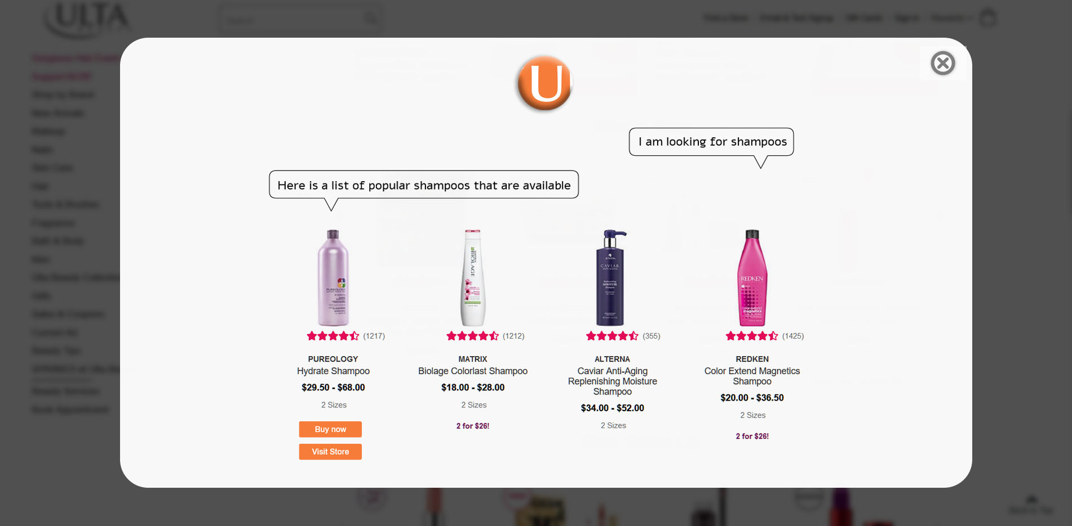
Chataus

