Slide 1

Portable Calendar
Hongshan Shang
Ziyan Yang
Shuangqian Lu
Dekai Meng
Zhuoran Yang
Cong Qi
Haopeng zhu
Yurong Jia
Yulin Xue

Slide 2
Purpose
Nowadays, with the rapid development of technology, digital products are becoming more popular all over the world. People often worry about forgetting the business events or appointments because of busy work. It is no longer a rarity for owning a personalized digital calendar. ‘portable-calendar’ application is a kind of mobile application that facilitates users to plan their daily schedule and keep track of their reminders. The user can set a reminder period and time by creating a schedule or task, and this application will remind you. The ‘portable-calender’ support set up a regular shutdown and alarm clock for the mobile phone. What is more, that also supports multiple cycles, times, cycles reminders for schedules and tasks.

Slide 3
Introduction
This application not only provides intimate viewing of upcoming events but also has many practical tools such as memo scheduling activities, creating events, searching events and setting alarm. Helping people have a clear plan for a busy life.
Portable calendar is a mobile application that users can use to prepare their daily events and set the notifications to remain users of some important events. What is more, they also can use the application to search for some important events. This application will have Ios and Android version.

Slide 4
Function
View Upcoming Events
Create Event
Set Alarm Preference
Search Event
Choose Language
Email Setting
Dark Mode

Slide 5
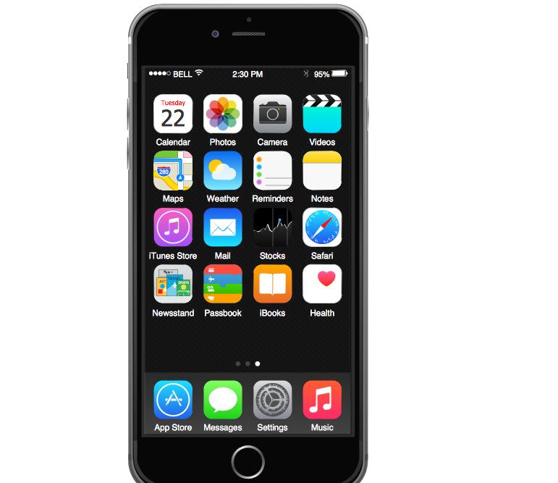

The Best Calendar Anywhere, Anytime interactive, innovative, irresistible

Slide 6
The Best Calendar Features
Free
Don’t need Wi-Fi
Simple operation
No advertisement
Low delay
Less power consumption

Slide 7
User guide
1. open app

Slide 8
Set rememder
1. open app

Slide 9
Select date

Slide 10
Set alarm

Slide 11
Convenient tools
Delete all with one click,
Drag pages to refresh
simply check before creation. For example, if the end date is earlier than the start date, an error will be reported
Sort events by time

Slide 12
Our Services
Provide user guide
Provide update

Slide 13

Thanks

