Slide 1
A. EXISTING CONDITION

Slide 2
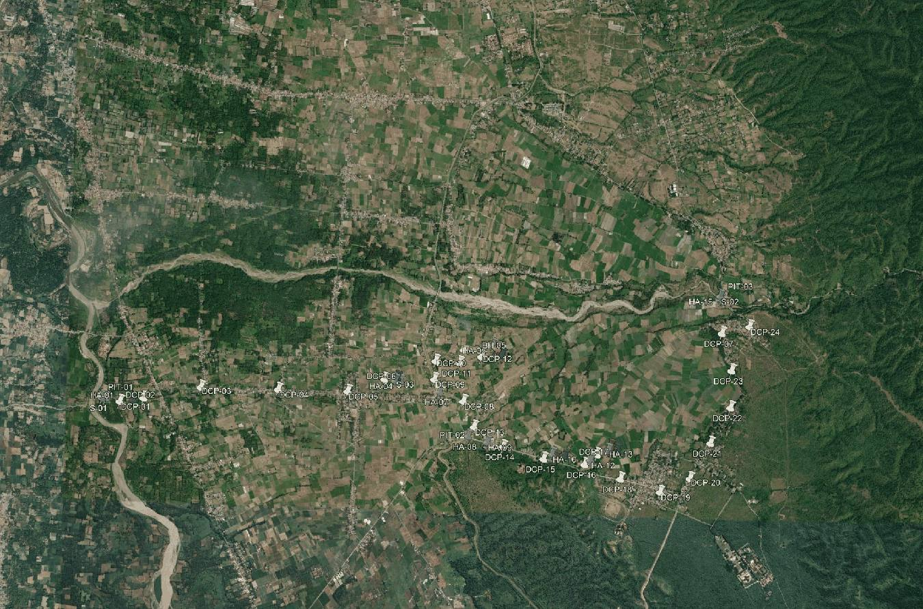
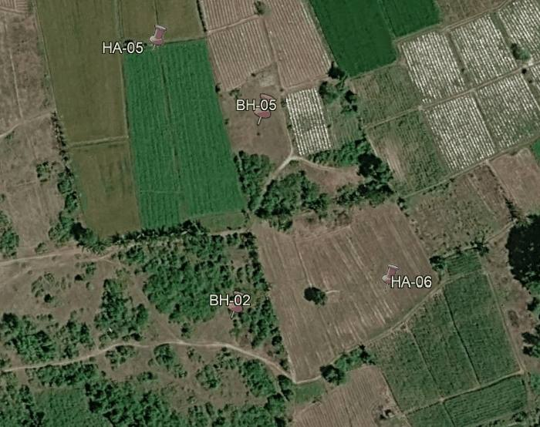
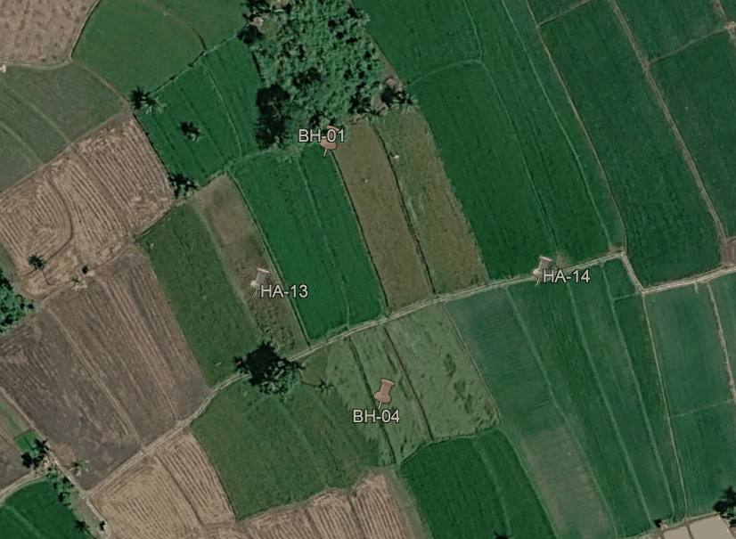
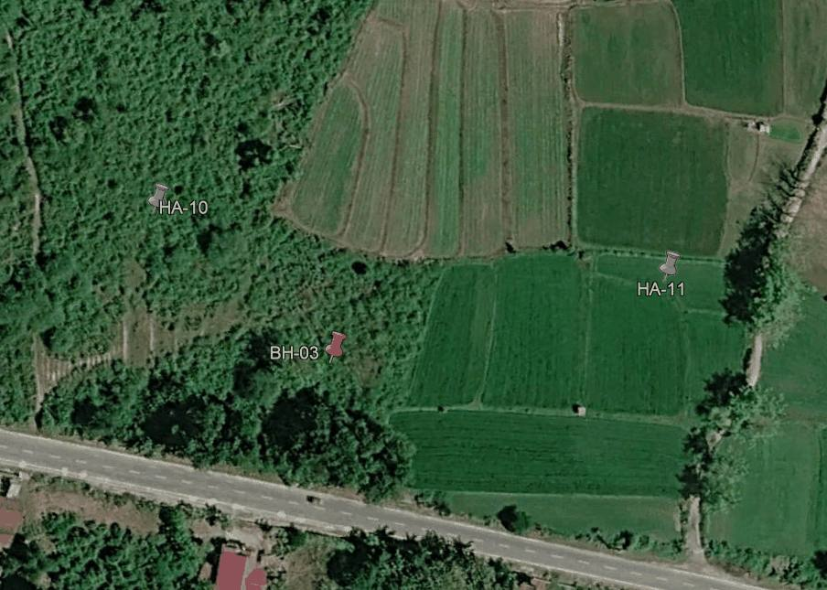

SOIL INVESTIGATION LOCATION
Well Pad A
Well Pad D
Log Yard & Camp
Soil Investigation Location
GEOTECHNICAL INVESTIGATION & DETAILED ENGINEERING DESIGN
BORA PULU GEOTHERMAL PSPE AREA

Slide 3
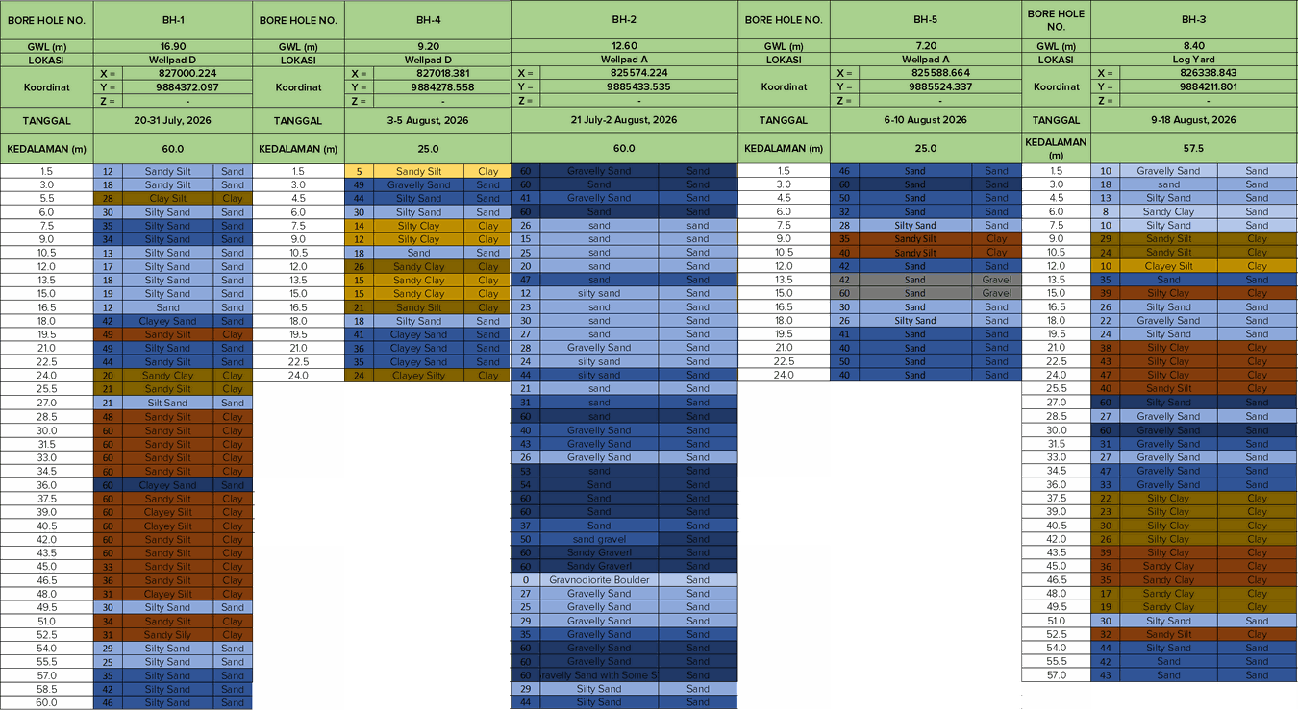
SOIL STRATIGRAPHY
GEOTECHNICAL INVESTIGATION & DETAILED ENGINEERING DESIGN
BORA PULU GEOTHERMAL PSPE AREA

Slide 4
B. BEARING CAPACITY & SETTLEMENT

Slide 5
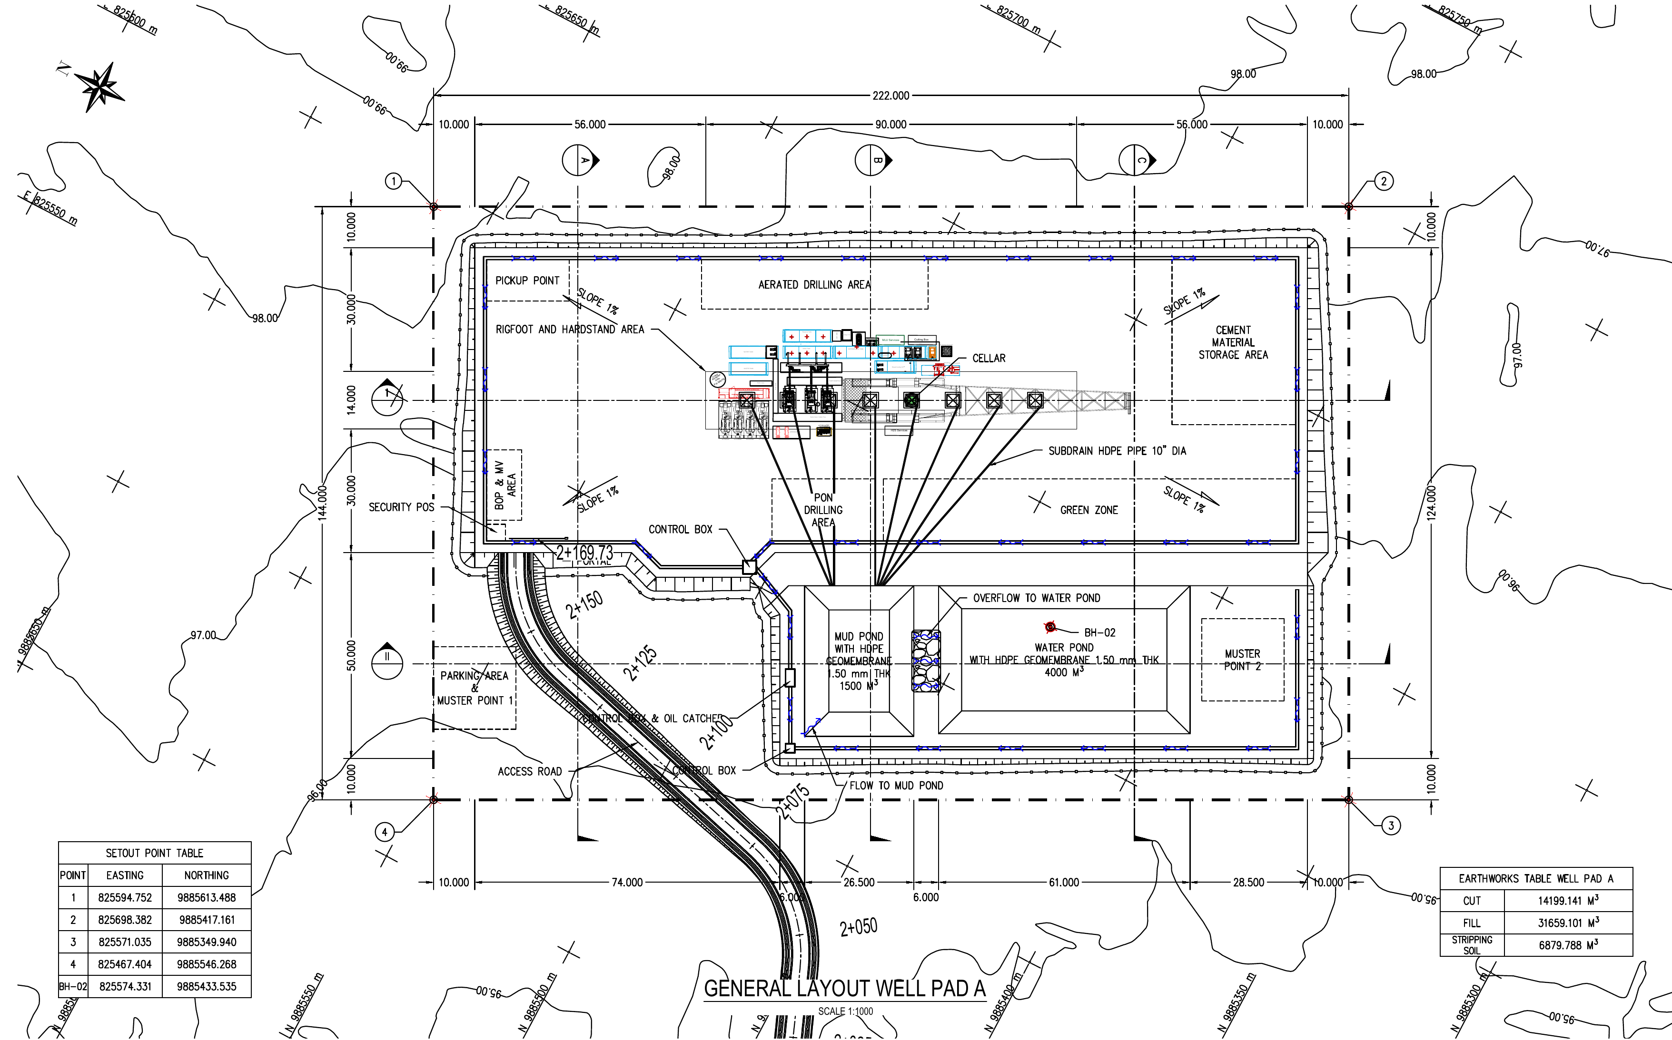
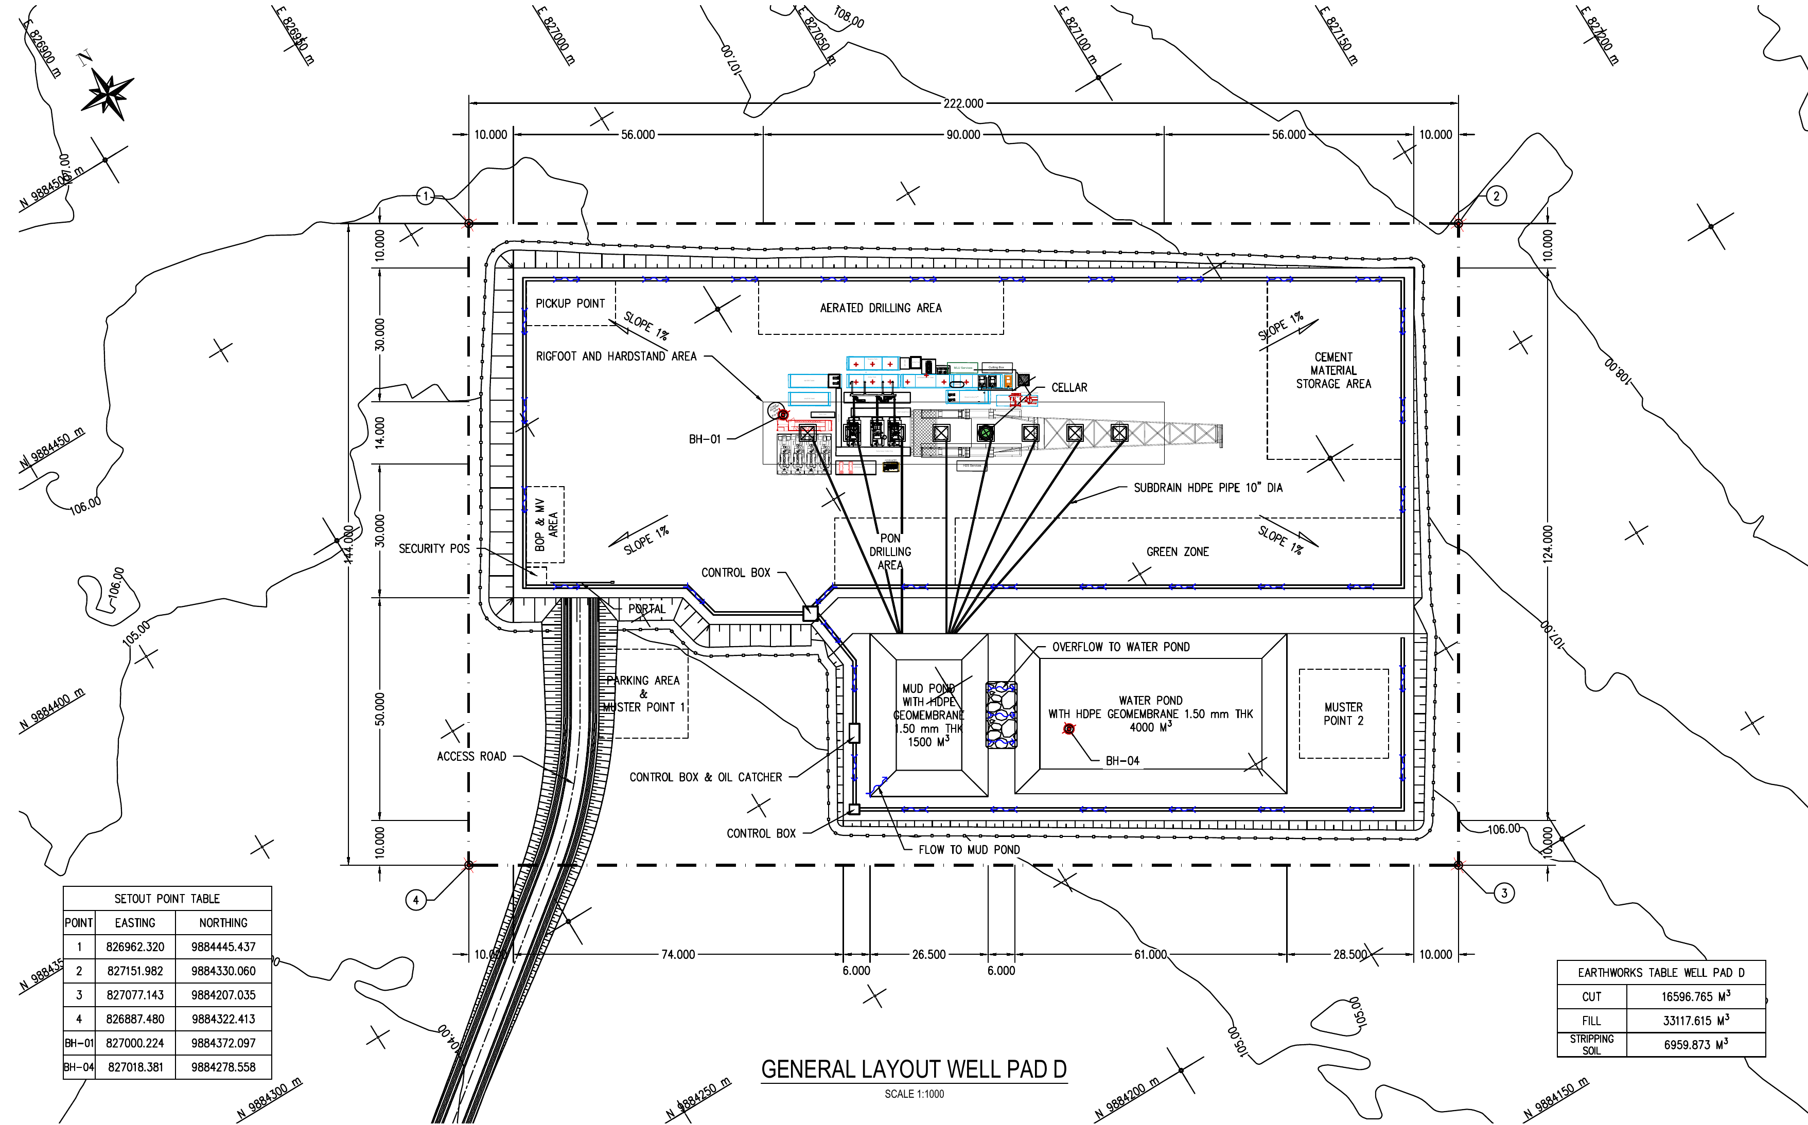
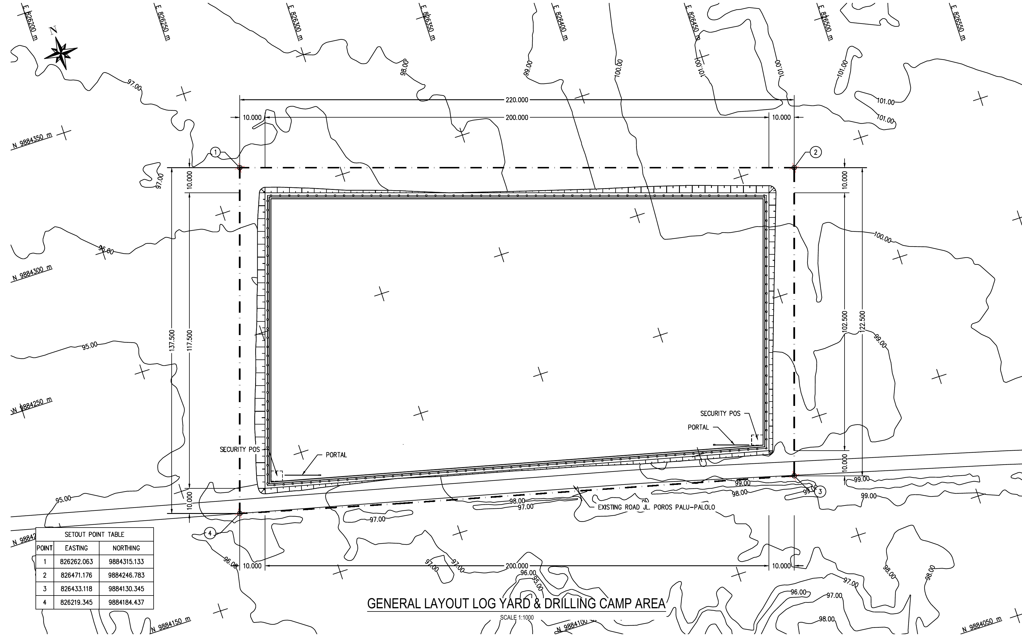
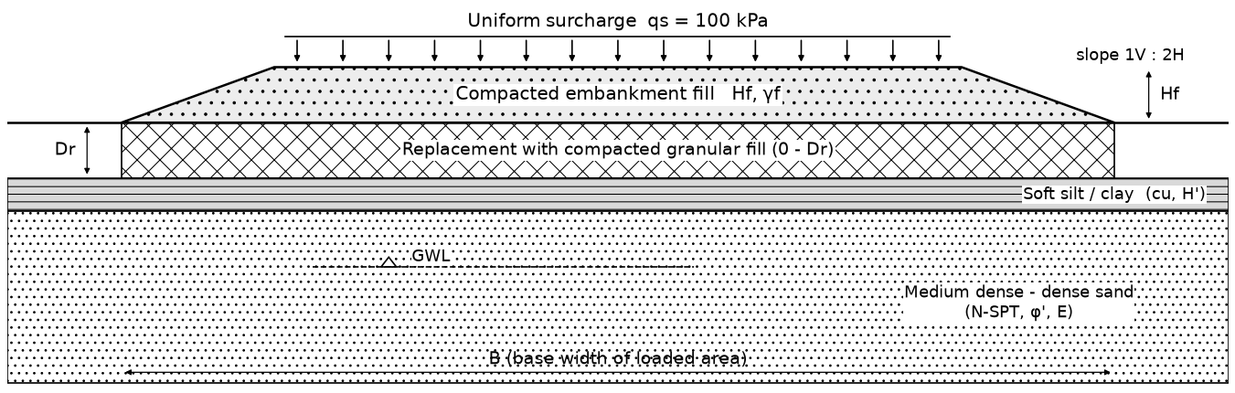
BEARING CAPACITY & SETTLEMENT: DESIGN LOAD AND AREAS
Figure 1. Wellpad A – general layout (BH-02, BH-05)
Figure 2. Wellpad D – general layout (BH-01, BH-04)
Figure 3. Log Yard & Drilling Camp – general layout (BH-03)
Design load (all areas)
Item | Value
Embankment fill height Hf | 2.0 m
Unit weight of fill γf | 18 kN/m³
Uniform surcharge qs | 100 kPa
Pressure on subgrade q | 136 kPa
Loaded area B × L | 74 × 202 m
Side slope | 1V : 2H
Required FS (bearing) | 3.0
Required FS (lateral squeeze) | 1.5
Replacement at BH-01, BH-04 | 1.5 m
Figure 4. Typical section: compacted fill, uniform surcharge, replacement zone and subsoil
q = Hf·γf + qs = 2 × 18 + 100 = 136 kPa over the whole platform. At BH-01 and BH-04 (Wellpad D) the top 1.5 m is stripped and replaced with compacted granular fill to raise the bearing capacity.
GEOTECHNICAL INVESTIGATION & DETAILED ENGINEERING DESIGN
BORA PULU GEOTHERMAL PSPE AREA

Slide 6
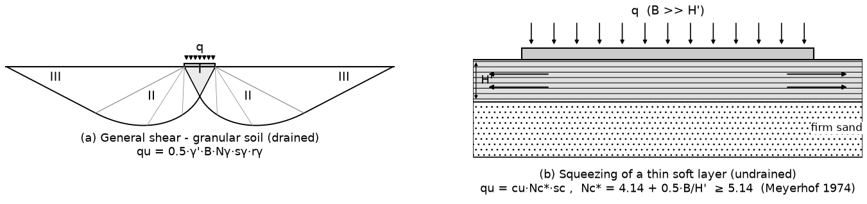
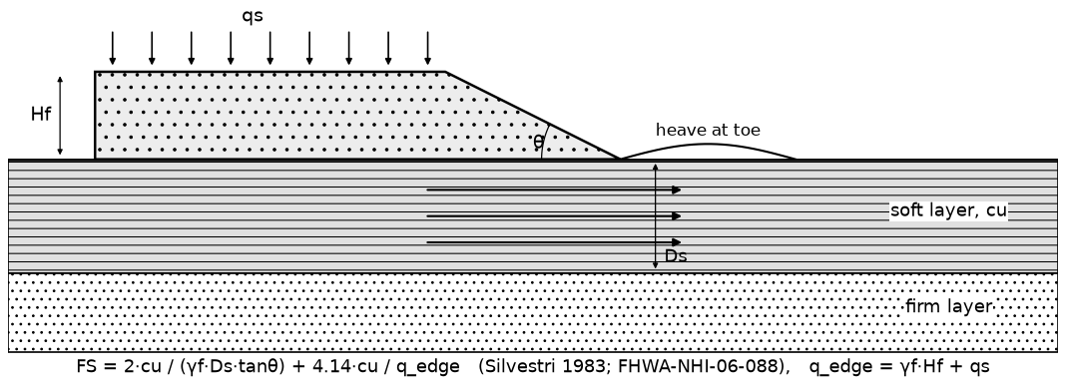
BEARING CAPACITY: METHOD
How the bearing capacity is checked
Load: q = 136 kPa at ground level on a 74 × 202 m area.
Undrained (short term): used when silt/clay is in the top 5 m. qu = cu·Nc*·sc, with cu = 5·N.
Thin soft layer: soft silt over dense sand cannot fail deep; it can only squeeze out sideways. Nc* = 4.14 + 0.5·B/H' ≥ 5.14 (Meyerhof 1974).
Drained (long term): qu = 0.5·γ'·B·Nγ·sγ·rγ (Vesic 1975), φ' from N-SPT (Wolff 1989).
Design value: smaller qu of the two; qall = qu / 3 (SNI 8460:2017).
Replacement: top soil to depth Dr replaced with compacted granular fill; remaining soft layer H' = 3 − Dr m. Thinner H' gives higher Nc*. Adopted: Dr = 1.5 m at BH-01 and BH-04 (stripping + bearing capacity).
Lateral squeeze at the toe: FS = 2·cu/(γf·Ds·tanθ) + 4.14·cu/q ≥ 1.5 (Silvestri 1983; FHWA-NHI-06-088). Surcharge assumed up to the crest.
Key parameters
cu = 5·N (Stroud 1974); φ' sand = 27.1 + 0.3·N60 − 0.00054·N60² (Wolff 1989); φ' silt/clay from PI; replacement fill γ = 19 kN/m³, φ' = 25°.
Figure 5. Bearing capacity mechanisms: (a) general shear in sand, (b) squeezing of a thin soft layer
Figure 6. Lateral squeeze of the soft layer at the embankment toe
GEOTECHNICAL INVESTIGATION & DETAILED ENGINEERING DESIGN
BORA PULU GEOTHERMAL PSPE AREA

Slide 7
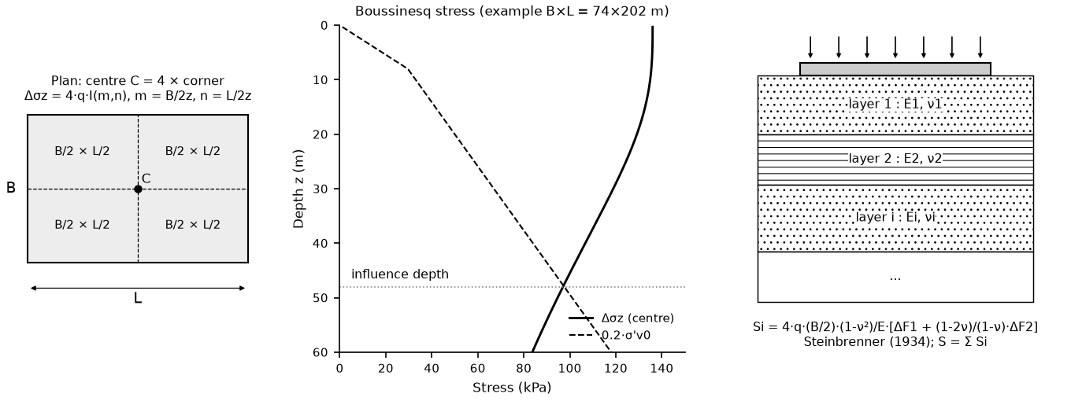
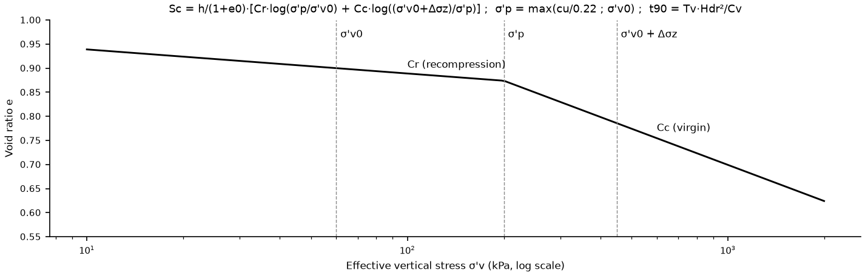
SETTLEMENT: METHOD
How the settlement is calculated
Stress increase: Δσz below the centre of the 74 × 202 m area (Boussinesq, 4 × corner).
Immediate (all soils): layered elastic method (Steinbrenner 1934; Bowles 1996). Sand: drained E, ν = 0.3. Silt/clay: undrained Eu, ν = 0.5.
Sand: immediate settlement only, no consolidation.
Consolidation (silt/clay only): e–log σ' method; σ'p = cu/0.22; drainage on both sides (sand above and below).
Influence depth: layers with Δσz < 0.2·σ'v0 are not counted.
Not included: post-liquefaction settlement (100–383 mm, liquefaction report), checked separately.
Figure 7. Boussinesq stress below the area and layered elastic (Steinbrenner) settlement
Correlations (no oedometer test available)
Parameter | Correlation | Source
Undrained strength | cu = 5·N | Stroud (1974)
Sand modulus | E = 1000·N60 kPa | Kulhawy & Mayne (1990)
Silt/clay modulus | Eu = 500·cu | Bowles (1996)
Compression index | Cc = 0.009 (LL − 10) | Terzaghi & Peck (1967)
Recompression | Cr = 0.2·Cc ; σ'p = cu/0.22 | Das (2019); Mesri (1975)
Consolidation coeff. | Cv from LL | NAVFAC DM-7.1
Figure 8. Compression curve used for the consolidation settlement of silt/clay
GEOTECHNICAL INVESTIGATION & DETAILED ENGINEERING DESIGN
BORA PULU GEOTHERMAL PSPE AREA

Slide 8
BEARING CAPACITY: RESULTS
Borehole | Area | Soft layer 0–5 m (m) | cu (kPa) | φ' (°) | FS no improvement | Dr (m) | Nc* | FS design | FS lateral squeeze | Status
BH-01 | Wellpad D | 3.0 | 25 | 31.1 | 3.25 | 1.5 | 28.8 | 5.68 | 4.46 | OK
BH-02 | Wellpad A | 0.0 | – | 41.5 | > 100 | 0.0 | – | > 100 | n/a | OK
BH-03 | Log Yard | 0.0 | – | 31.1 | 61.60 | 0.0 | – | 61.60 | n/a | OK
BH-04 | Wellpad D | 3.0 | 25 | 34.6 | 3.25 | 1.5 | 28.8 | 5.68 | 4.46 | OK
BH-05 | Wellpad A | 0.0 | – | 41.1 | > 100 | 0.0 | – | > 100 | n/a | OK
q = 136 kPa; required FS = 3.0 (bearing) and 1.5 (lateral squeeze). Dr = replacement depth used in the design condition (Drive version of the calculation).
What it shows
Wellpad D (BH-01, BH-04): soft silt/clay 0–3 m (N = 5, cu ≈ 25 kPa) over dense sand governs. FS = 3.25 without improvement.
1.5 m replacement at BH-01, BH-04: top soil stripped and replaced with compacted granular fill; H' = 1.5 m, Nc* = 28.8, FS = 5.68; lateral squeeze FS = 4.46.
Wellpad A and Log Yard: sand only (N 10–50); FS > 60. Shear failure is not an issue.
Sensitivity: FS for Wellpad D rises with Dr (0.5 m: 3.74; 1.0 m: 4.47; 1.5 m: 5.68; 2.0 m: 8.1).
Caution: cu comes from one SPT value (N = 5). Check cu with CPT/vane before final design.
Critical borehole per wellpad: Wellpad A: BH-05 (FS 344 vs 373 at BH-02). Wellpad D: BH-01 and BH-04 equal (FS 5.68 with 1.5 m replacement).
Bearing capacity OK at all boreholes (FS ≥ 3).
Lowest FS = 5.68 at Wellpad D with 1.5 m replacement. Global stability is checked separately (PLAXIS, next slides).
GEOTECHNICAL INVESTIGATION & DETAILED ENGINEERING DESIGN
BORA PULU GEOTHERMAL PSPE AREA

Slide 9
SETTLEMENT: RESULTS
Borehole | Si (mm) | Sc (mm) | Total (mm) | t90 (yr) | Post-liq. (mm)*
BH-01 | 93 | 107 | 200 | 0.12 | 289
BH-02 | 131 | 0 | 131 | – | 383
BH-03 | 139 | 67 | 206 | 0.08 | 227
BH-04 | 61 | 148 | 209 | 0.12 | 159
BH-05 | 105 | 7 | 111 | 0.05 | 100
* post-liquefaction settlement from the liquefaction report (Table 5.4), not part of the static total.
What it shows
Total settlement 111–209 mm: above the assumed 100 mm at all boreholes.
Wide area (74 × 202 m): the stress increase reaches deep layers.
Wellpad D: most settlement is consolidation of silt/clay (Sc 107–148 mm, after 1.5 m replacement).
Consolidation is fast (t90 < 0.2 yr): thin silt layers drain to sand.
Critical borehole per wellpad: Wellpad A BH-02 (131 mm, vs 111 mm at BH-05); Wellpad D BH-04 (209 mm, vs 200 mm at BH-01).
Figure 9. Immediate (Si) and consolidation (Sc) settlement; assumed allowable total settlement = 100 mm
Settlement governs, not bearing capacity.
Confirm the settlement limit. Settle the platform before building sensitive items (preload / surcharge); keep the rig on piles.
GEOTECHNICAL INVESTIGATION & DETAILED ENGINEERING DESIGN
BORA PULU GEOTHERMAL PSPE AREA

Slide 10
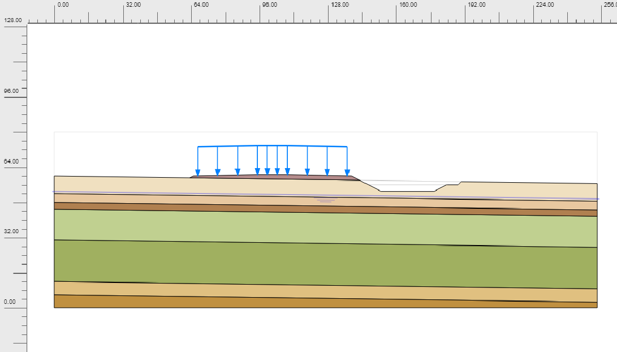
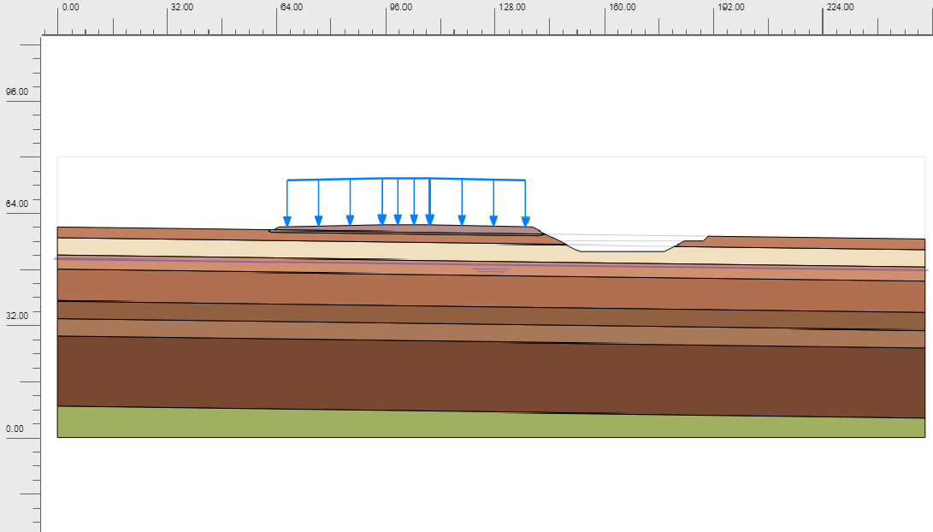
GLOBAL STABILITY (PLAXIS 2D): MODEL AND LOADS
Design load
Item | Value
Embankment fill | 2.0 m, γ = 18 kN/m³
Fill pressure | 36 kPa
Uniform surcharge | 100 kPa
Total pressure q | 136 kPa
Side slope | 1V : 2H
Replacement (Wellpad D) | 1.5 m
Seismic coefficient | kh 0.35, kv 0
(a) Wellpad A (BH-02): sand at surface
(b) Wellpad D (BH-04): firm silty clay 0–3 m, 1.5 m replaced
Calculation stages and required safety factor (SNI 8460:2017)
Notes
The 100 kPa surcharge is applied over the full platform, up to the crest of the slope (conservative).
Wellpad D: replacement increased from 0.5 m to 1.5 m for this analysis (also used in the bearing capacity and settlement results).
Liquefaction is not included in the pseudo-static case; a post-earthquake check with residual strength is still needed.
Stage | Analysis | Condition | FS min
0. Initial | K0 procedure; GWL −7.0 m (A), −9.0 m (D) | – | –
1. Fill + 100 kPa surcharge | Plastic; clay Undrained (A), sand Drained | Short term | 1.25
2. Consolidation | Excess pore pressure dissipated (3,664 days) | Long term | 1.50
3. Pseudo-static | kh = 0.35, kv = 0 (towards the slope) | Earthquake | 1.10
Safety | φ–c reduction after stages 1, 2 and 3 | FS = ΣMsf
Plane-strain section across the platform (short side, 74 m) including the excavation next to the platform edge.
Hardening Soil model for all soils; parameters on the next slide (same layering as the Midas model).
kh = 0.5 × PGAM = 0.5 × 0.69 g ≈ 0.35 (PGA 0.63 g, site class SD, FPGA 1.1; BP-00-HZD-RPT-001).
GEOTECHNICAL INVESTIGATION & DETAILED ENGINEERING DESIGN
BORA PULU GEOTHERMAL PSPE AREA

Slide 11
GLOBAL STABILITY: SOIL PARAMETERS (HARDENING SOIL)
Wellpad A (BH-02), GWL −7.0 m
Wellpad D (BH-04; BH-01 below 25 m), GWL −9.0 m
Layer | Depth (m) | Soil | Drain. | γ / γsat (kN/m³) | E50ref (MPa) | m | c' (kPa) | φ' (°) | ψ (°)
L01 | 0–7.5 | Sand | Drained | 18.5/18.5 | 60.0 | 0.39 | 1 | 41.0 | 11.0
L02 | 7.5–12 | Sand | Drained | 18.5/18.5 | 34.0 | 0.52 | 1 | 32.7 | 2.7
L03 | 12–15 | Clay | Undr. (A) | 18.5/18.5 | 35.3 | 0.80 | 10 | 30.0 | 0.0
L04 | 15–28.5 | Sand | Drained | 18.5/18.5 | 32.9 | 0.53 | 1 | 32.3 | 2.3
L05 | 28.5–48 | Sand | Drained | 18.5/18.5 | 38.9 | 0.50 | 1 | 34.3 | 4.3
L06 | 48–54 | Sand | Drained | 18.5/18.5 | 28.9 | 0.55 | 1 | 31.2 | 1.2
L07 | 54–60 | Sand | Drained | 18.5/18.5 | 35.6 | 0.52 | 1 | 33.2 | 3.2
Layer | Depth (m) | Soil | Drain. | γ / γsat (kN/m³) | E50ref (MPa) | m | c' (kPa) | φ' (°) | ψ (°)
L01 | 0–3 | Clay | Undr. (A) | 19.6/20.2 | 17.4 | 0.80 | 2 | 24.0 | 0.0
L02 | 3–7.5 | Sand | Drained | 19.6/20.2 | 51.9 | 0.43 | 1 | 39.5 | 9.5
L03 | 7.5–10.5 | Clay | Undr. (A) | 19.6/20.2 | 13.1 | 0.80 | 4 | 26.0 | 0.0
L04 | 10.5–19.5 | Clay | Undr. (A) | 19.6/20.2 | 15.9 | 0.80 | 6 | 28.0 | 0.0
L05 | 19.5–24 | Clay | Undr. (A) | 19.6/20.2 | 27.5 | 0.80 | 10 | 30.0 | 0.0
L06 | 24–28.5 | Clay | Undr. (A) | 17.8/19.2 | 13.8 | 0.80 | 6 | 28.0 | 0.0
L07 | 28.5–49.5 | Clay | Undr. (A) | 17.8/19.2 | 24.9 | 0.80 | 10 | 30.0 | 0.0
L08 | 49.5–60 | Sand | Drained | 17.8/19.2 | 29.1 | 0.55 | 1 | 31.2 | 1.2
Fill materials (assumed, no lab test yet)
Material | Thickness | γ / γsat | E50ref (MPa) | c' (kPa) | φ' (°)
Embankment fill | 2.0 m | 18 / 20 | 20 | 5 | 30
Replacement fill | 1.5 m (WPD) | 19 / 20 | 30 | 1 | 25
Common input
Eoed,ref = E50,ref; Eur,ref = 3·E50,ref; νur = 0.2; Rf = 0.9; pref = 100 kPa.
OCR = 1 and POP = 0 for all layers (lesson from the Midas back-analysis).
Sand: φ' from (N1)60 (Wolff 1989), E50ref = 60·Dr MPa. Clay: E50ref from N, c'/φ' by consistency (assumed).
Interface: Rinter 0.67 (sand), 0.70 (clay). Permeability: USDA defaults.
Critical layer for Wellpad D: L01 firm silty clay, N = 5, c' = 2 kPa, φ' = 24° (red).
Depth measured from the original ground surface; fill and replacement are separate clusters.
GEOTECHNICAL INVESTIGATION & DETAILED ENGINEERING DESIGN
BORA PULU GEOTHERMAL PSPE AREA

Slide 12
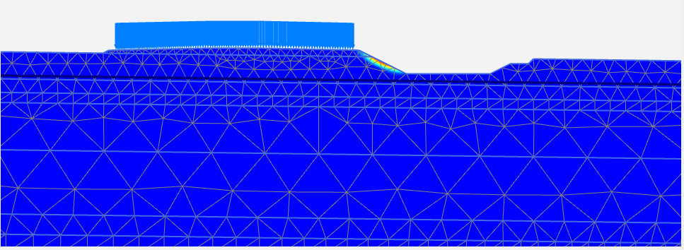
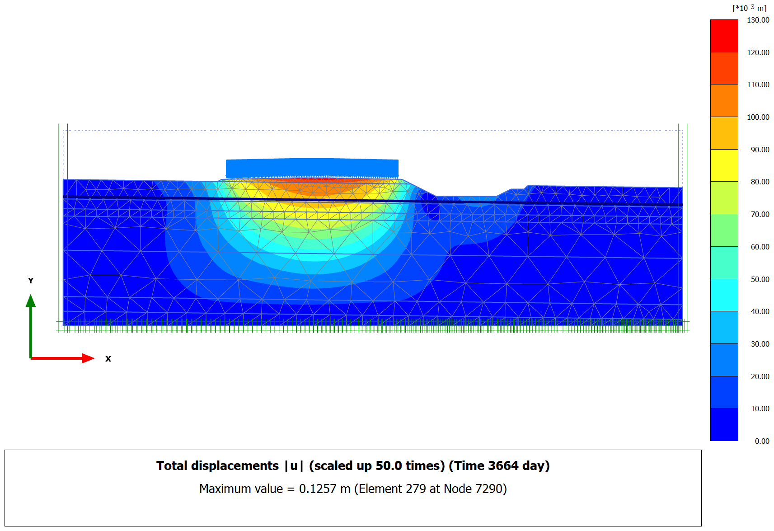
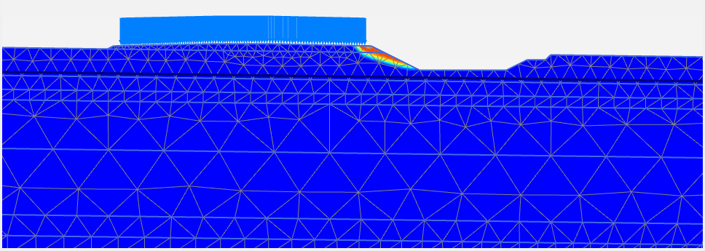
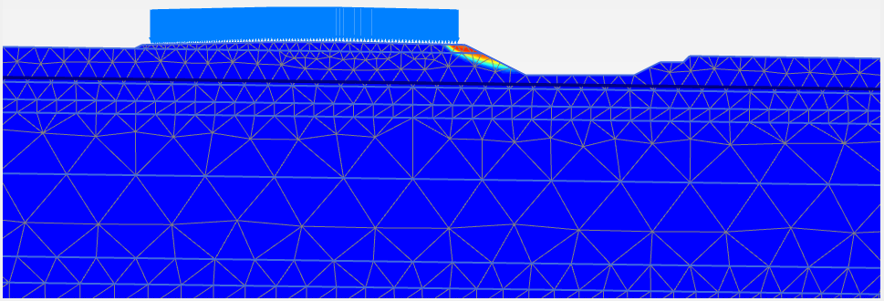
GLOBAL STABILITY – WELLPAD A: PLAXIS RESULTS
Condition | FS | FS min | Check
Short term | 2.161 | 1.25 | OK
Long term | 2.018 | 1.50 | OK
Earthquake (kh 0.35) | 1.109 | 1.10 | OK
What it shows
Slip surface is shallow and local: at the platform edge, through the fill slope towards the excavation. The deep subsoil is not involved.
Static FS are high (2.16 short term, 2.02 long term): dense sand at the surface (N ≈ 48).
Earthquake FS 1.109 is marginal: a heavier load near the crest or a weaker fill could bring it below 1.10.
Long-term displacement 126 mm agrees with the 1D estimate (131 mm at BH-02).
Action
Confirm the load plan near the platform edge (surcharge up to the crest was assumed).
Specify fill compaction so that the assumed fill strength (φ' 30°, c' 5 kPa) is achieved.
Short term: FS = 2.161 ≥ 1.25 OK
Long term: FS = 2.018 ≥ 1.50 OK
Total displacement, long term: 126 mm (1D estimate 131 mm, BH-02)
Wellpad A: global stability OK.
All three cases meet the minimum FS. The earthquake case (1.109) is only just above 1.10.
Earthquake (kh 0.35): FS = 1.109 ≥ 1.10 OK
GEOTECHNICAL INVESTIGATION & DETAILED ENGINEERING DESIGN
BORA PULU GEOTHERMAL PSPE AREA

Slide 13
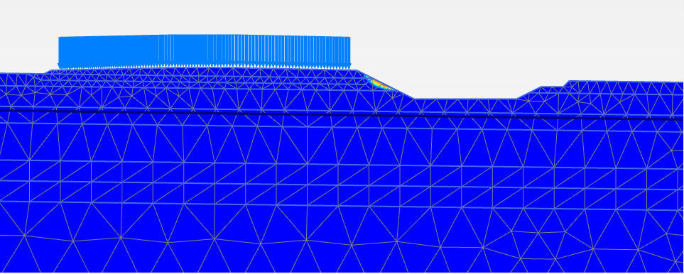
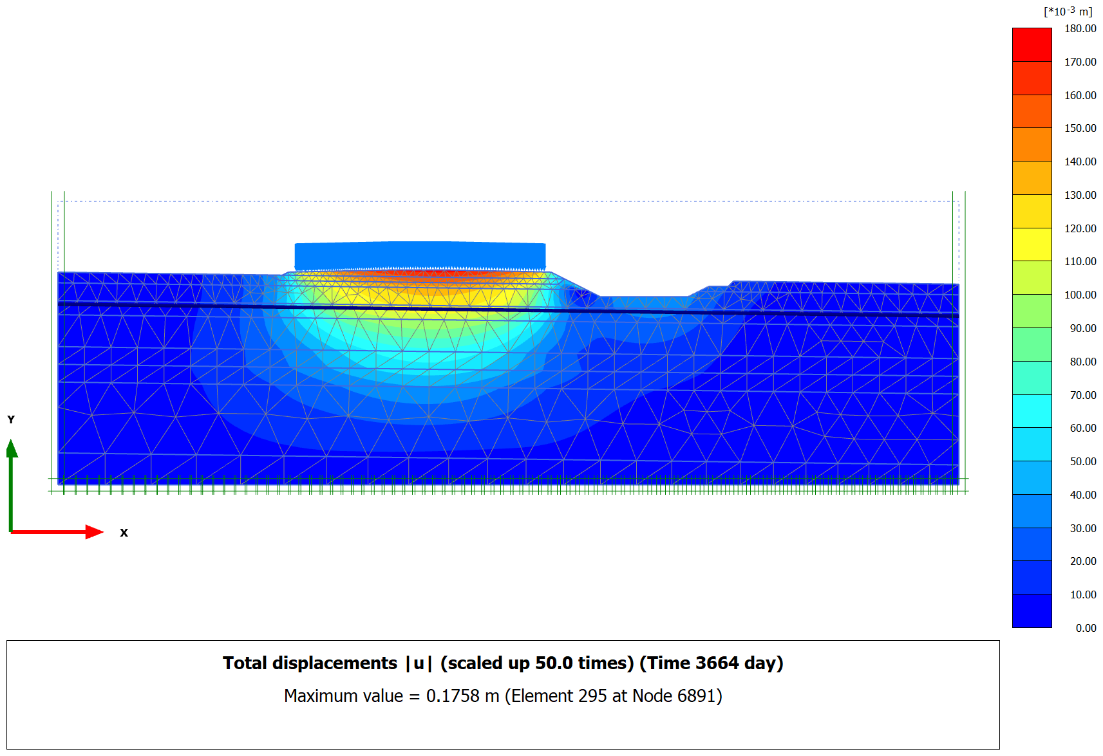
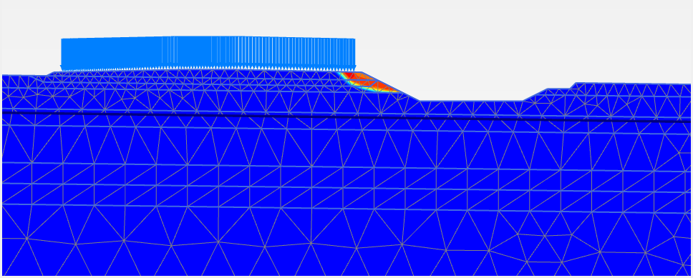
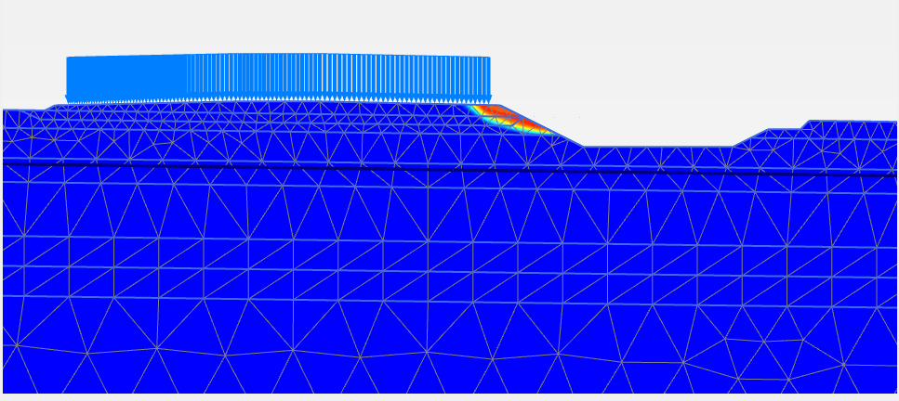
GLOBAL STABILITY – WELLPAD D: PLAXIS (1.5 m REPLACEMENT)
Condition | FS | FS min | Check
Short term | 1.341 | 1.25 | OK
Long term | 1.301 | 1.50 | NOT OK
Earthquake (kh 0.35) | 0.900 | 1.10 | NOT OK
Why the minimum FS is not met
Slip surface at the platform edge, towards the excavation, through the fill, the 1.5 m replacement and the remaining 1.5 m of firm silty clay (L01: N = 5, c' = 2 kPa, φ' = 24°).
Replacement raised the bearing capacity (FS 5.68), but it does not cut this slip surface: the problem is an edge (slope) failure, not bearing failure under the platform.
Long term is lower than short term: after consolidation the clay only has its low drained strength (c' 2 kPa).
kh = 0.35 adds a large horizontal force on the fill and the 100 kPa surcharge near the crest.
Options to be studied
Replace the full clay layer (3.0 m, down to dense sand N ≈ 42), at least along the edge and under the excavation slope.
Flatter slope or toe berm; increase the distance between the platform edge and the excavation.
Keep the surcharge away from the crest (confirm the load plan).
Basal geogrid under the fill edge.
Triaxial CU/CD tests on L01 clay: c'/φ' are assumed now.
Short term: FS = 1.341 ≥ 1.25 OK
Long term: FS = 1.301 < 1.50 NOT OK
Total displacement, long term: 176 mm (1D estimate 209 mm, BH-04)
Wellpad D: NOT OK, even with 1.5 m replacement.
Long term FS 1.30 < 1.50 (needs +15 %). Earthquake FS 0.90 < 1.10 (needs +22 %); FS < 1.0 means the edge slips in the design earthquake.
Earthquake (kh 0.35): FS = 0.900 < 1.10 NOT OK
GEOTECHNICAL INVESTIGATION & DETAILED ENGINEERING DESIGN
BORA PULU GEOTHERMAL PSPE AREA

Slide 14
C. RIG FOUNDATION ANALYSIS

Slide 15
RIG FOUNDATION ANALYSIS
MAT FOUNDATION

Slide 16
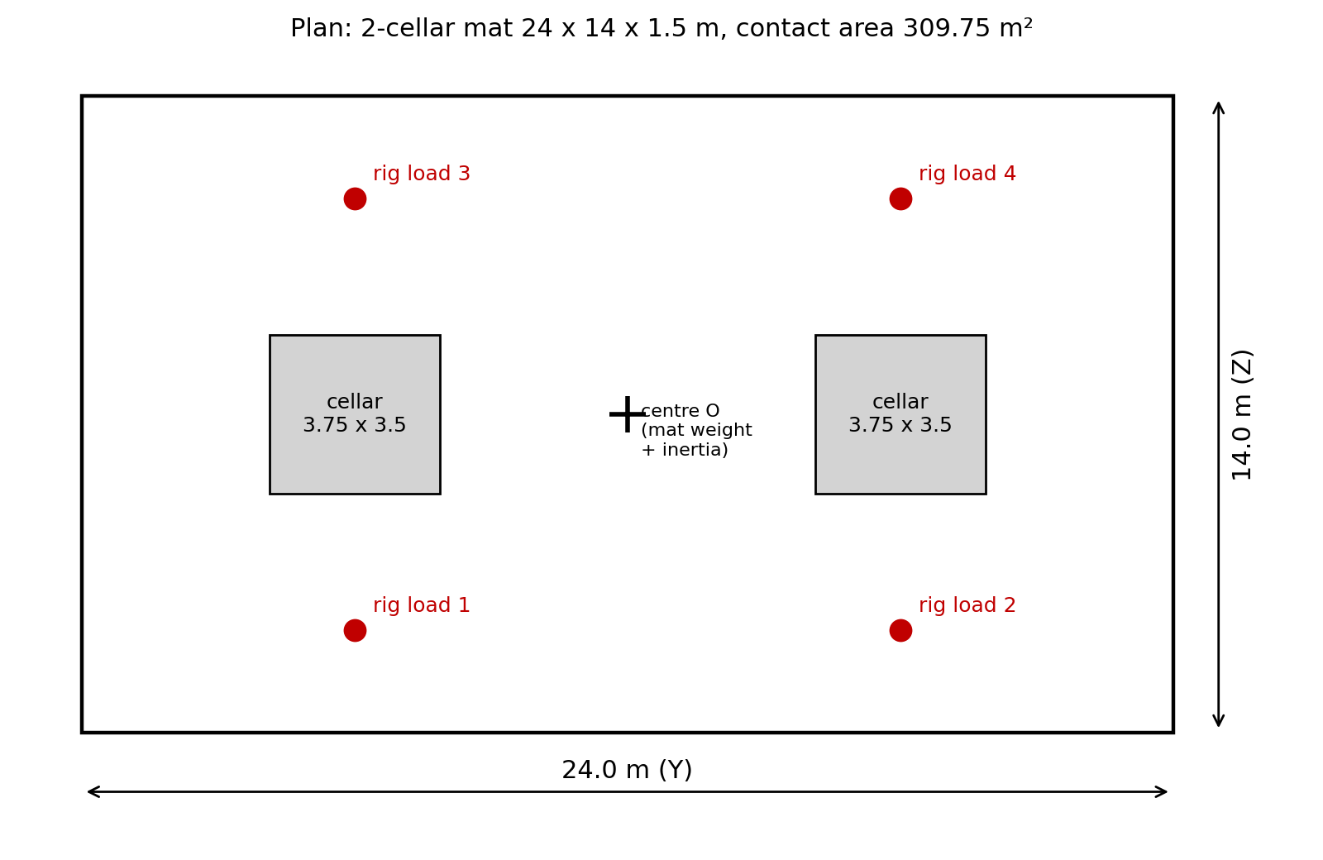
MAT FOUNDATION OPTION: INPUT AND METHOD
1
Geometry
2-cellar mat 24 x 14 x 1.5 m with two cellar openings 3.75 x 3.5 m. Base at Df = 1.0 m. Contact area A = 309.75 m².
2
Resultant
All loads are moved to the centre of the mat base (V, Hy, Hz, MY, MZ). Resultant point yR = -MZ/V, zR = MY/V.
3
Contact pressure
Rigid mat, linear pressure, cellars removed from A and I. If q min < 0, a no-tension solution is used.
Figure 1. Mat plan, cellar openings and rig load points.
4
Bearing capacity
Terzaghi (1943) and Meyerhof (1963) on the effective area B' x L’.
Key data
Section: A = 309.75 m², Iz = 15,152 m⁴, Iy = 5,461 m⁴
Kern (core): ±4.08 m in Y and ±2.52 m in Z. Resultant inside kern = no uplift.
GWT: 7.0 m (WPA), 9.0 m (WPD). Top of liquefied layer 7.0 m and 9.75 m.
Required SF:
3 for ASD1, ASD2.
2 for seismic ASD3,
ASD4. 1.1 after liquefaction.
5
After liquefaction
2:1 spread check, Meyerhof & Hanna (1978) two-layer check, and settlement (Idriss & Boulanger 2008).
GEOTECHNICAL INVESTIGATION & DETAIL ENGINEERING DESIGN
BORA PULU GEOTHERMAL PSPE AREA

Slide 17
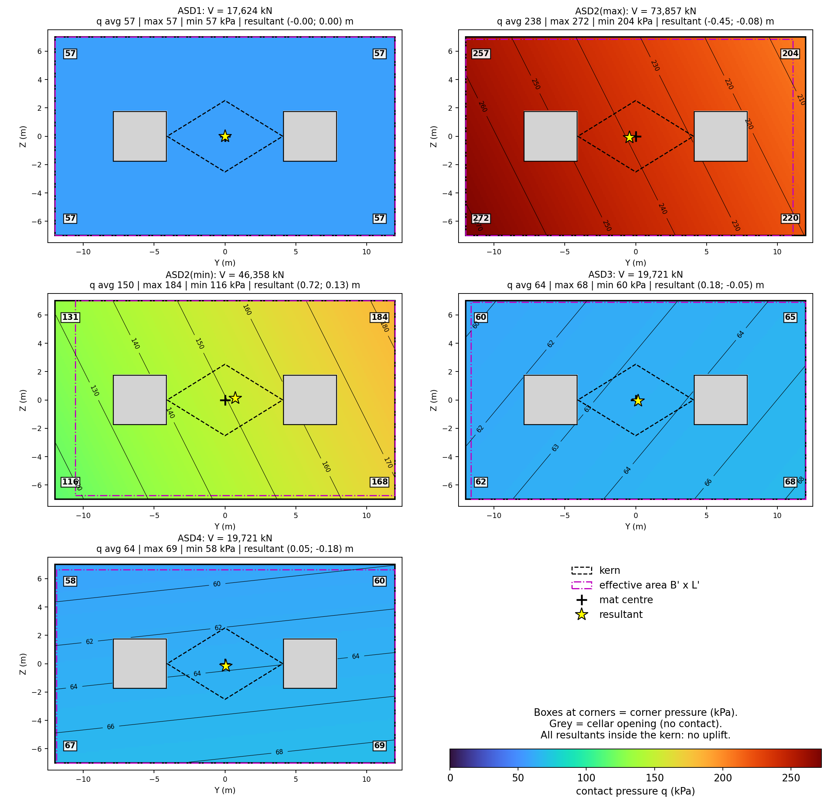
CONTACT PRESSURE: ALL LOAD COMBINATIONS (PLAN)
How the pressure is found
Linear: q(y,z) = V/A + (V·yR/Iz)·y + (V·zR/Iy)·z
Kern check: |yR|/4.08 + |zR|/2.52 ≤ 1: whole mat in compression.
No tension: if q min < 0, solved again with zero pressure on the lifted part.
Combination | V (kN) | yR (m) | zR (m) | Kern | q avg | q max | q min
ASD1 | 17,624 | -0.00 | 0.00 | 0.00 | 57 | 57 | 57
ASD2(max) | 73,857 | -0.45 | -0.08 | 0.14 | 238 | 272 | 204
ASD2(min) | 46,358 | 0.72 | 0.13 | 0.23 | 150 | 184 | 116
ASD3 | 19,721 | 0.18 | -0.05 | 0.07 | 64 | 68 | 60
ASD4 | 19,721 | 0.05 | -0.18 | 0.08 | 64 | 69 | 58
q in kPa. Same loads, so same pressure for WPA and WPD.
What it shows
No uplift: all resultants inside the kern (max ratio 0.23).
Highest pressure: 272 kPa at corner Y = -12, Z = -7 m (ASD2(max)).
Resultant: max offset 0.72 m from the centre, so the pressure is almost uniform (q max / q avg ≤ 1.23).
GEOTECHNICAL INVESTIGATION & DETAIL ENGINEERING DESIGN
BORA PULU GEOTHERMAL PSPE AREA

Slide 18
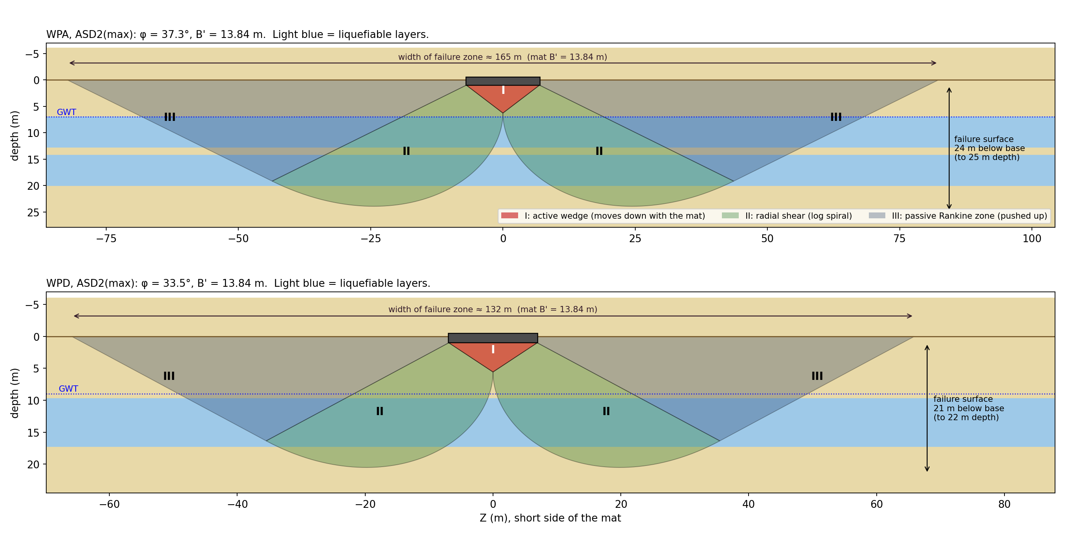
BEARING CAPACITY: FAILURE MECHANISM
How Terzaghi works
Zone I: wedge under the mat moves down with it (angle φ).
Zone II: soil shears along a log spiral, r = r0·e^(θ·tanφ).
Zone III: soil beside the mat is pushed up (passive, 45 - φ/2).
Resistance: q·Nq (weight of soil beside the mat) + 0.5·γ·B'·Nγ (soil weight inside the mechanism).
ASD2(max) | WPA | WPD
φ (°) | 37.3 | 33.5
Nq / Nγ | 56 / 73 | 34 / 36
q·Nq (kPa) | 900 | 546
0.5γB'Nγ s (kPa) | 4,847 | 2,679
qu (kPa) | 5,747 | 3,225
q' (kPa) | 251 | 251
FS | 22.9 | 12.9
Figure. Terzaghi failure mechanism drawn to scale for ASD2(max). Background: soil layers, light blue = liquefiable.
Important
Big mechanism: failure surface goes about 24 m (WPA) and 21 m (WPD) below the mat base, and the zone is 165 m and 132 m wide.
It passes through the liquefiable layers: the high static FS is valid only when the sand does not liquefy. After liquefaction the mat must be checked as crust over weak soil (next slides).
GEOTECHNICAL INVESTIGATION & DETAIL ENGINEERING DESIGN
BORA PULU GEOTHERMAL PSPE AREA

Slide 19
BEARING CAPACITY: NON LIQUEFACTION CONDITION
Method
Terzaghi (1943): qu = q·Nq + 0.5·γ·B'·Nγ·(1 - 0.2B'/L'), c = 0, Nγ from Coduto (2001).
Meyerhof (1963): qu = q·Nq·sq·dq·iq + 0.5·γ·B'·Nγ·sγ·dγ·iγ, Nγ = (Nq - 1)·tan(1.4φ).
Effective area: B' = B - 2e, L' = L - 2e. q' = V / A', A' reduced for the cellars.
Water table: γe = γ' + (d/B)(γ - γ'), d = depth of GWT below mat base.
φ design: thickness-weighted average from Df to Df + B (1 to 15 m).
Inclination: θ = atan(H/V), used only in Meyerhof.
Parameter | WPA | WPD
φ design (°) | 37.3 | 33.5
γe (kN/m³) | 10.97 | 12.22
q = γ·Df (kPa) | 16 | 16
Terzaghi Nq / Nγ | 56.3 / 72.6 | 34.1 / 36.0
Meyerhof Nq / Nγ | 44.8 / 56.7 | 27.6 / 28.3
All combinations OK. Lowest FS = 12.9 (WPD, ASD2(max)).
Without liquefaction, bearing capacity is not the problem.
Combination | B' (m) | L' (m) | q' (kPa) | θ (°) | WP-A FS Terzaghi | WP-A FS Meyerhof | WP-D FS Terzaghi | WP-D FS Meyerhof | SF req. | Status
ASD1 | 14.00 | 24.00 | 57 | 0.0 | 102.3 | 111.9 | 57.4 | 61.3 | 3 | OK
ASD2(max) | 13.84 | 23.10 | 251 | 0.0 | 22.9 | 25.3 | 12.9 | 13.8 | 3 | OK
ASD2(min) | 13.74 | 22.56 | 162 | 0.0 | 35.2 | 38.9 | 19.7 | 21.3 | 3 | OK
ASD3 | 13.89 | 23.64 | 65 | 10.0 | 88.7 | 55.7 | 49.8 | 28.7 | 2 | OK
ASD4 | 13.64 | 23.89 | 66 | 10.0 | 87.0 | 54.2 | 48.8 | 28.0 | 2 | OK
q' is the same for WPA and WPD (same loads). B' and L' follow the resultant offset. Capacity uses c = 0, so results are conservative for the crust.
GEOTECHNICAL INVESTIGATION & DETAIL ENGINEERING DESIGN
BORA PULU GEOTHERMAL PSPE AREA

Slide 20
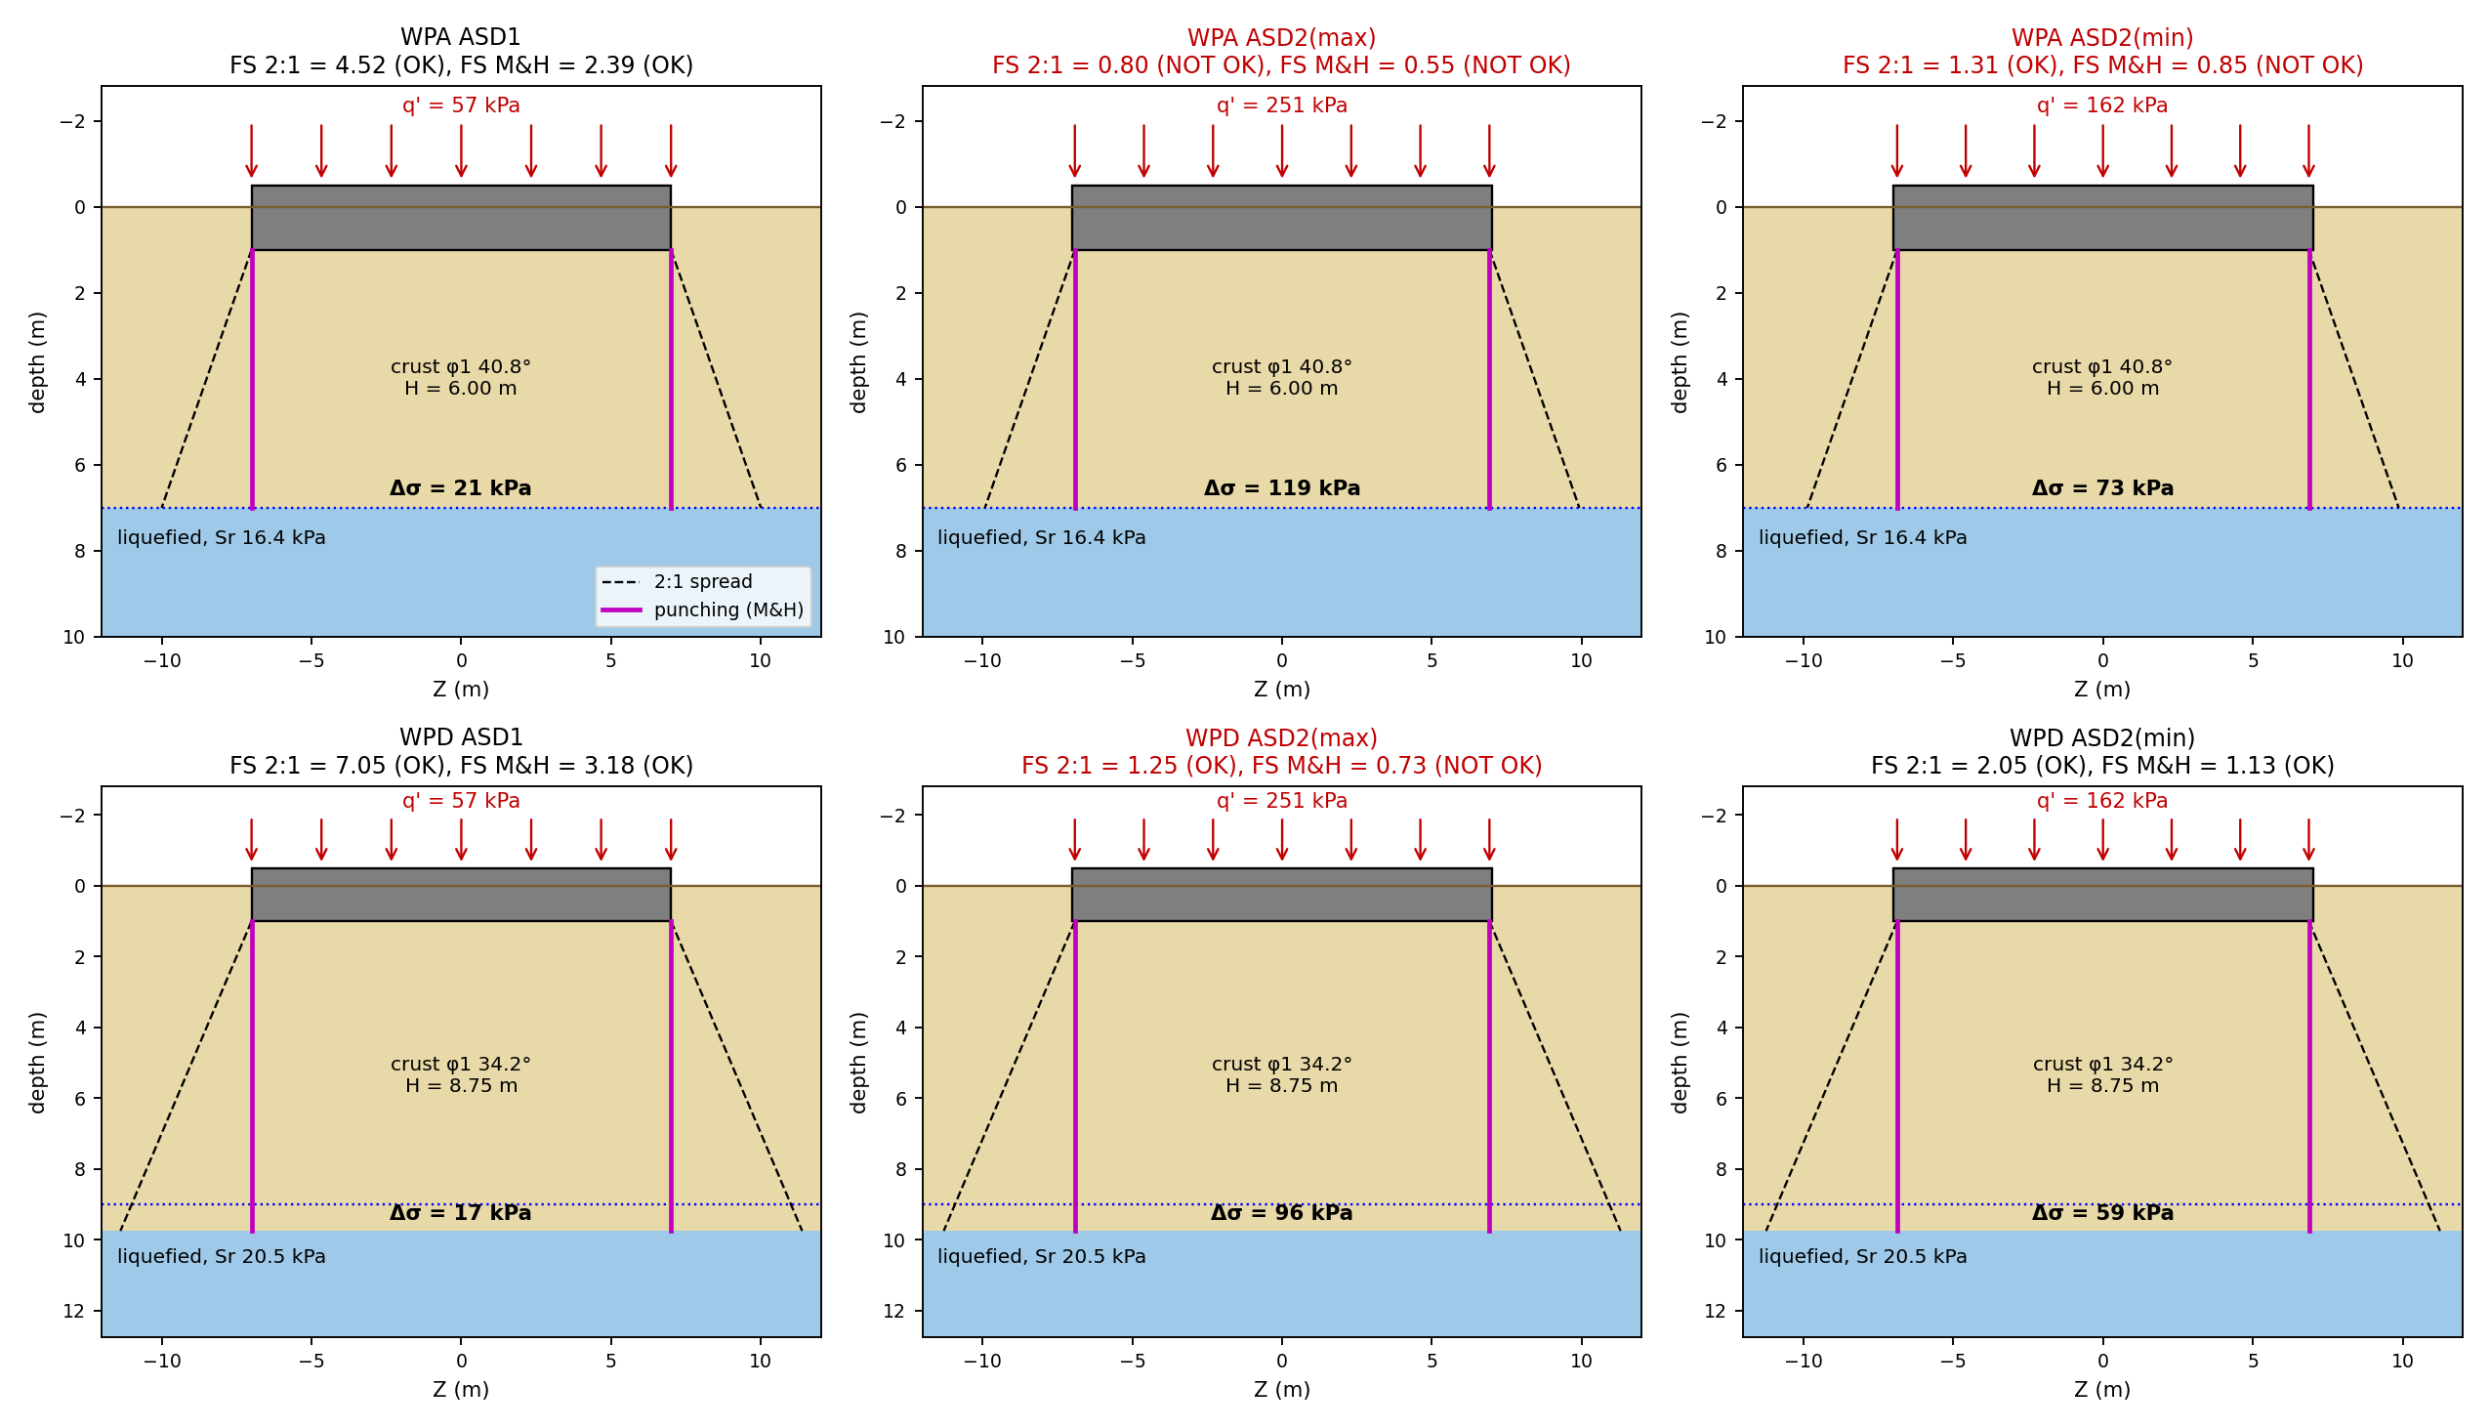
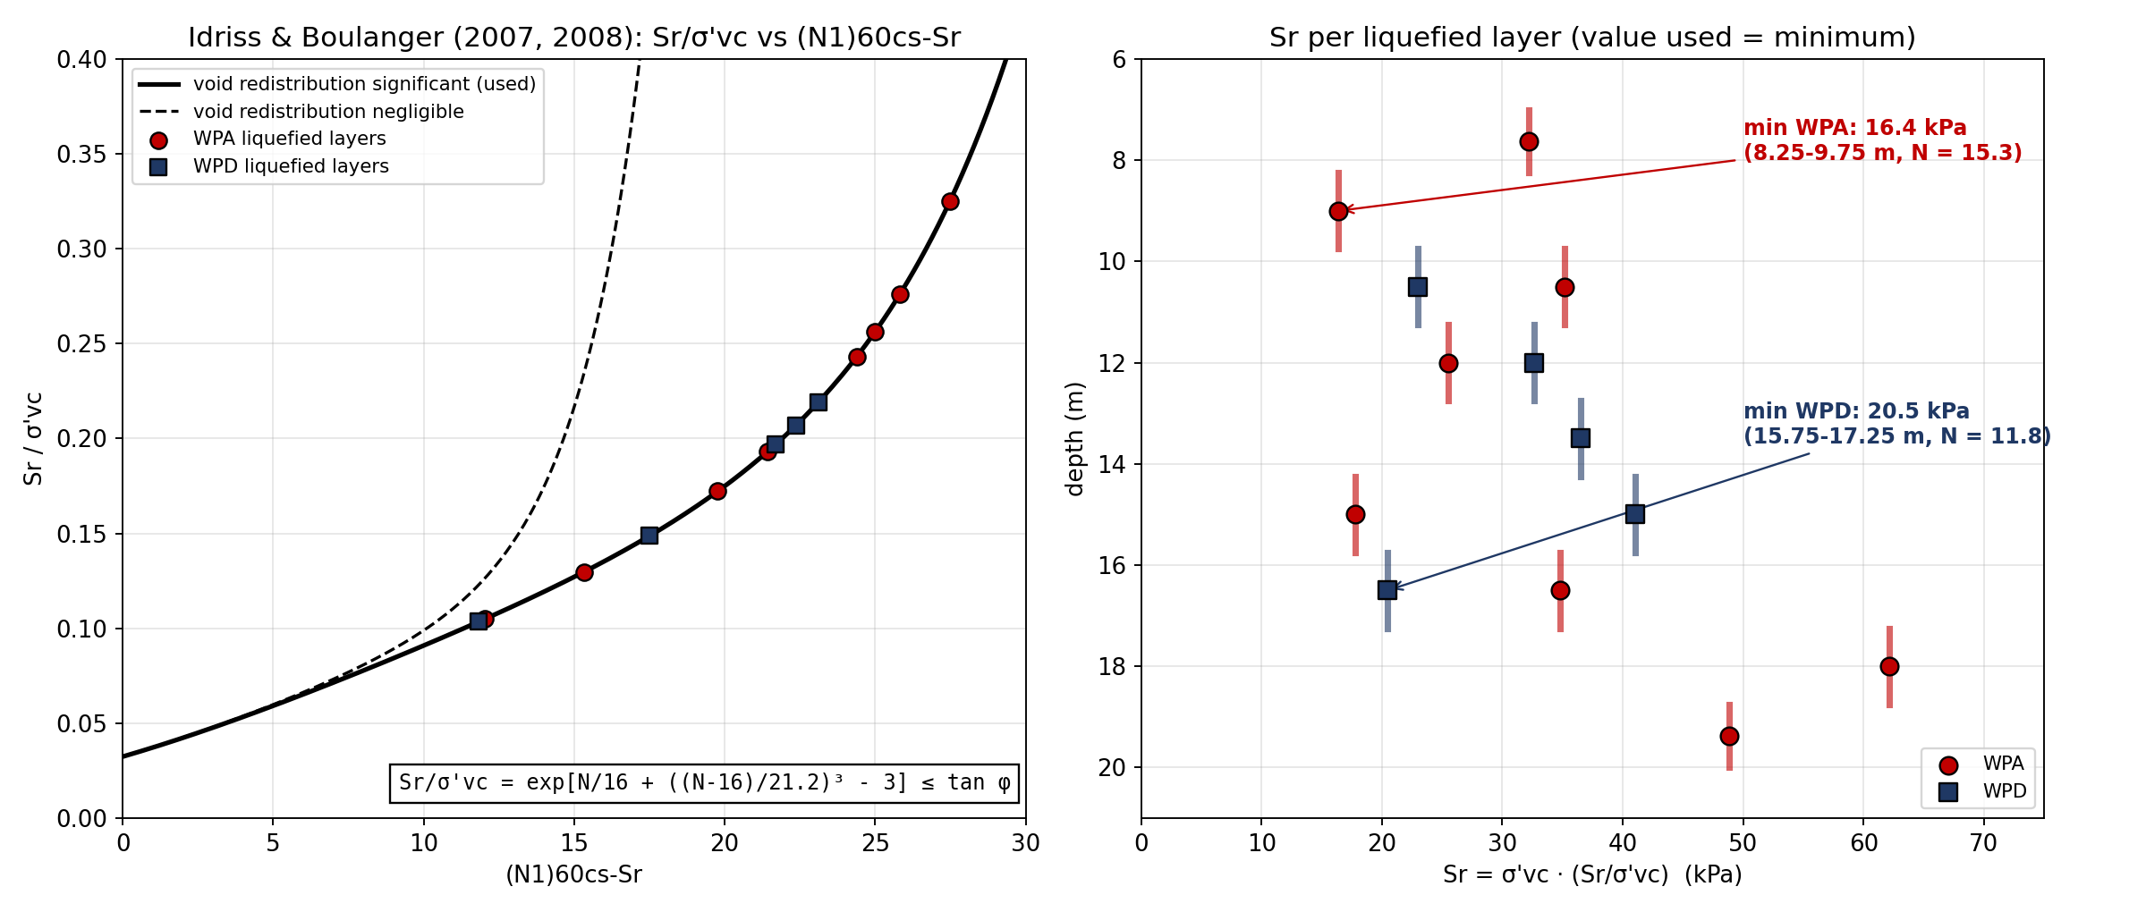
BEARING CAPACITY: LIQUEFACTION CONDITION
Method: Two checks (static loads after shaking)
(a) 2:1 spread:
Δσ = (V - γ·Df·A) / [(B'+H)(L'+H)].
Capacity = 5.14·Sr·(1 + 0.2B/L).
(b) Meyerhof & Hanna:
qu = (1 + 0.2B'/L')·5.14·Sr + γ1·H²·(1 + B'/L')(1 + 2Df/H)·Ks·tanφ1/B' + γ1·Df ≤ qt.
Ks: 1 - sin φ1 (lower bound). Last column: Ks needed for FS 1.1.
Sr: lowest residual strength of the liquefied layers, I&B (2007, 2008)
Target: FS ≥ 1.1. Red title = NOT OK.
There are several combinations NOT OK
Lowest FS = 0.55 (WPA, ASD2(max))
With liquefaction, bearing capacity is the problem,
at both Wellpad A and Wellpad D
Wellpad | Combination | H (m) | Sr (kPa) | Δσ 2:1 (kPa) | 5.14·Sr·sc (kPa) | FS 2:1 | qu M&H (kPa) | q' (kPa) | FS M&H | Status
WP-A | ASD1 | 6.00 | 16.4 | 21 | 95 | 4.52 | 136 | 57 | 2.39 | OK
 | ASD2(max) | 6.00 | 16.4 | 119 | 96 | 0.80 | 137 | 251 | 0.55 | NOT OK
 | ASD2(min) | 6.00 | 16.4 | 73 | 96 | 1.31 | 137 | 162 | 0.85 | NOT OK
WP-D | ASD1 | 8.75 | 20.5 | 17 | 120 | 7.05 | 181 | 57 | 3.18 | OK
 | ASD2(max) | 8.75 | 20.5 | 96 | 120 | 1.25 | 182 | 251 | 0.73 | NOT OK
 | ASD2(min) | 8.75 | 20.5 | 59 | 120 | 2.05 | 183 | 162 | 1.13 | OK
GEOTECHNICAL INVESTIGATION & DETAIL ENGINEERING DESIGN
BORA PULU GEOTHERMAL PSPE AREA

Slide 21
RIG FOUNDATION ANALYSIS
PILE FOUNDATION

Slide 22
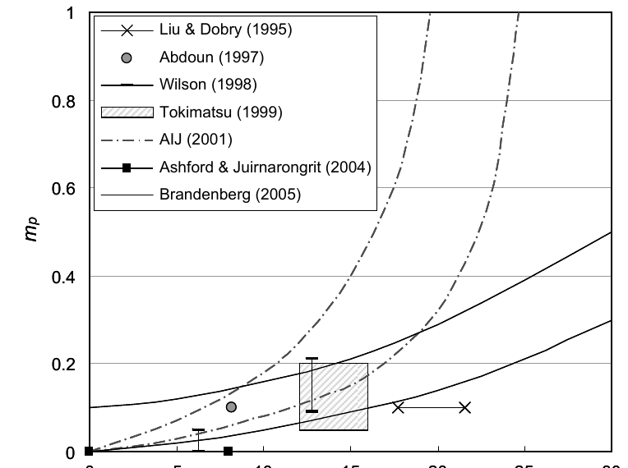
RIG FOUNDATION: ANALYSIS METHOD
Scope: bored piles Ø1000 mm under a rigid pile cap for the drilling rig, at Wellpad A and Wellpad D (both with 2 cellars). Pile group analysed in Ensoft GROUP.
Steps
1. Pile capacity: allowable axial and pull-out capacity from SPT, before and after liquefaction. Shaft friction in the liquefied zone is set to about zero.
2. Loads: support reactions of the MIDAS rig model, in ASD (bearing, settlement) and LRFD (pile strength) combinations. Cap self-weight added and factored.
3. Pile group model: rigid cap on piles with p-y, t-z and q-z springs (beam on nonlinear Winkler foundation).
4. Liquefied case: p-y springs scaled by p-multipliers mp from PEER 2011/04 (Table 4.1), static p-y, no group reduction in the liquefied layer.
5. Checks: capacity ratio ≤ 1.0, settlement ≤ 25.4 mm (SNI 9247:2024), lateral deflection ≤ 25 mm, pile stress ≤ fc' 30 MPa. Layout: 4x1 piles per rig node.
M1
NON-LIQUEFIED
Static ground conditions
Analysed
M3
LIQUEFIED
p-multipliers, zero shaft friction in the liquefied zone
Analysed
M4
LATERAL SPREADING
Free-field ground displacement and crust load on the cap
NOT YET ANALYSED
(N1)60cs | mp, PEER | mp used
< 8 | 0.0-0.1 | 0.05
8-16 | 0.05-0.2 | 0.125
16-24 | 0.1-0.3 | 0.20
> 24 | 0.2-0.5 | 0.35
Item | Wellpad A | Wellpad D
Pile cap | 25 × 12 × 1.2 m (2 cellars) | 25 × 12 × 1.2 m (2 cellars)
Piles | 16 × Ø1000 mm, L = 43 m | 16 × Ø1000 mm, L = 48 m
Design borehole | BH-02 | BH-04
Water table | 7.0 m | 9.0 m
Liquefiable zone | 7.5-21 m | 10.5-19.5 m
Rig moment per node (ASD) | ± 14,086 kNm | ± 14,086 kNm
(b) mp from PEER Table 4.1; mid-range adopted,
(a) Published p-multipliers for liquefied sand (PEER 2011/04, Fig. 4.2).
NOTICE: LATERAL SPREADING NOT YET REVIEWED
The results cover model M1 (non-liquefied) and M3 (liquefied) only. Model M4 (lateral spreading) has not been analysed yet.
The foundation design is not final until M4 is checked (PEER 2011/04)
GEOTECHNICAL INVESTIGATION & DETAILED ENGINEERING DESIGN
BORA PULU GEOTHERMAL PSPE AREA

Slide 23
LOAD COMBINATIONS – 2 CELLARS
Code | Combination | FZ per node (kN) | Max |MY| per node (kNm) | Purpose
ASD1 | 1.0D | 1,618 | 1,003 | Bearing capacity & settlement
ASD2 | 1.0D + 1.0RIG (max/min envelope) | 7,680 / 805 | 14,086 | Bearing capacity & settlement
ASD3/4 | 1.118D + 0.7E (nominal) | 1,812 | 1,259 | Bearing capacity, nominal earthquake
LRFD1 | 1.4D | 2,266 | 1,404 | Pile strength
LRFD2 | 1.2D + 1.6RIG (max/min envelope) | 11,640 / 640 | 22,136 | Pile strength
LRFD3/4 | 1.369D + 1.0E (strong) | 2,217 | 1,569 | Strength, strong earthquake
Loads from MIDAS support reactions of the 2-cellar rig model, converted to GROUP axes; the same rig loads are used for Wellpad A and Wellpad D.
Rig moments at the two cellars act with different magnitudes and are resisted jointly by the combined cap (node lever arm ±6 m).
Total vertical load on the pile group incl. cap self-weight: 46,673 kN (ASD1) to 70,918 kN (ASD2 max); static p-y for M1 gravity cases and all M3 cases, cyclic p-y for M1 seismic cases.
GEOTECHNICAL INVESTIGATION & DETAIL ENGINEERING DESIGN
BORA PULU GEOTHERMAL PSPE AREA

Slide 24
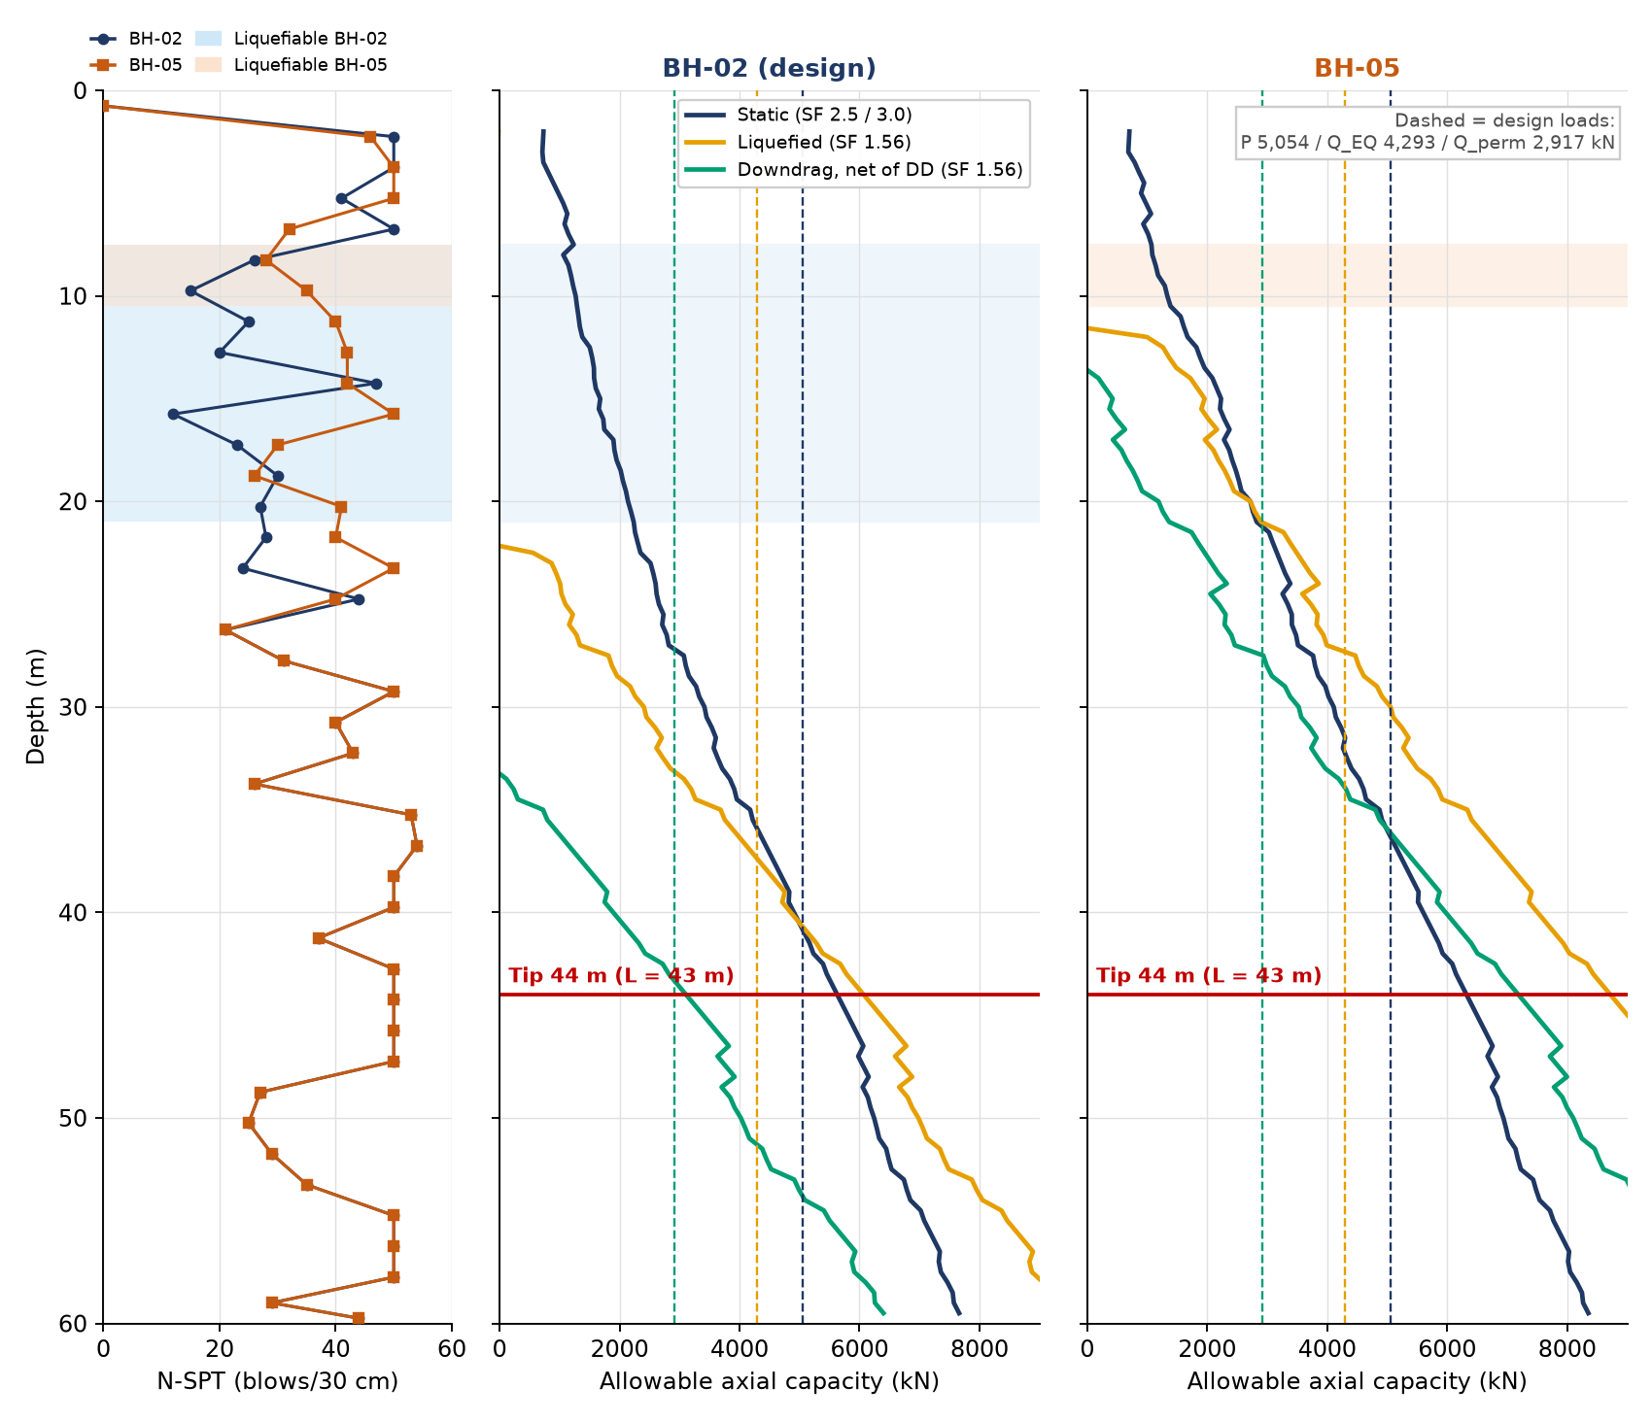
PILE CAPACITY – WELLPAD A: Ø1000 mm, BH-02
Capacity at L = 43 m (tip 44 m), both boreholes
Condition | Load (kN) | Qa BH-02 | Ratio | Qa BH-05 | Ratio
Static (SF 2.5 / 3.0) | 5,054 | 5,628 | 0.90 | 6,321 | 0.80
Liquefied (SF 1.56) | 4,293 | 6,067 | 0.71 | 8,719 | 0.49
Downdrag (SF 1.56) | 2,917 | 3,108 | 0.94 | 7,186 | 0.41
Tension (SF 3.0) | 0 | 3,653 | 0.00 | 4,057 | 0.00
Basis
Two boreholes in this wellpad: BH-02 and BH-05. Same pile length and loads checked for both.
Static: Qa = Qs/2.5 + Qb/3 − W'p; qb = 57.5·N ≤ 2,870 kPa; no friction over the bottom 1D.
Liquefied: no friction above the liquefiable base; SF 1.56.
Downdrag: Qa = R/1.56 − W'p − DD; DD = 2,959 kN (BH-02) and 1,533 kN (BH-05).
Loads: max. pile axial from GROUP (ASD2 max M1, LRFD3 M3, ASD1).
BH-02 gives the lower capacity in every case, so it is the critical borehole and is used for design (GWL 7.0 m, liquefiable 7.5–21.0 m). All checks OK at L = 43 m.
Figure. N-SPT (BH-02 and BH-05, shaded = liquefiable) and allowable axial capacity per pile vs depth; dashed lines = design loads from GROUP
GEOTECHNICAL INVESTIGATION & DETAILED ENGINEERING DESIGN
BORA PULU GEOTHERMAL PSPE AREA

Slide 25
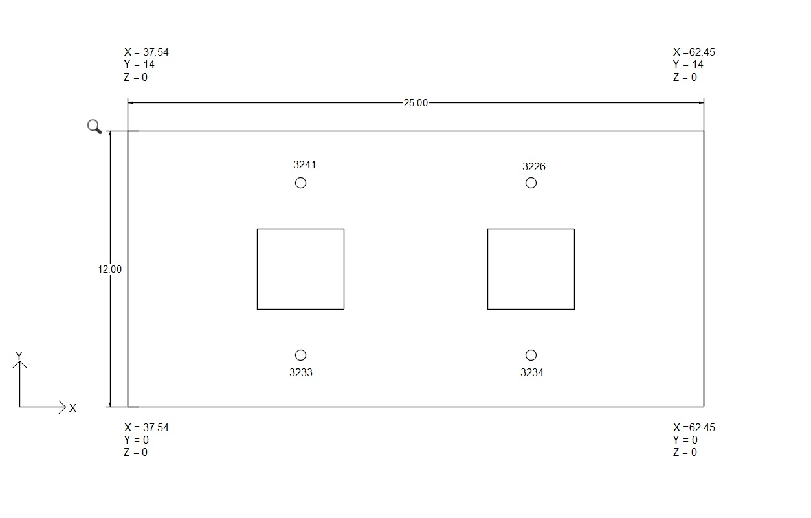
GROUP RESULTS – WELLPAD A: PILE REACTIONS
Model | Load case | Vert. load (kN) | Max axial (kN) | Min axial (kN) | Max shear (kN) | Max moment (kNm) | Settlement (mm) | Head defl. (mm)
M1 | ASD1 | 46,673 | 2,917 | 2,917 | 0 | 0 | 3.4 | 0.0
M1 | ASD2(max) | 70,918 | 5,054 | 3,811 | 0 | 44 | 6.1 | 0.2
M1 | ASD2(min) | 43,420 | 3,282 | 2,024 | 0 | 37 | 3.2 | 0.2
M1 | ASD3 | 53,301 | 3,593 | 3,070 | 307 | 530 | 4.2 | 1.6
M1 | ASD4 | 53,301 | 3,561 | 3,102 | 307 | 524 | 4.2 | 1.6
M1 | LRFD1 | 65,343 | 4,084 | 4,084 | 0 | 0 | 5.5 | 0.0
M1 | LRFD2(max) | 94,800 | 6,880 | 4,924 | 0 | 71 | 8.8 | 0.3
M1 | LRFD2(min) | 50,802 | 4,127 | 2,063 | 0 | 66 | 4.0 | 0.3
M1 | LRFD3 | 65,421 | 4,471 | 3,707 | 439 | 783 | 5.5 | 2.4
M1 | LRFD4 | 65,421 | 4,424 | 3,754 | 439 | 775 | 5.5 | 2.4
M3 | ASD1 | 46,673 | 2,917 | 2,917 | 0 | 0 | 5.4 | 0.0
M3 | ASD3 | 52,596 | 3,456 | 3,078 | 215 | 358 | 6.2 | 1.1
M3 | ASD4 | 52,596 | 3,440 | 3,116 | 215 | 351 | 6.2 | 1.1
M3 | LRFD1 | 65,343 | 4,084 | 4,084 | 0 | 0 | 8.6 | 0.0
M3 | LRFD3 | 64,415 | 4,293 | 3,759 | 307 | 518 | 8.4 | 1.6
M3 | LRFD4 | 64,415 | 4,260 | 3,792 | 307 | 509 | 8.4 | 1.7
Pile cap 25 × 12 × 1.2 m, rig load nodes
Check | Demand (kN) | Capacity (kN) | Ratio
Static, ASD2 max (M1) | 5,054 | 5,628 | 0.90
Liquefied, M3 max | 4,293 | 6,067 | 0.71
Downdrag, ASD1 | 2,917 | 3,108 | 0.94
All checks OK at L = 43 m.
No tension in any pile (min. axial 2,024 kN). Settlement and deflection far below 25.4 mm (SNI 9247:2024) and 25 mm. Lateral spreading (M4) not yet analysed.
M1 = non-liquefied, M3 = liquefied (p-multipliers, no friction in liquefied zone). 16 piles Ø1000 mm, 4x1 under each rig node.
0.94
6.2 mm
2.4 mm
0
Max capacity ratio
Max pile-group settlement (ASD)
Max lateral head deflection
Piles in tension
GEOTECHNICAL INVESTIGATION & DETAILED ENGINEERING DESIGN
BORA PULU GEOTHERMAL PSPE AREA

Slide 26
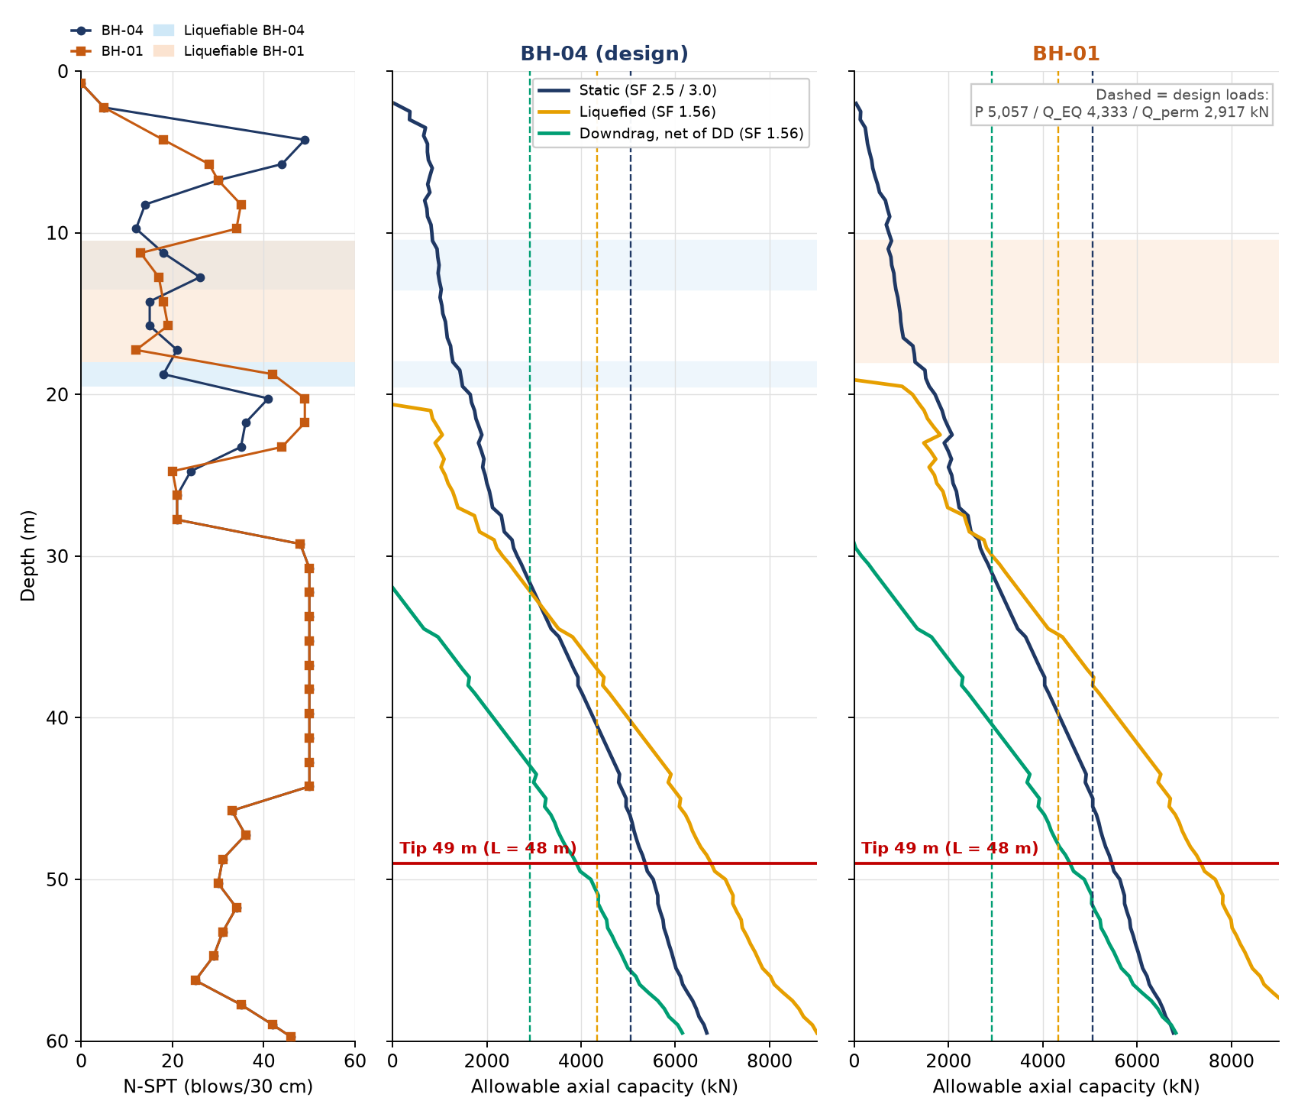
PILE CAPACITY – WELLPAD D: Ø1000 mm, BH-04
Capacity at L = 48 m (tip 49 m), both boreholes
Condition | Load (kN) | Qa BH-04 | Ratio | Qa BH-01 | Ratio
Static (SF 2.5 / 3.0) | 5,057 | 5,359 | 0.94 | 5,463 | 0.93
Liquefied (SF 1.56) | 4,333 | 6,757 | 0.64 | 7,352 | 0.59
Downdrag (SF 1.56) | 2,917 | 3,901 | 0.75 | 4,575 | 0.64
Tension (SF 3.0) | 0 | 3,807 | 0.00 | 3,868 | 0.00
Basis
Two boreholes in this wellpad: BH-04 and BH-01. Same pile length and loads checked for both.
Static: Qa = Qs/2.5 + Qb/3 − W'p; qb = 57.5·N ≤ 2,870 kPa; no friction over the bottom 1D.
Liquefied: no friction above the liquefiable base; SF 1.56.
Downdrag: Qa = R/1.56 − W'p − DD; DD = 2,856 kN (BH-04) and 2,778 kN (BH-01).
Loads: max. pile axial from GROUP (ASD2 max M1, LRFD3 M3, ASD1).
BH-04 gives the lower capacity in every case, so it is the critical borehole and is used for design (GWL 9.0 m, liquefiable 10.5–19.5 m). All checks OK at L = 48 m.
Figure. N-SPT (BH-04 and BH-01, shaded = liquefiable) and allowable axial capacity per pile vs depth; dashed lines = design loads from GROUP
GEOTECHNICAL INVESTIGATION & DETAILED ENGINEERING DESIGN
BORA PULU GEOTHERMAL PSPE AREA

Slide 27
GROUP RESULTS – WELLPAD D: PILE REACTIONS
Model | Load case | Vert. load (kN) | Max axial (kN) | Min axial (kN) | Max shear (kN) | Max moment (kNm) | Settlement (mm) | Head defl. (mm)
M1 | ASD1 | 46,673 | 2,917 | 2,917 | 0 | 0 | 3.2 | 0.0
M1 | ASD2(max) | 70,918 | 5,057 | 3,808 | 0 | 33 | 5.2 | 0.2
M1 | ASD2(min) | 43,420 | 3,341 | 2,087 | 0 | 25 | 3.0 | 0.2
M1 | ASD3 | 53,301 | 3,632 | 3,031 | 307 | 653 | 3.7 | 2.5
M1 | ASD4 | 53,301 | 3,595 | 3,067 | 307 | 649 | 3.7 | 2.5
M1 | LRFD1 | 65,343 | 4,084 | 4,084 | 0 | 0 | 4.7 | 0.0
M1 | LRFD2(max) | 94,800 | 6,840 | 4,829 | 0 | 63 | 7.7 | 0.4
M1 | LRFD2(min) | 50,802 | 4,118 | 2,153 | 0 | 41 | 3.6 | 0.3
M1 | LRFD3 | 65,421 | 4,518 | 3,621 | 439 | 957 | 4.7 | 3.9
M1 | LRFD4 | 65,421 | 4,466 | 3,690 | 439 | 951 | 4.7 | 4.0
M3 | ASD1 | 46,673 | 2,917 | 2,917 | 0 | 0 | 4.2 | 0.0
M3 | ASD3 | 52,596 | 3,501 | 3,074 | 215 | 446 | 4.8 | 1.7
M3 | ASD4 | 52,596 | 3,475 | 3,100 | 215 | 442 | 4.8 | 1.8
M3 | LRFD1 | 65,343 | 4,084 | 4,084 | 0 | 0 | 6.6 | 0.0
M3 | LRFD3 | 64,415 | 4,333 | 3,719 | 307 | 643 | 6.5 | 2.6
M3 | LRFD4 | 64,415 | 4,295 | 3,757 | 307 | 636 | 6.5 | 2.7
Pile cap 25 × 12 × 1.2 m, rig load nodes
Check | Demand (kN) | Capacity (kN) | Ratio
Static, ASD2 max (M1) | 5,057 | 5,359 | 0.94
Liquefied, M3 max | 4,333 | 6,757 | 0.64
Downdrag, ASD1 | 2,917 | 3,901 | 0.75
All checks OK at L = 48 m.
No tension in any pile (min. axial 2,087 kN). Settlement and deflection far below 25.4 mm (SNI 9247:2024) and 25 mm. Lateral spreading (M4) not yet analysed.
M1 = non-liquefied, M3 = liquefied (p-multipliers, no friction in liquefied zone). 16 piles Ø1000 mm, 4x1 under each rig node.
0.94
5.2 mm
4.0 mm
0
Max capacity ratio
Max pile-group settlement (ASD)
Max lateral head deflection
Piles in tension
GEOTECHNICAL INVESTIGATION & DETAILED ENGINEERING DESIGN
BORA PULU GEOTHERMAL PSPE AREA

Slide 28
MIDAS GTS NX: SOIL PARAMETERS AND LOADS
Wellpad A (BH-02), GWL 7.0 m – Hardening Soil small
Wellpad D (BH-04, BH-01 below 25 m), GWL 9.0 m
Layer | Depth (m) | Description | N | γ (kN/m³) | φ' (°) | c' (kPa) | E50ref (kPa)
L01 | 0–7.5 | Sand, dense–very dense | 48 | 18.5 | 41.0 | 1 | 60,000
L02 | 7.5–12 | Sand, medium dense (liq.) | 22 | 18.5 | 32.7 | 1 | 33,994
L03 | 12–15 | Clay, very stiff–hard | 34 | 18.5 | 30.0 | 10 | 35,275
L04 | 15–28.5 | Sand, medium dense | 27 | 18.5 | 32.3 | 1 | 32,908
L05 | 28.5–48 | Sand, dense–very dense | 46 | 18.5 | 34.3 | 1 | 38,877
L06 | 48–54 | Sand, medium dense | 29 | 18.5 | 31.2 | 1 | 28,927
L07 | 54–60 | Sand, dense–very dense | 46 | 18.5 | 33.2 | 1 | 35,562
Layer | Depth (m) | Description | N | γ (kN/m³) | φ' (°) | c' (kPa) | E50ref (kPa)
L01 | 0–3 | Silty clay, firm | 5 | 19.6 | 24.0 | 2 | 17,432
L02 | 3–7.5 | Sand, dense | 42 | 19.6 | 39.5 | 1 | 51,946
L03 | 7.5–10.5 | Clay, stiff | 13 | 19.6 | 26.0 | 4 | 13,090
L04 | 10.5–19.5 | Clay, very stiff (+sand) | 19 | 19.6 | 28.0 | 6 | 15,860
L05 | 19.5–24 | Clay, hard (+sand) | 37 | 19.6 | 30.0 | 10 | 27,521
L06 | 24–28.5 | Clay, very stiff (+sand) | 22 | 17.8 | 28.0 | 6 | 13,803
L07 | 28.5–49.5 | Clay, hard (+sand) | 46 | 17.8 | 30.0 | 10 | 24,921
L08 | 49.5–60 | Sand, medium dense–dense | 32 | 17.8 | 31.2 | 1 | 29,093
Eurref = 3·E50ref; Eoedref = E50ref (sand) ; m = 0.5 (sand), 0.8 (clay); ν = 0.2. Sand: Dr from (N1)60 (Skempton 1986), φ' Wolff (1989), E50ref = 60,000·Dr (Brinkgreve et al. 2010). Clay: su = 5N, E50 = 1000N.
Rig loads per node (Midas support reactions, ASD)
Model set-up
Cap as shell elements; piles as beam elements with pile interface springs.
Pile length L = 43 m (Wellpad A) and 48 m (Wellpad D); 16 piles Ø1000 mm.
Interface: kt = Gi/(tv·L), kn = Eoed,i/(tv·L), R = 0.67, tv = 0.1; ultimate shaft and tip values from the single-pile capacity.
Soil: Hardening Soil small (HSs), merged layers of the design borehole.
Static, non-liquefied condition (service settlement).
Combination | Description | FZ per node (kN) | Max |MY| per node (kNm)
ASD1 | 1.0D | 1,618 | 1,003
ASD2 (max) | 1.0D + 1.0RIG | 7,680 | 14,086
ASD2 (min) | 1.0D + 1.0RIG | 805 | 14,086
ASD3/4 | 1.118D + 0.7E | 1,812 | 1,259
Loads applied at nodes 3226, 3233, 3234 and 3241 on the 25 × 12 × 1.2 m cap (2 cellars).
GEOTECHNICAL INVESTIGATION & DETAILED ENGINEERING DESIGN
BORA PULU GEOTHERMAL PSPE AREA

Slide 29
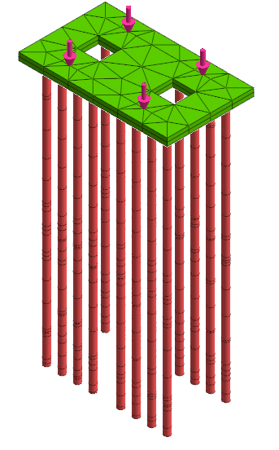
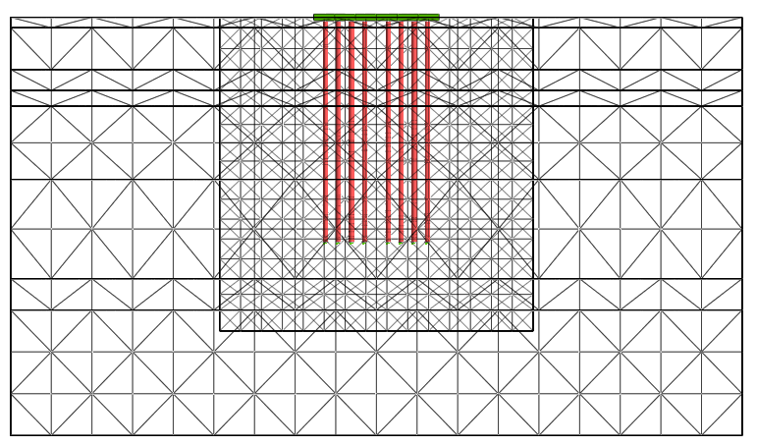
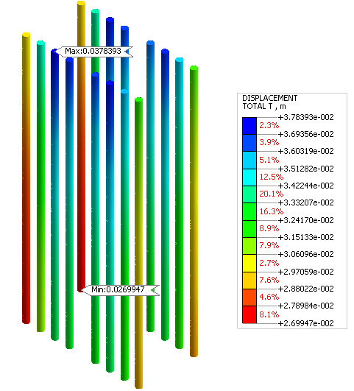
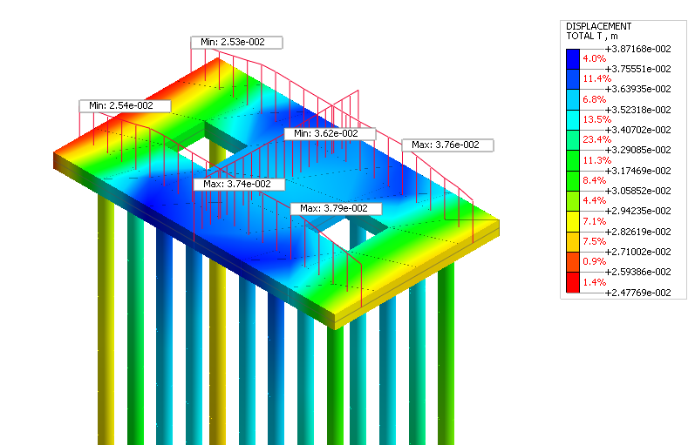
RESULTS SETTLEMENT WELLPAD A – MIDAS GTS NX
Settlement summary
Result | Min (mm) | Max (mm)
Pile cap | 25.3 | 37.9
Piles (head) | 27.0 | 37.8
Differential over cap |  | 12.6
What it shows
Maximum settlement 38 mm under the heaviest rig nodes.
Differential settlement over the cap 12.6 mm vs 25.4 mm limit (SNI 9247:2024): OK.
Piles and cap move together (rigid cap behaviour).
(a) 3D model: cap, piles and rig loads
(b) Mesh section with piles
Total 38 mm, differential 13 mm.
Includes the soil settlement under the full platform load; static, non-liquefied case.
(c) Total displacement of the cap (m)
(d) Total displacement of the piles (m)
GEOTECHNICAL INVESTIGATION & DETAILED ENGINEERING DESIGN
BORA PULU GEOTHERMAL PSPE AREA

Slide 30
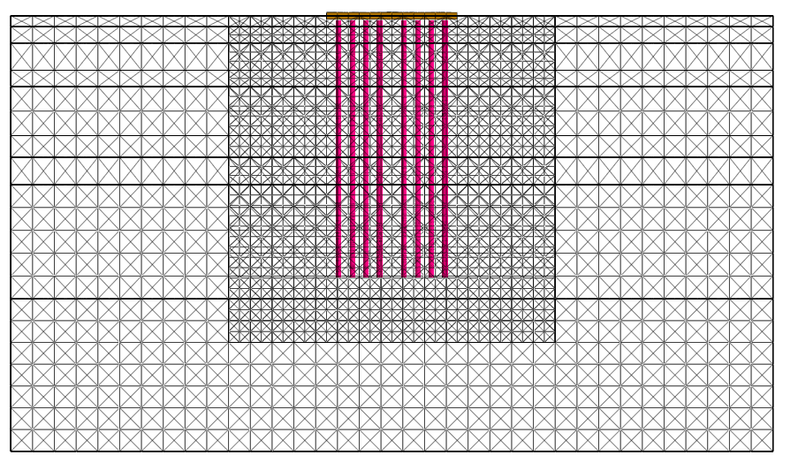
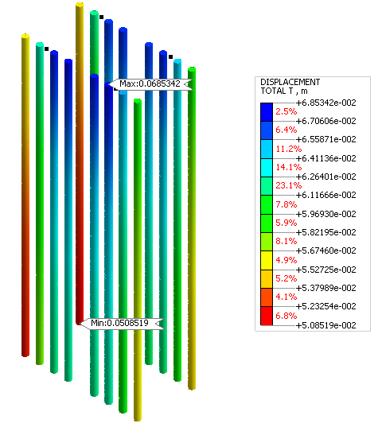
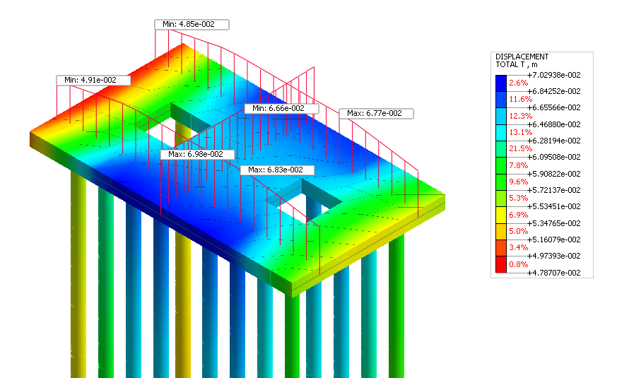
RESULTS SETTLEMENT WELLPAD D – MIDAS GTS NX
Settlement summary
Result | Min (mm) | Max (mm)
Pile cap | 48.5 | 69.8
Piles (head) | 50.9 | 68.5
Differential over cap |  | 21.3
What it shows
Maximum settlement 70 mm under the heaviest rig nodes.
Differential settlement over the cap 21.3 mm vs 25.4 mm limit (SNI 9247:2024): OK.
Piles and cap move together (rigid cap behaviour).
(a) 3D model: cap, piles and rig loads
(b) Mesh section with piles
Total 70 mm, differential 21 mm.
Includes the soil settlement under the full platform load; static, non-liquefied case.
(c) Total displacement of the cap (m)
(d) Total displacement of the piles (m)
GEOTECHNICAL INVESTIGATION & DETAILED ENGINEERING DESIGN
BORA PULU GEOTHERMAL PSPE AREA

Slide 31
SOIL IMPROVEMENT
RECOMMENDATION

Slide 32
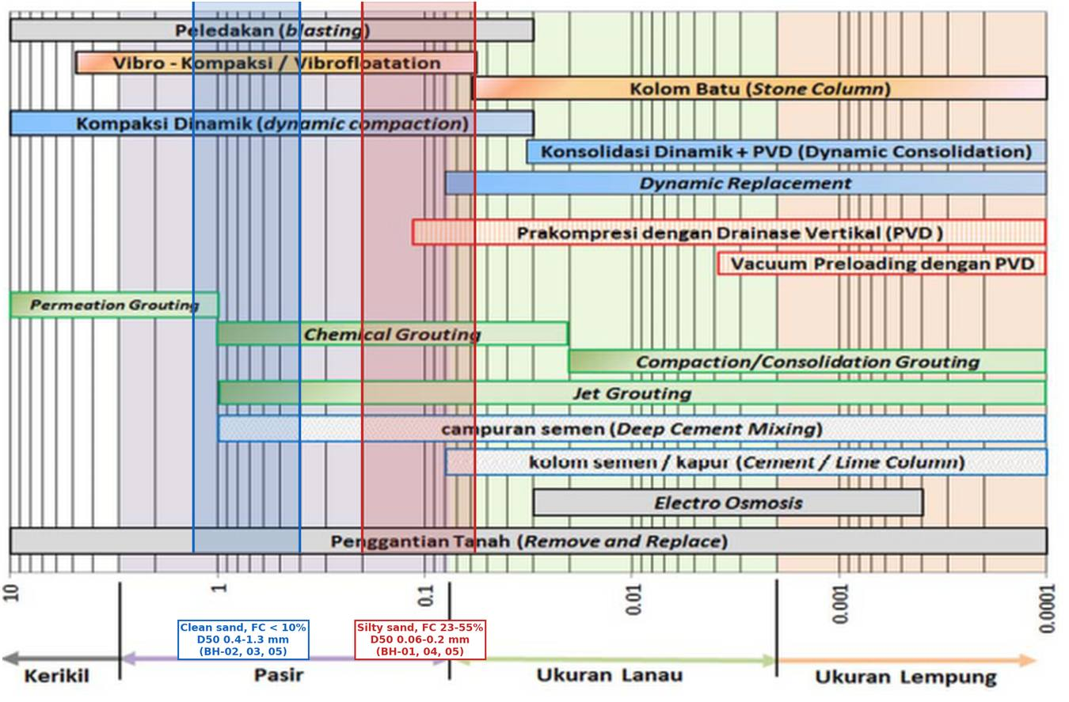
SOIL IMPROVEMENT ALTERNATIVE: SCREENING
Three checks per method:
(1) Fits the soil grain size (SNI chart)? (2) Reaches 7.5–20 m? (3) Gives FS ≥ 1.25 and limits spreading?
Site conditions
Two soil groups: clean sand, FC < 10% (Well Pad A, Log Yard, BH-05); silty sand, FC 23–55% (Well Pad D)
Depth: GWL 7–9 m; liquefiable 7.5–20 m (22.5 m at BH-02) → treat through the crust to 20–23 m
Target FS ≥ 1.25: needs (N1)60cs 31–33; now 12–29
Lateral spreading: 3.3–6.0 m
Other standards
EN 1998-5: compact or drain; piles alone only with caution
FHWA (2017): vibro-compaction only in clean sand (fines < 10–15%)
PHRI (1997): treat beyond the footprint; DSM worked in Kobe 1995
NZGS/MBIE (2021): set settlement and spreading limits; test before and after
(a) Ground improvement methods by grain size (SNI), with the site D50 range
Key point:
Raising (N1)60cs to 31–33 is hard, mainly in silty sand. DSM, jet grouting or piles are more reliable for critical items.
GEOTECHNICAL INVESTIGATION & DETAILED ENGINEERING DESIGN
BORA PULU GEOTHERMAL PSPE AREA

Slide 33
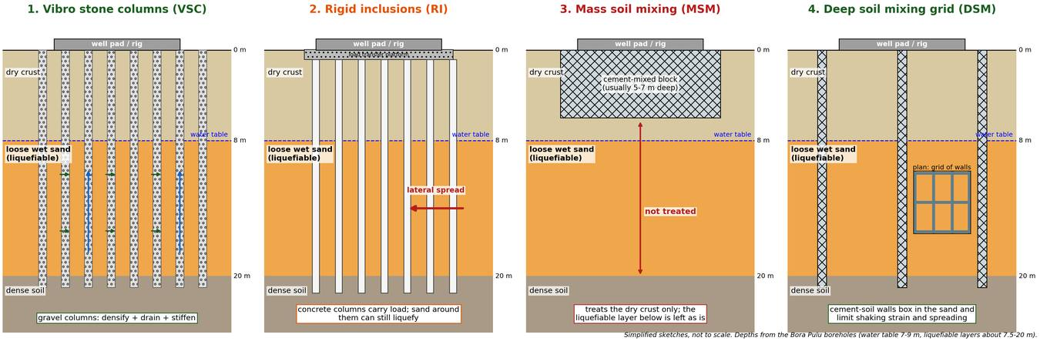
SOIL IMPROVEMENT ALTERNATIVE: HOW EACH METHOD WORKS
How it works
Vibrating probe forms gravel columns: densify, drain, reinforce
At this site
Reaches 20–25 m. Good in clean sand; weak in silty sand (Well Pad D). Needs a field trial.
How it works
Concrete columns + gravel platform carry the load to dense soil
At this site
Controls settlement, but the sand still liquefies. Columns can break under 3–6 m spreading. Not a stand-alone fix.
How it works
Cement mixed in place → one stiff block
At this site
Only 5–7 m deep: dry crust only. Liquefiable layers (7.5–20 m) stay untreated. Platform only.
How it works
Overlapping cement-soil walls in a grid: box in the sand, limit strain, resist spreading
At this site
Both soil groups, 20–30 m. Most reliable, but costly. Best for the rig and sensitive equipment.
GEOTECHNICAL INVESTIGATION & DETAILED ENGINEERING DESIGN
BORA PULU GEOTHERMAL PSPE AREA

Slide 34
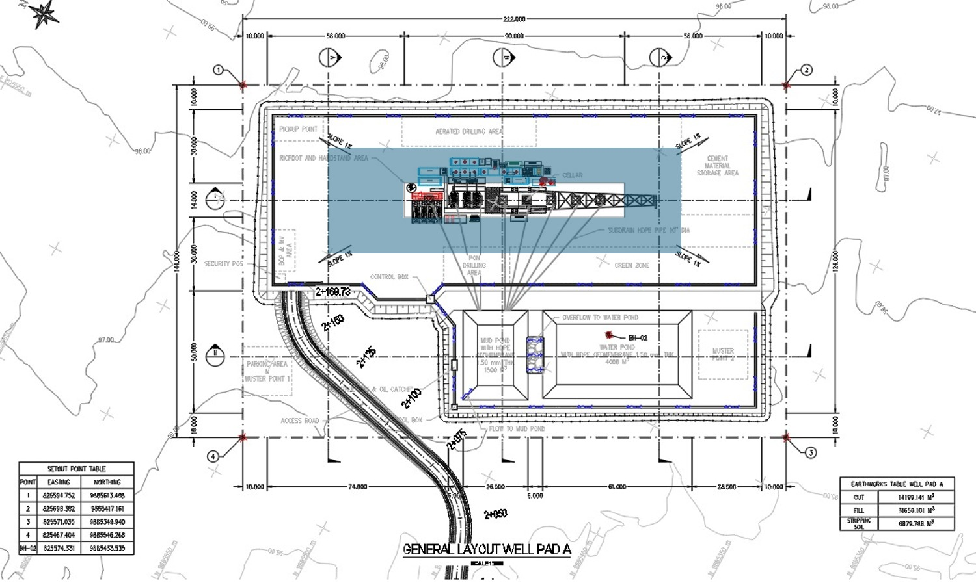
SOIL IMPROVEMENT ALTERNATIVE: LAYOUT AREA IMPROVEMENT
Recommendation Plan Area Improvement
GEOTECHNICAL INVESTIGATION & DETAILED ENGINEERING DESIGN
BORA PULU GEOTHERMAL PSPE AREA

Slide 35
PROS AND CONS OF EACH ALTERNATIVE
Method | Soil fit (SNI chart) | Reaches 7.5-20 m? | Effect on liquefaction | Pros | Cons | Relative cost | Fit for this site
Vibro stone columns (VSC) | Clean sand: yes. Silty sand: as reinforcement | Yes, to 20-25 m | Densify, drain and reinforce | Proven for liquefaction; fast; widely available | Weak densification when FC > 15-20%; (N1)60cs 31-33 hard to reach; needs trial | Medium | Good: shortlist
Vibro-compaction | Clean sand only | Yes | Densification only | Low cost; no cement | Not effective in the silty sand at Well Pad D | Low | Clean sand areas only
Dynamic compaction | Sand: yes | No, about 8-10 m | Densifies the upper part only | Cheap and simple | Does not reach 20 m; strong vibration near wells and facilities | Low | Not suitable
Compaction grouting | Silty sand: yes | Yes | Densification by displacement | Works under or next to existing structures | Slow and costly over large areas; risk of heave | High | Spot use
Jet grouting | All soils | Yes | Solid soil-cement columns | Any soil and any depth; precise | Very high cost; spoil disposal; column size hard to check | Very high | Spot use
Deep soil mixing grid (DSM) | All sands | Yes, 20-30 m | Confines the sand; cuts strain and spreading | Most reliable against liquefaction and spreading; performed well in Kobe 1995 | Specialist rig; needs mix design and coring | High | Good: rig and critical areas
Mass soil mixing (MSM) | All | No, about 5-7 m | Treats the dry crust only | Fast; makes a stiff platform | Does not reach the liquefiable layers | Medium | Not as a stand-alone fix
Rigid inclusions (RI) | All | Yes | None: sand still liquefies | Controls static settlement; quick | Unreinforced columns can crack under lateral spreading; downdrag | Medium | Not as a stand-alone fix
Deep piles | Not a soil treatment | Yes, toe below 20-23 m | Bypasses the liquefied layer | Reliable bearing for the rig | Must carry downdrag and spreading loads; EN 1998-5 advises caution | Medium to high | With full design check
Proposed approach
Exploration phase:
• DSM grid (or jet grouting where access is tight) under the rig, sensitive equipment, and silty sand at Well Pad D
• Deep piles: structural alternative
Before final design:
• Field trial, SPT/CPT before and after
• Target FS ≥ 1.25, or each facility's settlement and movement limits
• Treat beyond the footprint; confirm costs with local contractors
GEOTECHNICAL INVESTIGATION & DETAILED ENGINEERING DESIGN
BORA PULU GEOTHERMAL PSPE AREA

Slide 36

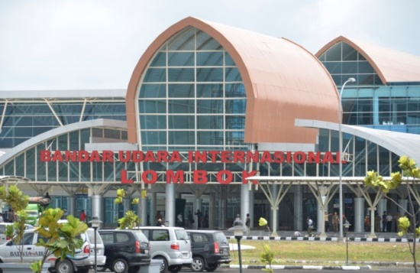
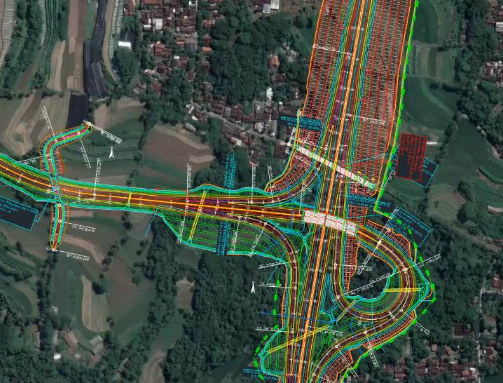
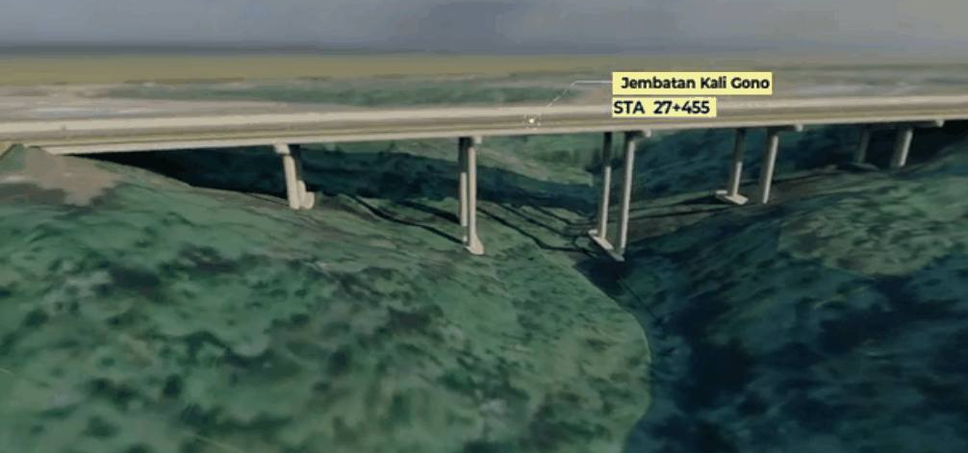
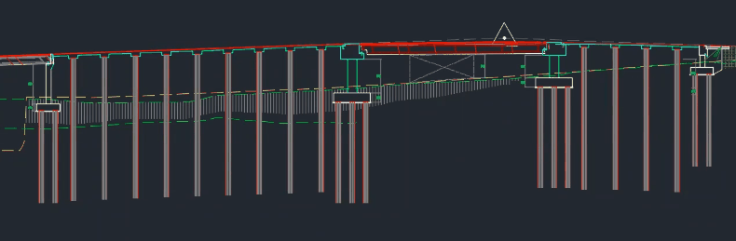
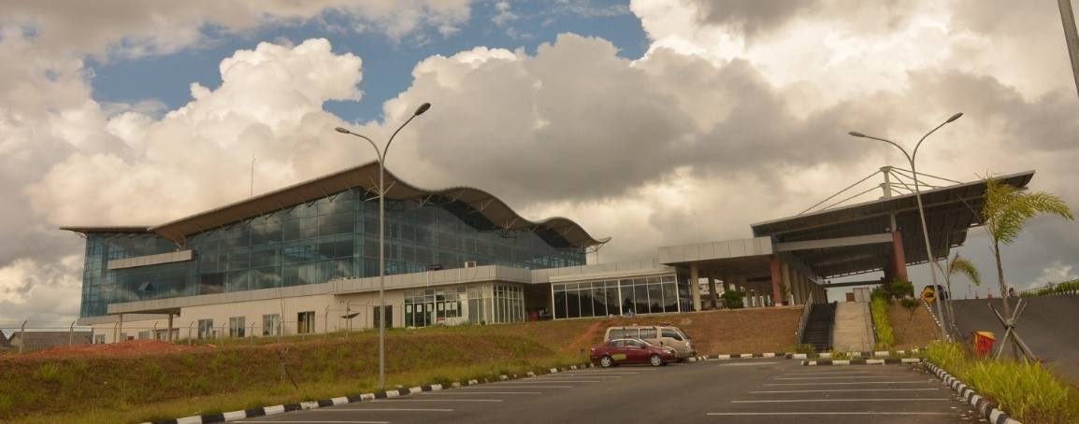
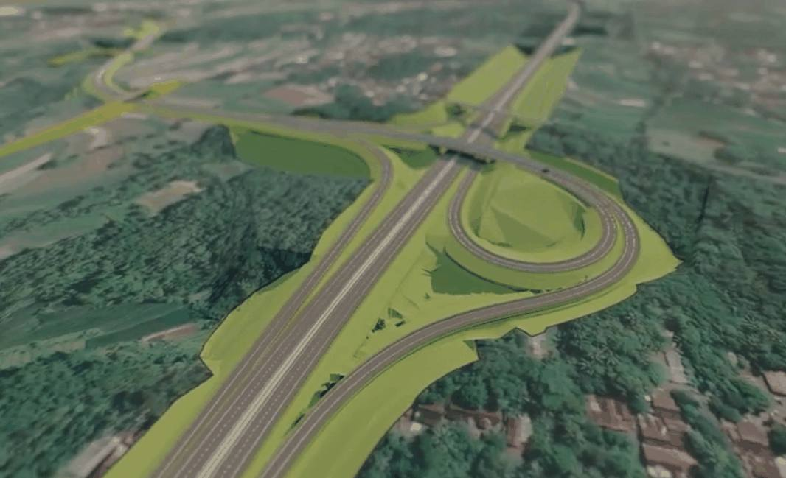

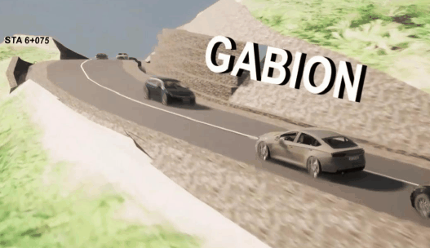
GEOTECHNICAL INVESTIGATION & DETAILED ENGINEERING DESIGN BORA PULU GEOTHERMAL PSPE AREA
THANK YOU

