Slide 1
Merge Sort
DATA STRUCTURES & ALGORITHMS
Divide & Conquer Strategy
Piyush Dekate
O(n log n)
PRN: 25070521195 · Section D · III Semester
Best · Average · Worst
Merge Sort — Divide & Conquer

Slide 2



What is Merge Sort?
INTRODUCTION
A comparison-based sorting algorithm that recursively splits an array into halves, sorts each half independently, then merges them back into a single sorted array.
Recursive
Consistent
Stable
Breaks the problem into sub-problems until each sub-array is trivially sorted (a single element).
Guarantees O(n log n) time in all cases — best, average, and worst — unlike Quick Sort.
Equal elements retain their original relative order, crucial for multi-key sorting scenarios.
Merge Sort — Divide & Conquer

Slide 3
Divide & Conquer
CORE STRATEGY
÷
Divide
⊕
Conquer
Split the array at the midpoint. Keep splitting recursively until every sub-array is a single element — which is already sorted by definition.
Merge two adjacent sorted sub-arrays into one sorted array using a two-pointer technique, writing back to the original array via a temp buffer.
1.
Compute mid = (left + right) / 2
1.
Pointer i on left, j on right sub-array
2.
Recurse on left half [left .. mid]
2.
Copy smaller element into temp buffer
3.
Recurse on right half [mid+1 .. right]
3.
Copy any remaining elements, write back
Merge Sort — Divide & Conquer

Slide 4
Step-by-Step Overview
ALGORITHM
1
Check the base case
If left >= right, the sub-array has at most one element and is already sorted — return immediately.
2
Find the midpoint
Compute mid = (left + right) / 2 to split the range into two roughly equal halves.
3
Recurse on both halves
Call mergeSort(left, mid) and mergeSort(mid+1, right) until base cases are reached.
4
Merge the sorted halves
Call merge(left, mid, right) to combine the two sorted sub-arrays into one sorted result.
Merge Sort — Divide & Conquer

Slide 5
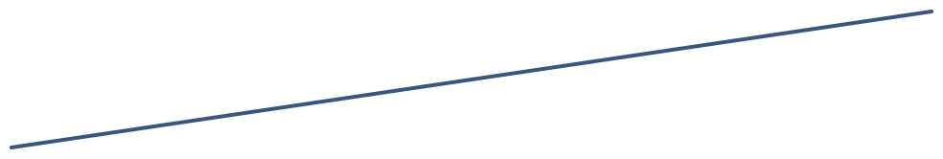
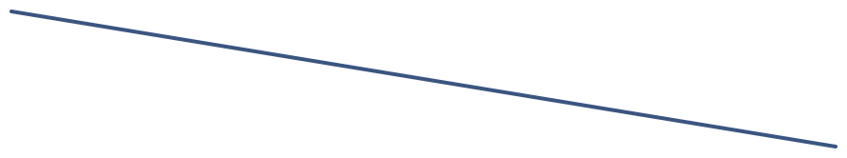

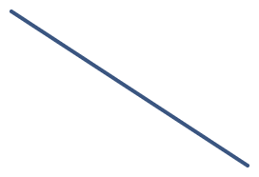




Divide Phase — Recursion Tree
PHASE 1
Input: [9, -5, 7, -2, -1] · Green = base case (single element, already sorted)
9, -5, 7, -2, -1
9, -5, 7
-2, -1
Dividing
Base case
9, -5
7
-2
-1
9
-5
Merge Sort — Divide & Conquer

Slide 6
Merge Phase — Two Pointers
PHASE 2
Merging sorted sub-arrays [-5, 9] and [-2, -1] into one sorted result
Left sub-array (i)
Right sub-array (j)
Merged result (temp)
-5
9
-2
-1
-5
-2
-1
9
i=0 ↑ comparing
j=0 ↑ comparing
Fully merged ✓
Step
Compare
Action
Temp buffer
1
-5 vs -2
-5 < -2, take -5, i++
[-5]
2
9 vs -2
-2 < 9, take -2, j++
[-5, -2]
3
9 vs -1
-1 < 9, take -1, j++
[-5, -2, -1]
4
j exhausted
Copy remaining 9, write back
[-5, -2, -1, 9]
Merge Sort — Divide & Conquer

Slide 7
mergeSort() Function
C IMPLEMENTATION · SLIDE 1 OF 2
Recursive divide — splits the array and calls itself on both halves
// Recursive divide function
void mergeSort(int arr[], int temp[], int left, int right) {
if (left < right) {
// Find midpoint to split evenly
int mid = (left + right) / 2;
// Recurse on left half
mergeSort(arr, temp, left, mid);
// Recurse on right half
mergeSort(arr, temp, mid + 1, right);
// Merge both sorted halves
merge(arr, temp, left, mid, right);
}
}
Base case: When left >= right, the sub-array has ≤1 element — return without doing anything.
temp buffer: Passed from main() so it is allocated once — avoids repeated malloc/free in recursion.
Merge Sort — Divide & Conquer

Slide 8
merge() Function
C IMPLEMENTATION · SLIDE 2 OF 2
Combines two adjacent sorted sub-arrays into one sorted result using two pointers
void merge(int arr[], int temp[], int left, int mid, int right) {
int i = left, j = mid + 1, k = left;
// Compare and pick the smaller element
while (i <= mid && j <= right) {
if (arr[i] <= arr[j]) temp[k++] = arr[i++];
else temp[k++] = arr[j++];
}
// Copy any remaining elements
while (i <= mid) temp[k++] = arr[i++];
while (j <= right) temp[k++] = arr[j++];
// Write sorted result back to original array
for (i = left; i <= right; i++) arr[i] = temp[i];
}
Stability: Using <= ensures equal elements from the left sub-array are placed first, preserving original order.
Write-back: The for-loop at the end copies from temp[] back into arr[], completing the in-place update.
Cost: Each merge step touches every element once — O(n) work per level, O(log n) levels = O(n log n) total.
Merge Sort — Divide & Conquer

Slide 9
Time & Space Complexity
ANALYSIS
TIME COMPLEXITY
SPACE COMPLEXITY
O(n log n)
O(n)
Best · Average · Worst — always the same
Auxiliary temp buffer of size n
Best case
Θ(n log n)
Not in-place — requires additional memory proportional to the input size.
Average case
Θ(n log n)
Worst case
Θ(n log n)
RECURRENCE RELATION
Solved by Master Theorem (Case 2)
T(n) = 2T(n/2) + O(n)
→ O(n log n)
Merge Sort — Divide & Conquer

Slide 10
Full Trace: [9, -5, 7, -2, -1]
WORKED EXAMPLE
DIVIDE
9
-5
7
|
-2
-1
→ split at mid=2
DIVIDE
9
-5
|
7
‖
-2
|
-1
→ 7,-2,-1 are base cases
BASE
9
-5
|
7
|
-2
|
-1
→ all single elements
MERGE
-5
9
|
7
‖
-2
-1
→ merge [9,-5] and [-2,-1]
MERGE
-5
7
9
|
-2
-1
→ merge [-5,7,9] with [-2,-1]
SORTED!
-5
-2
-1
7
9
Merge Sort — Divide & Conquer

Slide 11
Merge Sort vs Other Algorithms
COMPARISON
Algorithm
Best Case
Worst Case
Space
Stable
Strategy
Merge Sort
Θ(n log n)
Θ(n log n)
O(n)
✓ Yes
Divide & Conquer
Bubble Sort
O(n)
O(n²)
O(1)
✓ Yes
Comparison swaps
Quick Sort
O(n log n)
O(n²)
O(log n)
✗ No
Pivot partition
Insertion Sort
O(n)
O(n²)
O(1)
✓ Yes
In-place shifting
Key advantage: Merge Sort is the only algorithm here that guarantees O(n log n) in ALL cases — making it the reliable choice for large, unpredictable data sets.
Merge Sort — Divide & Conquer

Slide 12
Key Takeaways
SUMMARY
1
Divide & Conquer at its core
Split the array in half recursively until single elements remain, then merge sorted halves back up.
AT A GLANCE
Time
O(n log n)
2
Guaranteed O(n log n)
Space
O(n)
Unlike Quick Sort, performance never degrades to O(n²) — best, average, and worst cases are identical.
Stable
✓ Yes
3
Stable but not in-place
In-place
✗ No
Equal elements maintain their original order (stable). Requires O(n) extra temp buffer memory.
4
C implementation tip
RECURRENCE
Allocate temp buffer once in main() — not inside the recursive function — to avoid repeated malloc/free overhead.
T(n) = 2T(n/2) + n
→ O(n log n)
Master Theorem, Case 2
Piyush Dekate
PRN 25070521195 · Section D · III Semester
O(n log n)

