Slide 1
Sphere Embedding
Dekel Matalon.

Slide 2

Sphere representation
$z=\left\{z_{1},z_{2},…,z_{n}\right\}∈R^{n+1}$ is discrete point on n-dim sphere, living in $R^{n+1}$.
r is the radius of the sphere. For every point on the sphere: $\sum_{i=1}^{n}{{z_{i}}^{2}}=r^{2}$
${\left(D_{s}\right)}_{ij}$ is the geodesic distance between points i,j
Z is the matrix which holds all the points

Slide 3

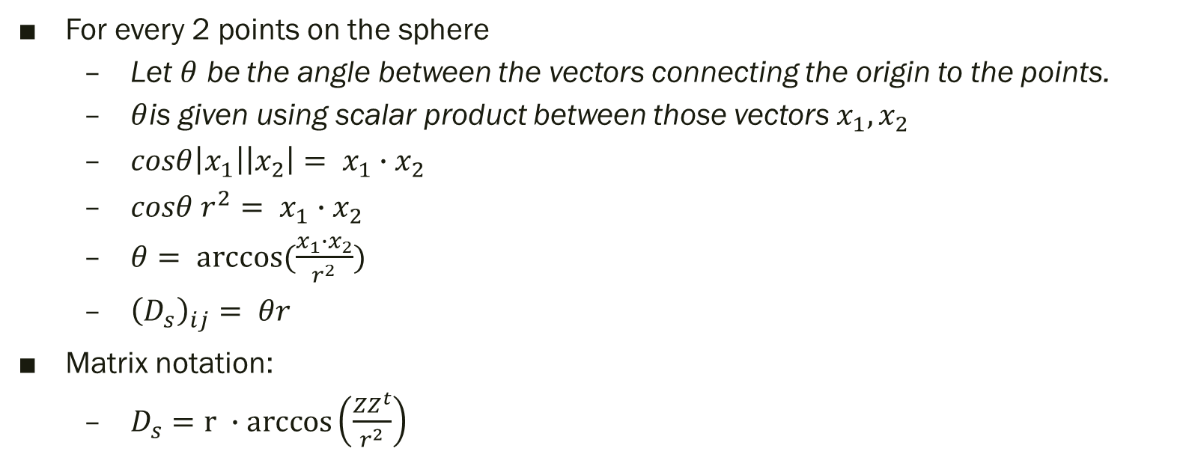

Sphere representation
$D_{s}$ is the geodesic distances Matrix
Relation between Z and $D_{s}$
Z is the matrix which holds all the points
For every 2 points on the sphere
Let $θ$ be the angle between the vectors connecting the origin to the points.
$θ$is given using scalar product between those vectors $x_{1},x_{2}$
$cosθ\left|x_{1}\right|\left|x_{2}\right|= x_{1}∙x_{2}$
$cosθ r^{2}= x_{1}∙x_{2}$
$θ= arccos⁡(\frac{x_{1}∙x_{2}}{r^{2}})$
${\left(D_{s}\right)}_{ij}= θr$
Matrix notation:
$D_{s}=r ∙arccos\left(\frac{ZZ^{t}}{r^{2}}\right)$

Slide 4
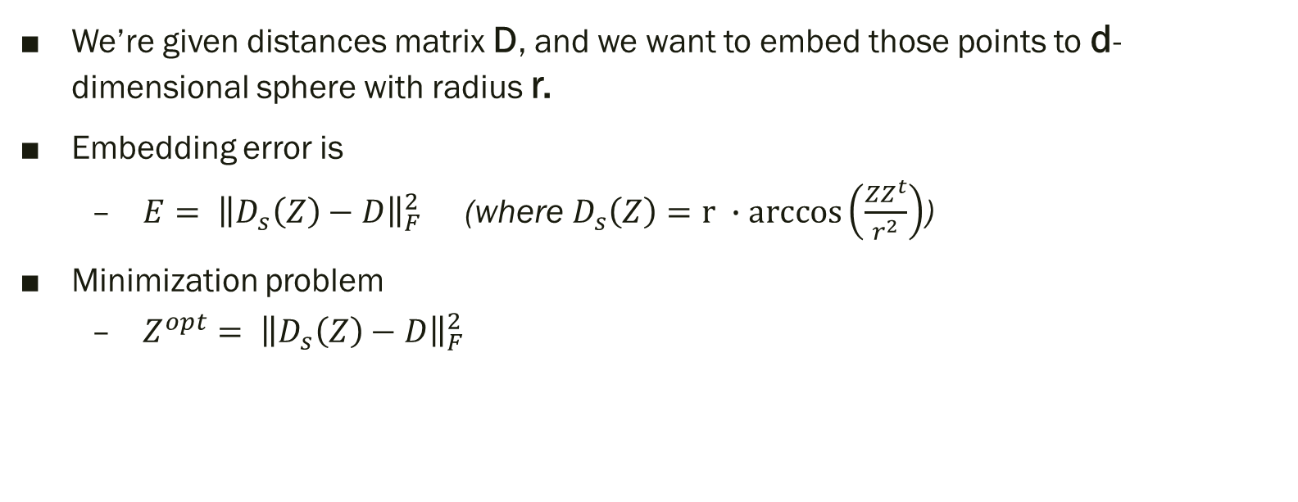
Embedding process
We’re given distances matrix D, and we want to embed those points to d-dimensional sphere with radius r.
Embedding error is
$E= {\left\|D_{s}\left(Z\right)−D\right\|}_{F}^{2}$ (where $D_{s}\left(Z\right)=r ∙arccos\left(\frac{ZZ^{t}}{r^{2}}\right)$)
Minimization problem
$Z^{opt}= {\left\|D_{s}\left(Z\right)−D\right\|}_{F}^{2}$

Slide 5
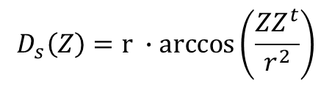

Embedding process
Minimization problem
$Z^{opt}= {\left\|D_{s}\left(Z\right)−D\right\|}_{F}^{2}$
Steepest descent
$Z^{k+1}= Z^{k}−λ\frac{∂E}{∂Φ}$
$\frac{∂E}{∂Φ}$Approximated by $\frac{∂E}{∂Z}$ Projected back to the sphere in every step.
$\frac{∂E}{∂Z}=2\left(D_{s}−D\right){\left(∇D_{s}\right)}^{t}$
$∇D_{s}= \frac{2Z}{r^{3} \sqrt{r^{4}−{(ZZ^{t})}^{2}}}$
$$D_{s}\left(Z\right)=r ∙arccos\left(\frac{ZZ^{t}}{r^{2}}\right)$$

Slide 6
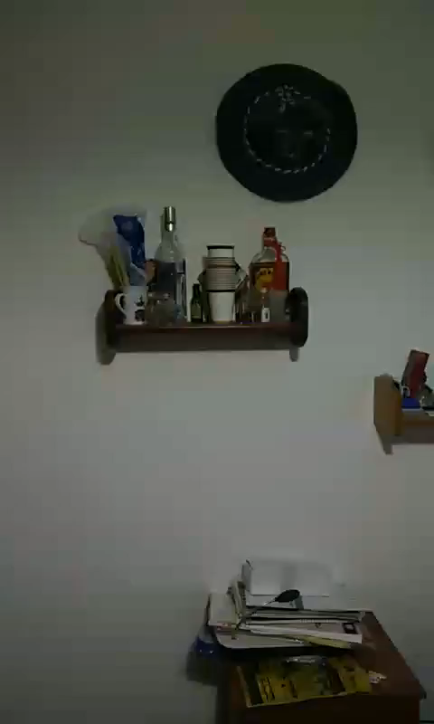
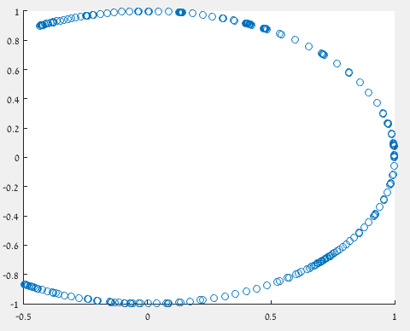
Application 1

Slide 7
Application2

