Slide 1


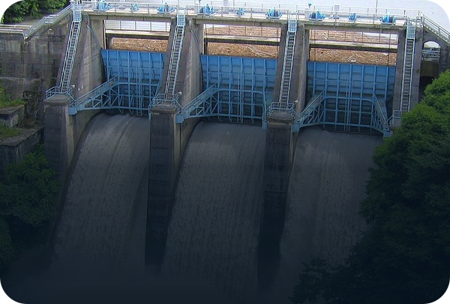
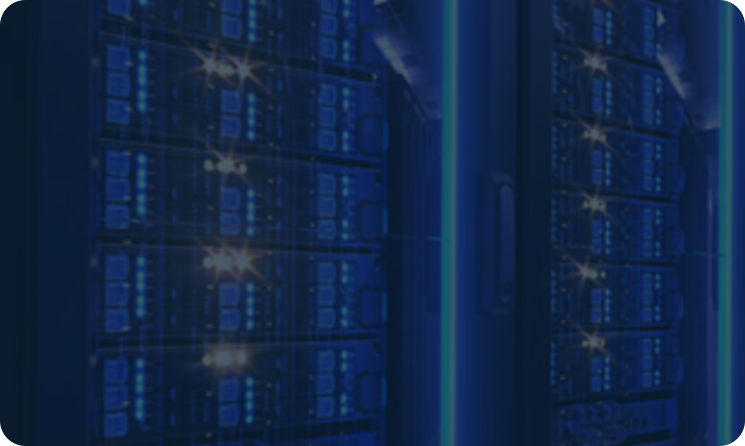


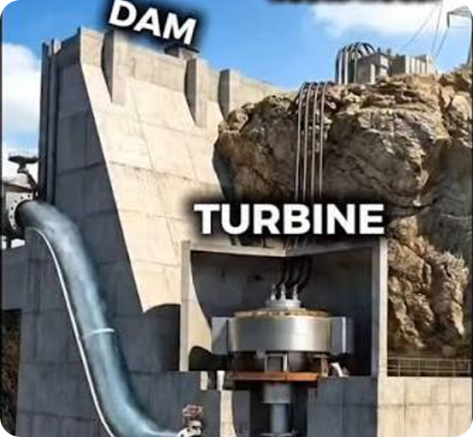





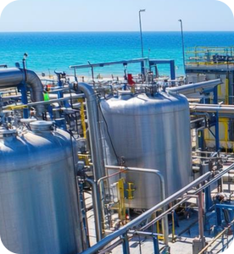

How One AI Question Uses Water and Power
6
rain fills rivers and dams
Clouds
River & dam
Water falls from a height
vapor rises
2
1
Data center
falling water
internet
4
Heat
Phone or PC
3
AI chips
5
Cooling tower
rain
You ask a question
inner cooling loop
electricity
Cool water
Power plant
Falling water or steam spins a turbine
fresh water
8
electricity
Desalination
7
Sea
Sea water → fresh water
Question & computing
Heat
Water
Electricity
sea water
Notes:
DIAGRAM – how one AI question uses water and power (simplified)
1. You ask a chatbot a question on your phone or PC. It travels over the internet to a data center, and the answer comes back the same way.
2–3. In the data center, AI chips do billions of calculations. They run on electricity from the power plant.
4. All that work turns electricity into heat. Water flows past the chips and carries the heat away.
5. The hot water goes to a cooling tower. Some of it evaporates, and that cools the rest. The cooled water goes back to the chips: this is the inner cooling loop.
6. The vapor rises and forms clouds. It falls again as rain: some into rivers and dams, some into the sea.
7–8. Desalination plants turn sea water into fresh water. In Israel, most tap water comes from desalination. Fresh water refills the cooling loop, so the big water circle closes.
Power plant: makes the electricity for the data center AND for the desalination plant. Here, water falling from a dam spins a turbine: its kinetic energy becomes electricity.
Be honest if asked: most electricity, especially in Israel, comes from gas plants. They heat water into steam, and the moving steam spins the turbine. These plants also evaporate cooling water. That is the off-site water on Slide 2 (about 12 times more than US data centers use on-site).
Simplified: real water takes days to years to go around the cycle, and the rain does not fall back on the same data center.
Photos: our team's pictures of a dam, a hydro power plant (a drawing: water from the dam spins the turbine), a phone, server racks (behind the data center) and a desalination plant.
The power plant photo shows a steam plant: it burns fuel to boil water, the steam spins the turbine, and the big cooling tower evaporates water. That evaporated water is the off-site water from Slide 2.

