Slide 1
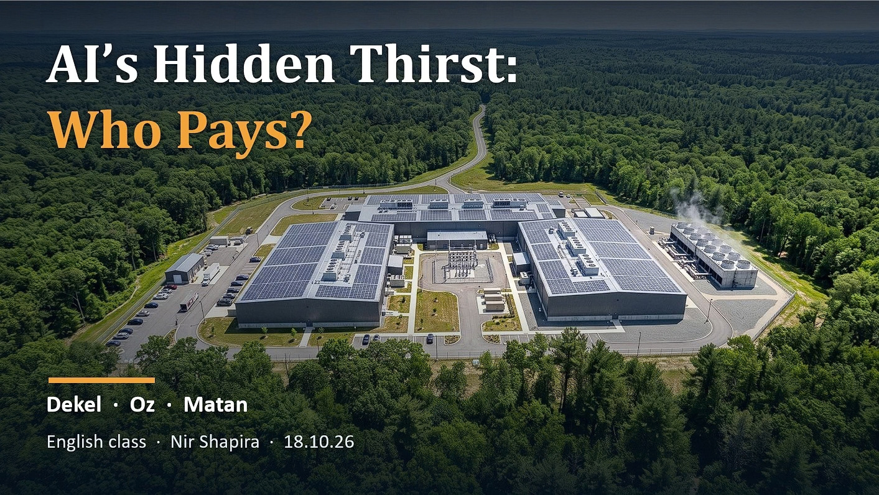
Notes:
SPEAKER A – SCRIPT, part 1 of 2 (say this)
Hi everyone. We are [A], [B] and [C]. Our topic today is AI's hidden thirst, and who pays for it.
[CLICK -> Slide 2]
————————————————————
SLIDE 1 – title slide
- Before presenting: type your three names, your class and the date over the placeholders.
- Background: the same example data-center campus as Slide 3 (a wider crop with more sky). It is NOT in Israel.
1

Slide 2
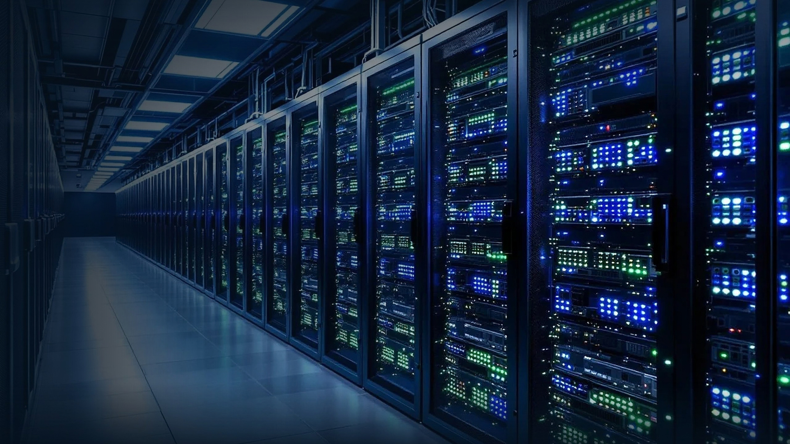

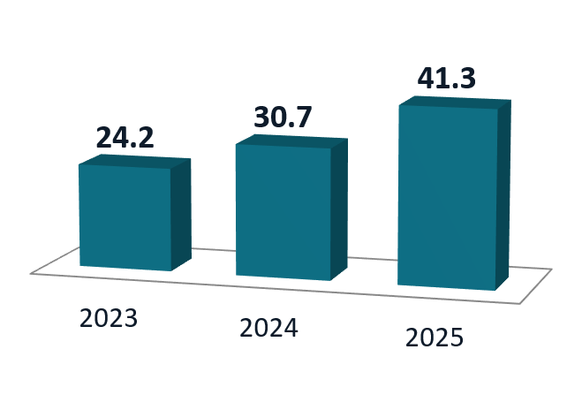
AI’s Hidden Thirst: Who Pays?
  AI data centers run on water and power
  On-site: water evaporates to cool servers
  Off-site: US power plants use about 12× more power
  Uruguay 2023: drought, salty tap water, protests
  Result: Google switched its plan to air cooling
Google’s water use rose 70%
in two years
Notes:
SPEAKER A – SCRIPT, part 2 of 2 (say this)
When you ask an AI chatbot a question, the work happens in huge buildings called data centers. Data centers need two things: electricity to run, and water to stay cool.
There are two kinds of water use. On-site: inside the building, water evaporates to cool the servers. Off-site: the power plants that make the electricity also use water. A US government lab studied the year 2023. It found that the power plants used about twelve times more water than the data centers themselves.
And it is growing fast. Look at our chart. Google's total water use went from 24 billion litres in 2023 to 41 billion in 2025. That is 70 percent more in two years.
So this is a question of sustainability. But it is also a question of social justice. The benefits of AI go to people all over the world. The impact lands on the people who live near the data center.
Here is an example. In 2023, Uruguay had its worst drought in 74 years. In the capital, Montevideo, the tap water turned salty. At the same time, Google planned a data center there. It would use about seven and a half million litres of water a day. People protested. After the protests, Google made the project smaller and changed to air cooling.
HANDOFF -> "Now [B] will show you what this looks like here in Israel."
————————————————————
SLIDE 2 – talking points and sources (full scripts and Q&A: speaker-notes.txt)
- Background: an AI-generated image made by our team of the inside of a data center (rows of server racks). Not a real place.
- Data centers need water for cooling and electricity to run.
- ON-SITE vs OFF-SITE [S1 LBNL 2024]: US data centers used 66 billion litres on-site in 2023 and about 800 billion litres off-site (water used by the power plants). 800 / 66 ≈ 12.
- Google +70% [S6 Google Environmental Reports]: 6.4B gal = 24.2B L (2023); 8.1B gal = 30.7B L (2024); 10.9B gal = 41.3B L (2025). 41.3 / 24.2 = 1.71. Company-reported, all operations.
- Uruguay [S9]: 2023 drought, worst in 74 years. Montevideo tap water was mixed with salty water. Google's plan: about 7.6 million litres a day. Slogan: 'It's not drought, it's pillage.' Google made the project smaller and switched to air cooling.
- Careful: 'one bottle of water per question' is a misreading. The study [S3] says 500 ml per about 10–50 answers.
2

Slide 3
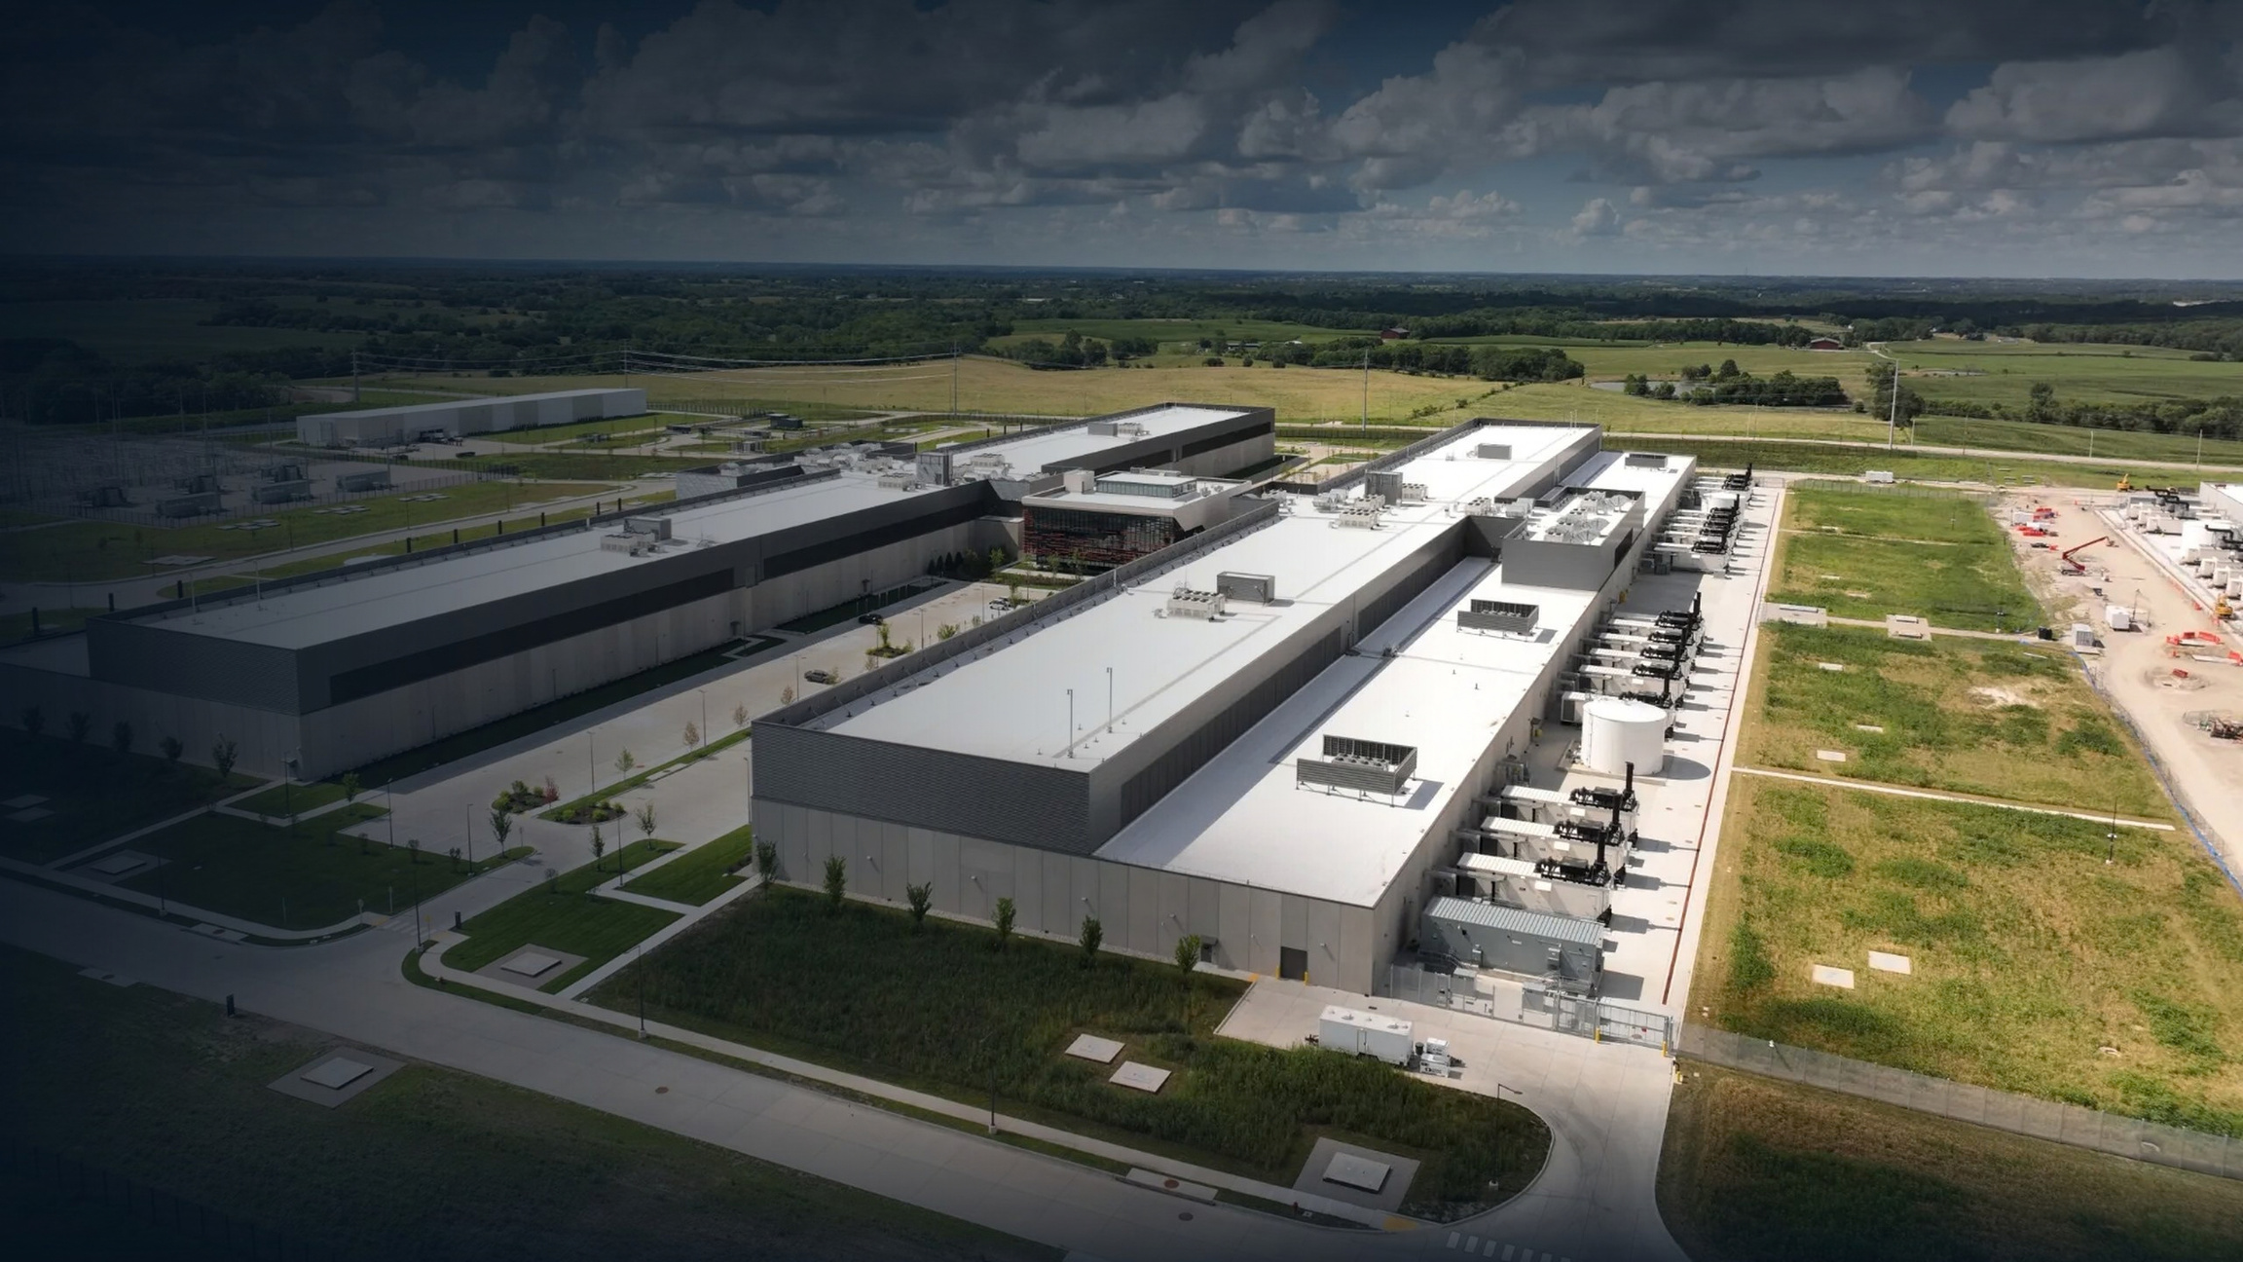
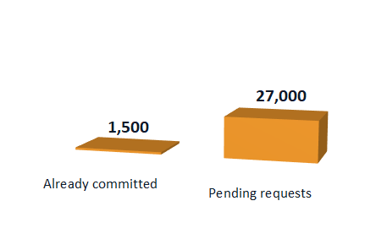
Israel & Lev HaSharon: The Power Problem
Requests are 18× what
is already promised
  Most of our tap water is desalinated
  Desalination needs a lot of electricity
  Data centers requested 27,000 MW (≈3× average)
  July 2026: regulator froze new connections
  Near us: Kfar Yona, Netanya, Hadera projects
  2026 water shortage: farms were cut first
Notes:
SPEAKER B – SCRIPT, part 1 of 2 (say this)
Thank you, [A]. Now let's look at Israel.
Israel is different. Most of our tap water comes from the sea, through desalination. So here, the bigger problem is electricity. Desalination and data centers both need a lot of it.
Look at the chart. Data centers were already promised 1,500 megawatts. That uses up all the new power planned until 2035. But new requests add up to 27,000 megawatts. That is eighteen times more, and about three times Israel's average use. So in July 2026, the Electricity Authority froze new requests for 140 days.
And it is close to home: there are projects in Kfar Yona, Netanya and Hadera.
In a shortage, who is cut first? In late August 2026, algae shut five of the six big desalination plants. Farms were cut first. Data centers did not cause this. But it shows who pays first.
[CLICK -> Slide 4]
————————————————————
SLIDE 3 – talking points and sources
- Background: an example of a large data-center campus next to farmland, with its own electricity substation (left). It is NOT in Israel; it shows what these projects look like.
- Chart: data-center grid demand in Israel, megawatts (2026). 1,500 MW already committed; 27,000 MW pending. 27,000 / 1,500 = 18.
- Desalination share [S17]: sources disagree (State Comptroller 2024: 'about half'; Times of Israel 2026: over 80%). Say 'most', not a single number.
- Desalination needs electricity [S16]: the State Comptroller (2024) names desalination AND data centers as drivers of 2030 electricity demand.
- 27,000 MW [S14, S15]: pending data-center requests to Noga, about 3 times Israel's average electricity use. 1,500 MW already committed uses up the planned new supply to 2035 (Ctech).
- July 2026 freeze [S14]: the Electricity Authority stopped new data-center applications of 8 MW or more for 140 days from 21 July 2026 (until about early December).
- Near us [S21, S22, S15]: MedOne, two underground data centers in Kfar Yona (next to Lev HaSharon, not inside it), first opens 2026. NED Alpha Campus in Netanya, 42 MW, early 2027. Mega Or asked for 1,111 MW at the old Alliance factory in Hadera.
- Farms first [S18]: end of Aug 2026, algae shut 5 of 6 big desalination plants. The Water Authority told councils to cut farm and park irrigation. Ramat HaNegev farms lost fresh water completely. NOT caused by data centers. It shows who is cut first.
- Unverified: water quotas for Lev HaSharon moshavim (no public figures found).
3

Slide 4
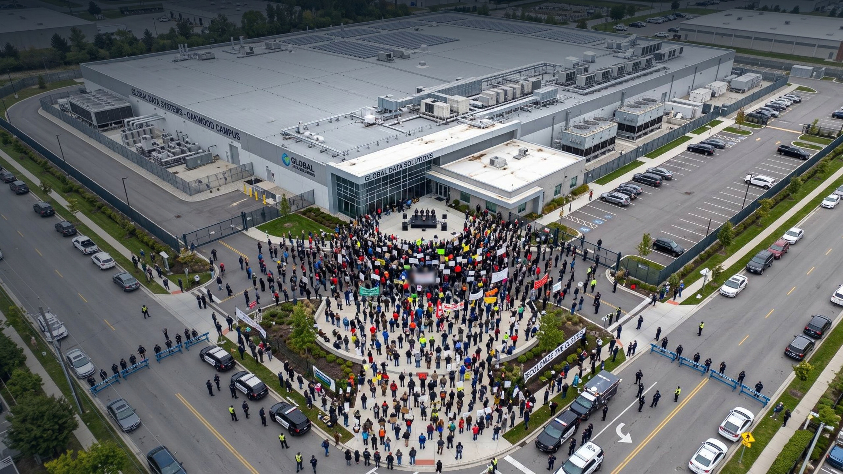
Who Is Pushing Back? NGOs & Laws
NGO: SPNI
Society for the Protection of Nature in Israel
  Advocacy against the AI server-farm fast-track bill
  The bill lets big farms skip local committees
Legislation & regulation
  EU (2023): data centers must report water use
  Israel’s Water Law (1959): water is public
  Israel: there is no disclosure rule
Notes:
SPEAKER B – SCRIPT, part 2 of 2 (say this)
Who is pushing back? SPNI, the Society for the Protection of Nature in Israel, is an NGO. It does advocacy against a new bill. The bill would let big AI server farms skip local planning committees, so neighbors lose their chance to object. In our opinion, that can become discrimination against small communities.
In Europe, 2023 legislation makes big data centers report their water and energy use every year. In Israel, the Water Law of 1959 says water sources are public property. But we found no Israeli regulation that makes data centers report their water use.
HANDOFF -> "Now [C] will tell you our idea."
————————————————————
SLIDE 4 – talking points and sources
- Background: an AI-generated image made by our team; not a real event. It shows residents protesting at the gate of a data center, seen from a drone.
- SPNI [S25]: publicly opposed the bill that makes AI server farms 'national infrastructure'. Warned of a 'destructive domino effect' on open land and energy security. Wants the status only for security, intelligence and academic use. Also active: Greenpeace Israel, Green Course.
- The bill [S24]: Planning and Building Law amendment. AI server farms of 50 MW or more become 'national infrastructure'. They go to the National Infrastructure Committee and skip local and district committees and their objections. Passed first reading on 1 June 2026. FINAL PASSAGE UNVERIFIED: check before presenting.
- Discrimination (required word): when big projects skip local committees, the people who live next door lose their voice. Critics say this is unfair and can become discrimination against small communities. We did not find proof that Israel targets poor areas on purpose.
- EU law [S28]: Energy Efficiency Directive (EU) 2023/1791, Article 12. Data centers with 500 kW or more of IT power must report energy and water use every year to an EU database.
- Water Law [S27]: Water Law 5719-1959, section 1. Water sources in Israel are public property, controlled by the State, for the needs of the residents and the development of the country.
- Gap: we found no Israeli rule that makes data centers publish their water or power use. Say 'we found no', not 'there is no'.
4

Slide 5
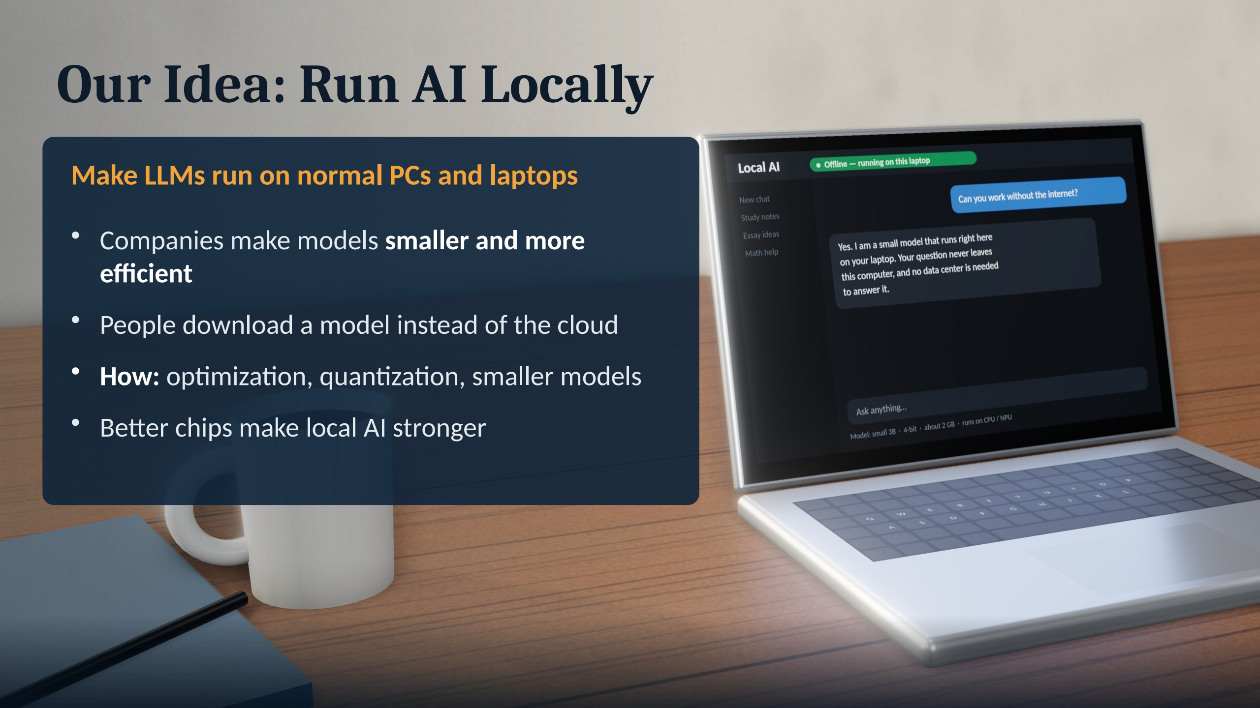
Notes:
SPEAKER C – SCRIPT, part 1 of 3 (say this)
Thanks, [B]. So what would we do?
Our idea is simple: run AI locally. We want large language models, the AI behind chatbots like ChatGPT, to run on normal laptops and PCs.
How? Companies can make models smaller and more efficient. One method is quantization: it stores the model's numbers in a shorter form, so it needs much less memory. And new laptops have special AI chips that make local AI stronger.
[CLICK -> Slide 6]
————————————————————
SLIDE 5 – our idea (Speaker C). Full original wording:
Run AI Locally. Our idea is simple: Make LLMs able to run on normal PCs and laptops.
- AI companies should optimize their models so they can run locally.
- People could download an LLM instead of always connecting to a data center.
- Companies should make models smaller and more efficient.
- We can use: better optimization, quantization, smaller models, better computer chips.
- As chips become more powerful, more AI could run locally.
Instead of only building bigger data centers, make AI more efficient.
Facts: Meta Llama 3.2 1B/3B (Sep 2024): built for phones and edge devices. QLoRA (2023): 4-bit quantization makes models much smaller. Copilot+ PCs (May 2024) have an AI chip (NPU) of 40+ TOPS to run AI locally.
Background: a 3D illustration of a laptop running a small AI model offline.
The real-world example (UGREEN HomeAgent HA100) is on the next slide.
Be honest if asked: a laptop's electricity also comes from power plants. The big saving comes from smaller, optimized models doing less work (Google cut energy per prompt 33x in one year by optimizing).

Slide 6

Real Example: UGREEN HomeAgent HA100
Announced at IFA 2026 · ships early 2027
A home AI hub, not a cloud server
Its assistant runs the Qwen3 model at home
Spots people, pets, cars and packages
Search your camera videos by keyword
Your videos stay on your own drives
Honest: some features still need the internet
Notes:
SPEAKER C – SCRIPT, part 2 of 3 (say this)
A real example: at IFA 2026, UGREEN showed the HomeAgent HA100, an AI box for your home. Its assistant runs an open AI model, Qwen3, at home, not in a data center. Your camera videos stay on your own drives. It should ship in early 2027.
[CLICK -> Slide 7]
————————————————————
SLIDE 6 – real example (Speaker C)
- UGREEN HomeAgent HA100: a local-AI home hub shown at IFA 2026 (September 2026). Its assistant, Uliya, uses Qwen3, an open AI model from Alibaba, running on the hub itself. Cloud models such as ChatGPT are optional.
- It recognises people, vehicles, pets and packages in camera video, writes event summaries, and lets you search recorded video by keyword. Video is stored on the hub's own drives, with no monthly storage fee.
- Not on sale yet: Kickstarter campaign from 27 October 2026; shipping from late January 2027 at the earliest.
- Be honest if asked: UGREEN says sign-in, remote access, phone notifications, software updates and optional services still need the internet. Reports disagree on its price and AI speed, so we give no numbers.
- Background: the laptop scene from Slide 5, blurred. It is not a picture of the HA100.

Slide 7
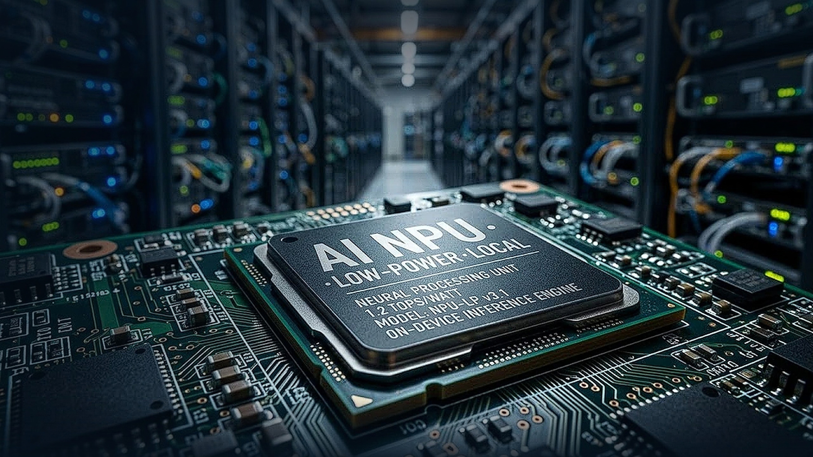
Our call to action is:
“Don’t just build bigger data centers. Make AI smarter and more efficient.”
It's possible, JUST
DO IT!
Notes:
SPEAKER C – SCRIPT, part 3 of 3 (say this)
Here is our plan. One: AI companies should release local versions of their models. Two: they should optimize their models, not just make them bigger. Three: data centers should stay for training and for the biggest models.
This policy reform could mean fewer new data centers: less water, less land, and more privacy, because your data stays on your computer.
To be honest, a laptop also uses power-plant electricity. The real saving comes from smaller, smarter models.
Our awareness idea is an "AI label", like a food label. It shows how much water and power an AI tool uses.
This way, AI can keep growing without one community paying the price. So our message is: Don't just build bigger data centers. Make AI smarter and more efficient.
Thank you. Any questions?
————————————————————
SLIDE 7 – our plan and message (Speaker C). Full original wording:
What Would We Do? Our plan:
1. AI companies should make local versions of their LLMs.
2. These models should work on normal PCs and laptops whenever possible.
3. Companies should focus on optimization instead of just making models bigger.
4. New chips can gradually make local AI more powerful.
5. Data centers can still be used for extremely large models and training.
Possible benefits: less need for new data centers; less land used for AI infrastructure; potentially less water needed for cooling; more AI can run directly on people's computers; more privacy and control for users.
Our message: Don't just build bigger data centers. Make AI smarter and more efficient.
Background: an AI-generated image made by our team: a low-power AI chip (NPU) in front of rows of data-center servers. The chip's label and numbers are part of the illustration, not a real product.
Awareness idea: an 'AI label' (like a food label) showing how much water and electricity an AI tool uses, with the source and year.
Likely question: 'How do you make companies do this?' Answer: public pressure and awareness, plus reporting laws like the EU rule, which make water and power use visible.
Be honest: training still needs data centers, and local AI still uses electricity. The benefit comes from smaller, more efficient models.

