Slide 1
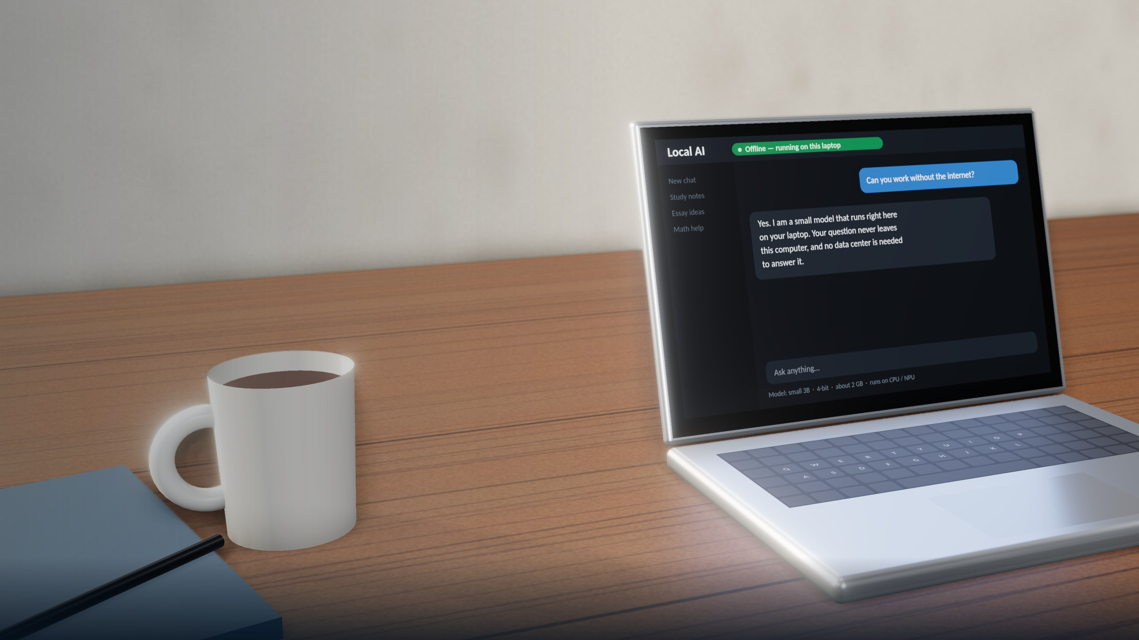
Our Idea: Run AI Locally
Make LLMs run on normal PCs and laptops
Companies make models smaller and more efficient
People download a model instead of the cloud
How: optimization, quantization, smaller models
Better chips make local AI stronger
Already real: Phi-3 runs on a phone
Notes:
SPEAKER C – SCRIPT, part 1 of 2 (say this)
Thanks, [B]. So what would we do?
Our idea is simple: run AI locally. Today, most AI runs in huge data centers. We want large language models, the AI behind chatbots like ChatGPT, to run on normal laptops and PCs.
How? Companies can make models smaller and more efficient. One method is quantization: it stores the model's numbers in a shorter form, so it needs much less memory. This is already real. Microsoft's small model, Phi-3, runs on a phone. And new laptops have special AI chips that make local AI stronger.
[CLICK -> Slide 6]
————————————————————
SLIDE 5 – our idea (Speaker C). Full original wording:
Run AI Locally. Our idea is simple: Make LLMs able to run on normal PCs and laptops.
- AI companies should optimize their models so they can run locally.
- People could download an LLM instead of always connecting to a data center.
- Companies should make models smaller and more efficient.
- We can use: better optimization, quantization, smaller models, better computer chips.
- As chips become more powerful, more AI could run locally.
Instead of only building bigger data centers, make AI more efficient.
Facts: Microsoft Phi-3 report (Apr 2024): a 3.8B model, about 1.8 GB at 4 bits, runs on an iPhone 14. Meta Llama 3.2 1B/3B (Sep 2024): built for phones and edge devices. QLoRA (2023): 4-bit quantization makes models much smaller. Copilot+ PCs (May 2024) have an AI chip (NPU) of 40+ TOPS to run AI locally.
Background: a 3D illustration of a laptop running a small AI model offline.
Be honest if asked: a laptop's electricity also comes from power plants. The big saving comes from smaller, optimized models doing less work (Google cut energy per prompt 33x in one year by optimizing).

