Slide 1
Magic: The Gathering Cube Multi-Purpose Model
Group 7
Gwen Dekker

Slide 2
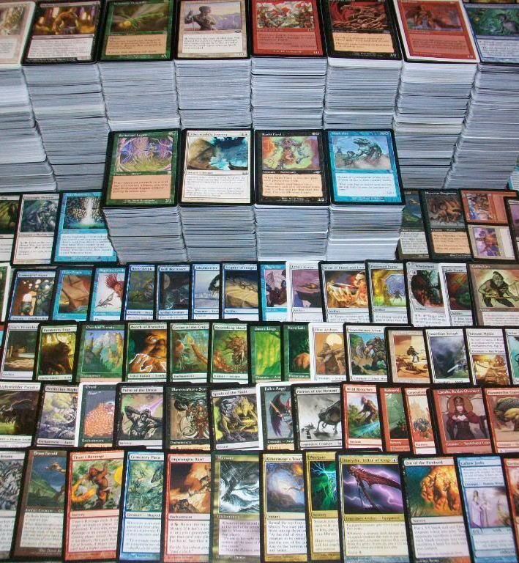
Problem Domain
Magic: The Gathering (MTG) a popular trading card game
Notes:
MTG is a TCG produced by wizards of the coast. It has over twenty thousand unique cards, and is enjoyed by millions of players all over the world.

Slide 3
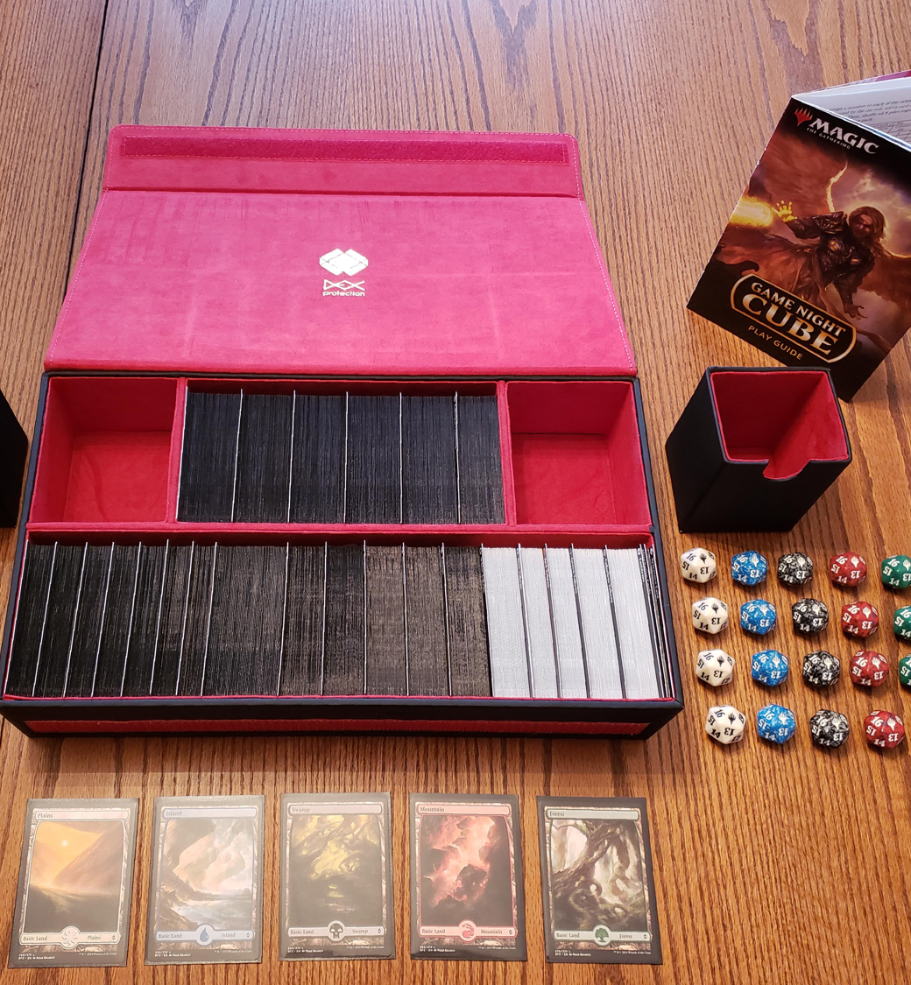
Problem Domain
Magic: The Gathering (MTG) a popular trading card game
MTG Cube is a way to play the game that involves a single person putting together a set of cards, like a board game
Notes:
Cube is one way to play the game where one player puts together a set of cards for a group of players to play with. It’s closer to a traditional board game than a TCG. Cubes can contain anywhere from 100 to 1000 cards.

Slide 4
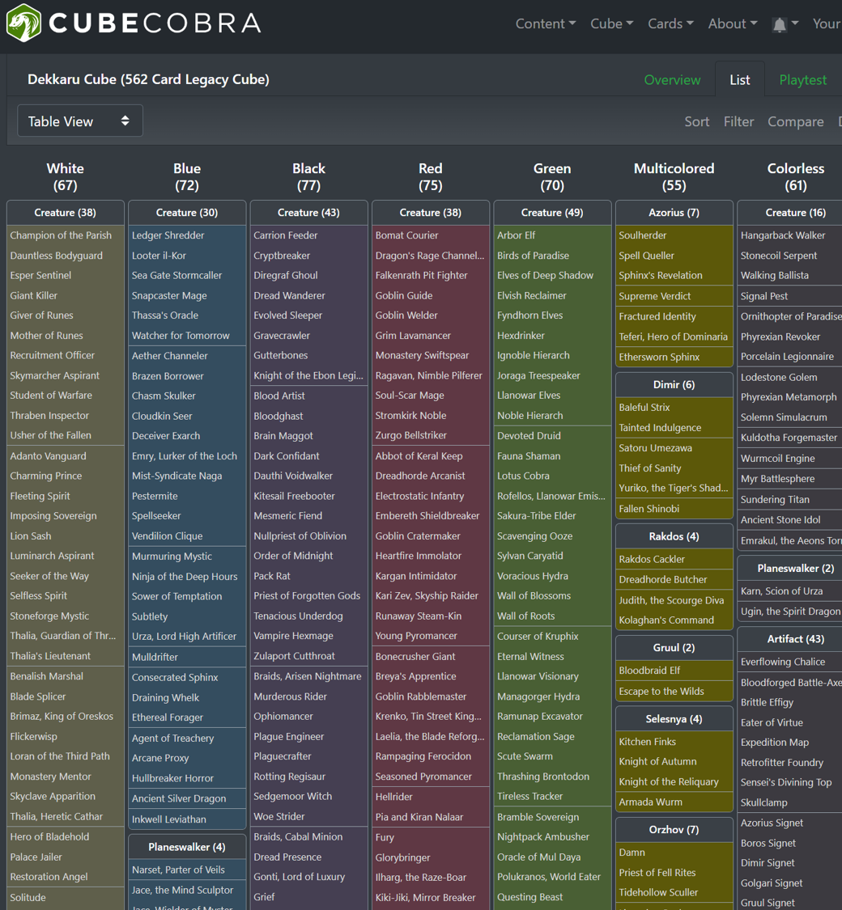
Problem Domain
Magic: The Gathering (MTG) a popular trading card game
MTG Cube is a way to play the game that involves a single person putting together a set of cards, like a board game
Designers spend a lot of time perfecting their cube
Notes:
Designers will spend a lot of time tuning their list. They will run virtual playtest against simulated players to gain data on how the list plays before presenting it to human players.

Slide 5
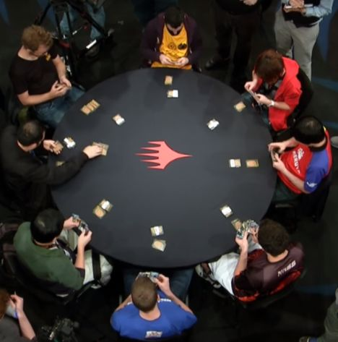
Problem Domain
Magic: The Gathering (MTG) a popular trading card game
MTG Cube is a way to play the game that involves a single person putting together a set of cards, like a board game
Designers spend a lot of time perfecting their cube
Drafting is a preferred method for distributing cards
Notes:
MTG Cube is played by constructing a series of packs, typically three packs of fifteen cards each for eight players. The players then draft the cards one pack at a time, picking one card, then passing the rest to the next player, and picking from the pack they’ve received. After all cards are drafted, each player builds a deck to play with against the other players using their drafted pool of forty-five cards plus some from a “free” pool.

Slide 6
Basic Idea
[0,0,0,1,0,1,0……,0]
Encoder
Recommend
Draft
Build
Encoding
Recommend
Draft
Build
[0,0,0,1,0,1,0……,0]
Notes:
The model will essentially be a denoising autoencoder, with three separate decoders, all sharing the same latent space encoding. We can represent the input of the model as a list of cards, a vector of dimensionality N, where N is the number of unique cards. Since each index corresponds to a card, a cube can be represented as this vector with 1’s representing the presence of a card, and 0’s representing the absence. The output is the same shape as the input.
For the Recommend task, the input to the encoder will be an entire cube list. After going through the Recommend decoder, each dimension of the output vector represents the probability a user would add that card to the cube, or keep the card in the cube if it’s present in the original list, given the existing contents of the list.
For the Draft task, the input to the encoder will be a list of cards that the player has already drafted. After going through the Draft decoder, each dimension of the output vector represents the probability a user would draft that card. We can mask this output by the cards available in a given pack, normalize that reduced dimensionality vector, to get the probability a user would pick any given card from that pack given the cards they have already picked.
For the Build task, the input to the encoder will be a list of cards that the player has already drafted. After going through the Build decoder, each dimension of the output vector represents the probability a user would play that card given the cards in their pool.
These three tasks aim to improve existing playtest and recommendation tools available to cube designers.

Slide 7
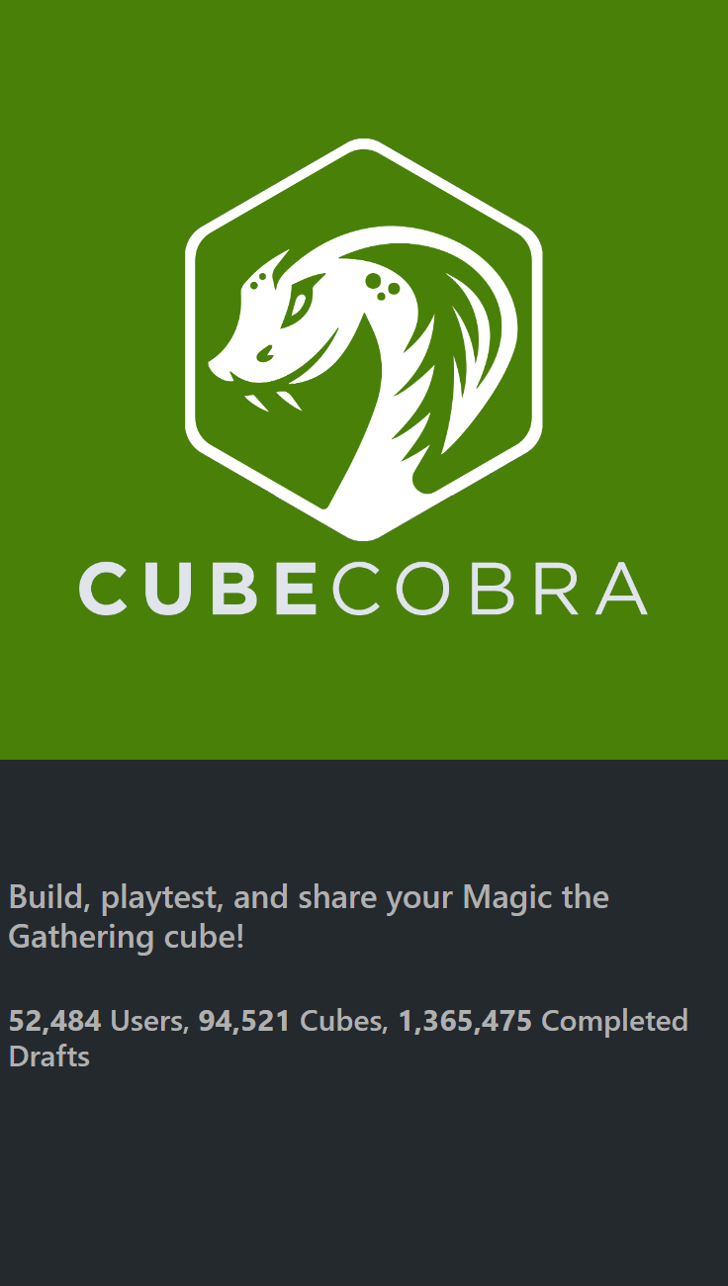
Data Source
Cube Cobra is an open source web application built by the community
Data is publicly available to drive collaborative projects that benefit the entire community
All files are in JSON format and will require some ablation
Notes:
Cube Cobra is an open source web application built by a community of players heavily enfranchised in MTG cube. Cube Cobra has approximately 100,000 cubes, and 1.4 million playtest drafts. This data is made public by the maintainers of the site, so that members of the community can build tools for everyone to use. We can use this data to train our model.
The format of the source data needs a bit of data processing to get it into the vectors I’ve described. For cubes, each cube is a list of card IDs. I’ll first need to create a mapping of card IDs to the respective index. I’ll need to then use this mapping to transform the list of IDs to the correct vector shape. For the Draft input, the data needs even more processing. The source data contains an initial state of the contents of each pack before they’re opened, as well as a pick order for each seat. I’ll need to reverse engineer the cards present in each pack as the player seat is making each choice, and then transform each deck into a list of pack, pool, pick triplets. Decks in the source dataset are formatted the same as a cube, and will need the same transformation.

Slide 8



Assessment Methodology
Train/Test split for validation
Binary cross entropy for loss function
Notes:
I will construct my model in such a way that I can give the input annotated with which of the three functions to use, and have it provide the error of the combined autoencoder. I will use binary cross entropy for my loss function regardless of which function is being used. I will be evaluated the model on a sample of the data that was not part of the training data.

