Slide 1

Tassen Overview
Tassen = German for “cups”
Notes:
In the next slides I will provide an overview of the Tassen project.

Slide 2
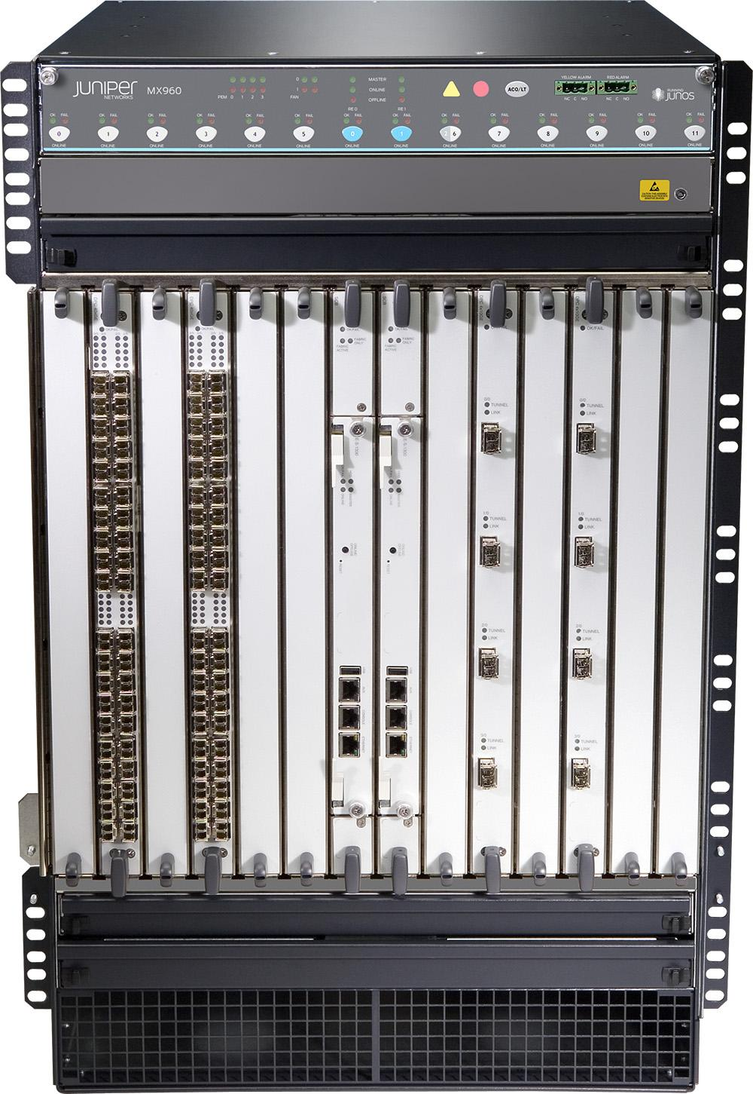
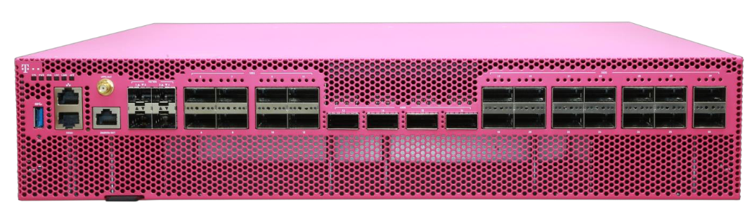
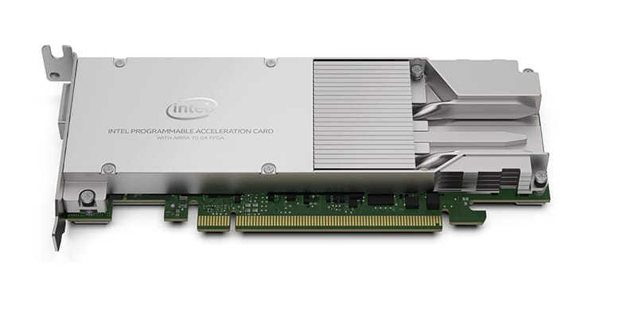
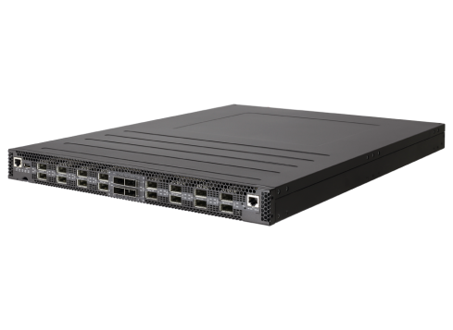
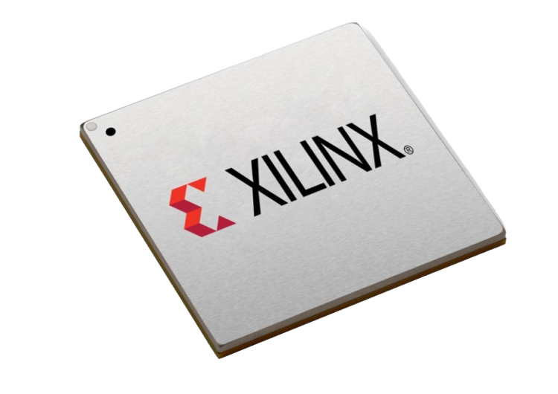
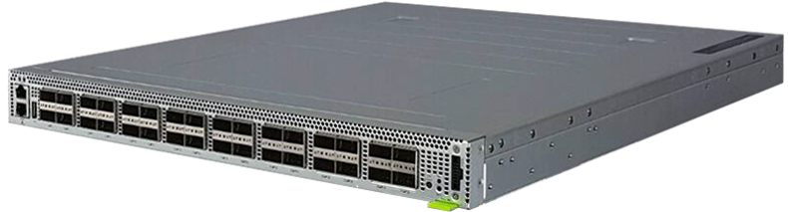
Options for BNG Disaggregation
Traditional chassis-based vendor Broadband Network Gateway (BNG)
BNG-CP → Intelligence
Choice of programming language and architecture
Open CUPS API
Provides silicon-independence & facilitates interoperability
BNG-UP → High-speed forwarding
Choice of merchant silicon and port configuration
SDN-ize
Magenta Switch Single-chip Qumran 2C
SmartNIC Single-chip FPGA
Equivalent features, but different pipelines!
Known problem with SDN v1 and OpenFlow
Deutsche Telekom
Dell, Intel, Benu
Tofino + Qumran AX Dual-chip, HQoS in OLT (WIP)
Tofino + FPGA Dual-chip, HQoS in FPGA
Specialized router
QinQ, PPPoE, IPoE, accounting, HQoS, lawful intercept, wholesale tunnel relay (L2TP), multicast, etc.
OLT (QAX)
FPGA
Leaf switch (Tofino)
ONF
TU Darmstadt
Example of HW-based implementations existing today.
Others are possible, including SW-based processing.
Notes:
Before describing Tassen, it’s useful to visualize what we mean by BNG disaggregation and why we need a CUPS API
A BNG is essentially a specialized router, following the SDN paradigm [CLICK] it can be disaggregated in two pieces: the control plane and the user plane.
BNG-CP
The control plane is where we run all the intelligence, including routing protocols, but also authentication, accounting, etc.
Choice of programming language and architecture, e.g. microservice-based or monolithic component.
BNG-UP
The user plane is responsible of performing the actual packet processing.
Slide shows some options available today.
The choice around the type or merchant silicon and the port configuration.
Whether it’s a switch-like box with many ports, or a SmartNIC with few ports...
Whether it’s a single or dual chip solution, whether its based on a switching ASIC or FPGA…
This talk is not about discussing the merits of any specific option and electing the best one, indeed, as we heard before operators have reason to wanting to preserve and promoting this optionality.
[CLICK]
Instead, this talk is about finding the right CUPS API that truly allows interoperability without too much pain, and so to minimize the risks of vendor lock-ins.
[CLICK]
PROBLEM
While providing equivalent features, each silicon option has different pipelines (think of the specific structure and actions of the routing or PPPoE table).
A known problem with productions deployments of (what we call) SDN v1 and OpenFlow is the tight coupling between the control plane and the pipeline. Operators invest a lot of resources in optimizing a control plane for a given silicon, but then porting the same CP to a different silicon and pipeline usually requires the same amount of time and resources as the first time. This is not ideal.
A solution to this problem is to formally define a pipeline that is common to all option.
** On control and user plane separation, this is the same as control and data plane separation If someone argues that user plane and data plane have different meanings, the core of this proposal is that the user plane should be treated exactly as the SDN data plane, essentially a dumb entity implementing a packet forwarding pipeline.

Slide 3
Tassen BNG-UP Logical Model and API
High-level pipeline model common to all BNG-UP options
Next-gen SDN APIs
Generic CRUD interfaces
High-performance
gRPC-based
P4Runtime
gNMI
P4Runtime
Read/write tables, counters, packet-in/out, mastership, etc.
Set/get sched hierarchy, policy, shaping rates, etc.
Read/write tables, counters, packet-in/out, mastership, etc.
Packets
Upstream
Inport
Count
QoS class
Count
...
Downstream
Re-use or extend OpenConfig QoS models
New logical P4 program
Ingress pipe
HQoS
(traffic manager)
Egress pipe
Bit-level behavioral specification
table {
match
action }
sched {
queues
policy }
Model configuration data
.p4
.yang
Notes:
A solution to the problem of having to handle a diverse set of pipelines, is that of defining a common model to all BNG-UP options.
Tassen defines this model as a 3-stage logical pipeline.
An ingress pipe, a traffic manager, and an egress pipe
The ingress pipe is where we find match-action tables for upstream and downstream processing, including things like PPPoE/QinQ termination, as well as accounting, QoS classification, etc
In the middle, we have the traffic manager responsible for HQoS, this is where we have all queues and multiple levels of scheduling.
Finally, If a packet is not dropped and makes it through the HQoS, it is processed by the ingress pipe where we find post-QoS counters, etc.
[CLICK]
First, we use P4 to precisely model the behavior of the two pipes, by formally defining match-action tables, counters, and other entities.
[CLICK]
Second we use YANG, to model the configuration state of the HQoS module, think of defining the scheduler hierarchy, setting the scheduling policy, shaping rates, etc.
[CLICK]
Once we have modeled the pipeline, we can use P4Runtime and gNMI to manipulate table entries and QoS configuration at runtime.
[CLICK]
These APIs are what we call next-gen SDN APIs, as they are an evolution over first-generation SDN APIs such as OpenFlow, Netconf, and others.
These APIs are essentially generic, model-independent interfaces for manipulating state described by a P4 program or Yang model
They’re designed with performance in mind and are easy to implement in many languages since they are based on gRPC/protobuf.
** For the HQoS we don’t have a way to formally specify the behavior, so that part is still ambiguous.

Slide 4
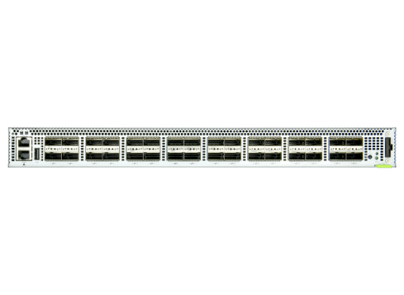
Logical vs. Physical Pipelines
BNG-CP
Abstracts commonality, does not need to optimize HW resources.
Few database-like tables for VLAN tags, PPPoE session IDs, routes, counters, etc.
Logical
pipeline
bng-logical.p4
P4Runtime
Translation
Manual or automated*
Split tables between TCAM and SRAM allocation
BNG-UP
Optimize placement
Some other optimization
Physical
pipelines
bng-tofino.p4
bng-fpga.p4
BRCM SDK
Equivalent forwarding behavior, but different tables because of different HW constraints.
* Eric Campbell “Avenir: Future-Proofing the Control Plane via Data Plane Synthesis”, P4 Expert Roundtable Series, 2019
Notes:
We’ve mentioned the term logical P4 program and logical pipeline many times, what do we mean by that?
[CLICK]
The idea of a logical pipeline is something that abstracts commonality between different physical implementations.
[CLICK]
To give you an example, in Tassen we abstract a BNG with a few tables that look like a database for storing things like VLAN tags, PPPoE session IDs, routes, counters, etc.
[CLICK]
In the physical pipelines we have similar but different table structure because of the different HW constraints of each target.
[CLICK]
For example, in a switching ASIC like Tofino we usually spit tables to optimize memory usage between TCAM and SRAM resources. For FPGA targets people usually prefer designs that optimize placement during the compilation process. And we can think of other optimizations for other targets like Broadcom silicon used in the Magenta Switch.
The idea behind Tassen is that the control plane con operate against the logical pipeline, writing entries for the database like tables.
While the BNG user plane translates the logical P4Runtime entries into ones for the physical pipeline.
This process can be based on manual translation, but if both pipelines are specified in P4, there is research about automatically generating the translation logic.

Slide 5
Test Everything!
Validate logical pipeline and P4Runtime API via packet-based test
Functional tests: set up PPPoE termination, punt control pkts, accounting, etc.
Tests as reference for CP and UP implementers
Discover hard-to-catch bugs via fuzz testing based on P4 program analysis *
Vendor BNG-CP
(tester)
Tassen Tests
(functional)
Tassen Tests
(functional and fuzzer)
P4Runtime entries
Input packet
P4Runtime
entries
Verifies
output
P4Runtime
Vendor Translation
BMv2
bng-logical.p4
BMv2
bng-logical.p4
veth
veth
veth
veth
Vendor BNG-UP
port
port
veth
veth
veth
veth
port
port
* Google talk at P4 Workshop 2019 “Leveraging P4 for Fixed Function Switches”
* Andres Nötzli, et al. “p4pktgen: Automated Test Case Generation for P4 Programs”, SOSR 2018
Notes:
One other benefit of using P4 is that we can validate the pipeline specification and the resulting P4Runtime API by writing packet-based tests.
Indeed, by using a software switch like BMv2 loaded with the logical pipeline we can write tests to validate BNG functionalities such as PPPoE termination, sending control packets to the CPU, reading counters, etc.
Most importantly, tests can be used as a reference by BNG-CP and UP vendors.
[CLICK]
CP vendors can use the same logical pipeline and software switch to test their implementations.
[CLICK]
UP implementers can use the same functional tests, but they can also use techniques like fuzz testing to discover hard-to-catch bugs in the physical pipeline implementation.
Indeed, there is already research and open source tools available to automatically generate test cases. also, it is worth nothing that fuzz testing is the same approach used by google to validate switches in their data centers.

Slide 6
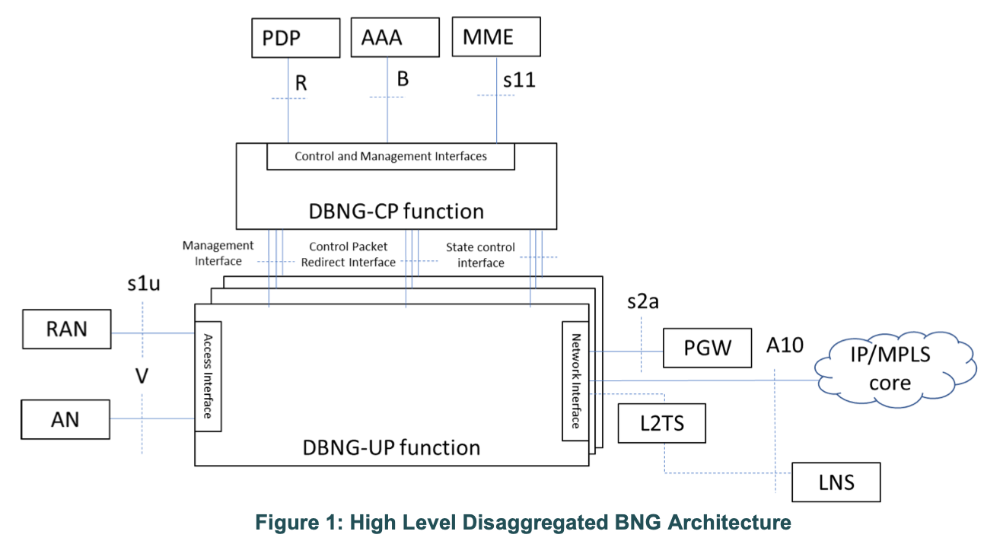
BBF Disaggregated BNG Architecture (WT-459)
PFCP
3GPP-defined protocol — Requires extensions for BNG
Heavyweight OpenFlow-style API — Defines wire protocol, Packet Detection Rules (PDR), Forwarding Action Rules (FAR), keep-alives, reliable delivery (retransmissions), etc.
Ambiguous pipeline model — Sort of “one big ACL-like table”, specified in English and figures.
Makes interoperability hard — Possible only with extensive manual testing
PFCP with BNG extensions is proposed to be used for the “State Control Interface (SCI)”
Note: This diagram is from the BBF WT-459 specification

Slide 7
CUPS API: From PFCP to Tassen
Learn from the OpenFlow experience
Formally specifying the forwarding pipeline is essential to achieve silicon-independence… lots hardware platforms coming
Re-use proven cloud native technologies (gRPC) and focus on the important stuff (pipeline data models)
Allows forwarding pipeline to be fully tested… “Test everything”
Native Tassen based BNGs
BNG-c components that support Tassen’s south bound interfaces (i.e. P4 Runtime and gNMI) can talk natively through the mapper to the BNG-u
BNG-c
P4 Runtime/gNMI Client
P4Runtime
gNMI
Tassen (logical to target mapper)
P4Runtime
BNG-u
(pipeline)

Slide 8
CUPS API: From PFCP to Tassen
DBNG-CP
(PFCP compliant)
BBF based BNGs
DBNG-CP will communicate normally with the DBNG-UP-c using BBF interfaces (i.e. SCI, Pkt redirect & Mgmt)
DBNG-UP can then be split into a DBNG-UP-c that will communicate southbound with the BNG-u using the Tassen interfaces (i.e. P4 Runtime & gNMI)... similar to 5G UPF-c and UPF-u split
Pkt redirect
PFCP
Mgmt
DBNG-UP
P4 Runtime/gNMI Client
P4Runtime
gNMI
Tassen (logical to target mapper)
P4Runtime
BNG-u
(pipeline)

Slide 9

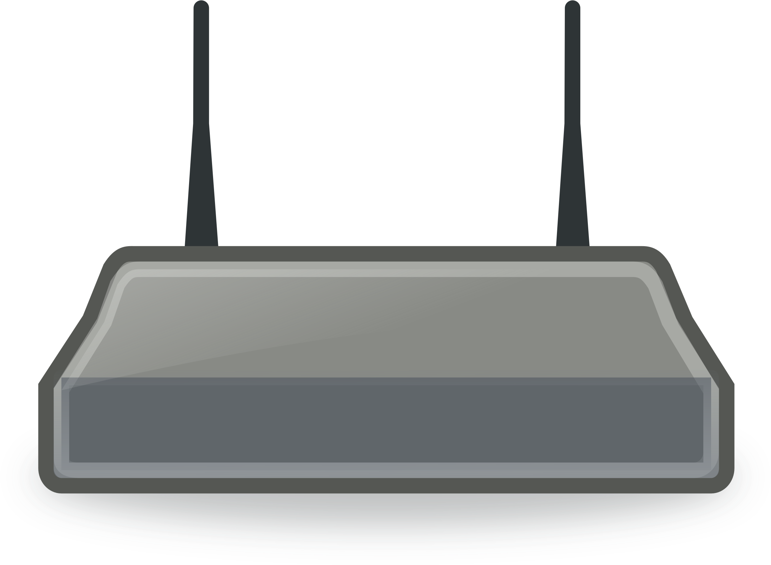
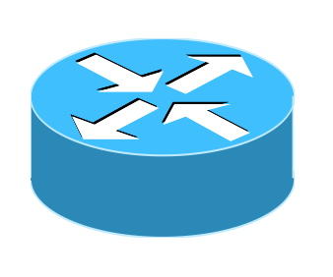
SEBA with Magenta Switch
Vendor BNG-CP
SEBA POD
P4Runtime
gNMI
bng-logical.p4
VOLTHA apps PON ctrl API
TRELLIS apps
Routing API
Tassen App
CUPS API impl
Maps to
ONOS
VOLTHA
bng-q2c.p4
BNG-UP
FW PLANE
PPPoE RG
ONU
Stratum
OLT
Magenta Switch (Q2C)
Core
Magenta Switch (Q2C)
OLT
Provides both fabric and BNG-UP capabilities in one chip.
Compute
servers
Notes:
This is how we can integrate the the Magenta Box with Stratum in SEBA
The BNG CUPS App will implement a mapping between the bng.p4 logical pipeline, and the qumran-optimized physical one

Slide 10
Aside: Proposal for a Stratum-based Magenta Switch
Via Stratum P4 compiler and runtime for Fixed Pipeline Model (FPM)
Looking for community help!
Vendor BNG-CP
bng-logical.p4
P4Runtime
Maps to
gNMI
Standalone translator
P4Runtime
P4Runtime/gNMI/gNOI server
bng-q2c.p4
Stratum
FPM runtime
(P4→SDK)
OpenConfig mapping (HQoS, interfaces, etc)
Abstracts
OpenNSA (Broadcom SDK)
BRCM BNG pipeline
(Qumran 2C)

Slide 11
SEBA with SmartNIC
Vendor BNG-CP
SEBA POD
P4Runtime
gNMI
bng-logical.p4
VOLTHA apps PON ctrl API
TRELLIS apps
Routing API
Tassen App
CUPS API impl
ONOS
Maps to
VOLTHA
BNG-UP
FW PLANE
bng-fpga.p4
PPPoE RG
ONU
Stratum
OLT
Compute (SmartNIC)
Core
OLT
Compute (SmartNIC)
Provides all the required capabilities in one chip.
4x100G ports per card (2 or 3 cards per server)

Slide 12
SEBA with SD-BNG
Tofino + Qumran AX
Vendor BNG-CP
SEBA POD
P4Runtime
gNMI
bng-logical.p4
Which API for HQoS?
Extend voltha.proto? Native gNMI support?
VOLTHA apps PON ctrl API
TRELLIS apps
Routing API
Tassen App
CUPS API impl
Maps to
ONOS
VOLTHA
fabric.p4
BNG-UP
FW PLANE
PPPoE RG
ONU
Stratum
OLT (Qumran AX)
Switch (Tofino)
Core
Switch (Tofino)
OLT (Qumran AX)
Functional split. HQoS performed in OLT (WIP).
Compute
servers
Notes:
ONOS BNG CUPS App - provides the P4Runtime/gNMI northbound to an external BNG-CP
Internally, it maps calls to the different infrastructure devices
gNMI calls for HQoS to the OLT
P4Runtime calls for the pipeline to the fabric switch

Slide 13
Tofino+QAX Pipeline with Functional Split
Classification
Policing
Double-VLAN termination
Anti-spoofing
PPPoE
term.
Routing
ACL
Accounting
Lawful intercept
UPSTREAM
Lawful intercept
Accounting
H-QoS
PPPoE
aggr.
Double-VLAN aggregation
Mcast
replication
ACL
Routing
Classification
DOWNSTREAM
BNG-UP
Barefoot Tofino (leaf switch)
Work in progress
Broadcom Qumran AX (OLT)
Notes:
Details of the proposed functional split between Qumran and Tofino

