Slide 1
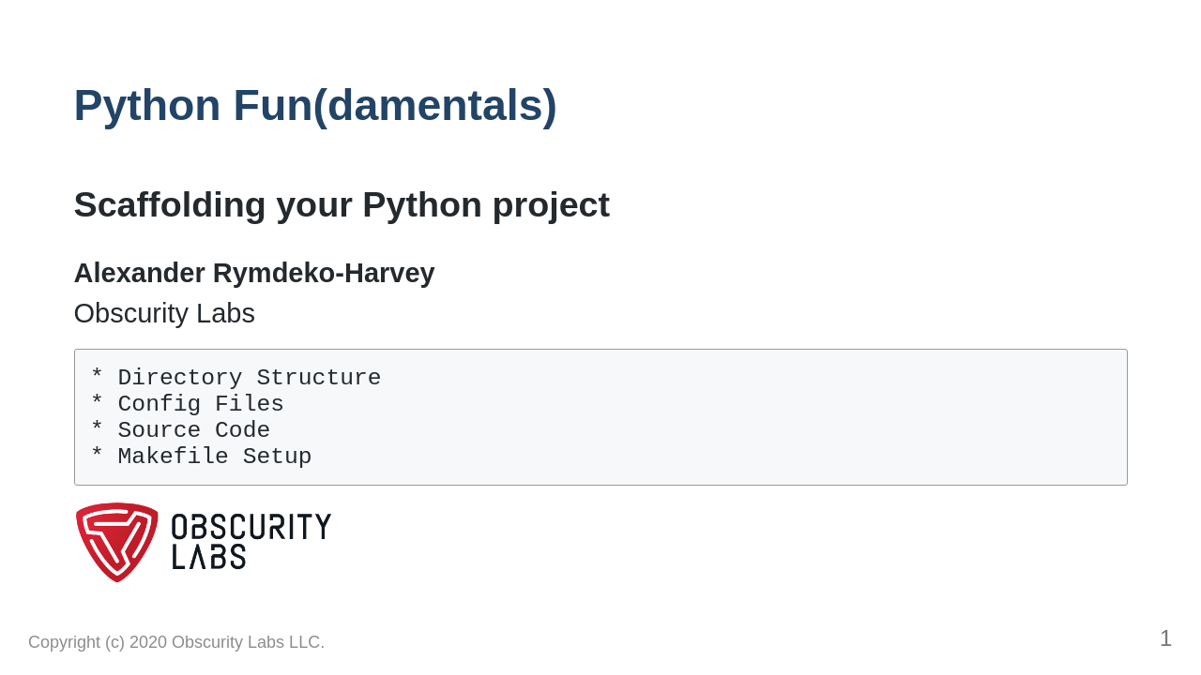

Slide 2
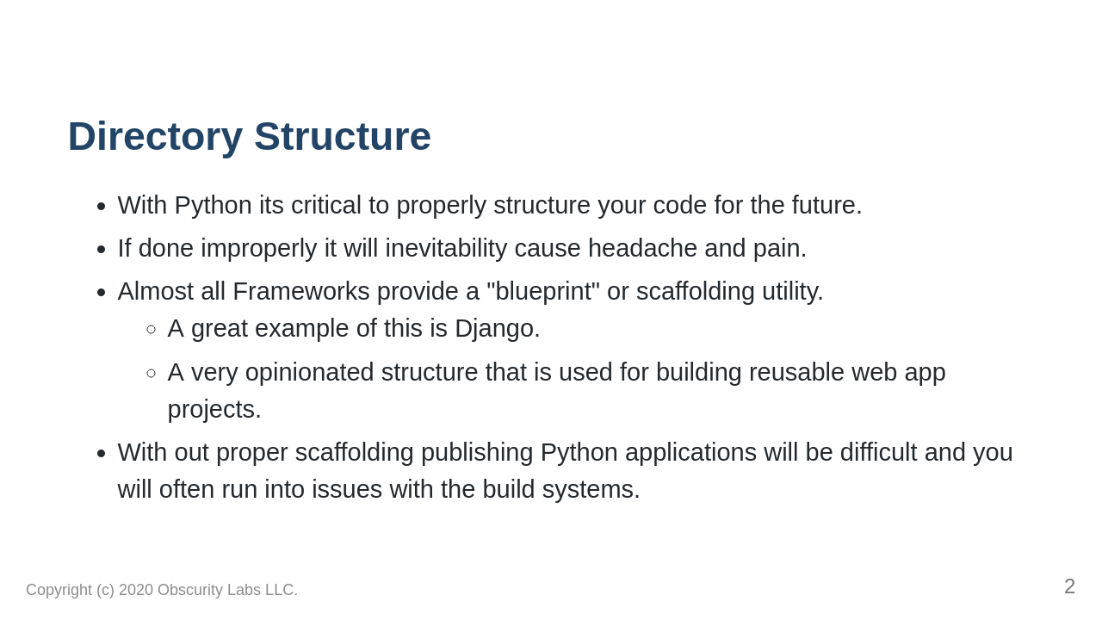

Slide 3
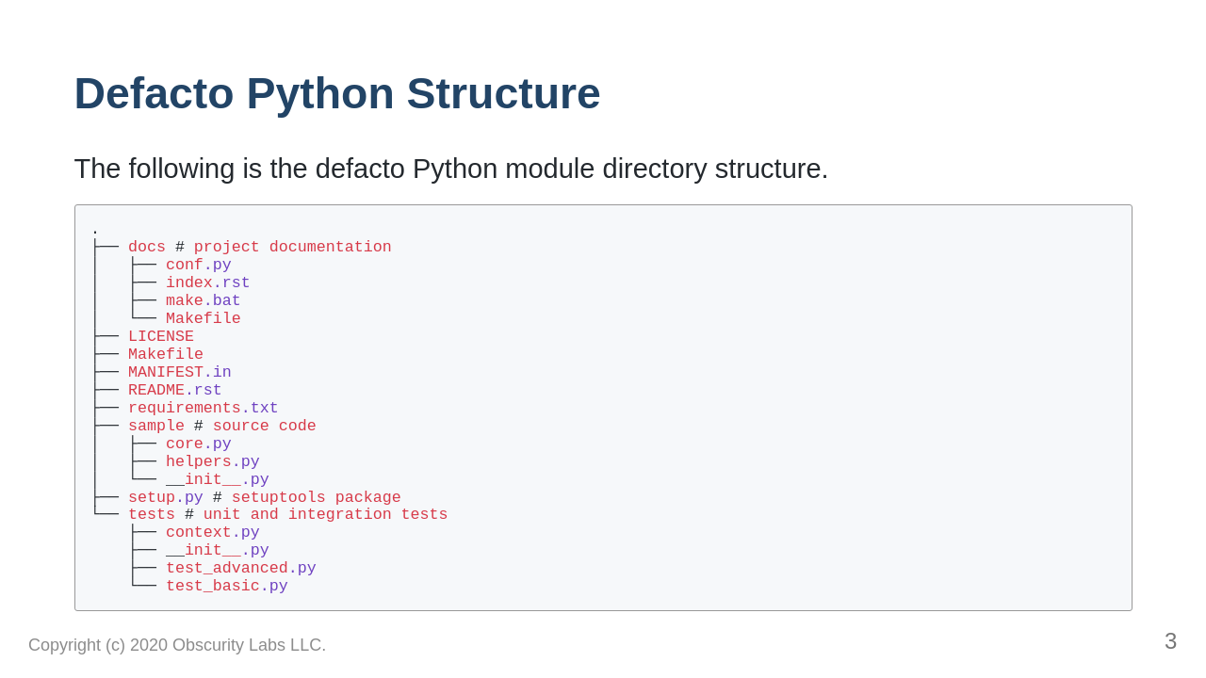
Notes:
https://docs.python-guide.org/writing/structure/

Slide 4
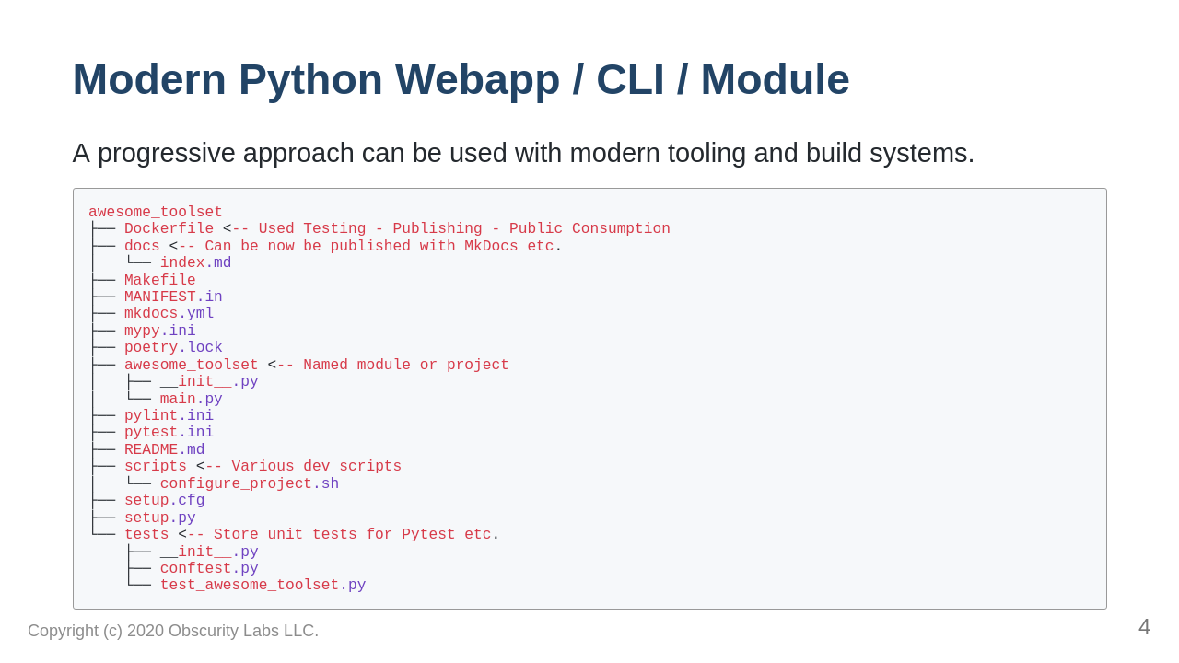
Notes:
https://towardsdatascience.com/ultimate-setup-for-your-next-python-project-179bda8a7c2c/

