Slide 1
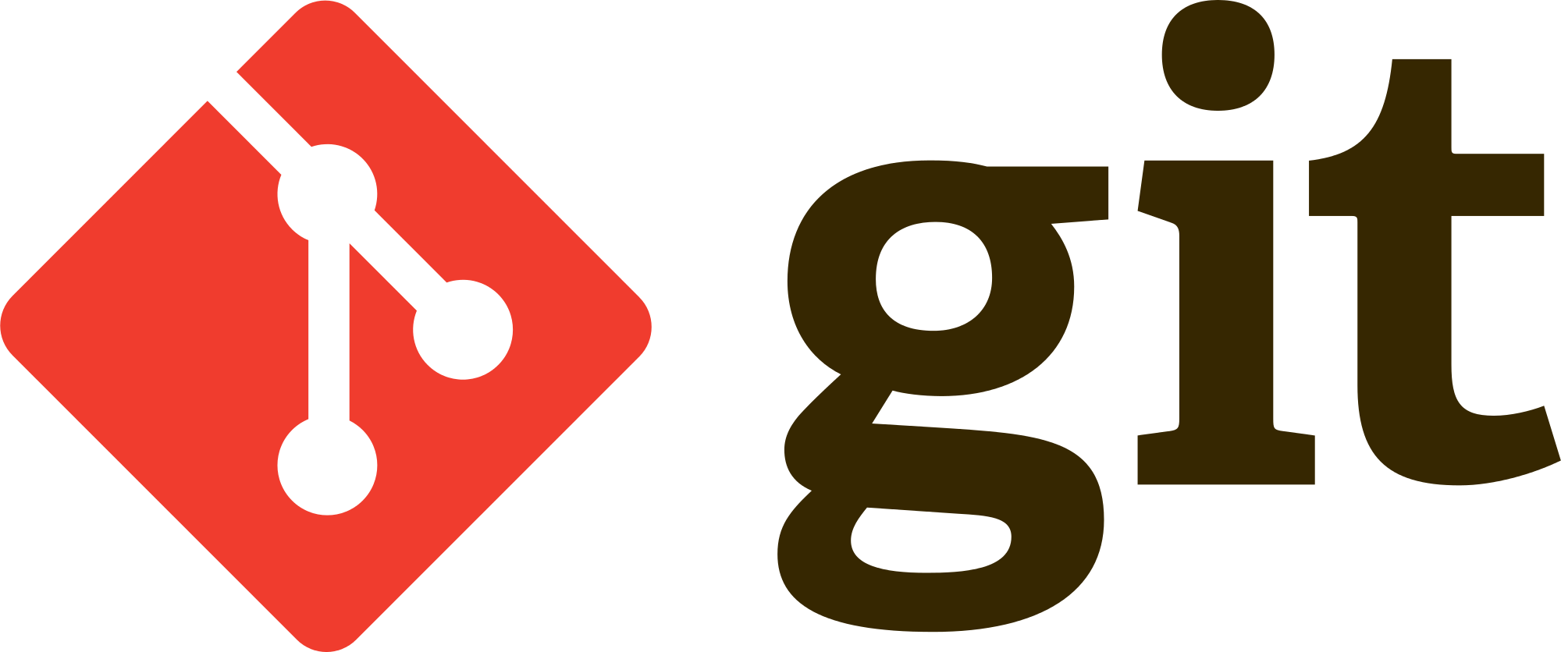

Slide 2
Contents
Version Control Systems
Git
Live Coding
Web based services

Slide 3
Git is a Version Control System

Slide 4
What is Version Control System?

Slide 5
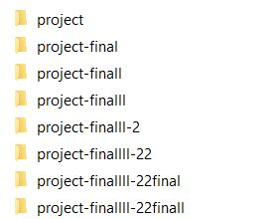
The easiest Version Control System

Slide 6
Version Control Systems
Local
Distributed
Centralized

Slide 7

Local Version Control Systems
Local VCSs have a simple database that keep all the changes to files under revision control.

Slide 8
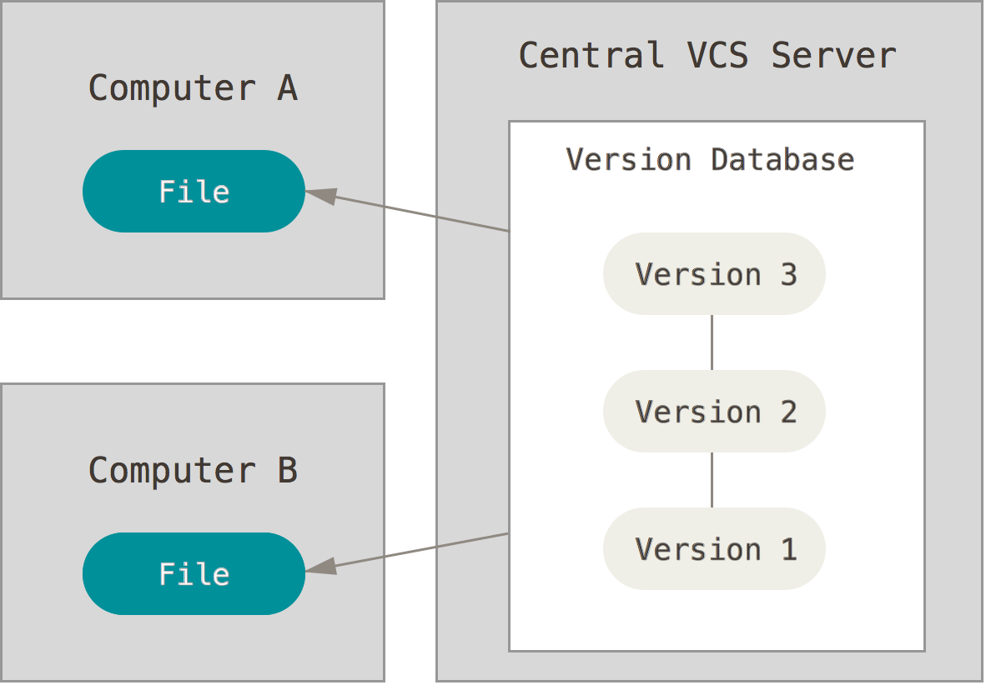
Centralized Version Control Systems
These systems, such as CVS, Subversion, and Perforce, have a single server that contains all the versioned files, and a number of clients that check out files from that central place.

Slide 9
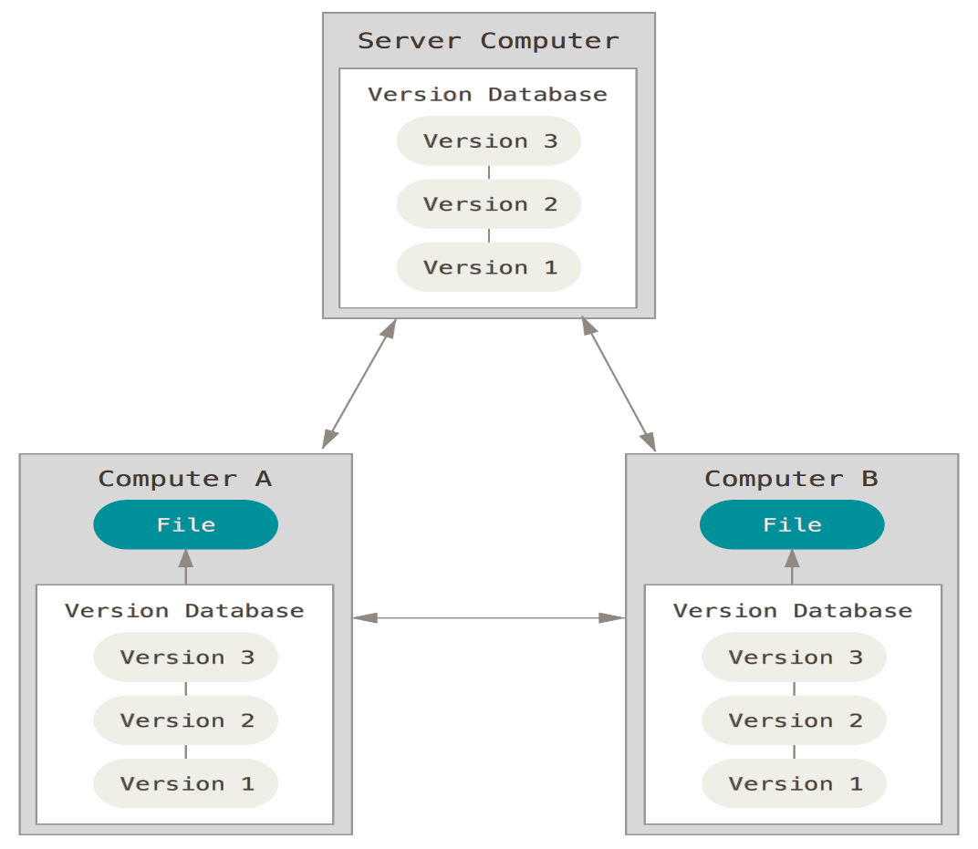
Distributed Version Control Systems
In a DVCS (such as Git, Mercurial, Bazaar or Darcs), clients don’t just check out the latest snapshot of the files: they fully mirror the repository.

Slide 10
What is Git?
Git is a version control system that is widely used for software development and other version control tasks. It is a distributed revision control system with an emphasis on speed, data integrity, and support for distributed, non-linear workflows. Git was initially designed and developed in 2005 by Linux kernel developers (including Linus Torvalds) for Linux kernel development.
As with most other distributed version control systems, and unlike most client-server systems, every Git working directory is a full repository with complete history and full version-tracking capabilities, independent of network access or a central server.

Slide 11
Some Advantages of Git
Strong support for non-linear development
Nearly every operation in local
You need internet if and only if you want to upload your workspace to server.
Distributed development
Efficient handling of large projects

Slide 12
Live Coding

Slide 13
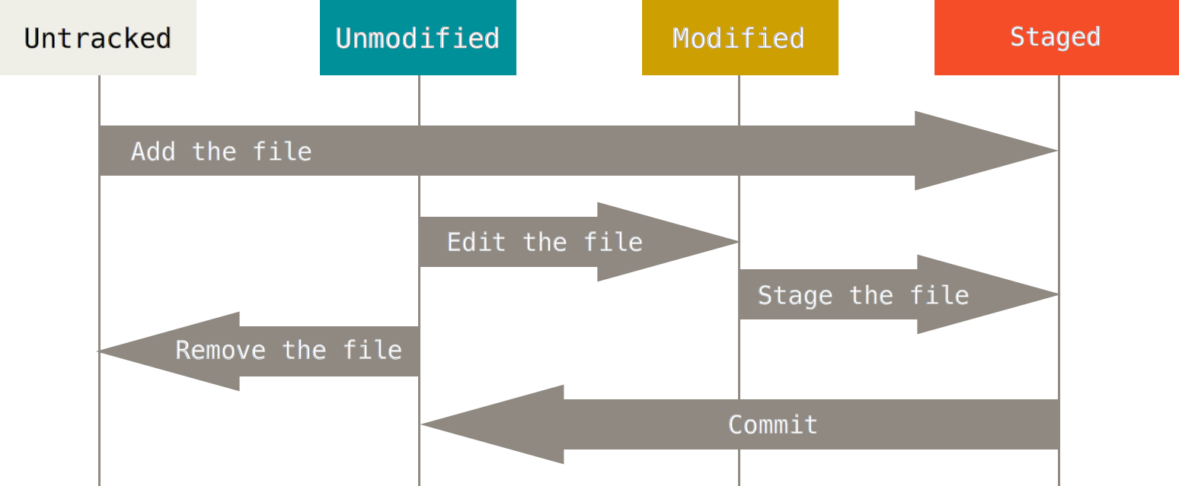

Slide 14
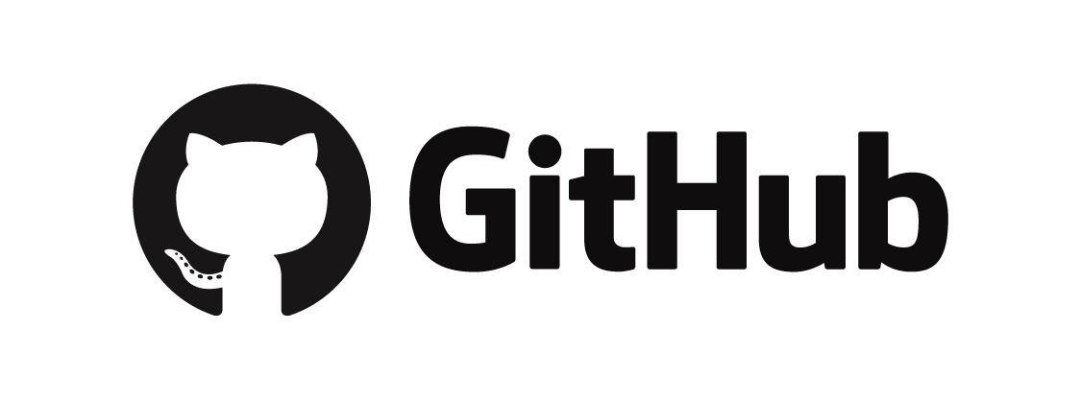
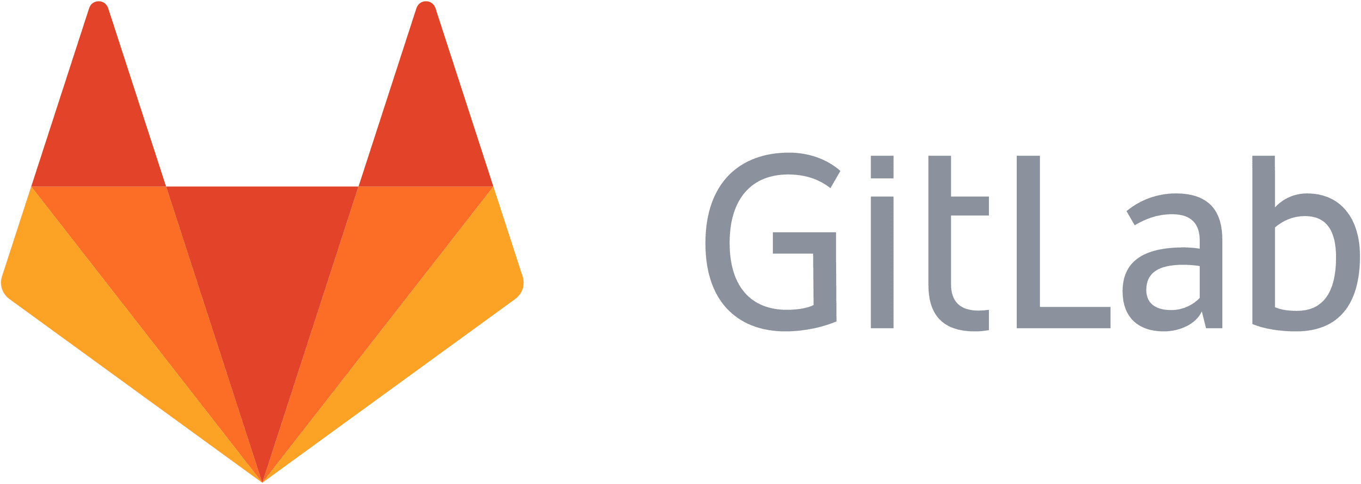

Different web-based Git repository hosting services

Slide 15

Move Further More
English version:
https://progit.org/
Turkish version:
https://git-scm.com/book/tr/v1

