Slide 1
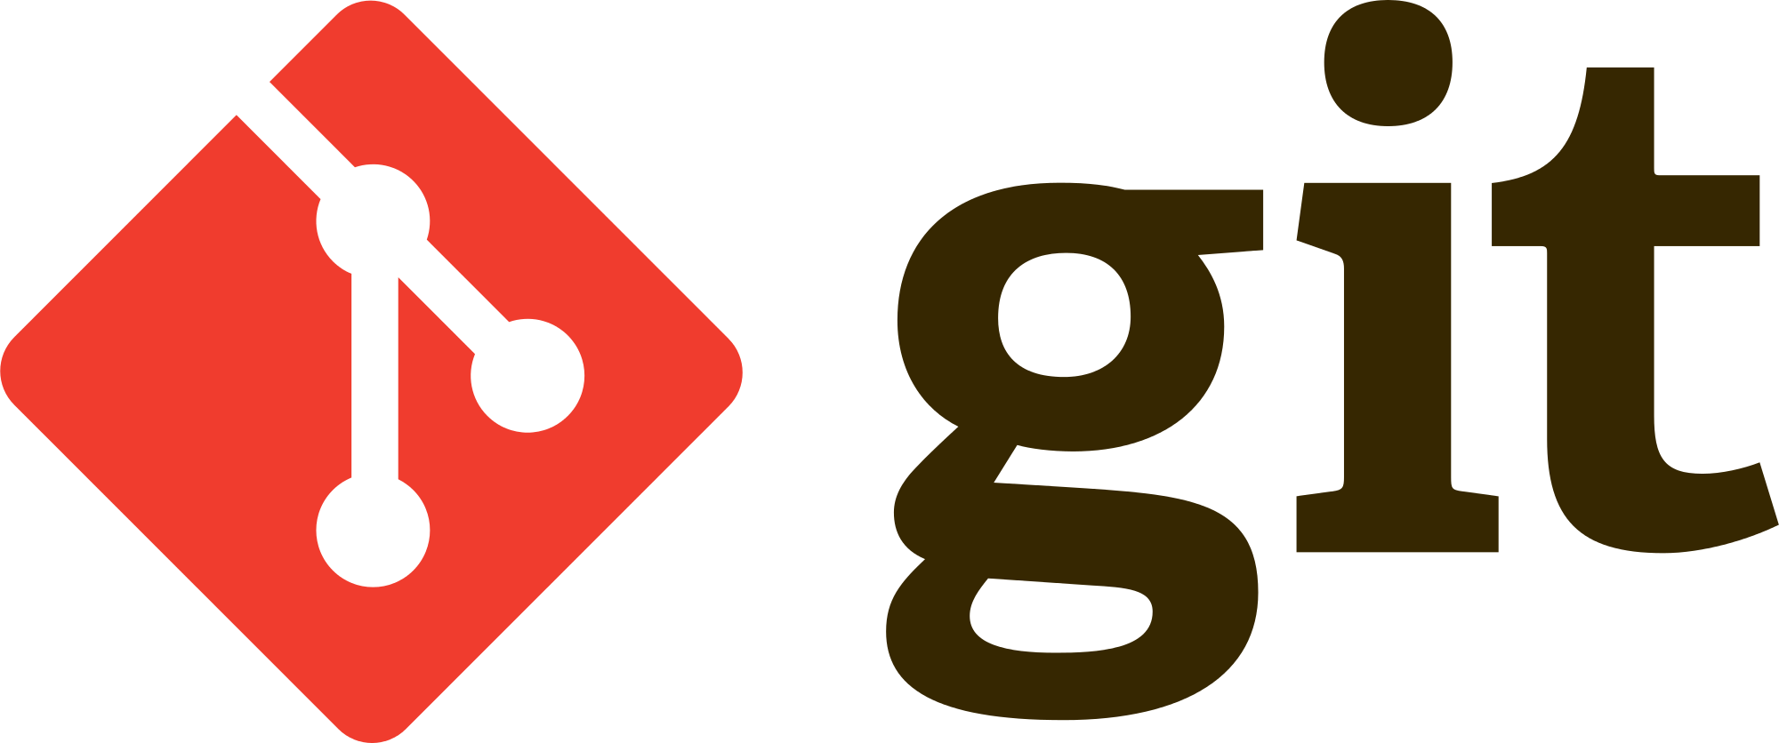

Slide 2
Contents
Version Control Systems
Git
Live Coding
Web based services

Slide 3
Git is a Version Control System

Slide 4
What is Version Control System?

Slide 5
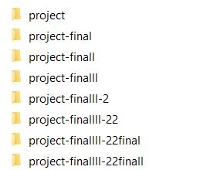
The easiest Version Control System

Slide 6
Version Control Systems
Local
Distributed
Centralized

Slide 7

Local Version Control Systems
Local VCSs have a simple database that keep all the changes to files under revision control.

Slide 8
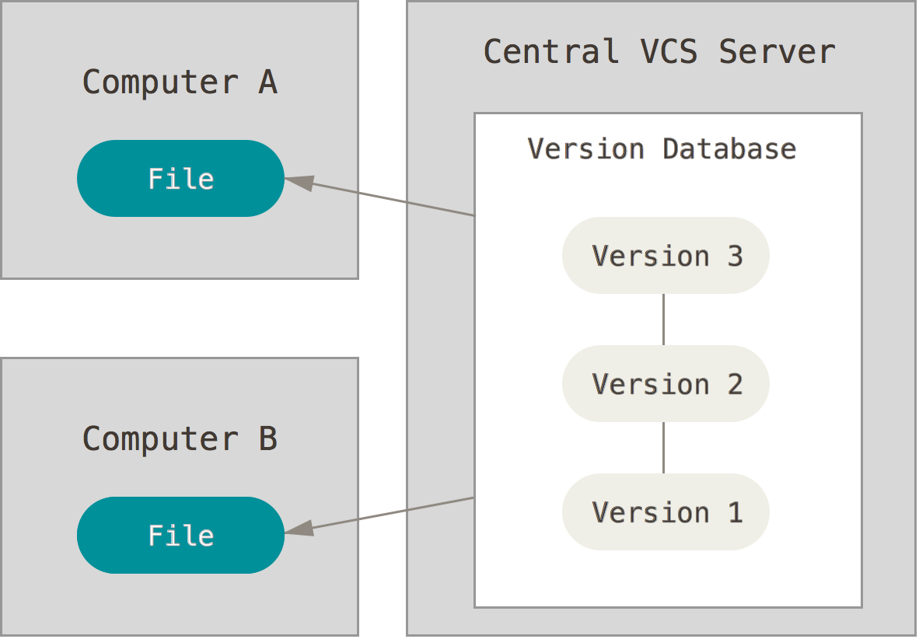
Centralized Version Control Systems
These systems, such as CVS, Subversion, and Perforce, have a single server that contains all the versioned files, and a number of clients that check out files from that central place.

Slide 9
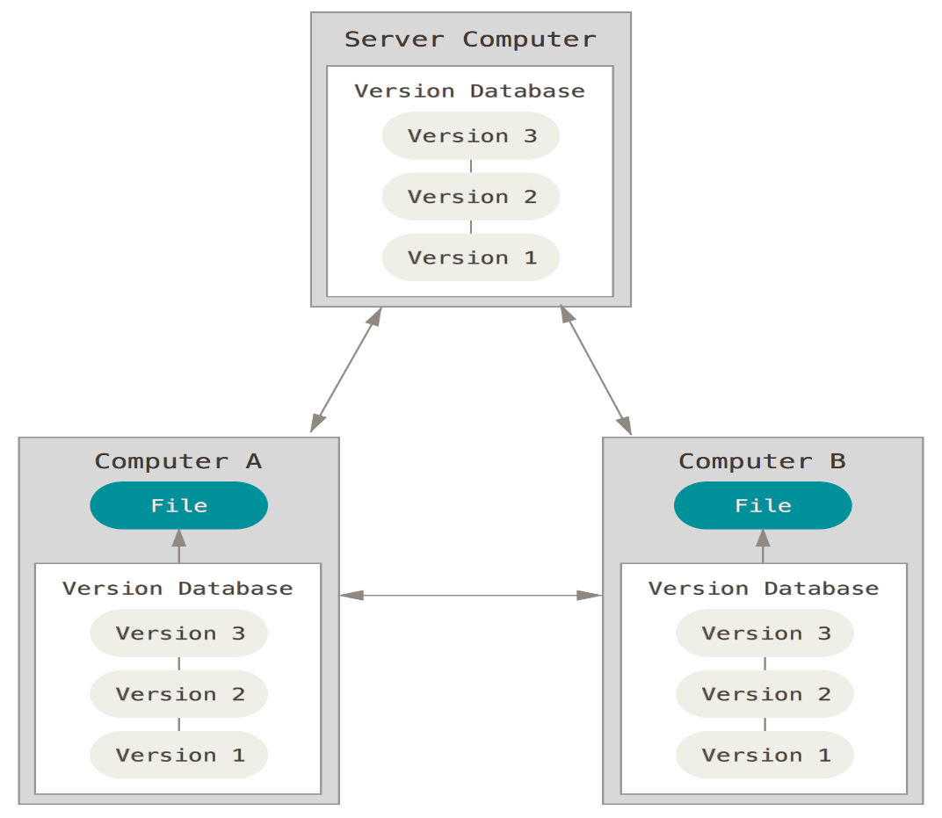
Distributed Version Control Systems
In a DVCS (such as Git, Mercurial, Bazaar or Darcs), clients don’t just check out the latest snapshot of the files: they fully mirror the repository.

Slide 10
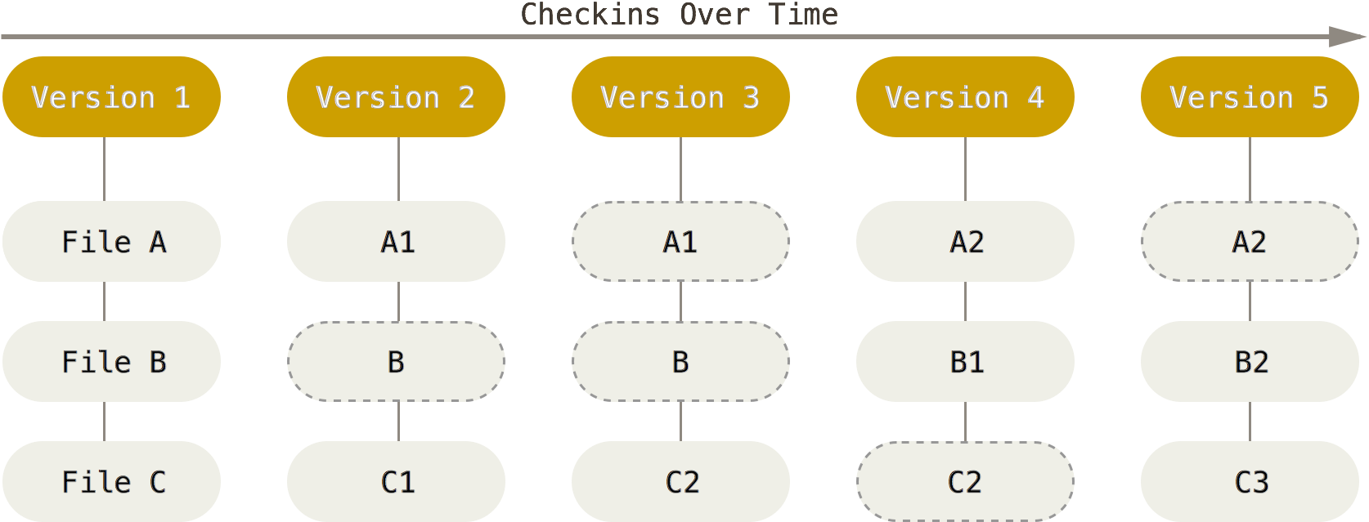
Storing data as snapshots of the project over time.

Slide 11
Nearly Every Operation Is Local
Most operations in Git only need local files and resources to operate
You need internet if and only if you want to upload your workspace to server.

Slide 12
Live Coding

Slide 13
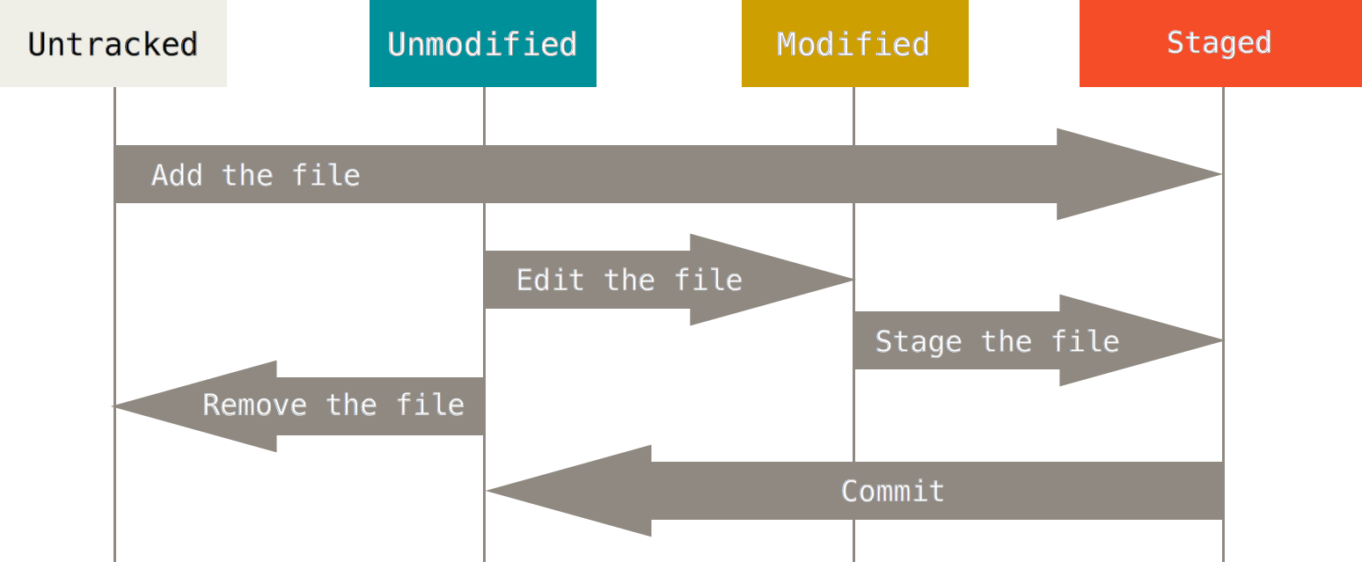

Slide 14



Different web-based Git repository hosting services

