Slide 1
Day 4

Slide 2
Agenda
Day 4
Nginx
Reverse Proxy
Load Balancer

Slide 3
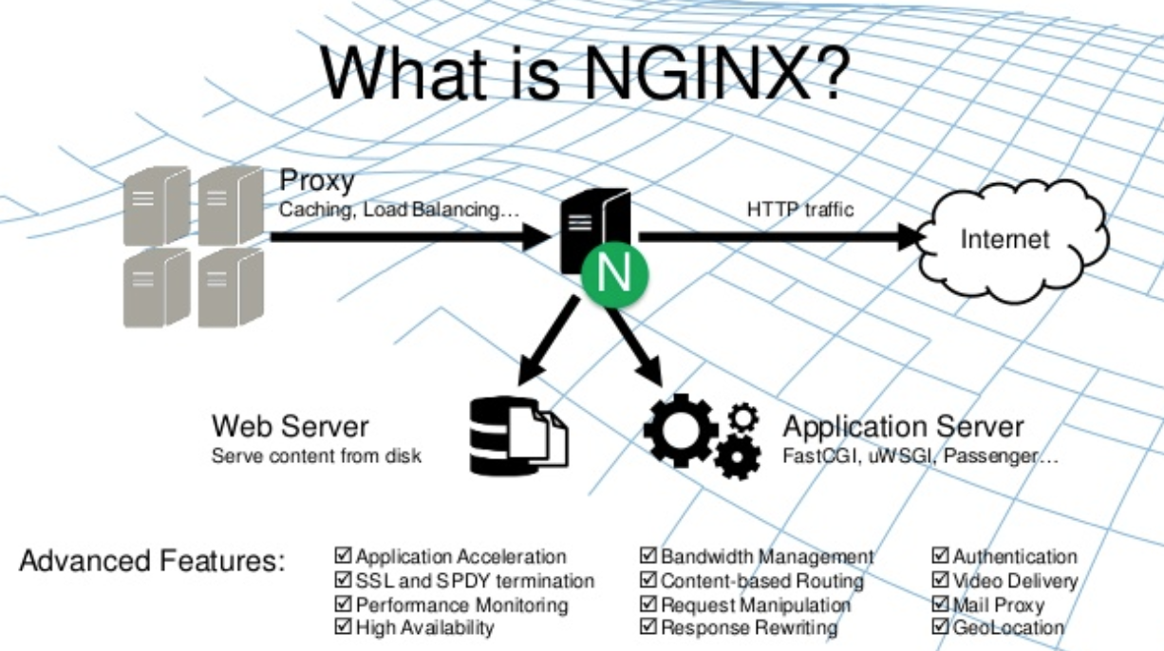

Slide 4
Nginx
circa 2002. Igor Sysoev. Russian dev.
writes mod_accel. Realizes the Apache’s low scalability.
2004 - powers rambler.ru. Initial public version released.
was built to address the C10K problem
143 Millions Websites (as of 2014)

Slide 5
Nginx - C10K problem
To serve concurrent 10K connections
Why? I/O is the bottleneck. A thread per connection model fails.
select() vs epoll()
http://www.kegel.com/c10k.html

Slide 6
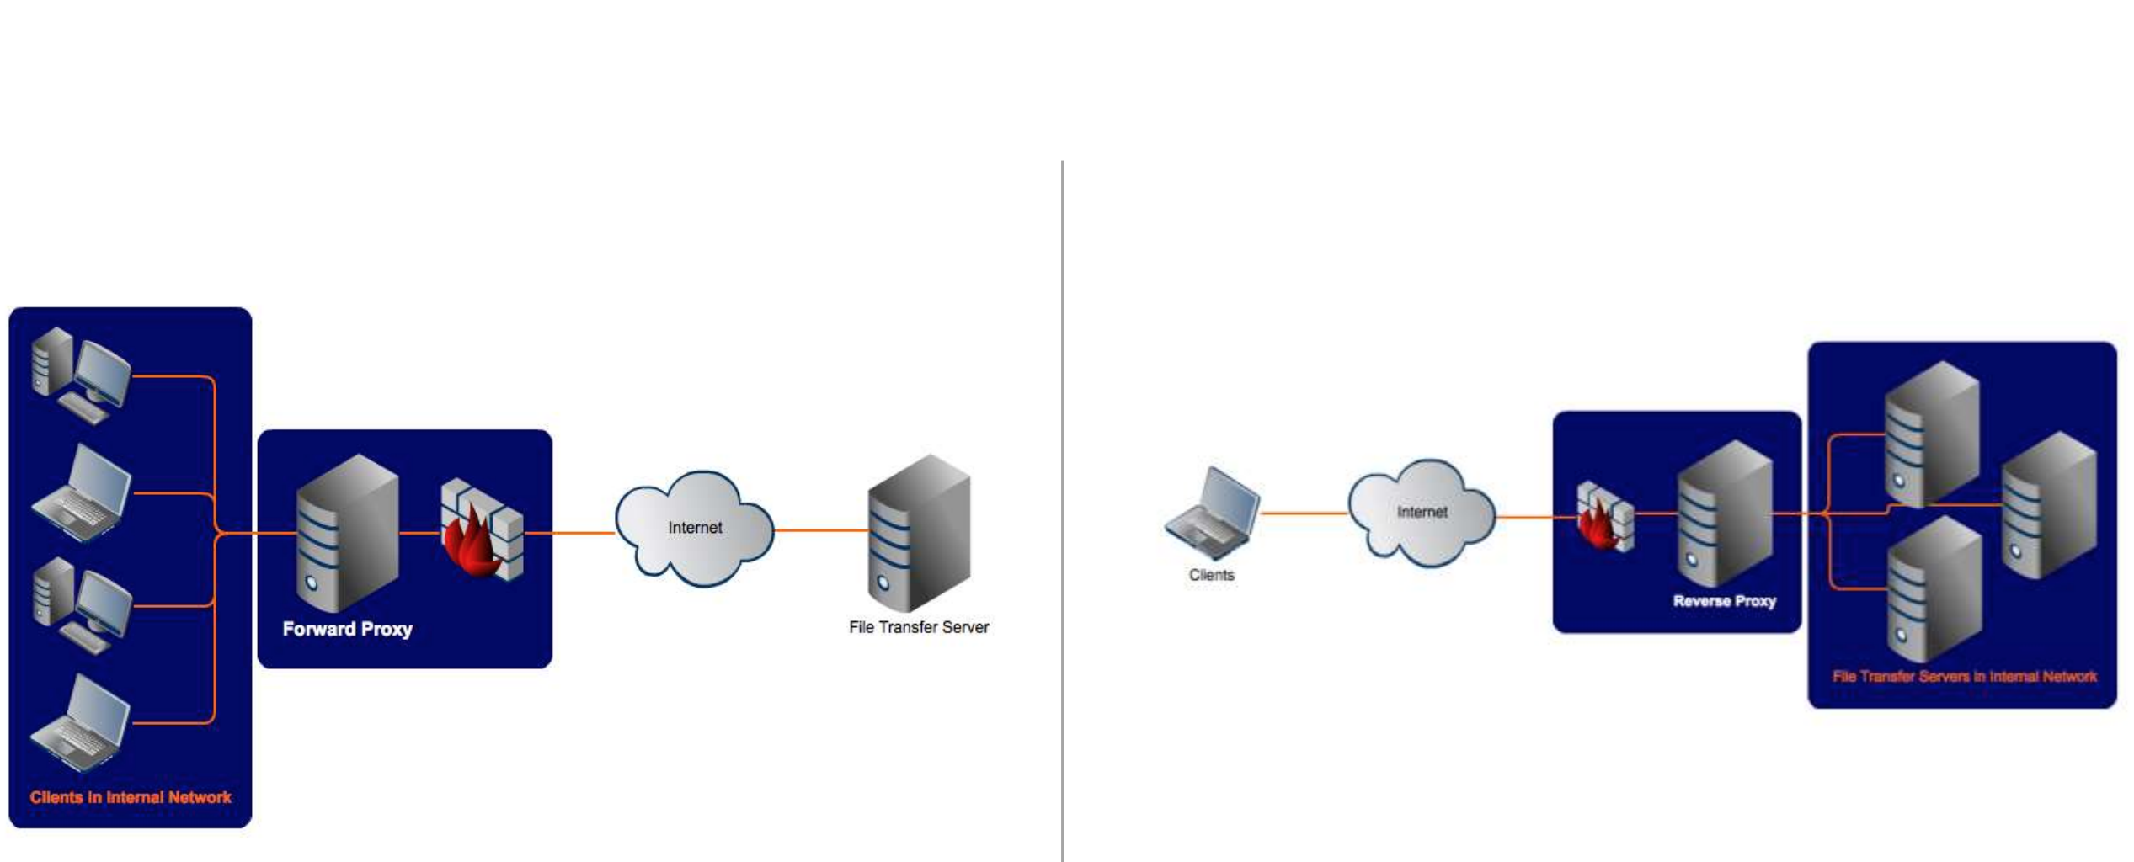
Proxy vs Reverse Proxy

Slide 7
Reverse Proxy Functions
Distribute the load among several servers
Seamlessly show content from different websites
Pass requests for processing to application servers (may be not HTTP)
FastCGI
Uwsgi
SCGI
memcached.

Slide 8
Nginx Configuration Location
Mac
/usr/local/etc/nginx/nginx.conf
Linux
/etc/nginx/nginx.conf
/usr/local/nginx/conf/nginx.conf
/usr/local/etc/nginx/nginx.conf

Slide 9
nginx.conf
http {
include mime.types;
default_type application/octet-stream;
sendfile on;
keepalive_timeout 65;
server {
listen 8080;
server_name localhost;
location / {
root html;
index index.html index.htm;
}

Slide 10
Sample Proxy Pass (proxy_pass )
location /some/path/ { proxy_pass http://www.example.com/link/; }
External
location ~ \.php { proxy_pass http://127.0.0.1:8000; }
Local

Slide 11
To pass a request to a non-HTTP proxied server
fastcgi_pass passes a request to a FastCGI server
uwsgi_pass passes a request to a uwsgi server
scgi_pass passes a request to an SCGI server
memcached_pass passes a request to a memcached server

Slide 12
Passing Request Headers
Default NGINX redefines two header fields in proxied requests
Host -> $proxy_host
Connection -> close
Set it to empty if do not want to pass the headers
location /some/path/ { proxy_set_header Accept-Encoding ""; proxy_pass http://localhost:8000; }

Slide 13
Load balancing
Traffic is intelligently distributed amongst multiple servers(app instances)
Features
Optimizing resource utilization
Reducing latency
Ensuring fault tolerance
Some load balancing solutions
Open source
Nginx
Haproxy
Corporate Standard
F5
Citrix

Slide 14
The costs of poor performance
Google: search enhancements cost 0.5s page load
Ad CTR dropped 20%
Amazon: Artificially increased page load by 100ms
Customer revenue dropped 1%
Walmart, Yahoo, Shopzilla, Edmunds, Mozilla…
All reported similar effects on revenue

Slide 15
Load-balancing Web Servers – Why?
Improved Application Availability
Management
Increased Capacity
Advanced techniques e.g. A|B testing

Slide 16
Load-balancing Web Servers – How?
DNS Round Robin
Hardware L4 load balancer
Software Reverse Proxy LB
Cloud solution

Slide 17
Load balancing with Nginx
Load balancing methods
Round robin
Least connected
Ip-hash
Session persistence
Weighted load balancing
Health check(passive)

Slide 18
Basic Load Balancing
All servers have same applications/services
Load-balancer extracts optimal performance

Slide 19
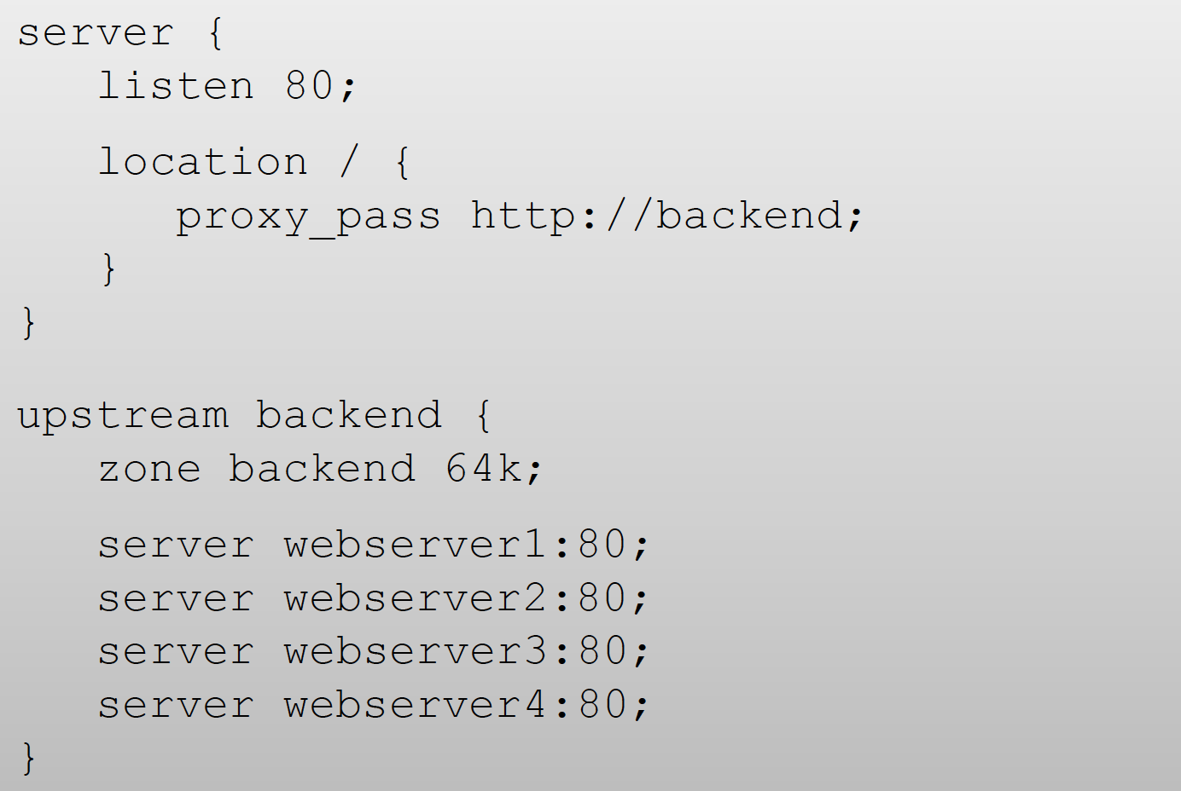
Basic load balancing

Slide 20
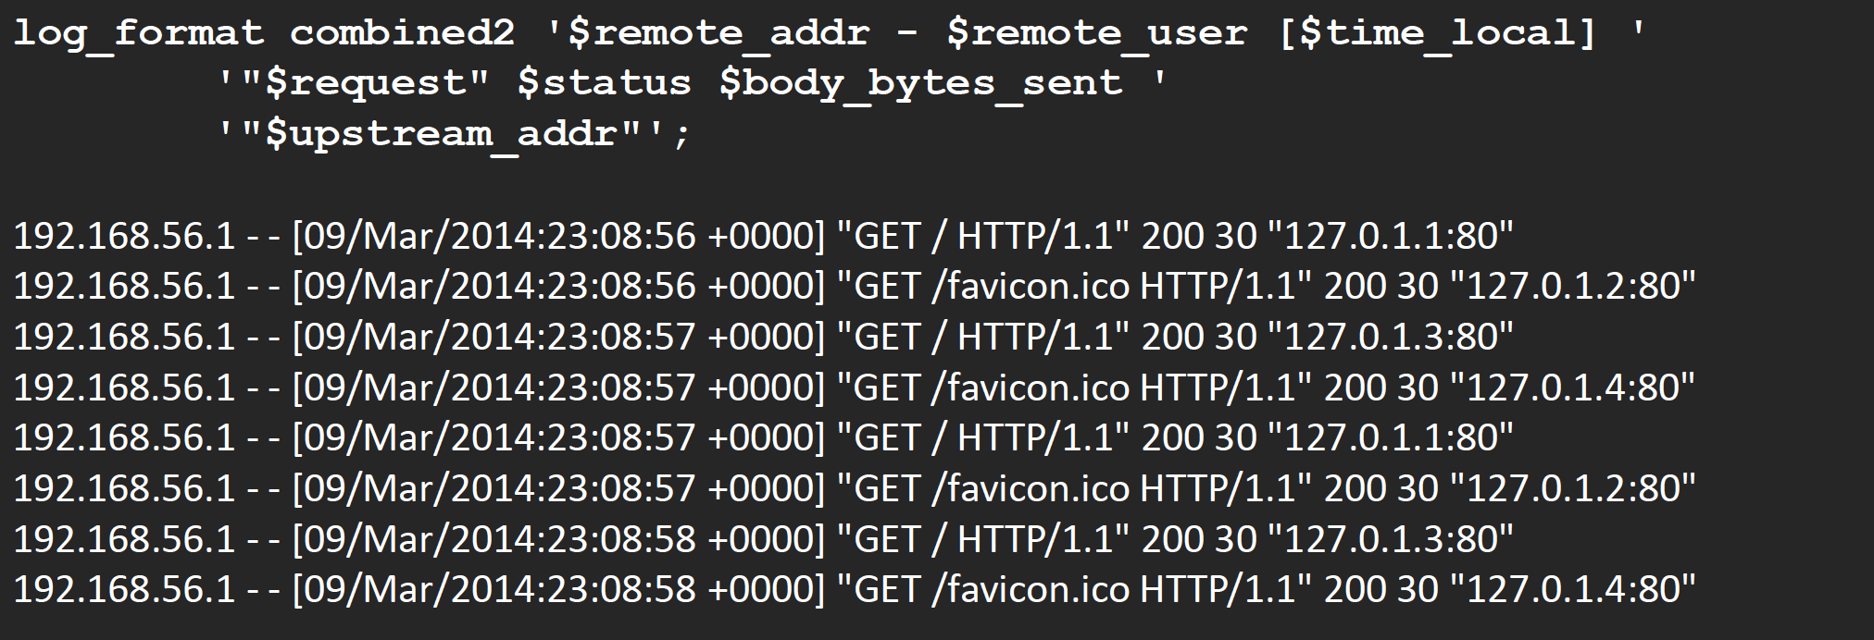
Basic load balancing
Use logging to debug: “$upstream_addr”

Slide 21
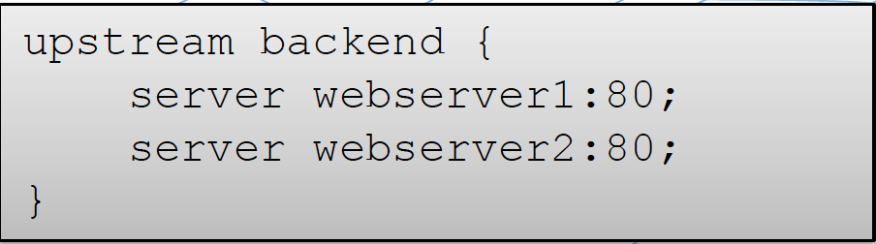
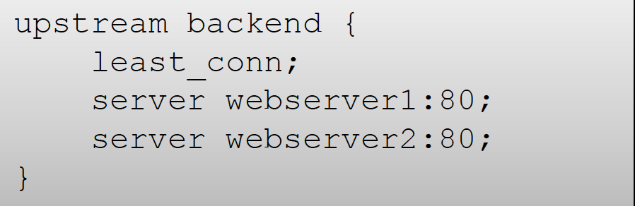
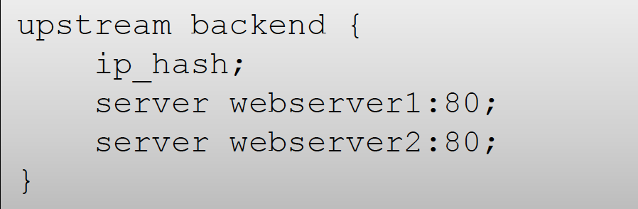
Basic Load Balancing
Round-robin is the default
– Suitable for consistent pages
Least Connections
– Suitable for varying pages
IP Hash
– Fixed mapping, basic session
persistence

Slide 22
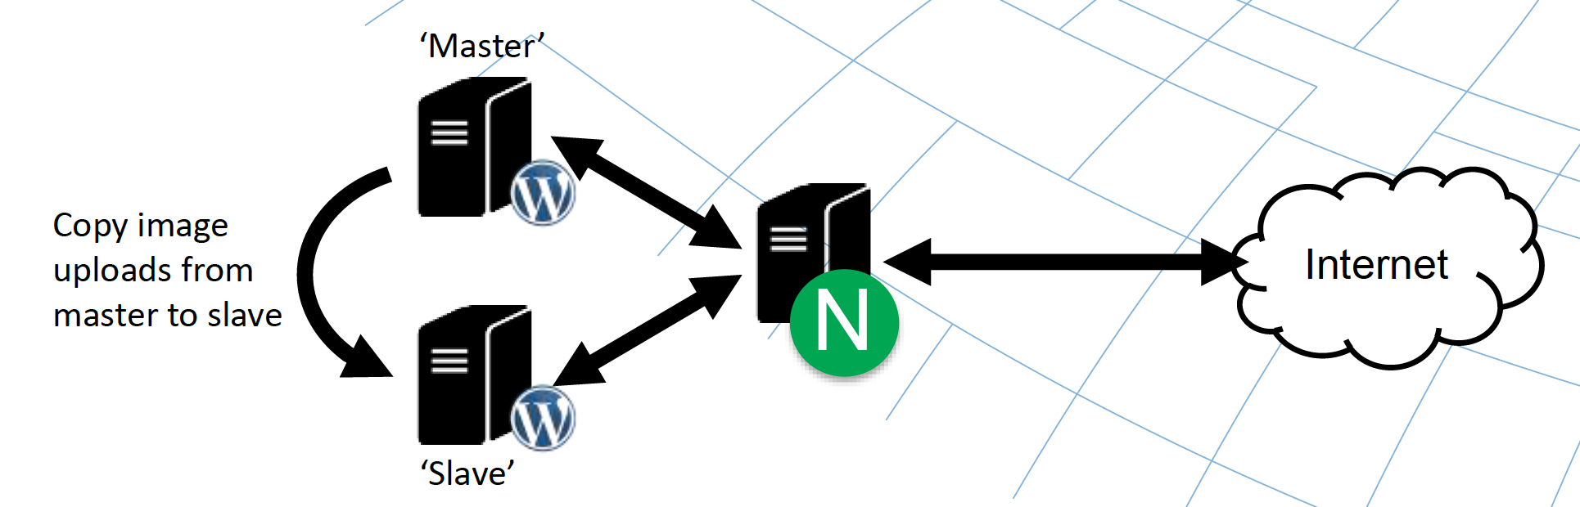
More advance - ‘Master’ and ‘Slave’ servers
Wordpress admin traffic (e.g. image uploads)

Slide 23
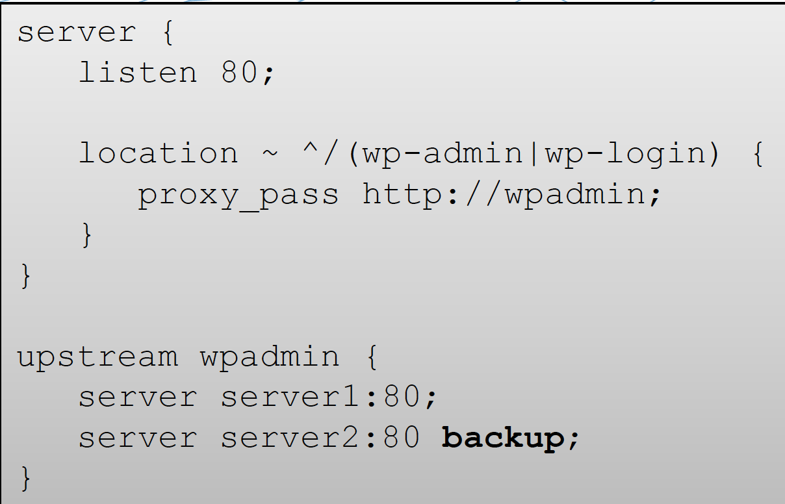
More advance - ‘Master’ and ‘Slave’ servers

Slide 24
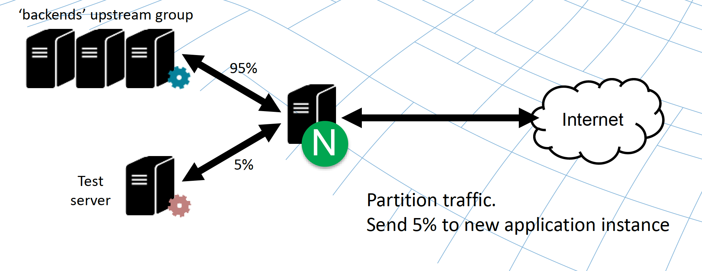
More advance - A|B Testing

Slide 25
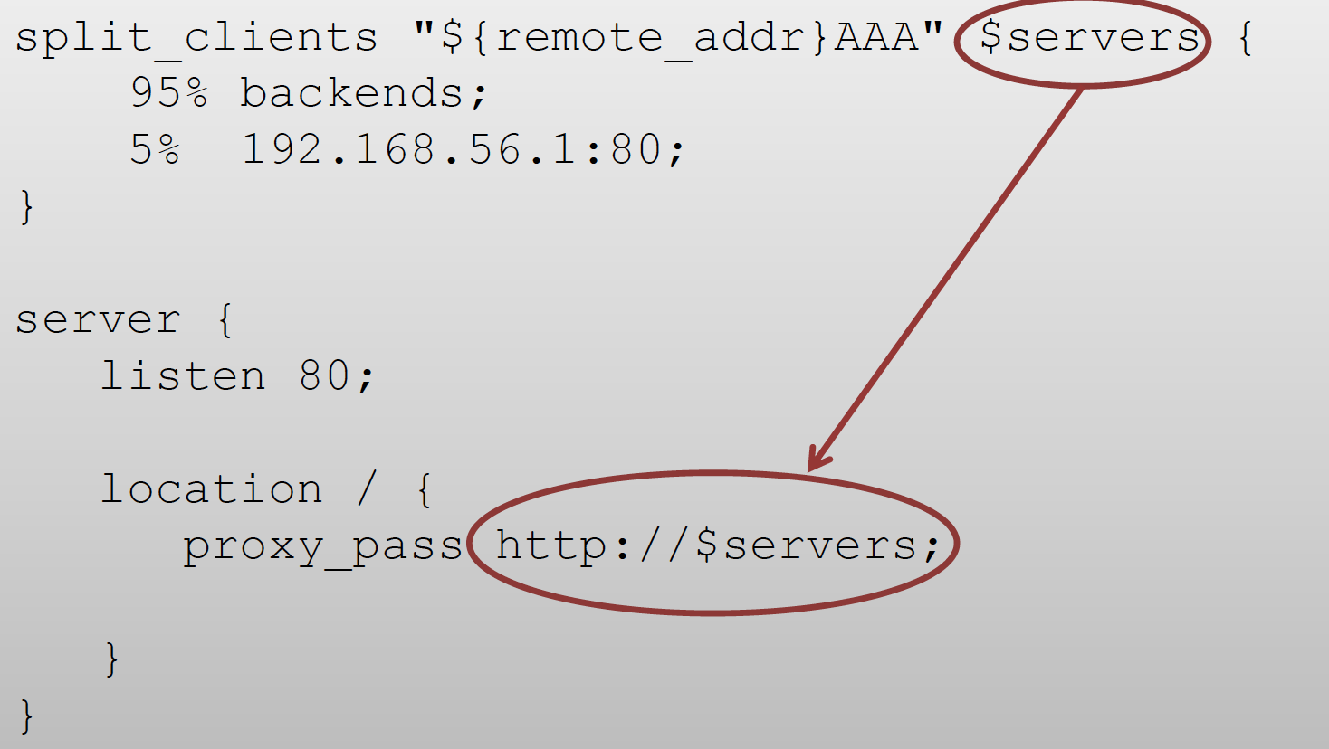
More advance - A|B Testing

