Slide 1
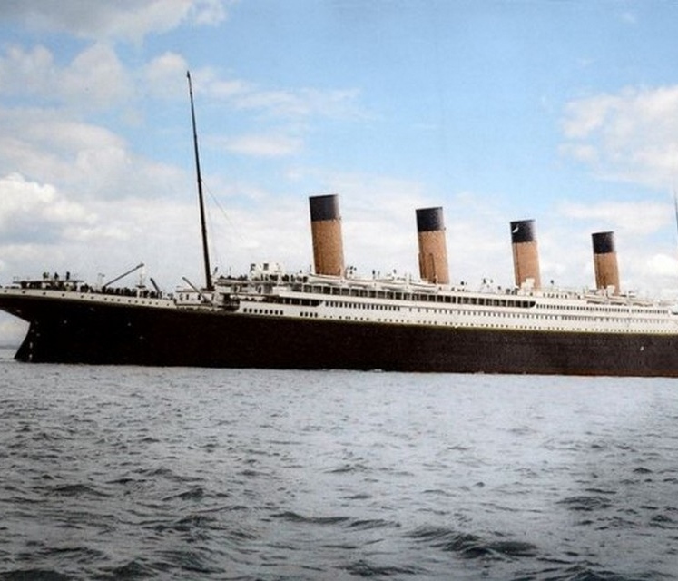

Titanic – A Survival Story
Robert Earland
Malav Ghia
Ariel Foy
Rachel Rodriguez

Slide 2
Overview
Titanic – A Survival Story
Survivability Predictions
Dataset Description
Preprocessing
Model Training and Evaluation

Slide 3
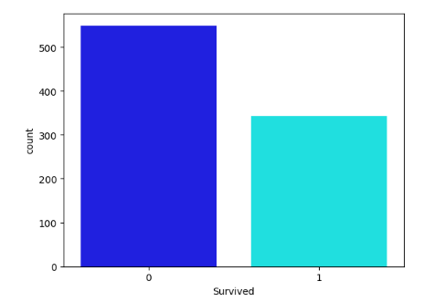
How Many Survived
Titanic – A Survival Story
Of the dataset we have 821
~ 500 – Perished (0)
~ 300 – Survived (1)

Slide 4
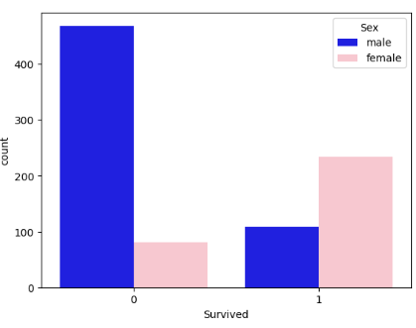
Breakdown of Survival by Sex
Titanic – A Survival Story
Perished
~ Over 400 male
~ 100 female
Survived
~ 100 male
~ 200 female

Slide 5
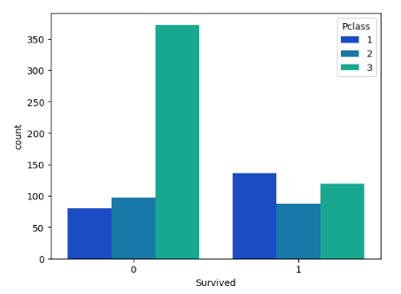
Survival by Class
Titanic – A Survival Story
Class 1 - Upper Class
Perished
~70
Survived
~150
Class 2 - Middle Class
Perished
~100
Survived
~100
Class 3 – Lower Class
Perished
~350
Survived
~125

Slide 6
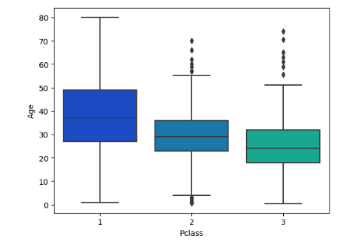
Age by Class
Titanic – A Survival Story
Older people are travelling by Class 1 & 2

Slide 7
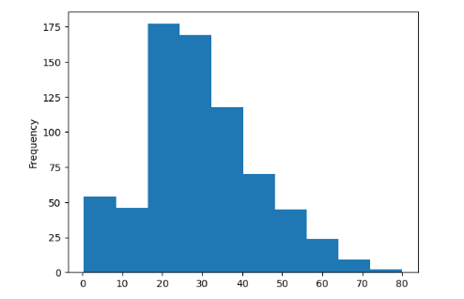
Age of Passengers
Titanic – A Survival Story
Majority of the passengers were from the ages 20-40

Slide 8
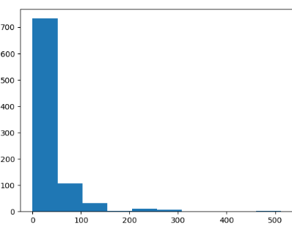
Fare
Titanic – A Survival Story
Majority of the passengers paid between 0-$150
2 people got free rides (Jack won his trip on a poker game)
And only 1 person paid $500

Slide 9
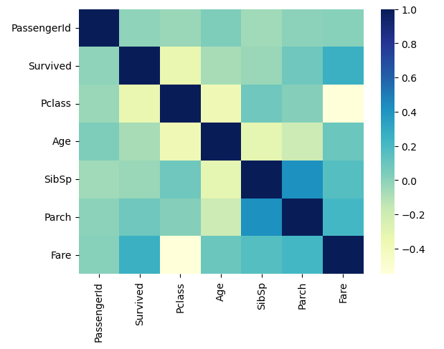
Titanic – A Survival Story
Heat Map
We used a heat map to see negative and positive correlation compared to the survived column.
Pclass
Fare

Slide 10
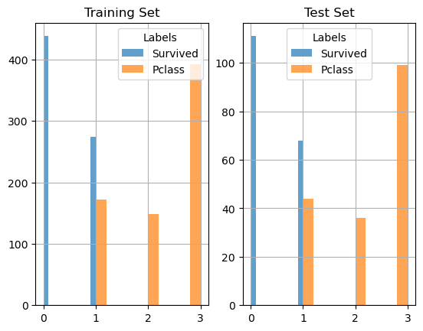
Titanic – A Survival Story
Stratified
Shuffle Split
We split our training data 80% - 20%
Verifying we have equal amount of features

Slide 11
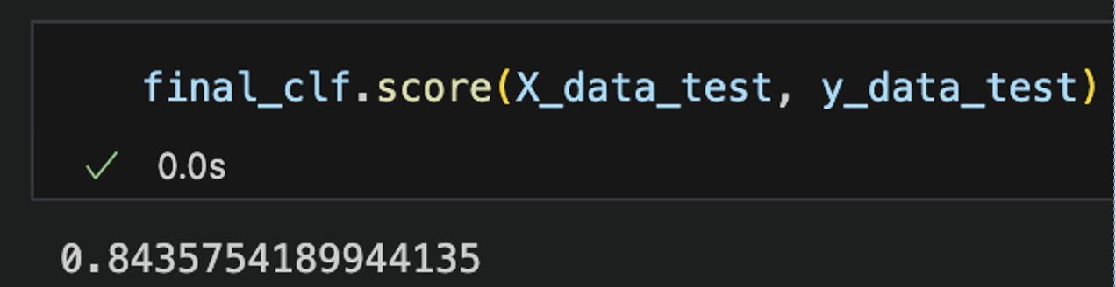
Titanic – A Survival Story
Our Accuracy Score

Slide 12
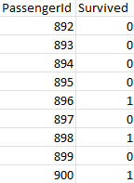
Test Data
Titanic – A Survival Story
418 passengers
Survived?
Model predicted that 141 passengers survived
Original data set close to 34% survived, while predicted data model 38% survived

Slide 13

Grab your lifesavers!

