Slide 1
📐 MATHEMATICS
CALCULUS & DIFFERENTIAL EQUATIONS
Official University / Board Level Comprehensive Examination Paper
🏆 Total Max Marks
100 Marks
📝 Question Count
15 Problems
⏱️ Duration / Time
3 Hours (180 Mins)
📋 CANDIDATE GENERAL INSTRUCTIONS:
1. All questions are compulsory unless specified otherwise. Marks are indicated against each question.
2. For mathematical & scientific problems, show complete step-by-step derivations, calculations, and state appropriate units.
3. For humanities & history questions, provide structured source analysis, contextual evidence, and critical reasoning.
4. Neat, labeled diagrams and plots must be provided wherever asked.
ExamGen Autonomous Examination System • Calculus & Differential Equations
Slide 1 of 18

Slide 2
Exam Blueprint & Questions Overview
📐 MATHEMATICS
Question # | Topic / Problem Focus | Allocated Marks | Visual Diagram
Question 1 | Find the general solution to the first-order linear differential equation: (dy / dx) + 2xy... | 6 Marks | Standard
Question 2 | Compute the Jacobian matrix for the vector-valued function f(x,y,z) = (x² y, sin(yz), e^{x... | 7 Marks | Standard
Question 3 | Evaluate the line integral ∫_C (x² + y²) ds where C is the semicircle x² + y² = 4 from (2,... | 8 Marks | Yes (Matplotlib)
Question 4 | Solve the exact differential equation: (2xy + y³)dx + (x² + 3xy²)dy = 0. | 7 Marks | Standard
Question 5 | Find the critical points of f(x,y) = x³ + y³ - 3xy and classify them as local maxima, mini... | 8 Marks | Yes (Matplotlib)
Question 6 | Determine the radius of convergence for the power series: ∑_{n=1}^∞ ((2x-3)ⁿ / n 5ⁿ). | 6 Marks | Standard
Question 7 | Solve the Bernoulli equation: (dy / dx) + (y / x) = x² y³. | 7 Marks | Standard
Question 8 | Compute the flux of F = (x², y², z²) across the surface of the unit cube [0,1]³. | 8 Marks | Standard
Question 9 | Find the general solution to the second-order ODE: y'' - 4y' + 4y = e^{2x} cos x. | 7 Marks | Standard
Question 10 | Evaluate the triple integral ∭_E z dV where E is bounded by the planes x=0, y=0, z=0 and x... | 7 Marks | Standard
Question 11 | Solve the initial value problem: y' = (x² / y(1+x³)) with y(0) = 2. | 6 Marks | Standard
Question 12 | Find the Fourier series representation of f(x) = x² on the interval [-π, π]. | 7 Marks | Standard
Question 13 | Use Green's Theorem to evaluate ∮_C (y² dx + x² dy) where C is the boundary of the region ... | 8 Marks | Standard
Question 14 | Solve the system of differential equations: (dx / dt) = 2x - y, (dy / dt) = x + 2y with in... | 7 Marks | Standard
Question 15 | Find the Laplace transform of f(t) = t² sin(3t) and use it to solve y'' + 4y = t² sin(3t) ... | 8 Marks | Standard
ExamGen Autonomous Examination System • Calculus & Differential Equations
Slide 2 of 18

Slide 3
Question 1 [6 Marks]
📐 MATHEMATICS
PROBLEM STATEMENT & TASKS:
Find the general solution to the first-order linear differential equation: (dy / dx) + 2xy = x e^{-x²}.
💡 EVALUATION & ANSWER DIRECTIVES:
Total Marks: 6 • Candidates must demonstrate rigorous mathematical proof / textual substantiation and clearly outline final conclusions.
ExamGen Autonomous Examination System • Calculus & Differential Equations
Slide 3 of 18
Notes:
Question 1 Notes:
- Allocated Marks: 6
- Subject: Mathematics
- Text: Find the general solution to the first-order linear differential equation: (dy / dx) + 2xy = x e^{-x²}.
- Marking Guidance: Award full marks for complete and rigorous answers. Deduct marks for missing steps, wrong algebraic units, or lack of critical citations.

Slide 4
Question 2 [7 Marks]
📐 MATHEMATICS
PROBLEM STATEMENT & TASKS:
Compute the Jacobian matrix for the vector-valued function f(x,y,z) = (x² y, sin(yz), e^{x+z}).
💡 EVALUATION & ANSWER DIRECTIVES:
Total Marks: 7 • Candidates must demonstrate rigorous mathematical proof / textual substantiation and clearly outline final conclusions.
ExamGen Autonomous Examination System • Calculus & Differential Equations
Slide 4 of 18
Notes:
Question 2 Notes:
- Allocated Marks: 7
- Subject: Mathematics
- Text: Compute the Jacobian matrix for the vector-valued function f(x,y,z) = (x² y, sin(yz), e^{x+z}).
- Marking Guidance: Award full marks for complete and rigorous answers. Deduct marks for missing steps, wrong algebraic units, or lack of critical citations.

Slide 5
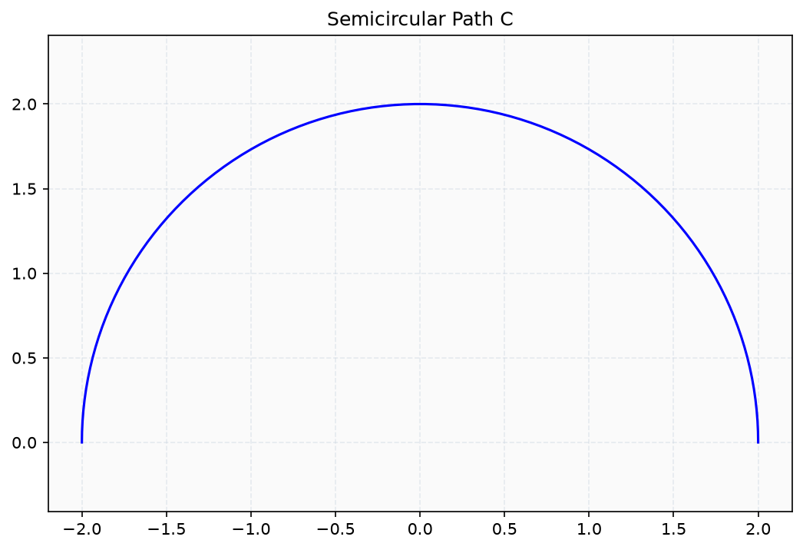
Question 3 [8 Marks]
📐 MATHEMATICS
PROBLEM STATEMENT:
Evaluate the line integral ∫_C (x² + y²) ds where C is the semicircle x² + y² = 4 from (2,0) to (-2,0).
Figure 3: Scientific Plot / Diagram
ExamGen Autonomous Examination System • Calculus & Differential Equations
Slide 5 of 18
Notes:
Question 3 Notes:
- Allocated Marks: 8
- Subject: Mathematics
- Text: Evaluate the line integral ∫_C (x² + y²) ds where C is the semicircle x² + y² = 4 from (2,0) to (-2,0).
- Marking Guidance: Award full marks for complete and rigorous answers. Deduct marks for missing steps, wrong algebraic units, or lack of critical citations.

Slide 6
Question 4 [7 Marks]
📐 MATHEMATICS
PROBLEM STATEMENT & TASKS:
Solve the exact differential equation: (2xy + y³)dx + (x² + 3xy²)dy = 0.
💡 EVALUATION & ANSWER DIRECTIVES:
Total Marks: 7 • Candidates must demonstrate rigorous mathematical proof / textual substantiation and clearly outline final conclusions.
ExamGen Autonomous Examination System • Calculus & Differential Equations
Slide 6 of 18
Notes:
Question 4 Notes:
- Allocated Marks: 7
- Subject: Mathematics
- Text: Solve the exact differential equation: (2xy + y³)dx + (x² + 3xy²)dy = 0.
- Marking Guidance: Award full marks for complete and rigorous answers. Deduct marks for missing steps, wrong algebraic units, or lack of critical citations.

Slide 7
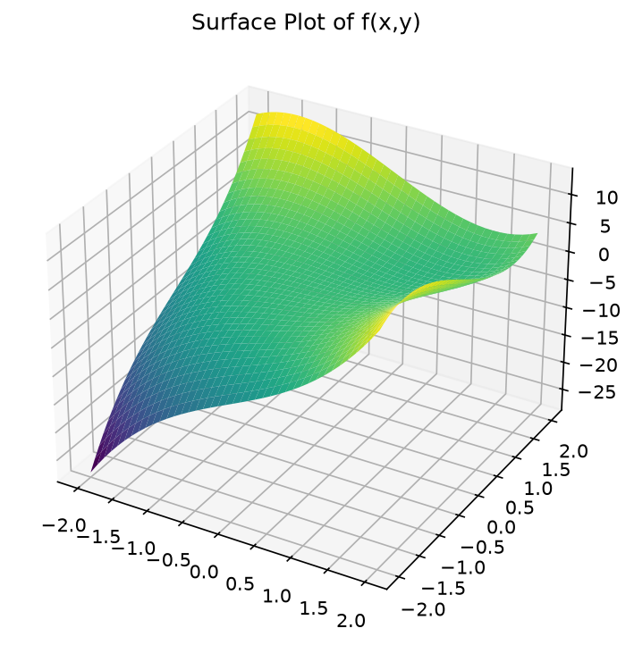
Question 5 [8 Marks]
📐 MATHEMATICS
PROBLEM STATEMENT:
Find the critical points of f(x,y) = x³ + y³ - 3xy and classify them as local maxima, minima or saddle points.
Figure 5: Scientific Plot / Diagram
ExamGen Autonomous Examination System • Calculus & Differential Equations
Slide 7 of 18
Notes:
Question 5 Notes:
- Allocated Marks: 8
- Subject: Mathematics
- Text: Find the critical points of f(x,y) = x³ + y³ - 3xy and classify them as local maxima, minima or saddle points.
- Marking Guidance: Award full marks for complete and rigorous answers. Deduct marks for missing steps, wrong algebraic units, or lack of critical citations.

Slide 8
Question 6 [6 Marks]
📐 MATHEMATICS
PROBLEM STATEMENT & TASKS:
Determine the radius of convergence for the power series: ∑_{n=1}^∞ ((2x-3)ⁿ / n 5ⁿ).
💡 EVALUATION & ANSWER DIRECTIVES:
Total Marks: 6 • Candidates must demonstrate rigorous mathematical proof / textual substantiation and clearly outline final conclusions.
ExamGen Autonomous Examination System • Calculus & Differential Equations
Slide 8 of 18
Notes:
Question 6 Notes:
- Allocated Marks: 6
- Subject: Mathematics
- Text: Determine the radius of convergence for the power series: ∑_{n=1}^∞ ((2x-3)ⁿ / n 5ⁿ).
- Marking Guidance: Award full marks for complete and rigorous answers. Deduct marks for missing steps, wrong algebraic units, or lack of critical citations.

Slide 9
Question 7 [7 Marks]
📐 MATHEMATICS
PROBLEM STATEMENT & TASKS:
Solve the Bernoulli equation: (dy / dx) + (y / x) = x² y³.
💡 EVALUATION & ANSWER DIRECTIVES:
Total Marks: 7 • Candidates must demonstrate rigorous mathematical proof / textual substantiation and clearly outline final conclusions.
ExamGen Autonomous Examination System • Calculus & Differential Equations
Slide 9 of 18
Notes:
Question 7 Notes:
- Allocated Marks: 7
- Subject: Mathematics
- Text: Solve the Bernoulli equation: (dy / dx) + (y / x) = x² y³.
- Marking Guidance: Award full marks for complete and rigorous answers. Deduct marks for missing steps, wrong algebraic units, or lack of critical citations.

Slide 10
Question 8 [8 Marks]
📐 MATHEMATICS
PROBLEM STATEMENT & TASKS:
Compute the flux of F = (x², y², z²) across the surface of the unit cube [0,1]³.
💡 EVALUATION & ANSWER DIRECTIVES:
Total Marks: 8 • Candidates must demonstrate rigorous mathematical proof / textual substantiation and clearly outline final conclusions.
ExamGen Autonomous Examination System • Calculus & Differential Equations
Slide 10 of 18
Notes:
Question 8 Notes:
- Allocated Marks: 8
- Subject: Mathematics
- Text: Compute the flux of F = (x², y², z²) across the surface of the unit cube [0,1]³.
- Marking Guidance: Award full marks for complete and rigorous answers. Deduct marks for missing steps, wrong algebraic units, or lack of critical citations.

Slide 11
Question 9 [7 Marks]
📐 MATHEMATICS
PROBLEM STATEMENT & TASKS:
Find the general solution to the second-order ODE: y'' - 4y' + 4y = e^{2x} cos x.
💡 EVALUATION & ANSWER DIRECTIVES:
Total Marks: 7 • Candidates must demonstrate rigorous mathematical proof / textual substantiation and clearly outline final conclusions.
ExamGen Autonomous Examination System • Calculus & Differential Equations
Slide 11 of 18
Notes:
Question 9 Notes:
- Allocated Marks: 7
- Subject: Mathematics
- Text: Find the general solution to the second-order ODE: y'' - 4y' + 4y = e^{2x} cos x.
- Marking Guidance: Award full marks for complete and rigorous answers. Deduct marks for missing steps, wrong algebraic units, or lack of critical citations.

Slide 12
Question 10 [7 Marks]
📐 MATHEMATICS
PROBLEM STATEMENT & TASKS:
Evaluate the triple integral ∭_E z dV where E is bounded by the planes x=0, y=0, z=0 and x+y+z=1.
💡 EVALUATION & ANSWER DIRECTIVES:
Total Marks: 7 • Candidates must demonstrate rigorous mathematical proof / textual substantiation and clearly outline final conclusions.
ExamGen Autonomous Examination System • Calculus & Differential Equations
Slide 12 of 18
Notes:
Question 10 Notes:
- Allocated Marks: 7
- Subject: Mathematics
- Text: Evaluate the triple integral ∭_E z dV where E is bounded by the planes x=0, y=0, z=0 and x+y+z=1.
- Marking Guidance: Award full marks for complete and rigorous answers. Deduct marks for missing steps, wrong algebraic units, or lack of critical citations.

Slide 13
Question 11 [6 Marks]
📐 MATHEMATICS
PROBLEM STATEMENT & TASKS:
Solve the initial value problem: y' = (x² / y(1+x³)) with y(0) = 2.
💡 EVALUATION & ANSWER DIRECTIVES:
Total Marks: 6 • Candidates must demonstrate rigorous mathematical proof / textual substantiation and clearly outline final conclusions.
ExamGen Autonomous Examination System • Calculus & Differential Equations
Slide 13 of 18
Notes:
Question 11 Notes:
- Allocated Marks: 6
- Subject: Mathematics
- Text: Solve the initial value problem: y' = (x² / y(1+x³)) with y(0) = 2.
- Marking Guidance: Award full marks for complete and rigorous answers. Deduct marks for missing steps, wrong algebraic units, or lack of critical citations.

Slide 14
Question 12 [7 Marks]
📐 MATHEMATICS
PROBLEM STATEMENT & TASKS:
Find the Fourier series representation of f(x) = x² on the interval [-π, π].
💡 EVALUATION & ANSWER DIRECTIVES:
Total Marks: 7 • Candidates must demonstrate rigorous mathematical proof / textual substantiation and clearly outline final conclusions.
ExamGen Autonomous Examination System • Calculus & Differential Equations
Slide 14 of 18
Notes:
Question 12 Notes:
- Allocated Marks: 7
- Subject: Mathematics
- Text: Find the Fourier series representation of f(x) = x² on the interval [-π, π].
- Marking Guidance: Award full marks for complete and rigorous answers. Deduct marks for missing steps, wrong algebraic units, or lack of critical citations.

Slide 15
Question 13 [8 Marks]
📐 MATHEMATICS
PROBLEM STATEMENT & TASKS:
Use Green's Theorem to evaluate ∮_C (y² dx + x² dy) where C is the boundary of the region between y = x² and y = x.
💡 EVALUATION & ANSWER DIRECTIVES:
Total Marks: 8 • Candidates must demonstrate rigorous mathematical proof / textual substantiation and clearly outline final conclusions.
ExamGen Autonomous Examination System • Calculus & Differential Equations
Slide 15 of 18
Notes:
Question 13 Notes:
- Allocated Marks: 8
- Subject: Mathematics
- Text: Use Green's Theorem to evaluate ∮_C (y² dx + x² dy) where C is the boundary of the region between y = x² and y = x.
- Marking Guidance: Award full marks for complete and rigorous answers. Deduct marks for missing steps, wrong algebraic units, or lack of critical citations.

Slide 16
Question 14 [7 Marks]
📐 MATHEMATICS
PROBLEM STATEMENT & TASKS:
Solve the system of differential equations: (dx / dt) = 2x - y, (dy / dt) = x + 2y with initial conditions x(0) = 1, y(0) = 0.
💡 EVALUATION & ANSWER DIRECTIVES:
Total Marks: 7 • Candidates must demonstrate rigorous mathematical proof / textual substantiation and clearly outline final conclusions.
ExamGen Autonomous Examination System • Calculus & Differential Equations
Slide 16 of 18
Notes:
Question 14 Notes:
- Allocated Marks: 7
- Subject: Mathematics
- Text: Solve the system of differential equations: (dx / dt) = 2x - y, (dy / dt) = x + 2y with initial conditions x(0) = 1, y(0) = 0.
- Marking Guidance: Award full marks for complete and rigorous answers. Deduct marks for missing steps, wrong algebraic units, or lack of critical citations.

Slide 17
Question 15 [8 Marks]
📐 MATHEMATICS
PROBLEM STATEMENT & TASKS:
Find the Laplace transform of f(t) = t² sin(3t) and use it to solve y'' + 4y = t² sin(3t) with y(0) = y'(0) = 0.
💡 EVALUATION & ANSWER DIRECTIVES:
Total Marks: 8 • Candidates must demonstrate rigorous mathematical proof / textual substantiation and clearly outline final conclusions.
ExamGen Autonomous Examination System • Calculus & Differential Equations
Slide 17 of 18
Notes:
Question 15 Notes:
- Allocated Marks: 8
- Subject: Mathematics
- Text: Find the Laplace transform of f(t) = t² sin(3t) and use it to solve y'' + 4y = t² sin(3t) with y(0) = y'(0) = 0.
- Marking Guidance: Award full marks for complete and rigorous answers. Deduct marks for missing steps, wrong algebraic units, or lack of critical citations.

Slide 18
Examiner Marking Scheme & Rubric Guidelines
GRADING RUBRIC
STANDARDIZED EVALUATION CHECKLIST & MARK DISTRIBUTION
• Conceptual Understanding & Formulation (30%)
Correct identification of applicable theorems, formulas, historical events, or core principles.
• Methodological Execution & Working Steps (40%)
Logical sequence of derivations, intermediate algebraic steps, balanced chemical reactions, or source analysis.
• Accuracy & Final Solution (20%)
Precise numerical results, correct physical units, or coherent synthesis of concluding arguments.
• Diagrams, Notation & Presentation (10%)
Neatness, accurate diagram labeling, standard mathematical/scientific notation, and clarity.
ExamGen Autonomous Examination System • Calculus & Differential Equations
Slide 18 of 18

