Slide 1
📐 MATHEMATICS
ADVANCED CALCULUS & DIFFERENTIAL EQUATIONS
Official University / Board Level Comprehensive Examination Paper
🏆 Total Max Marks
100 Marks
📝 Question Count
20 Problems
⏱️ Duration / Time
3 Hours (180 Mins)
📋 CANDIDATE GENERAL INSTRUCTIONS:
1. All questions are compulsory unless specified otherwise. Marks are indicated against each question.
2. For mathematical & scientific problems, show complete step-by-step derivations, calculations, and state appropriate units.
3. For humanities & history questions, provide structured source analysis, contextual evidence, and critical reasoning.
4. Neat, labeled diagrams and plots must be provided wherever asked.
ExamGen Autonomous Examination System • Advanced Calculus & Differential Equations
Slide 1 of 23

Slide 2
Exam Blueprint & Questions Overview
📐 MATHEMATICS
Question # | Topic / Problem Focus | Allocated Marks | Visual Diagram
Question 1 | Find the general solution to the first-order linear differential equation: (dy / dx) + 2xy... | 5 Marks | Standard
Question 2 | Compute the directional derivative of f(x,y,z) = x² y + y² z at point (1,2,3) in the direc... | 5 Marks | Yes (Matplotlib)
Question 3 | Solve the exact differential equation: (2xy + y³)dx + (x² + 3xy²)dy = 0. | 5 Marks | Standard
Question 4 | Find the critical points of f(x,y) = x³ + y³ - 3xy and classify them as maxima, minima or ... | 5 Marks | Standard
Question 5 | Compute the line integral ∫_C (x² + y²)ds where C is the right half of the unit circle x² ... | 5 Marks | Standard
Question 6 | Solve the Bernoulli equation: (dy / dx) + (y / x) = x² y³. | 5 Marks | Standard
Question 7 | Find the Fourier series representation of f(x) = x on the interval -π < x < π. | 5 Marks | Standard
Question 8 | Compute the surface integral ∬_S (x² + y²)dS where S is the surface z = √(x² + y²) for 0 ≤... | 5 Marks | Standard
Question 9 | Solve the initial value problem: y'' + 4y' + 4y = e^{-2x}, y(0) = 1, y'(0) = 0. | 5 Marks | Standard
Question 10 | Find the general solution to the system of differential equations: (dx / dt) = 2x + y, (dy... | 5 Marks | Standard
Question 11 | Compute the divergence and curl of the vector field F = (x² y, y² z, z² x). | 5 Marks | Standard
Question 12 | Solve the partial differential equation: (∂ u / ∂ t) = k (∂² u / ∂ x²) with boundary condi... | 5 Marks | Standard
Question 13 | Find the Laplace transform of f(t) = t² sin(3t). | 5 Marks | Standard
Question 14 | Compute the volume integral ∭_V (x² + y² + z²) dV where V is the unit sphere x² + y² + z² ... | 5 Marks | Standard
Question 15 | Solve the Cauchy-Euler equation: x² y'' - 3xy' + 4y = 0. | 5 Marks | Standard
Question 16 | Find the Green's function for the differential operator L[y] = y'' + y with boundary condi... | 5 Marks | Standard
Question 17 | Compute the flux of F = (x, y, z) through the surface z = 1 - x² - y² for z ≥ 0. | 5 Marks | Yes (Matplotlib)
Question 18 | Solve the wave equation (∂² u / ∂ t²) = c² (∂² u / ∂ x²) with initial conditions u(x,0) = ... | 5 Marks | Standard
Question 19 | Find the general solution to the nonhomogeneous differential equation: y'' + y = tan x usi... | 5 Marks | Standard
Question 20 | Compute the complex line integral ∮_C (e^z / z² + 1) dz where C is the circle |z| = 2 trav... | 5 Marks | Standard
ExamGen Autonomous Examination System • Advanced Calculus & Differential Equations
Slide 2 of 23

Slide 3
Question 1 [5 Marks]
📐 MATHEMATICS
PROBLEM STATEMENT & TASKS:
Find the general solution to the first-order linear differential equation: (dy / dx) + 2xy = x e^{-x²}.
💡 EVALUATION & ANSWER DIRECTIVES:
Total Marks: 5 • Candidates must demonstrate rigorous mathematical proof / textual substantiation and clearly outline final conclusions.
ExamGen Autonomous Examination System • Advanced Calculus & Differential Equations
Slide 3 of 23
Notes:
Question 1 Notes:
- Allocated Marks: 5
- Subject: Mathematics
- Text: Find the general solution to the first-order linear differential equation: (dy / dx) + 2xy = x e^{-x²}.
- Marking Guidance: Award full marks for complete and rigorous answers. Deduct marks for missing steps, wrong algebraic units, or lack of critical citations.

Slide 4
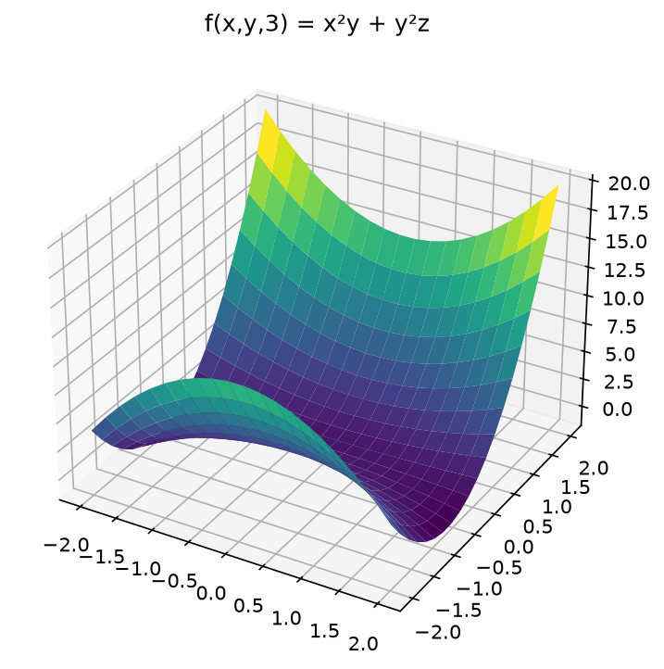
Question 2 [5 Marks]
📐 MATHEMATICS
PROBLEM STATEMENT:
Compute the directional derivative of f(x,y,z) = x² y + y² z at point (1,2,3) in the direction of v = (1,1,1).
Figure 2: Scientific Plot / Diagram
ExamGen Autonomous Examination System • Advanced Calculus & Differential Equations
Slide 4 of 23
Notes:
Question 2 Notes:
- Allocated Marks: 5
- Subject: Mathematics
- Text: Compute the directional derivative of f(x,y,z) = x² y + y² z at point (1,2,3) in the direction of v = (1,1,1).
- Marking Guidance: Award full marks for complete and rigorous answers. Deduct marks for missing steps, wrong algebraic units, or lack of critical citations.

Slide 5
Question 3 [5 Marks]
📐 MATHEMATICS
PROBLEM STATEMENT & TASKS:
Solve the exact differential equation: (2xy + y³)dx + (x² + 3xy²)dy = 0.
💡 EVALUATION & ANSWER DIRECTIVES:
Total Marks: 5 • Candidates must demonstrate rigorous mathematical proof / textual substantiation and clearly outline final conclusions.
ExamGen Autonomous Examination System • Advanced Calculus & Differential Equations
Slide 5 of 23
Notes:
Question 3 Notes:
- Allocated Marks: 5
- Subject: Mathematics
- Text: Solve the exact differential equation: (2xy + y³)dx + (x² + 3xy²)dy = 0.
- Marking Guidance: Award full marks for complete and rigorous answers. Deduct marks for missing steps, wrong algebraic units, or lack of critical citations.

Slide 6
Question 4 [5 Marks]
📐 MATHEMATICS
PROBLEM STATEMENT & TASKS:
Find the critical points of f(x,y) = x³ + y³ - 3xy and classify them as maxima, minima or saddle points.
💡 EVALUATION & ANSWER DIRECTIVES:
Total Marks: 5 • Candidates must demonstrate rigorous mathematical proof / textual substantiation and clearly outline final conclusions.
ExamGen Autonomous Examination System • Advanced Calculus & Differential Equations
Slide 6 of 23
Notes:
Question 4 Notes:
- Allocated Marks: 5
- Subject: Mathematics
- Text: Find the critical points of f(x,y) = x³ + y³ - 3xy and classify them as maxima, minima or saddle points.
- Marking Guidance: Award full marks for complete and rigorous answers. Deduct marks for missing steps, wrong algebraic units, or lack of critical citations.

Slide 7
Question 5 [5 Marks]
📐 MATHEMATICS
PROBLEM STATEMENT & TASKS:
Compute the line integral ∫_C (x² + y²)ds where C is the right half of the unit circle x² + y² = 1 traversed counterclockwise.
💡 EVALUATION & ANSWER DIRECTIVES:
Total Marks: 5 • Candidates must demonstrate rigorous mathematical proof / textual substantiation and clearly outline final conclusions.
ExamGen Autonomous Examination System • Advanced Calculus & Differential Equations
Slide 7 of 23
Notes:
Question 5 Notes:
- Allocated Marks: 5
- Subject: Mathematics
- Text: Compute the line integral ∫_C (x² + y²)ds where C is the right half of the unit circle x² + y² = 1 traversed counterclockwise.
- Marking Guidance: Award full marks for complete and rigorous answers. Deduct marks for missing steps, wrong algebraic units, or lack of critical citations.

Slide 8
Question 6 [5 Marks]
📐 MATHEMATICS
PROBLEM STATEMENT & TASKS:
Solve the Bernoulli equation: (dy / dx) + (y / x) = x² y³.
💡 EVALUATION & ANSWER DIRECTIVES:
Total Marks: 5 • Candidates must demonstrate rigorous mathematical proof / textual substantiation and clearly outline final conclusions.
ExamGen Autonomous Examination System • Advanced Calculus & Differential Equations
Slide 8 of 23
Notes:
Question 6 Notes:
- Allocated Marks: 5
- Subject: Mathematics
- Text: Solve the Bernoulli equation: (dy / dx) + (y / x) = x² y³.
- Marking Guidance: Award full marks for complete and rigorous answers. Deduct marks for missing steps, wrong algebraic units, or lack of critical citations.

Slide 9
Question 7 [5 Marks]
📐 MATHEMATICS
PROBLEM STATEMENT & TASKS:
Find the Fourier series representation of f(x) = x on the interval -π < x < π.
💡 EVALUATION & ANSWER DIRECTIVES:
Total Marks: 5 • Candidates must demonstrate rigorous mathematical proof / textual substantiation and clearly outline final conclusions.
ExamGen Autonomous Examination System • Advanced Calculus & Differential Equations
Slide 9 of 23
Notes:
Question 7 Notes:
- Allocated Marks: 5
- Subject: Mathematics
- Text: Find the Fourier series representation of f(x) = x on the interval -π < x < π.
- Marking Guidance: Award full marks for complete and rigorous answers. Deduct marks for missing steps, wrong algebraic units, or lack of critical citations.

Slide 10
Question 8 [5 Marks]
📐 MATHEMATICS
PROBLEM STATEMENT & TASKS:
Compute the surface integral ∬_S (x² + y²)dS where S is the surface z = √(x² + y²) for 0 ≤ z ≤ 1.
💡 EVALUATION & ANSWER DIRECTIVES:
Total Marks: 5 • Candidates must demonstrate rigorous mathematical proof / textual substantiation and clearly outline final conclusions.
ExamGen Autonomous Examination System • Advanced Calculus & Differential Equations
Slide 10 of 23
Notes:
Question 8 Notes:
- Allocated Marks: 5
- Subject: Mathematics
- Text: Compute the surface integral ∬_S (x² + y²)dS where S is the surface z = √(x² + y²) for 0 ≤ z ≤ 1.
- Marking Guidance: Award full marks for complete and rigorous answers. Deduct marks for missing steps, wrong algebraic units, or lack of critical citations.

Slide 11
Question 9 [5 Marks]
📐 MATHEMATICS
PROBLEM STATEMENT & TASKS:
Solve the initial value problem: y'' + 4y' + 4y = e^{-2x}, y(0) = 1, y'(0) = 0.
💡 EVALUATION & ANSWER DIRECTIVES:
Total Marks: 5 • Candidates must demonstrate rigorous mathematical proof / textual substantiation and clearly outline final conclusions.
ExamGen Autonomous Examination System • Advanced Calculus & Differential Equations
Slide 11 of 23
Notes:
Question 9 Notes:
- Allocated Marks: 5
- Subject: Mathematics
- Text: Solve the initial value problem: y'' + 4y' + 4y = e^{-2x}, y(0) = 1, y'(0) = 0.
- Marking Guidance: Award full marks for complete and rigorous answers. Deduct marks for missing steps, wrong algebraic units, or lack of critical citations.

Slide 12
Question 10 [5 Marks]
📐 MATHEMATICS
PROBLEM STATEMENT & TASKS:
Find the general solution to the system of differential equations: (dx / dt) = 2x + y, (dy / dt) = -x + 4y.
💡 EVALUATION & ANSWER DIRECTIVES:
Total Marks: 5 • Candidates must demonstrate rigorous mathematical proof / textual substantiation and clearly outline final conclusions.
ExamGen Autonomous Examination System • Advanced Calculus & Differential Equations
Slide 12 of 23
Notes:
Question 10 Notes:
- Allocated Marks: 5
- Subject: Mathematics
- Text: Find the general solution to the system of differential equations: (dx / dt) = 2x + y, (dy / dt) = -x + 4y.
- Marking Guidance: Award full marks for complete and rigorous answers. Deduct marks for missing steps, wrong algebraic units, or lack of critical citations.

Slide 13
Question 11 [5 Marks]
📐 MATHEMATICS
PROBLEM STATEMENT & TASKS:
Compute the divergence and curl of the vector field F = (x² y, y² z, z² x).
💡 EVALUATION & ANSWER DIRECTIVES:
Total Marks: 5 • Candidates must demonstrate rigorous mathematical proof / textual substantiation and clearly outline final conclusions.
ExamGen Autonomous Examination System • Advanced Calculus & Differential Equations
Slide 13 of 23
Notes:
Question 11 Notes:
- Allocated Marks: 5
- Subject: Mathematics
- Text: Compute the divergence and curl of the vector field F = (x² y, y² z, z² x).
- Marking Guidance: Award full marks for complete and rigorous answers. Deduct marks for missing steps, wrong algebraic units, or lack of critical citations.

Slide 14
Question 12 [5 Marks]
📐 MATHEMATICS
PROBLEM STATEMENT & TASKS:
Solve the partial differential equation: (∂ u / ∂ t) = k (∂² u / ∂ x²) with boundary conditions u(0,t) = u(L,t) = 0 and initial condition u(x,0) = f(x).
💡 EVALUATION & ANSWER DIRECTIVES:
Total Marks: 5 • Candidates must demonstrate rigorous mathematical proof / textual substantiation and clearly outline final conclusions.
ExamGen Autonomous Examination System • Advanced Calculus & Differential Equations
Slide 14 of 23
Notes:
Question 12 Notes:
- Allocated Marks: 5
- Subject: Mathematics
- Text: Solve the partial differential equation: (∂ u / ∂ t) = k (∂² u / ∂ x²) with boundary conditions u(0,t) = u(L,t) = 0 and initial condition u(x,0) = f(x).
- Marking Guidance: Award full marks for complete and rigorous answers. Deduct marks for missing steps, wrong algebraic units, or lack of critical citations.

Slide 15
Question 13 [5 Marks]
📐 MATHEMATICS
PROBLEM STATEMENT & TASKS:
Find the Laplace transform of f(t) = t² sin(3t).
💡 EVALUATION & ANSWER DIRECTIVES:
Total Marks: 5 • Candidates must demonstrate rigorous mathematical proof / textual substantiation and clearly outline final conclusions.
ExamGen Autonomous Examination System • Advanced Calculus & Differential Equations
Slide 15 of 23
Notes:
Question 13 Notes:
- Allocated Marks: 5
- Subject: Mathematics
- Text: Find the Laplace transform of f(t) = t² sin(3t).
- Marking Guidance: Award full marks for complete and rigorous answers. Deduct marks for missing steps, wrong algebraic units, or lack of critical citations.

Slide 16
Question 14 [5 Marks]
📐 MATHEMATICS
PROBLEM STATEMENT & TASKS:
Compute the volume integral ∭_V (x² + y² + z²) dV where V is the unit sphere x² + y² + z² ≤ 1.
💡 EVALUATION & ANSWER DIRECTIVES:
Total Marks: 5 • Candidates must demonstrate rigorous mathematical proof / textual substantiation and clearly outline final conclusions.
ExamGen Autonomous Examination System • Advanced Calculus & Differential Equations
Slide 16 of 23
Notes:
Question 14 Notes:
- Allocated Marks: 5
- Subject: Mathematics
- Text: Compute the volume integral ∭_V (x² + y² + z²) dV where V is the unit sphere x² + y² + z² ≤ 1.
- Marking Guidance: Award full marks for complete and rigorous answers. Deduct marks for missing steps, wrong algebraic units, or lack of critical citations.

Slide 17
Question 15 [5 Marks]
📐 MATHEMATICS
PROBLEM STATEMENT & TASKS:
Solve the Cauchy-Euler equation: x² y'' - 3xy' + 4y = 0.
💡 EVALUATION & ANSWER DIRECTIVES:
Total Marks: 5 • Candidates must demonstrate rigorous mathematical proof / textual substantiation and clearly outline final conclusions.
ExamGen Autonomous Examination System • Advanced Calculus & Differential Equations
Slide 17 of 23
Notes:
Question 15 Notes:
- Allocated Marks: 5
- Subject: Mathematics
- Text: Solve the Cauchy-Euler equation: x² y'' - 3xy' + 4y = 0.
- Marking Guidance: Award full marks for complete and rigorous answers. Deduct marks for missing steps, wrong algebraic units, or lack of critical citations.

Slide 18
Question 16 [5 Marks]
📐 MATHEMATICS
PROBLEM STATEMENT & TASKS:
Find the Green's function for the differential operator L[y] = y'' + y with boundary conditions y(0) = y(π) = 0.
💡 EVALUATION & ANSWER DIRECTIVES:
Total Marks: 5 • Candidates must demonstrate rigorous mathematical proof / textual substantiation and clearly outline final conclusions.
ExamGen Autonomous Examination System • Advanced Calculus & Differential Equations
Slide 18 of 23
Notes:
Question 16 Notes:
- Allocated Marks: 5
- Subject: Mathematics
- Text: Find the Green's function for the differential operator L[y] = y'' + y with boundary conditions y(0) = y(π) = 0.
- Marking Guidance: Award full marks for complete and rigorous answers. Deduct marks for missing steps, wrong algebraic units, or lack of critical citations.

Slide 19
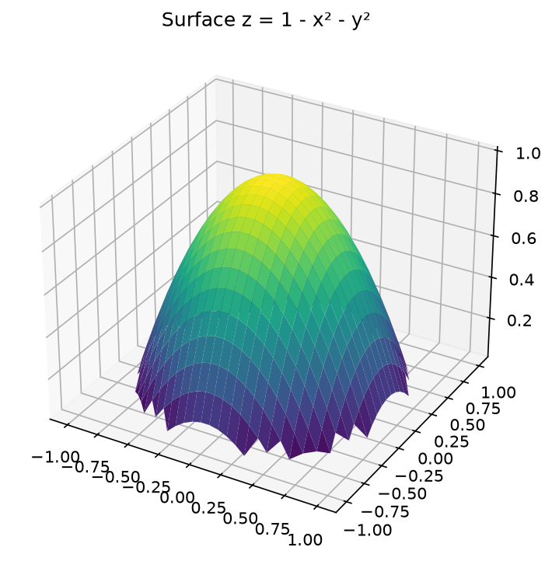
Question 17 [5 Marks]
📐 MATHEMATICS
PROBLEM STATEMENT:
Compute the flux of F = (x, y, z) through the surface z = 1 - x² - y² for z ≥ 0.
Figure 17: Scientific Plot / Diagram
ExamGen Autonomous Examination System • Advanced Calculus & Differential Equations
Slide 19 of 23
Notes:
Question 17 Notes:
- Allocated Marks: 5
- Subject: Mathematics
- Text: Compute the flux of F = (x, y, z) through the surface z = 1 - x² - y² for z ≥ 0.
- Marking Guidance: Award full marks for complete and rigorous answers. Deduct marks for missing steps, wrong algebraic units, or lack of critical citations.

Slide 20
Question 18 [5 Marks]
📐 MATHEMATICS
PROBLEM STATEMENT & TASKS:
Solve the wave equation (∂² u / ∂ t²) = c² (∂² u / ∂ x²) with initial conditions u(x,0) = sin(π x/L) and (∂ u / ∂ t)(x,0) = 0.
💡 EVALUATION & ANSWER DIRECTIVES:
Total Marks: 5 • Candidates must demonstrate rigorous mathematical proof / textual substantiation and clearly outline final conclusions.
ExamGen Autonomous Examination System • Advanced Calculus & Differential Equations
Slide 20 of 23
Notes:
Question 18 Notes:
- Allocated Marks: 5
- Subject: Mathematics
- Text: Solve the wave equation (∂² u / ∂ t²) = c² (∂² u / ∂ x²) with initial conditions u(x,0) = sin(π x/L) and (∂ u / ∂ t)(x,0) = 0.
- Marking Guidance: Award full marks for complete and rigorous answers. Deduct marks for missing steps, wrong algebraic units, or lack of critical citations.

Slide 21
Question 19 [5 Marks]
📐 MATHEMATICS
PROBLEM STATEMENT & TASKS:
Find the general solution to the nonhomogeneous differential equation: y'' + y = tan x using variation of parameters.
💡 EVALUATION & ANSWER DIRECTIVES:
Total Marks: 5 • Candidates must demonstrate rigorous mathematical proof / textual substantiation and clearly outline final conclusions.
ExamGen Autonomous Examination System • Advanced Calculus & Differential Equations
Slide 21 of 23
Notes:
Question 19 Notes:
- Allocated Marks: 5
- Subject: Mathematics
- Text: Find the general solution to the nonhomogeneous differential equation: y'' + y = tan x using variation of parameters.
- Marking Guidance: Award full marks for complete and rigorous answers. Deduct marks for missing steps, wrong algebraic units, or lack of critical citations.

Slide 22
Question 20 [5 Marks]
📐 MATHEMATICS
PROBLEM STATEMENT & TASKS:
Compute the complex line integral ∮_C (e^z / z² + 1) dz where C is the circle |z| = 2 traversed counterclockwise.
💡 EVALUATION & ANSWER DIRECTIVES:
Total Marks: 5 • Candidates must demonstrate rigorous mathematical proof / textual substantiation and clearly outline final conclusions.
ExamGen Autonomous Examination System • Advanced Calculus & Differential Equations
Slide 22 of 23
Notes:
Question 20 Notes:
- Allocated Marks: 5
- Subject: Mathematics
- Text: Compute the complex line integral ∮_C (e^z / z² + 1) dz where C is the circle |z| = 2 traversed counterclockwise.
- Marking Guidance: Award full marks for complete and rigorous answers. Deduct marks for missing steps, wrong algebraic units, or lack of critical citations.

Slide 23
Examiner Marking Scheme & Rubric Guidelines
GRADING RUBRIC
STANDARDIZED EVALUATION CHECKLIST & MARK DISTRIBUTION
• Conceptual Understanding & Formulation (30%)
Correct identification of applicable theorems, formulas, historical events, or core principles.
• Methodological Execution & Working Steps (40%)
Logical sequence of derivations, intermediate algebraic steps, balanced chemical reactions, or source analysis.
• Accuracy & Final Solution (20%)
Precise numerical results, correct physical units, or coherent synthesis of concluding arguments.
• Diagrams, Notation & Presentation (10%)
Neatness, accurate diagram labeling, standard mathematical/scientific notation, and clarity.
ExamGen Autonomous Examination System • Advanced Calculus & Differential Equations
Slide 23 of 23

