Slide 1
PORTFOLIO · AI FOR SCIENCE
AI-to-Lab Orchestrator
The operating layer between an AI's next-experiment suggestion
and the evidence that it actually ran.
2
65
30 x 30
use cases, both defensible
tests, including the governance and evidence layers
seed benchmark, reproducible from one script
A self-driving-lab orchestration prototype for materials discovery · not a physics simulator
Notes:
Opening frame: this is an operating-layer project, not a materials-modelling project. The claim I am making is about systems, data and governance judgment — and I say up front that it is not a physics simulator, because that boundary is the thing I want to be trusted on.

Slide 2
01 · THE PROBLEM
Predictions outpace validation
Models propose candidates far faster than labs can evaluate them. The bottleneck is not model
accuracy — it is that a prediction does not automatically become an experiment, an experiment does not
automatically become trustworthy data, and trustworthy data does not automatically become a decision.
What should we try next?
and by whose definition of a good result
Everything in that gap is operational.
Is it safe to run?
individually legal values can be jointly unsafe
Scheduling. Validation. Safety review. Provenance. Data quality. Deciding what is even eligible to feed back into a model.
None of it is a modelling problem. All of it decides how fast the loop actually turns — and the speed of that loop is the ceiling on how fast an AI-for-science programme can iterate.
That gap is what I built.
Did it actually run?
or did it fail, and was the failure recorded
Is the data good enough?
not every completed run deserves to be believed
What did we learn?
which hypothesis did this settle, if any
Notes:
The point to land: I am not claiming to out-model a computational materials scientist. I am claiming the bottleneck sits in the operational layer, and that I understand it well enough to run programmes in it.

Slide 3
02 · THE SYSTEM
Five layers, each answering one question
Data contracts
If a device changes its output shape, do we find out?
Partial
Orchestration
How does an intent become an auditable sequence of steps?
Done
Experiment data
What is the system's memory? Do failures count as data?
Partial
Decision
What next, and by whose definition of “good”?
Done
Governance
Who approved this, and which data may train a model?
Done
Separated so each can be reasoned about — and swapped — on its own. The optimizer sits behind a two-method interface; the dashboard renders state and owns no workflow logic; orchestration and decisions run headless without importing Streamlit.
Notes:
If asked why five: because these are the five questions that have different owners in a real lab. Instruments, scheduling, data, science strategy, and safety are not one person's job.

Slide 4
03 · DESIGN PRINCIPLE
Scientific honesty over fake physics
Where physical fidelity matters, use published data. Where systems benchmarking matters, use a
transparent surrogate that is honest about being one. The two use cases were chosen to sit on
opposite sides of that line.
TRANSPARENT SURROGATE
PUBLISHED DATA
CdTe thin-film process
Hydride superconductors
A benchmark environment for orchestration and optimization
Deliberately hard: observation noise, a narrow non-smooth treatment window, an over-treatment cliff, parameter interactions, outright failures
Literature-inspired in qualitative behaviour only
22 candidates transcribed verbatim from Sanna et al., Communications Physics (2026)
Triage, decision policy and validation planning built on top of published values
Provenance enforced as a file boundary, with a test to hold it
What it is not
What it is not
A physically accurate CdTe simulator
Any claim about real device efficiency
Any simulation of DFPT, electron-phonon coupling or Tc
Any score the paper did not publish, presented as though it had
Notes:
This is the slide I would lead with if I only had one. Knowing where it is legitimate to simulate and where it is not is the judgment the role actually needs.

Slide 5
04 · USE CASE 1
The closed loop, and what it refuses to do
1
Propose
2
Review
3
Execute
4
Score
5
Gate
optimizer suggests
the next parameters
→
bounds, then hazard
rules on combinations
→
six virtual instruments,
in YAML order
→
measurements become
one number, via policy
→
only clean, successful
runs feed back
blocked ≠ failed
The guardrail is set inside the uncertainty band
A failure means a sample was consumed and produced nothing. A block means the gate refused to consume one at all. They cost a real lab completely different amounts, so they are separate statuses and the benchmark reports them separately.
A blocked experiment runs zero devices.
blocks at 440 °C / 40 min
degrades at 450 °C / 45 min
A real lab does not know exactly where the cliff is, so the rule fires before the sample is destroyed. This costs reachable search space — which is why blocked is reported as its own rate. Governance is not free, and the system shows its price.
Notes:
The distinction between blocked and failed is the single detail that most reliably shows I have thought about lab economics rather than just about code.

Slide 6
05 · DOES IT ACTUALLY WORK
Bayesian optimization vs random, 30 seeds
0.818
Bayesian optimization, median best
IQR [0.723, 0.855]
0.724
Random search, median best
IQR [0.663, 0.806]
20 / 30
seeds where BO won, median gap +0.093
Paired comparison is valid because both
methods meet the same lab noise.
Every figure on this slide is produced by scripts/run_cdte_benchmark.py and written to artifacts/. Nothing is hand-entered — the deck reads the same JSON the dashboard does.
Notes:
If asked how I know BO is better: fixed budget, 30 seeds, median and IQR rather than a single trajectory, and common random numbers so the per-seed comparison is actually paired.

Slide 7
06 · READING IT HONESTLY
Three things I say before I am asked
1
2
3
The bands overlap
BO is behind early
Runs exceed the ceiling
BO wins in the median and on two seeds in three, but it does not dominate. On a five-dimensional landscape with a 30-experiment budget, clean separation would be evidence the benchmark was too easy — not evidence the optimizer is good.
It runs an initial design first, so it trails random search for roughly the first ten experiments. The advantage is sample efficiency later in the budget, not from experiment one. A chart cropped at 10 would tell the opposite story.
The dashed line is the noise-free maximum, but the reported score is a noisy observation — so best-found is an optimistically biased estimator. Taking a max over noisy draws captures luck. Any lab ranking candidates on a single best-observed inherits this, which is why replication is a governance concern.
A portfolio that only shows what worked is asking to be caught. Putting the weaknesses in the product surface itself — they are printed in the dashboard and the README — is cheaper than being asked.
Notes:
These three caveats are printed in the dashboard UI and the README, not just in this deck. That is the point — the honesty is in the product, not in the pitch.

Slide 8
07 · DECISION TRANSPARENCY
The weights are a policy, not a constant
How much is phase purity worth relative to efficiency? That is a research-strategy question, not a
property of an XRD machine. So the weights live in versioned policy files, every experiment records
which policy scored it, and the same mechanism drives hydride triage.
Policy
Median best
Treatment time
Treatment temp
Dopant
Performance first
0.773
35.9 min
387.4 °C
1.2 %
Balanced device quality
0.818
40.0 min
387.6 °C
1.3 %
Manufacturability first
0.926
27.7 min
388.6 °C
0.9 %
Median best is not comparable across these rows. Each policy defines a different objective, so a higher number does not mean a better process. The comparable quantity is the operating point: manufacturability-first converges on a treatment twelve minutes shorter and lighter doping — a visibly more conservative process. Treatment temperature lands near 388 °C under every policy, because that window dominates the landscape. Policy influences the parameters the objective leaves room to argue about.
Notes:
Stating that the scores are not comparable across rows is the whole slide. A candidate who shows this table without that caveat has shown a bug, not a feature.

Slide 9
08 · USE CASE 2
Published data, and judgment kept visible
The paper publishes λ, ω_log and an Allen–Dynes Tc. It publishes no score, no confidence and no
feasibility. Ranking needs those — so they are computed from documented rules and kept in
separate files. Provenance is a file boundary, not a convention, and a test fails if it erodes.
PUBLISHED
datasets/hydrides/
DERIVED
triage/derive.py
ANALYST
configs/triage/
Transcribed verbatim from Tables 1–2.
λ = 1.00 · ω_log = 341.59 K · Tc = 23.5 K
A documented transform of published values.
Tc confidence, from coupling regime and
whether a refinement exists.
Judgment encoded as a versioned rule set.
Synthesis feasibility, from elemental
constraints. Labelled as judgment.
Only 1 of 22 candidates has a beyond-Allen–Dynes Tc.
For that one, refinement moved 23.5 K → 17 K, which the authors call “an uncommon deviation”. Every other ranking rests on a number the paper's own authors caution against over-reading — so confidence is weighted separately from Tc, rather than folded invisibly into it.
Notes:
Source: Sanna, Cerqueira, Cubuk, Errea and Fang, Communications Physics 2026. I transcribed from the preprint; the refined Tc is reported four different ways in the paper and SOURCE.md records that ambiguity rather than hiding it.

Slide 10
09 · WHAT THE TRIAGE SURFACED
The finding a Tc-ordered list cannot show
10 of 22
Ranks move with the policy
Candidate
Bal.
High-Tc
Feas.
candidates contain technetium
LiZrH6Ru
1
1
1
It has no stable isotope and needs a licensed facility. That constraint is visible from the formula alone and invisible in any ranking sorted by predicted Tc. Feasibility combines as a minimum, not a mean — one disqualifying element is not offset by three convenient ones.
Ta6MoH16
2
3
2
EuCdH6Ru
6
2
9
EuLuTcH6
13
5
14
EuCdH6Ru moves 2 → 9 between policies — the warning label on every other row.
The consensus shortlist is the useful output, not rank 1.
LiZrH6Ru · Ta6MoH16 · TaNb3H8 — these sit in the top five under every policy considered. They are what a lab validates regardless of whose priorities win the argument, which is the question a programme lead actually has to answer.
A single ranking presented as the answer would manufacture authority the data does not carry. The sensitivity view and the consensus shortlist are the honest output.
Notes:
The technetium finding is the one to lead with in conversation: it is checkable, it is chemistry rather than modelling, and it reframes the whole cohort.

Slide 11
10 · ARCHITECTURE PAYOFF
One system, not two demos in one repository
Triage does not end at a ranked table. The selected candidate becomes a workflow that enters the
same machinery a CdTe experiment does — same parser, same safety gate, no orchestrator changes.
Ranked shortlist
Validation plan
(generated YAML)
workflow_parser
(unchanged)
safety_gate
(unchanged)
Hypothesis
registered
→
→
→
→
The CdTe safety gate blocked a hydride hazard it had never seen.
750 °C with 150 bar H₂ → blocked: hydrogen_pressure_at_temperature
Both values are individually within bounds. The generated workflow declares its own hazard rules and the existing gate enforces them correctly on first sight. A test asserts this — if it ever fails, the project has gone back to being two demos in one repository.
Plans stop at awaiting_device_implementation — no hydride synthesis is simulated, because there is no honest way to. That is the forward path. What comes back across the same seam is the next slide.
Notes:
If someone asks what the hardest architectural decision was: making triage an entry point into the existing loop rather than a parallel module. It is the difference between a system and a portfolio of scripts.

Slide 12
11 · CLOSING THE LOOP
A measurement changes the ranking that proposed it
Evidence is received, never manufactured. There are no hydride devices, so records enter from
outside — an instrument, a collaborator, a paper. A record with no named recorder or stated source
is rejected at load: a measurement nobody will sign for cannot overturn a prediction.
A null result is meaningless without its floor
The cohort re-ranks
Ta6MoH16: no transition seen — but the rig reached only 8 K and the prediction is 7.3 K. The run could not have observed what it was testing, so it refutes nothing. Marked inconclusive, excluded from the calibration, and its hypothesis stays open.
Candidate
was
now
Tc source
LiZrH6Ru
1
1
measured
TaNb3H8
3
2 (+1)
measured
EuCdH6Ru
6
3 (+3)
Allen–Dynes
Evidence about one compound calibrates the method
Ta6MoH16
2
4 (-2)
Allen–Dynes
21 of 22 candidates rest on Allen–Dynes alone. On 2 conclusive measurement(s), Allen–Dynes runs 28% high (median observed/predicted = 0.72). Confidence in every un-measured Allen–Dynes prediction is reduced by 14%. A calibration lowers confidence and never rewrites a prediction — a "corrected" Tc would invent a number nobody computed.
Ta3NbH8
4
5 (-1)
Allen–Dynes
Ta6NbH16
5
6 (-1)
Allen–Dynes
A measured Tc supersedes every calculation, and the hypothesis moves from proposed to supported or contradicted.
Measuring the leader low moved candidates nobody tested. Tc is normalized against the best in the cohort, so when the leader falls every untested compound becomes relatively more attractive — partly offset by the confidence penalty the same evidence applied to the method. A ranking is a statement about a set, not about a compound.
Notes:
Worth dwelling on in conversation: I did not design the second-order effect, I saw it by running the loop. It is the clearest evidence that this is a system with behaviour rather than a set of scripts.

Slide 13
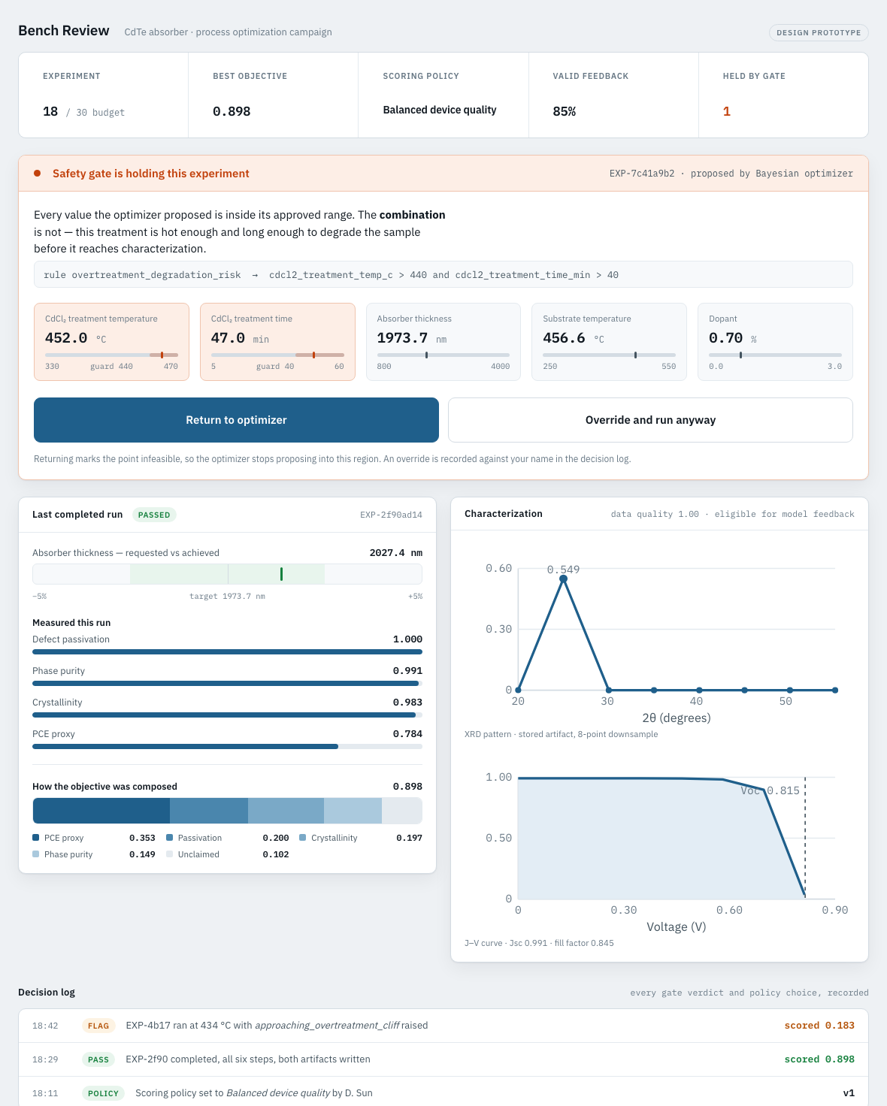
12 · THE OPERATOR SURFACE
Where a person actually meets the loop
The approval queue is the hero
The held experiment is the only thing on the loop that needs a human. Everything else — proposing, executing, logging — does not. Putting approval anywhere but first would mean missing why this screen exists.
Every value is real output
The held parameters, the triggered rule, the measurements, the objective breakdown and both artefacts are genuine system output, not illustration.
Sized for gloved hands
60px touch targets, no text entry, high contrast. A tablet at the bench, not a dashboard at a desk.
A high-fidelity prototype is a product manager's deliverable. Building it in React would have demonstrated wanting to be a front-end engineer instead.
Notes:
Prompted by watching how an automated-lab company actually runs their floor: an operator with gloves on, working from a tablet at the bench. That fixed the form factor.

Slide 14
13 · WHAT WENT WRONG
Six defects I found in my own build
These are real, not hypotheticals, and they are documented in the repository. Five of the six were silent — the system looked correct while being wrong.
01
The safety gate protected nothing
Its hazard region was a strict subset of the true failure region, so every experiment it flagged was already doomed. It prevented zero damage while appearing to work in every demo.
Governance fails identically to how it succeeds. It needs a test, not a demo.
02
The benchmark numbers were wrong
The README claimed a BO median of 0.84. The measured value was 0.806, and no script in the repository produced either number.
One script is now the sole source of every published figure.
03
One RNG served lab and optimizer
BO draws ~512 candidates per iteration, random search draws 5 — so the two methods faced different measurement noise. The per-seed comparison was meaningless.
Separate streams, and common random numbers across methods.
04
BO got trapped in failure regions
Failed experiments yield no objective, so a naive surrogate never learns to avoid them and keeps re-proposing into the dead zone, burning budget.
A feasibility penalty and an escape hatch — a real constrained-BO problem.
05
Rounding moved the median by 0.006
Rounding each weighted term to six decimals — a 1e-4 perturbation — changed which point the GP held as incumbent, changed the argmax of Expected Improvement, and redirected the whole search.
Closed loops are chaotically sensitive to their own numerics. Round for display, never before a decision.
06
Fabricated data labelled as published
An earlier version shipped a 25-row hydride dataset whose header said the values came straight from the paper. Three compounds in it appear nowhere in that paper. Invented numbers, presented as measurements.
A fabricated row is indistinguishable from a transcribed one once they share a file. Provenance has to be a boundary, not a comment.
Notes:
This is the slide that separates me from a candidate who only shows what worked. The pattern across all six is the same: the failure mode that matters is the silent one, where the system looks right and is not. If time is short, tell 01 and 06 and let the slide carry the rest — 06 is the one that connects back to the honesty principle the whole project rests on.

Slide 15
14 · SCOPE DISCIPLINE
What I deliberately did not build
Scope discipline is part of the argument, so the omissions are explicit and reasoned rather than quietly absent.
✕
A physically accurate CdTe simulator
Would need real process data. A fake physics model is worse than an honest surrogate.
✕
Simulated DFPT, electron-phonon or Tc
Same reason. The hydride module uses published values and builds decisions on top.
✕
A graphene tactile-sensor use case
No grounded response model available. Two defensible use cases beat three thin ones.
✕
Hydride synthesis devices
No honest way to simulate a hydrogenation anneal. Plans stop where a real lab's seam is.
✕
A real async task queue
The state machine is what matters. The infrastructure adds operational surface, not argument.
✕
A “correct” hydride ranking
The paper publishes no scores. One ranking as the answer would manufacture authority.
Notes:
Every row is a judgment call I would defend. In a real programme, deciding what not to build is most of the job.

Slide 16
15 · WHY THIS, WHY ME
I am not switching careers.
I am moving a proven delivery capability into a new domain.
Life-science consulting
0→1 founder
Platform growth at scale
A lab's bottleneck is usually its process and feedback loops, not a single technique. Optimizing R&D workflows is what I did.
Built and shipped end to end under ambiguity and resource constraints, owning the outcome. This orchestrator is the same instinct in a new domain.
Coordinated engineering, product and data teams, and translated technical work into measurable impact — the research-to-impact translation this work centres on.
What this prototype adds is the domain-technical layer: I understand the closed loop, the data, and the governance well enough to run programmes in it.
github.com/dekunsun/ai-to-lab-orchestrator · 65 tests · docs/architecture.md
Notes:
Close on intent, not on modesty. The seniority question is answered by saying plainly that I am optimizing for direction and team, not title.

