Slide 1

Acquire
Simulation of an investment game using Python

Slide 2
Overview
Motivation and objectives
Creating decisions
Results
Adapting player
Conclusion

Slide 3
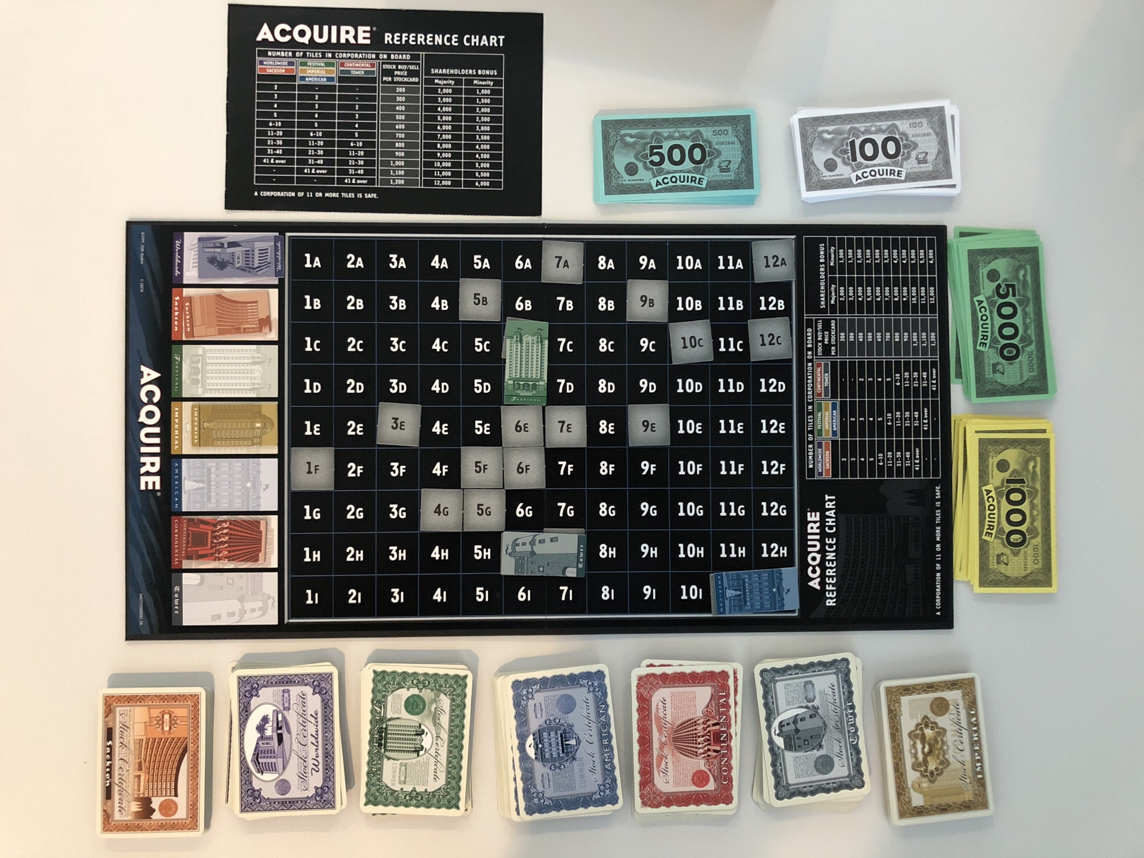
Motivation and objectives

Slide 4
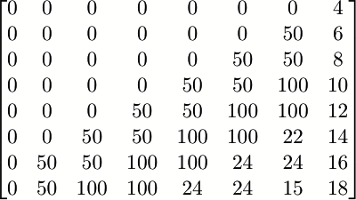
Creating decisions
System that awards points.
The choice with the most points is performed
Changing the variables leads to different decision
Stock available
Lead

Slide 5
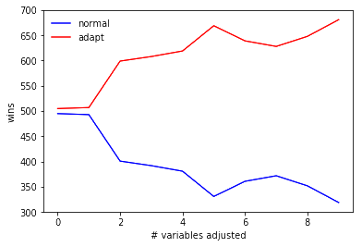
Adapting player
Parameters are variable
Player adjusts values
Resulting strategy: investing in small hotels and offensive playing

Slide 6
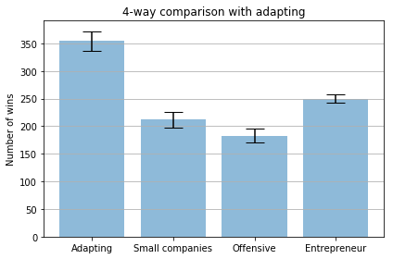
Adapting player

