Slide 1

Acquire
Simulation of an investment game using Python

Slide 2
Overview
Motivation and objectives
Creating decisions
Strategies
Results
Adapting player
Conclusion

Slide 3
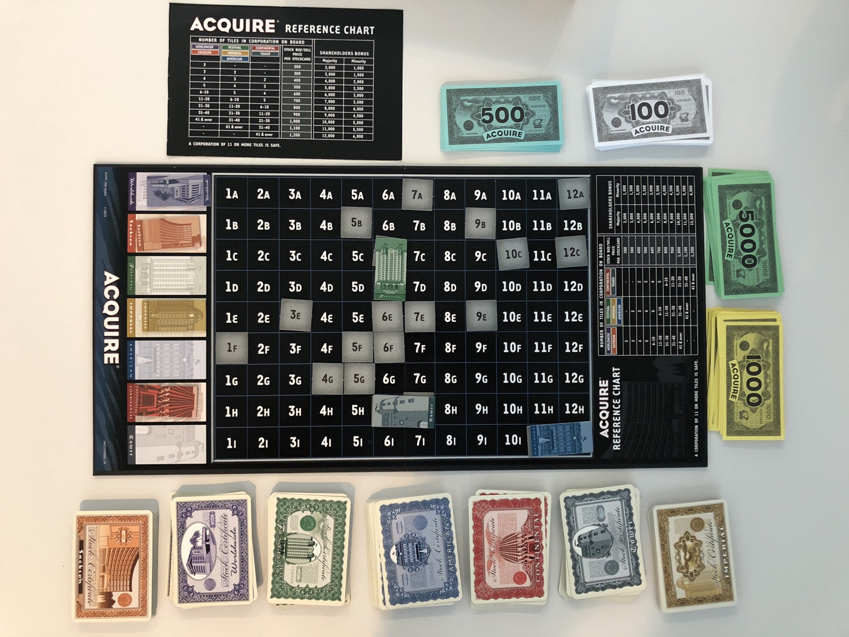
Motivation and objectives
Investment game, players act as businessmen
Goal is to make as much money as possible

Slide 4
Hypotheses and Further Goals
Risky strategy should prevail over conservative strategy
Investing in small hotels is more favorable than investing in large ones
Experiment with other investing strategies and find out which pay off best
Implement a self-adapting program which converges towards the optimal playing strategy

Slide 5
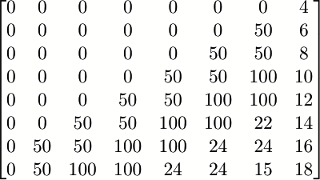
Creating decisions
System that awards points.
The choice with the most points is performed
Changing the variables leads to different decision
Stock available
Lead

Slide 6
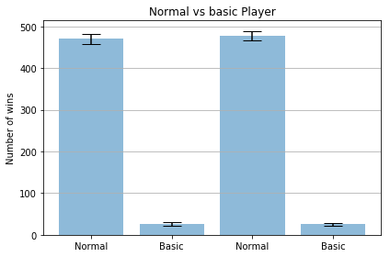
Results
Functioning test: Normal player versus basic, random event player

Slide 7
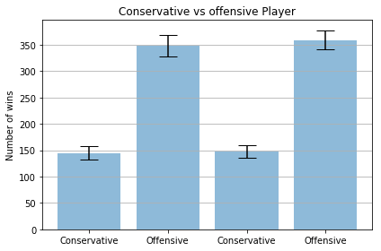
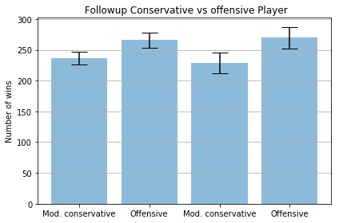
Results
Conservative player:
Will try to defend strong positions
Keeps some cash reserve
Invests in diverse companies
Offensive player:
Will challenge other players for their majority positions
Willing to invest all his money if the opportunity arises
Tends to focus on a few key companies

Slide 8
Results
Conservative player:
Will try to defend strong positions
Keeps some cash reserve
Invests in diverse companies
Offensive player:
Will challenge other players for their majority positions
Willing to invest all his money if the opportunity arises
Tends to focus on a few key companies

Slide 9
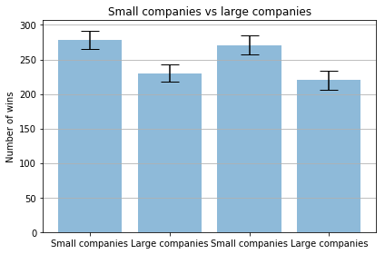
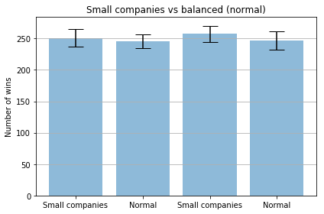
Results
«Small hotels» investing player: Focuses on small, emerging hotel change for potentially gain
«Large hotels» investing player: Focuses on large, established hotel chains which can potentially dominate the market

Slide 10
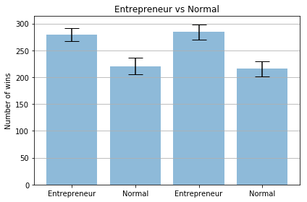
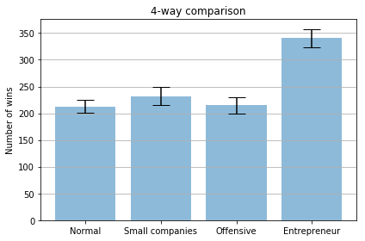
Results
The «Entrepreneur»: Lays his focus on creating hotel chains and investing mainly in these

Slide 11
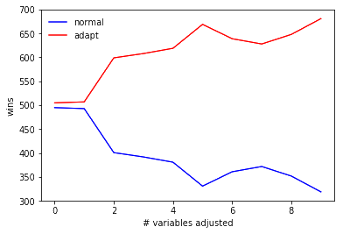
Adapting player
Parameters are variable
Player adjusts values
Resulting strategy: investing in small hotels and offensive playing

Slide 12
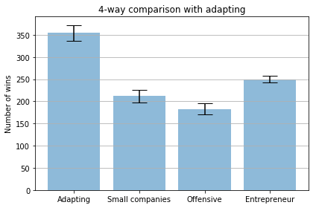
Adapting player

Slide 13

Conclusion
Hypotheses were largely confirmed
Greatest challenge: multi-level decision making
Using board game as model has serious limitations
For improvements one should revert to mathematical models of the stock market

