Slide 1
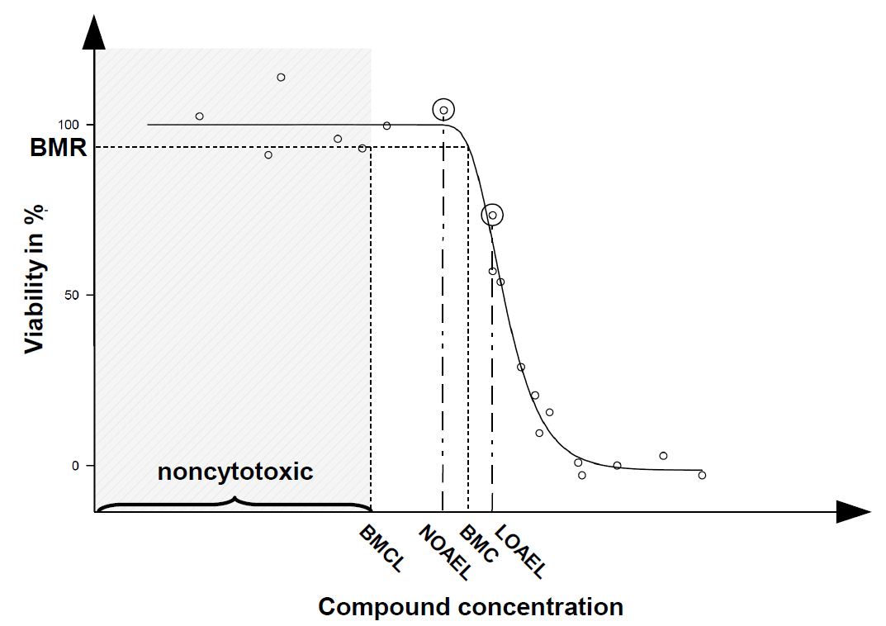
Fig 1: The benchmark dose concept for in vitro toxicology data. For benchmark dose calculation of continuous data a mathematical model is fit to the data. A benchmark response (BMR) is defined as change in response rate over background. The concentration that causes this BMR is called benchmark concentration (BMC). A two sided 90% confidence interval can be calculated for the BMC and is defined as benchmark concentration at lower confidence limit (BMCL). All concentrations below this value can be considered to be noncytotoxic. The NOAEL is defined as the maximal concentration that has no observable effect and the LOAEL is defined as lowest concentration that evokes an adverse effect.

Slide 2
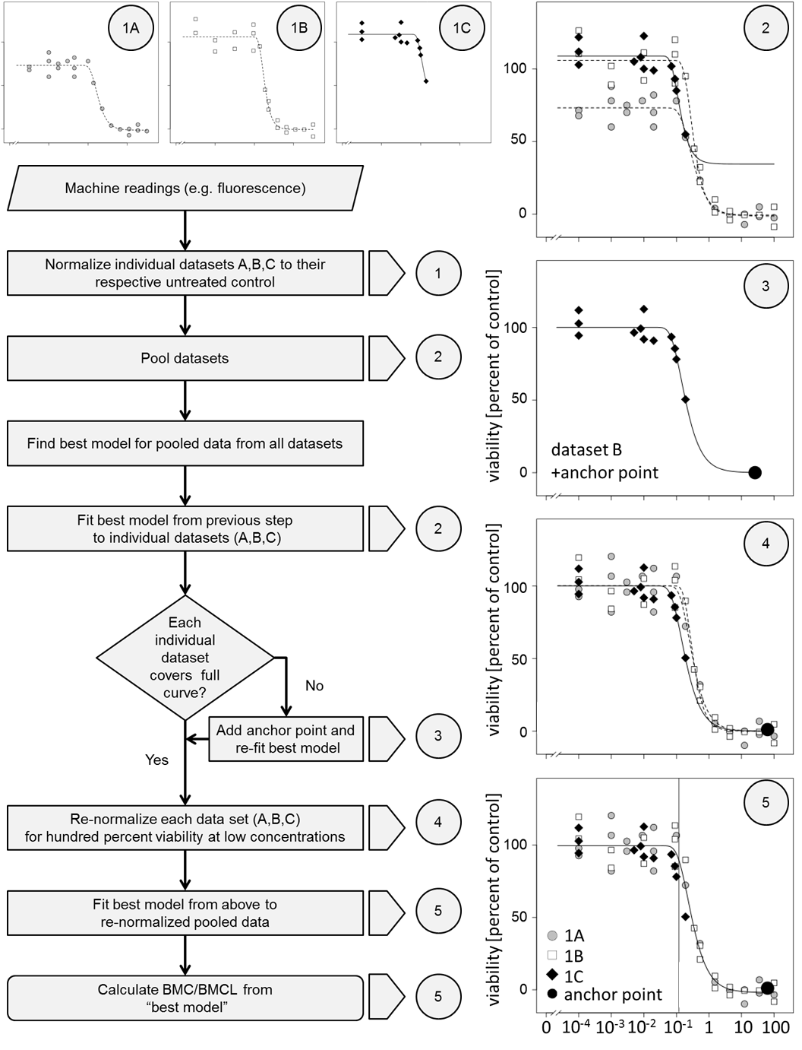
Fig. 2: Program sequence used to calculate the BMC. In step 1 Machine readings from experiment A, B and C are expressed as percent of control. In step 2 datasets are pooled and the best model is selected according to statistical criteria. The best model is now used to fit a curve through each experiment. In step 3 an anchor point is added only if data in the toxic range are missing. In step 4 all datasets are normalized to 100 percent viability. In step 5 data are pooled again and the previously determined model fit again. The BMC and its lower confidence Limit the BMCL are calculated from this curve fit.

Slide 3
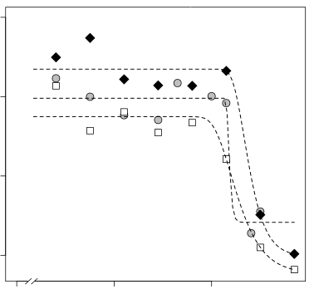
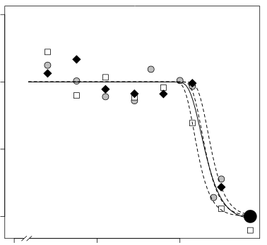
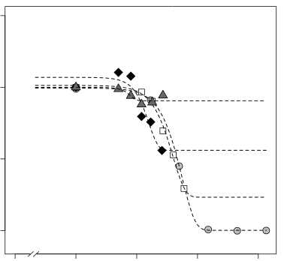
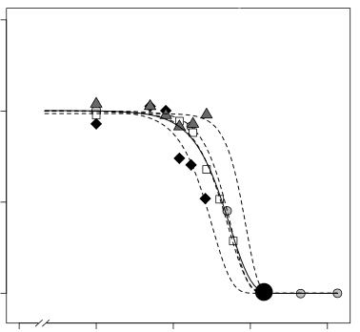
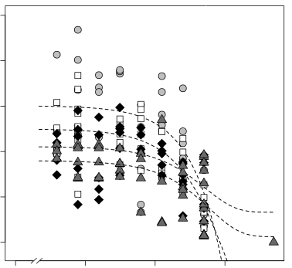
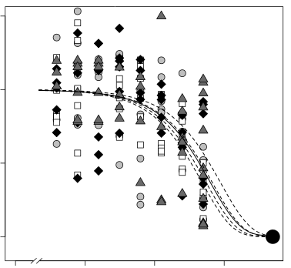
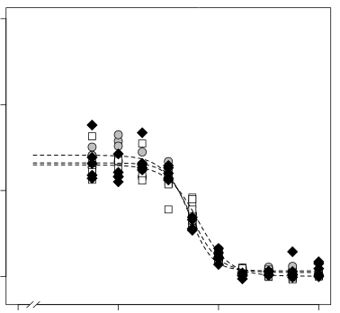
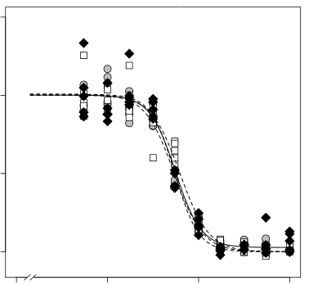
Before BMC modelling
After BMC modelling
UKN1 HgBr2
UKN1 HgBr2
Problem 1: Experiments not comparable
UKN1 HgCl2
UKN1 HgCl2
Problem 2: Missing values
Ispra SAHA
Ispra SAHA
Problem 3: High variability
UKK Thimerosal
UKK Thimerosal
Problem 4: Wrong control measurements
Fig. 3: Real Life Problems. Problem 1 Machine readings from experiment A, B and C are expressed as percent of control. In step 2 datasets are pooled and the best model is selected according to statistical criteria. The best model is now used to fit a curve through each experiment. In step 3 an anchor point is added only if data in the toxic range are missing. In step 4 all datasets are normalized to 100 percent viability. In step 5 data are pooled again and the previously determined model fit again. The BMC and its lower confidence Limit the BMCL are calculated from this curve fit.

Slide 4
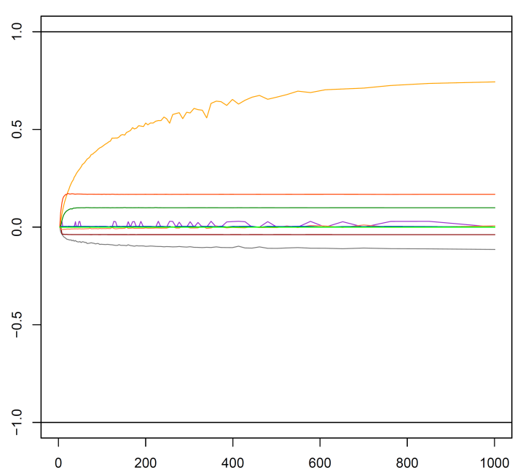
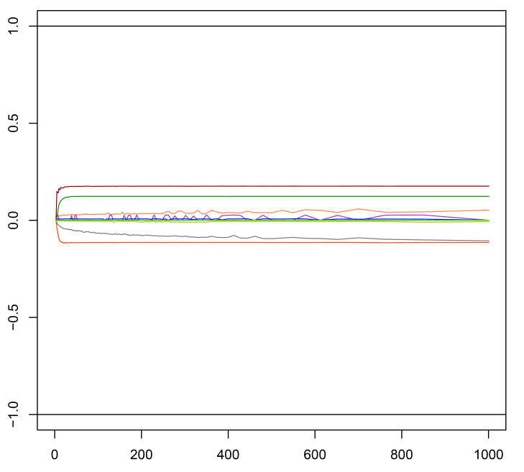
Influence of the anchor point on the fit
Relative CI change
Relative BMC change
Position of anchor point [EC50*x]
Position of anchor point [EC50*x]

Slide 5
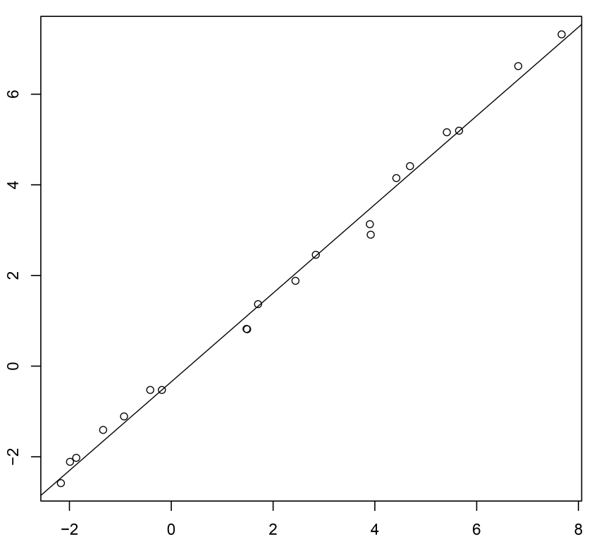
Correlation BMCL
Spearman
0.994
Log BMCL10
Log BMCL15
Fig. 4: Spearman Correlation between BMCL10 and BMCL15. To choose an acceptable risk

Slide 6
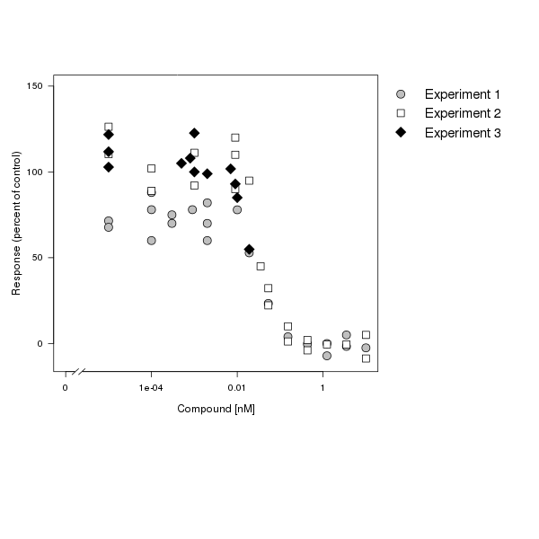
Image 1
The program plots the user specified data of all given experiments. Each data point corresponds to the response of the cells at a given compound concentration. Untreated control cells are defined as 100% viable and treated cells are normalized to their respective controls.

Slide 7
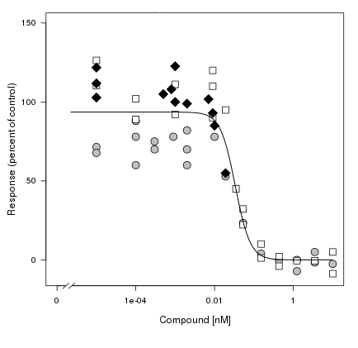
Image 2
All possible dose-response models are compared to each other. The Algorithm provides Log Logistic models and Weibull models with different numbers of parameters. The dose-response model with the smallest Akaike (AIC) information criterion fits the data best and is therefore fitted to the data.

Slide 8
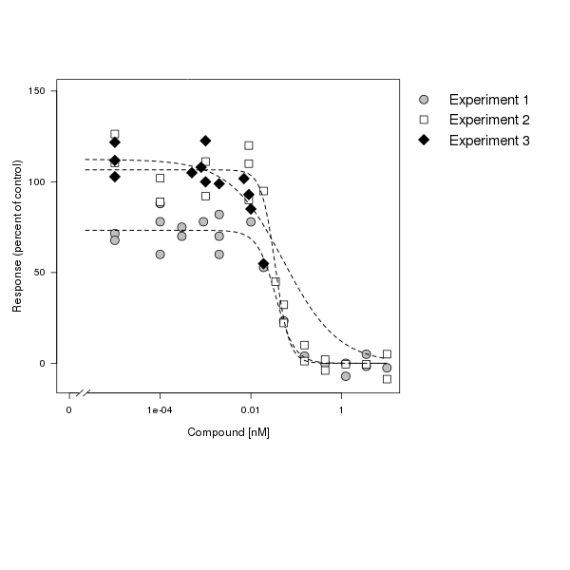
Image 3
The program tries to fit the chosen model to each single experiment. If the data for a single experiment are not sufficient to fit the chosen best model because the toxic dose range was not covered well the program predicts a response. For this purpose the highest dose from all performed experiments is used as “Anchor Point” to complete the missing value in the dataset. If all experiments are incomplete an “Anchor Point” is set at the effect concentration EC50*80.

Slide 9
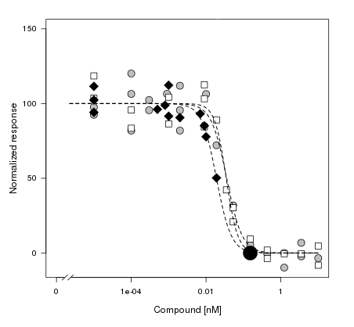
Image 4
To make sure that experiments can be compared each experiment is normalized to 100% viability. For this purpose the data are divided by the model parameter that intersects the y-axis The „Anchor Point“ is highlighted by a round black dot bigger than the other datapoints in size.

Slide 10
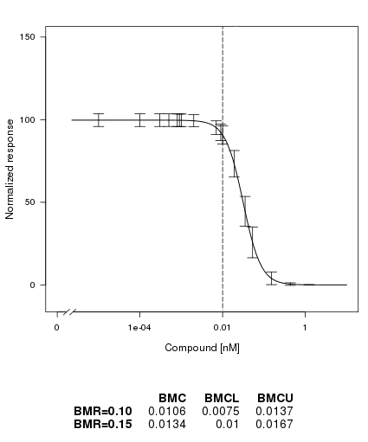
Image 5
To calculate the BMC for a 15% decrease in viability the average curve from all three normalized experiments is used. The two sided 90% confidence interval is calculated. All values lower than the the BMCL15 are non cytotoxic.
Error bars are calculated as the fitted value plus/minus the estimated error times the 97.5% quantile in the t distribution with degrees of freedom equal to the residual degrees of freedom for the model.

Slide 11
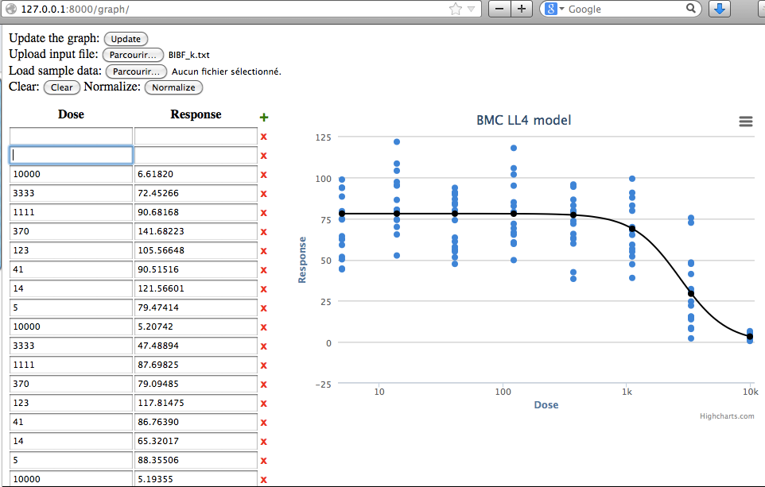
The Dynamic Website will make it possible to dynamically remove outliers and test the curve with suggestet anchorpoint and without!

Slide 12
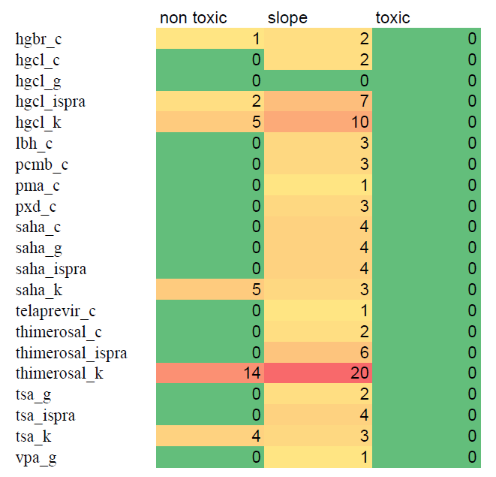
Mögliche weitere figures:
Tabelle welche Modelle gewählt wurden
Cooks Distance um zu zeigen welches Dose Spacing Sinn machen
würde (Daten im Toxischen irgendwann nicht mehr wichtig)

